Slide 1
HypoGator: Hypotheses Generation and Ranking
Ali Sadeghian, Sourav Dutta, Giacomo Bergami, Miguel Rodriguez, Daisy Zhe Wang
UF-GAIA TA3 • 2018

Slide 2
Introduction
Progress
Semantic Coherence
Logical Coherence
Hypothesis clustering
System architecture
Experiments and Results
Next steps
Overview

Slide 3
Introduction
An analyst is presented with multiple sources of information and is required to provide insights about “Who shot down MH17?”
The analyst has to make sense of noisy, conflicting and deceptive data.
Alternative narratives can be:
“Russian shot down MH17”
“Ukrainian separatists shot down MH17 with BUK missile”
The information from various sources can be modeled as a knowledge graph to understand the relation between entities.

Slide 4
Problem statement
Our problem is to generate hypothesis from a knowledge graph such that they
Are consistent and coherent
Have a confidence and coherence measure

Slide 5
Progress - Semantic Coherence
Training on LDC annot.
Feature engineering
Feature selection: Their effectiveness is evaluated on the annotated data.
Testing on TA2 data
Obtained features were used to measure the semantic coherence of each hypothesis.

Slide 6
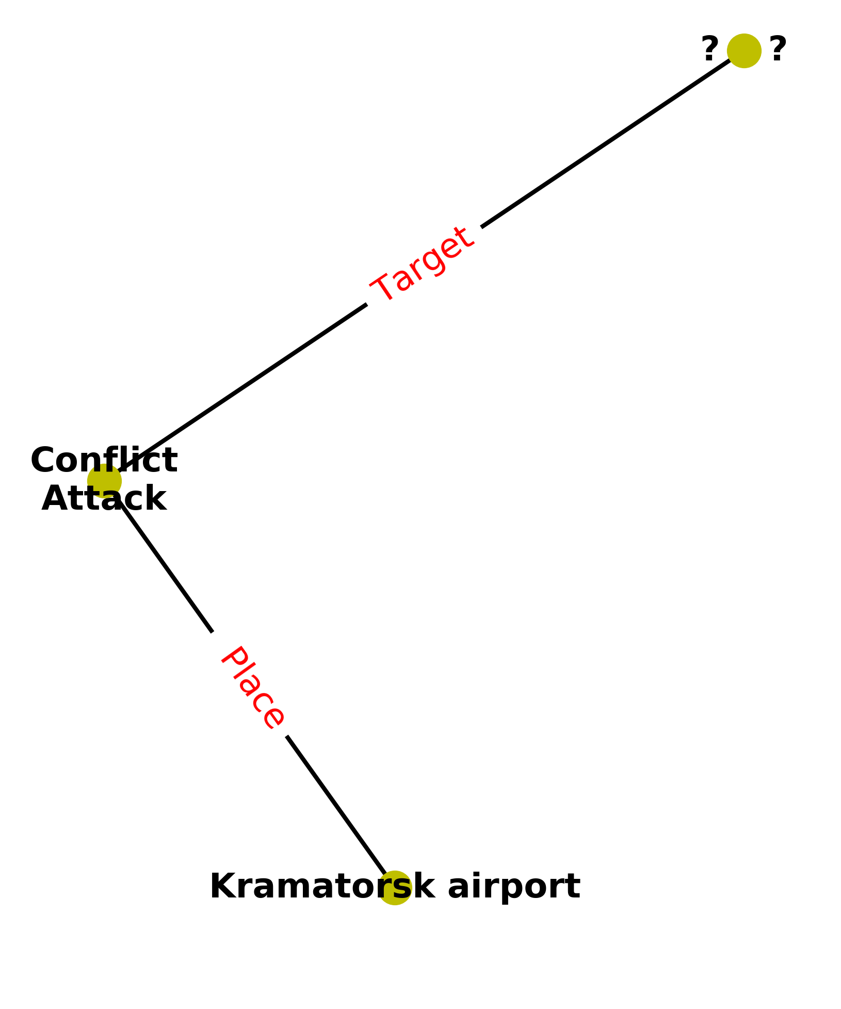
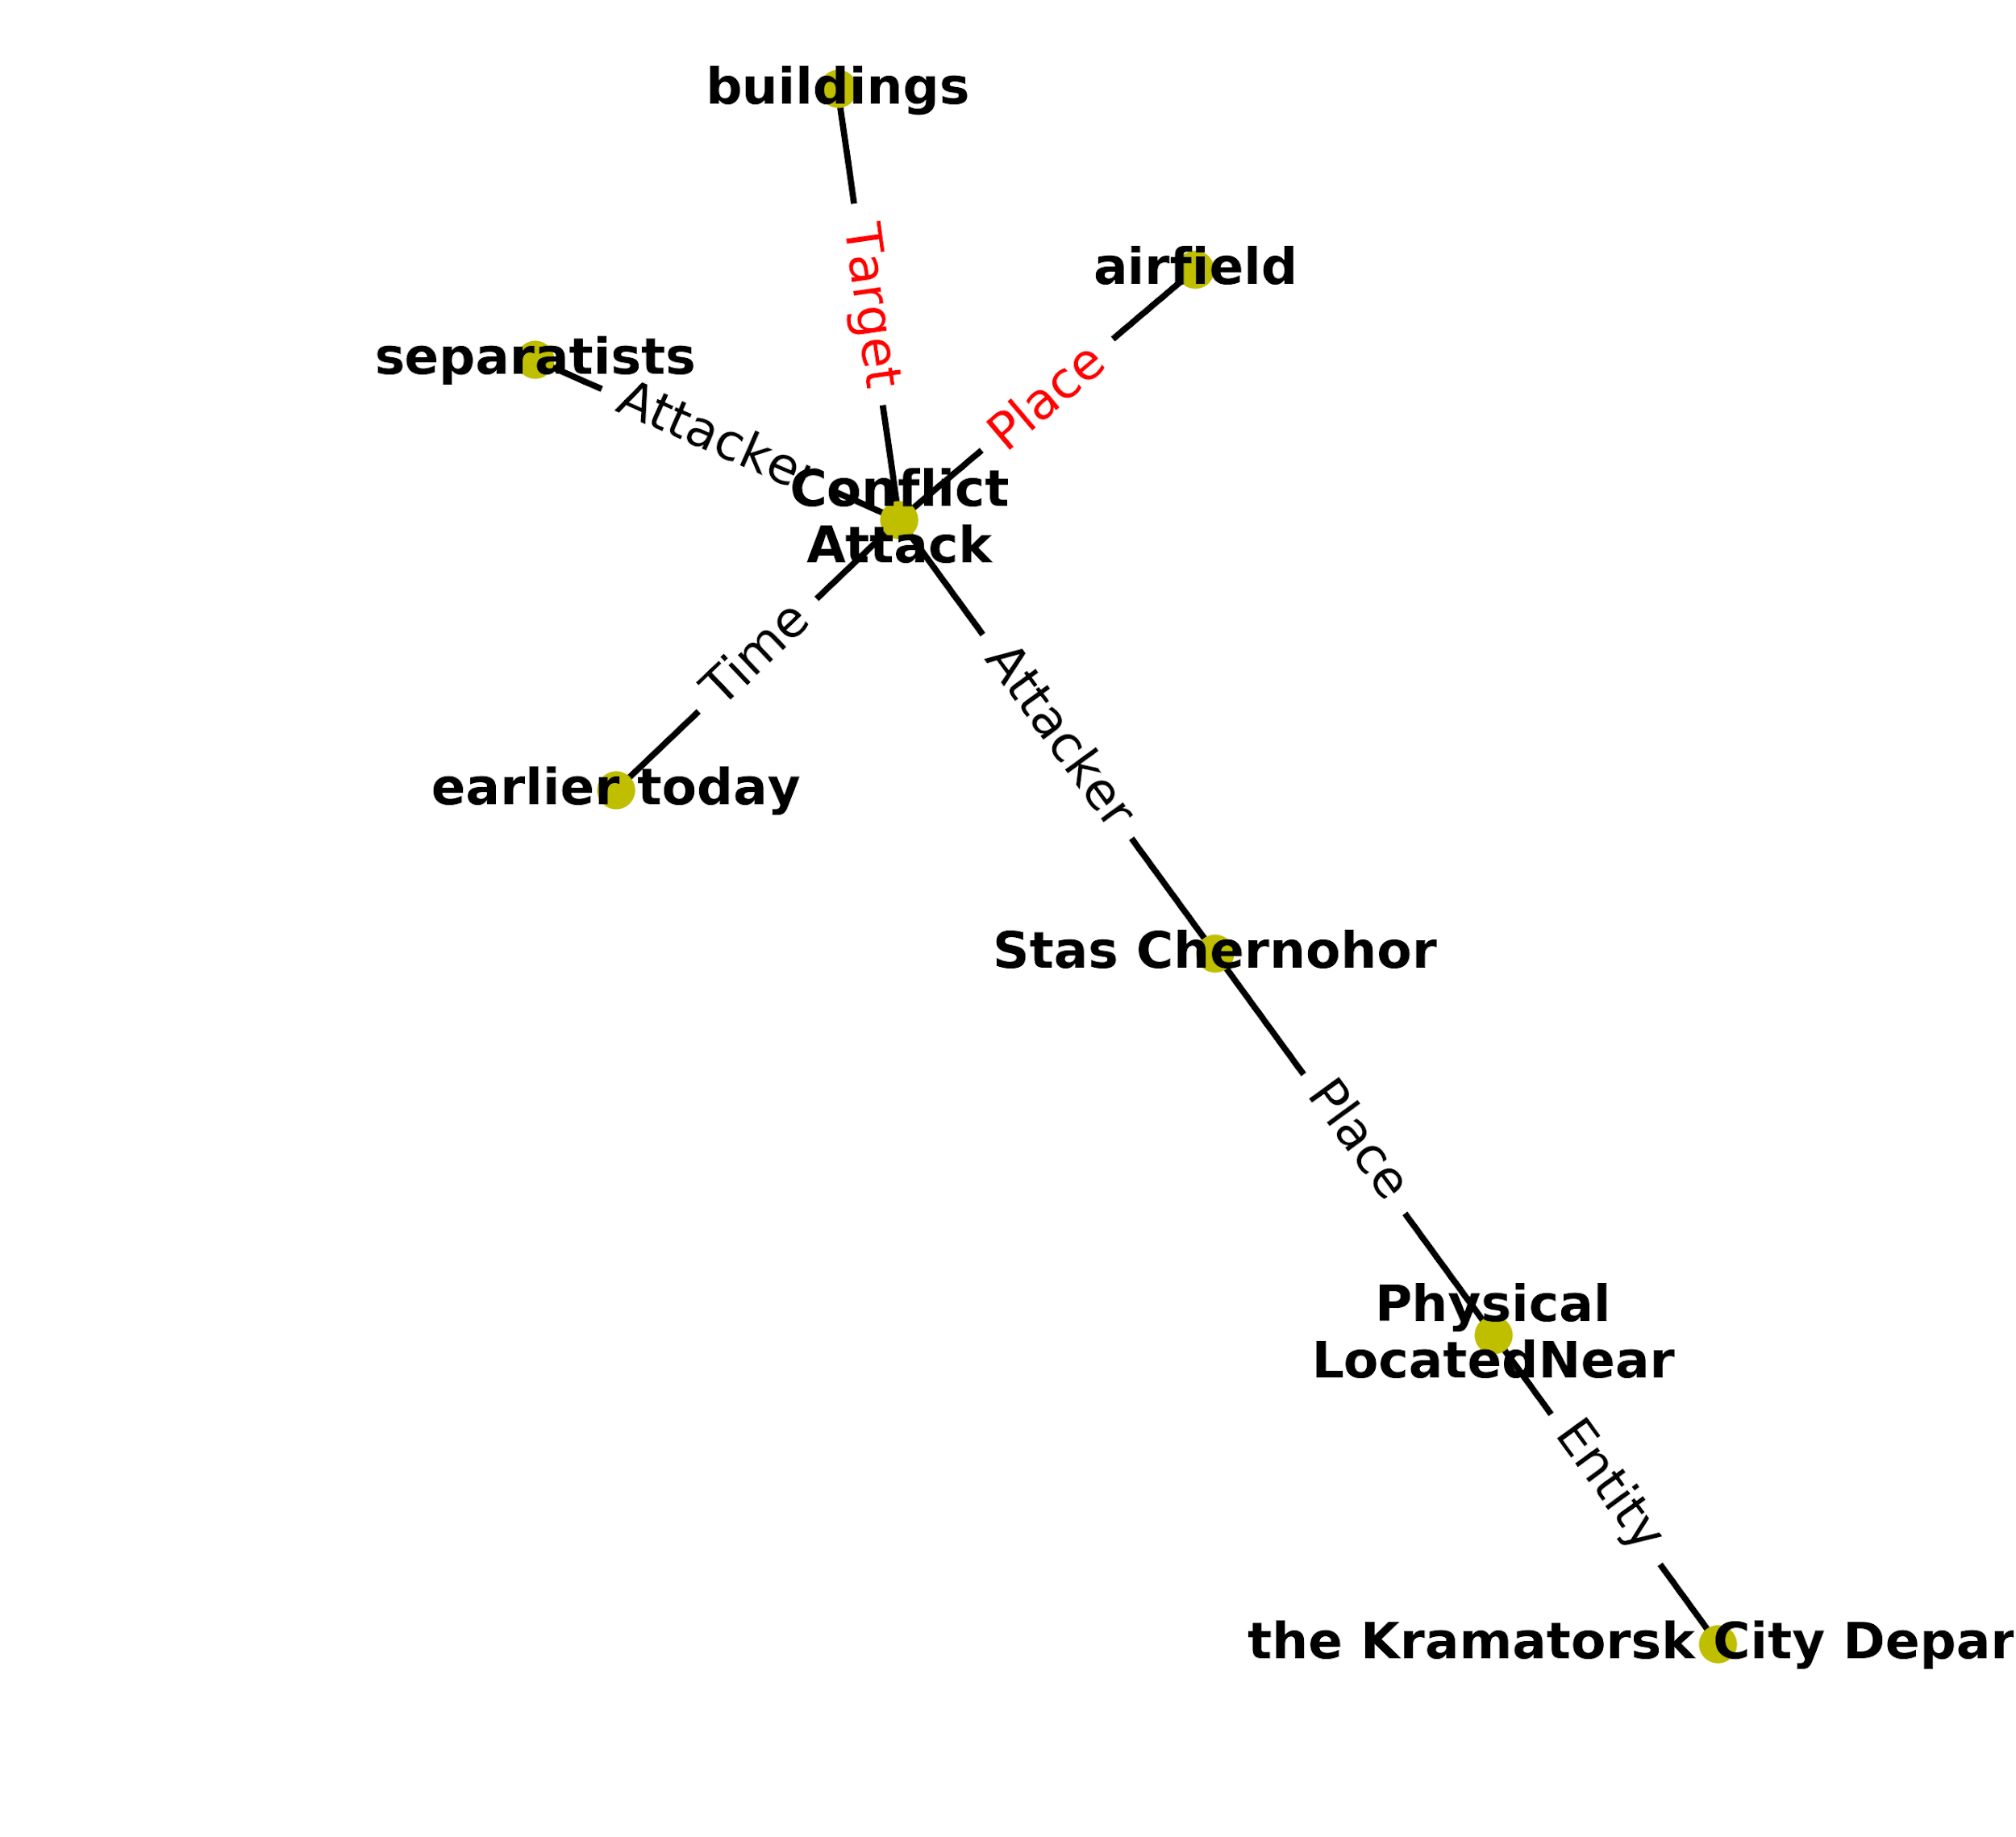
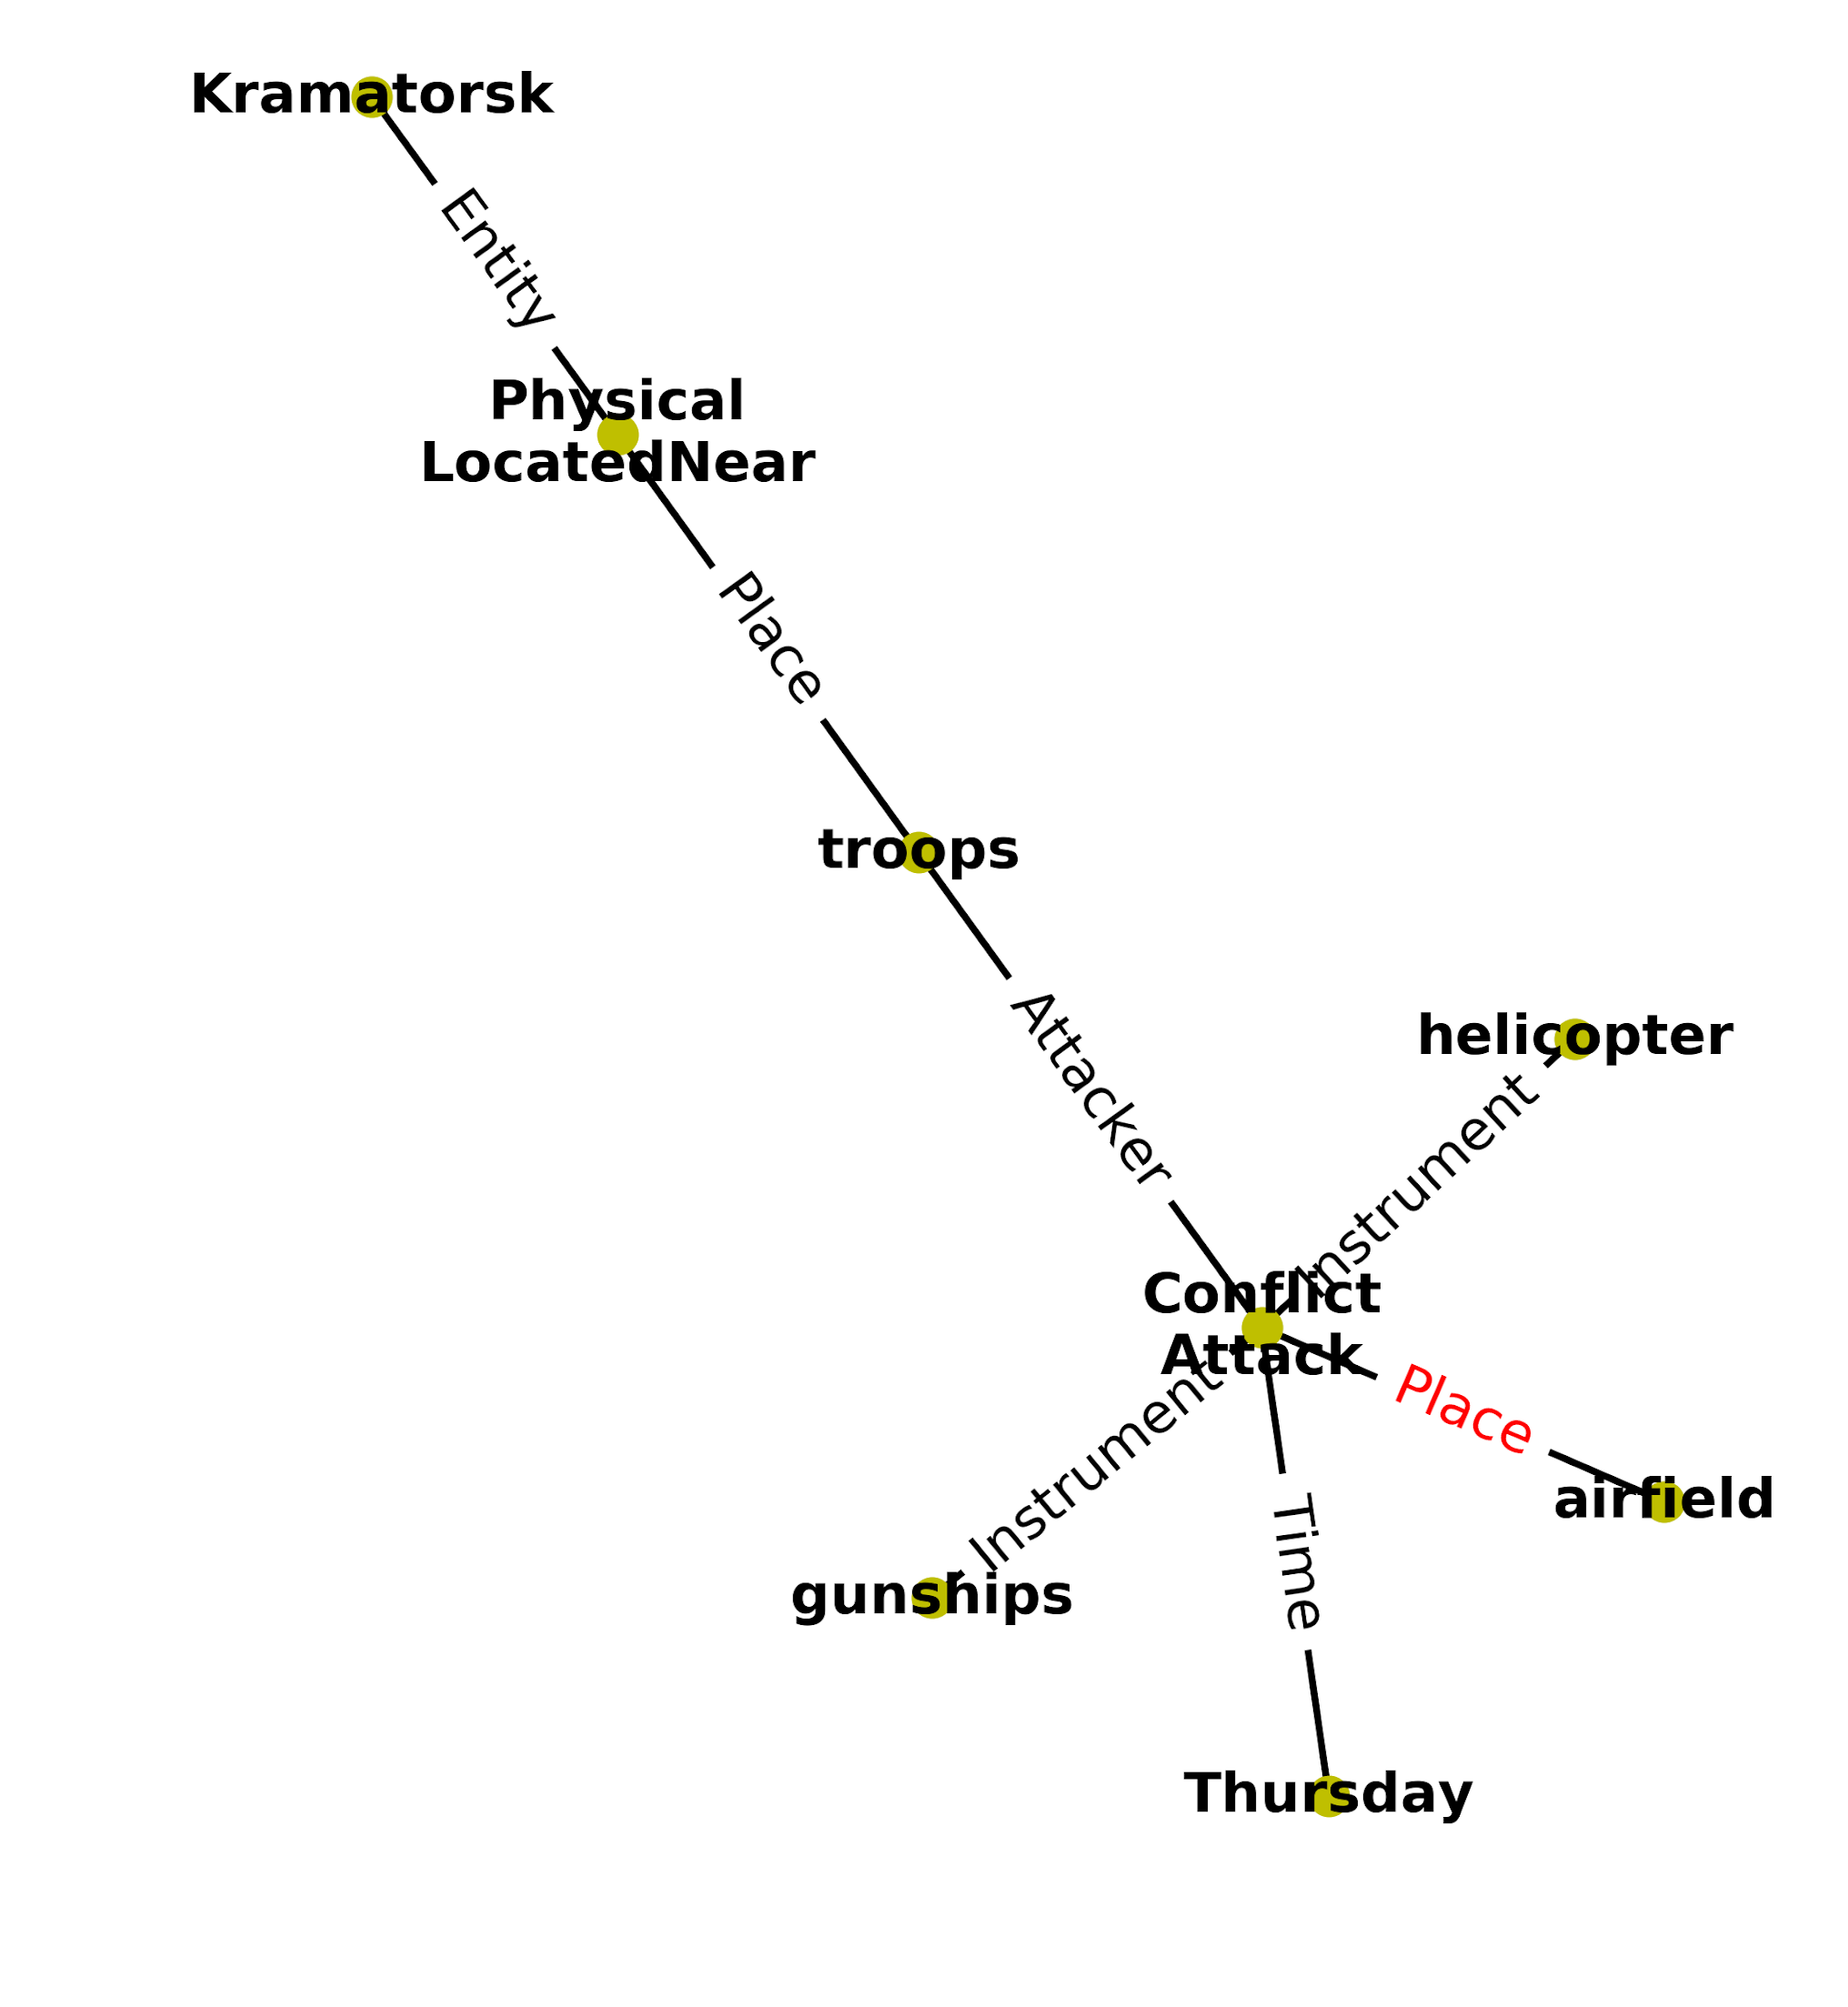
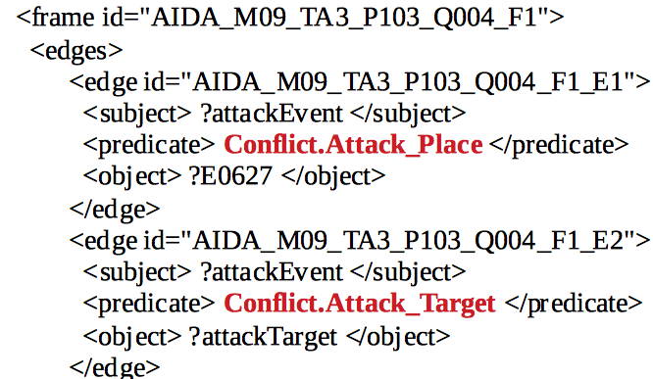
Examples: Query Relevance
Query004
scorer_qer = 0.27
scorer_qer = 0.13

Slide 7
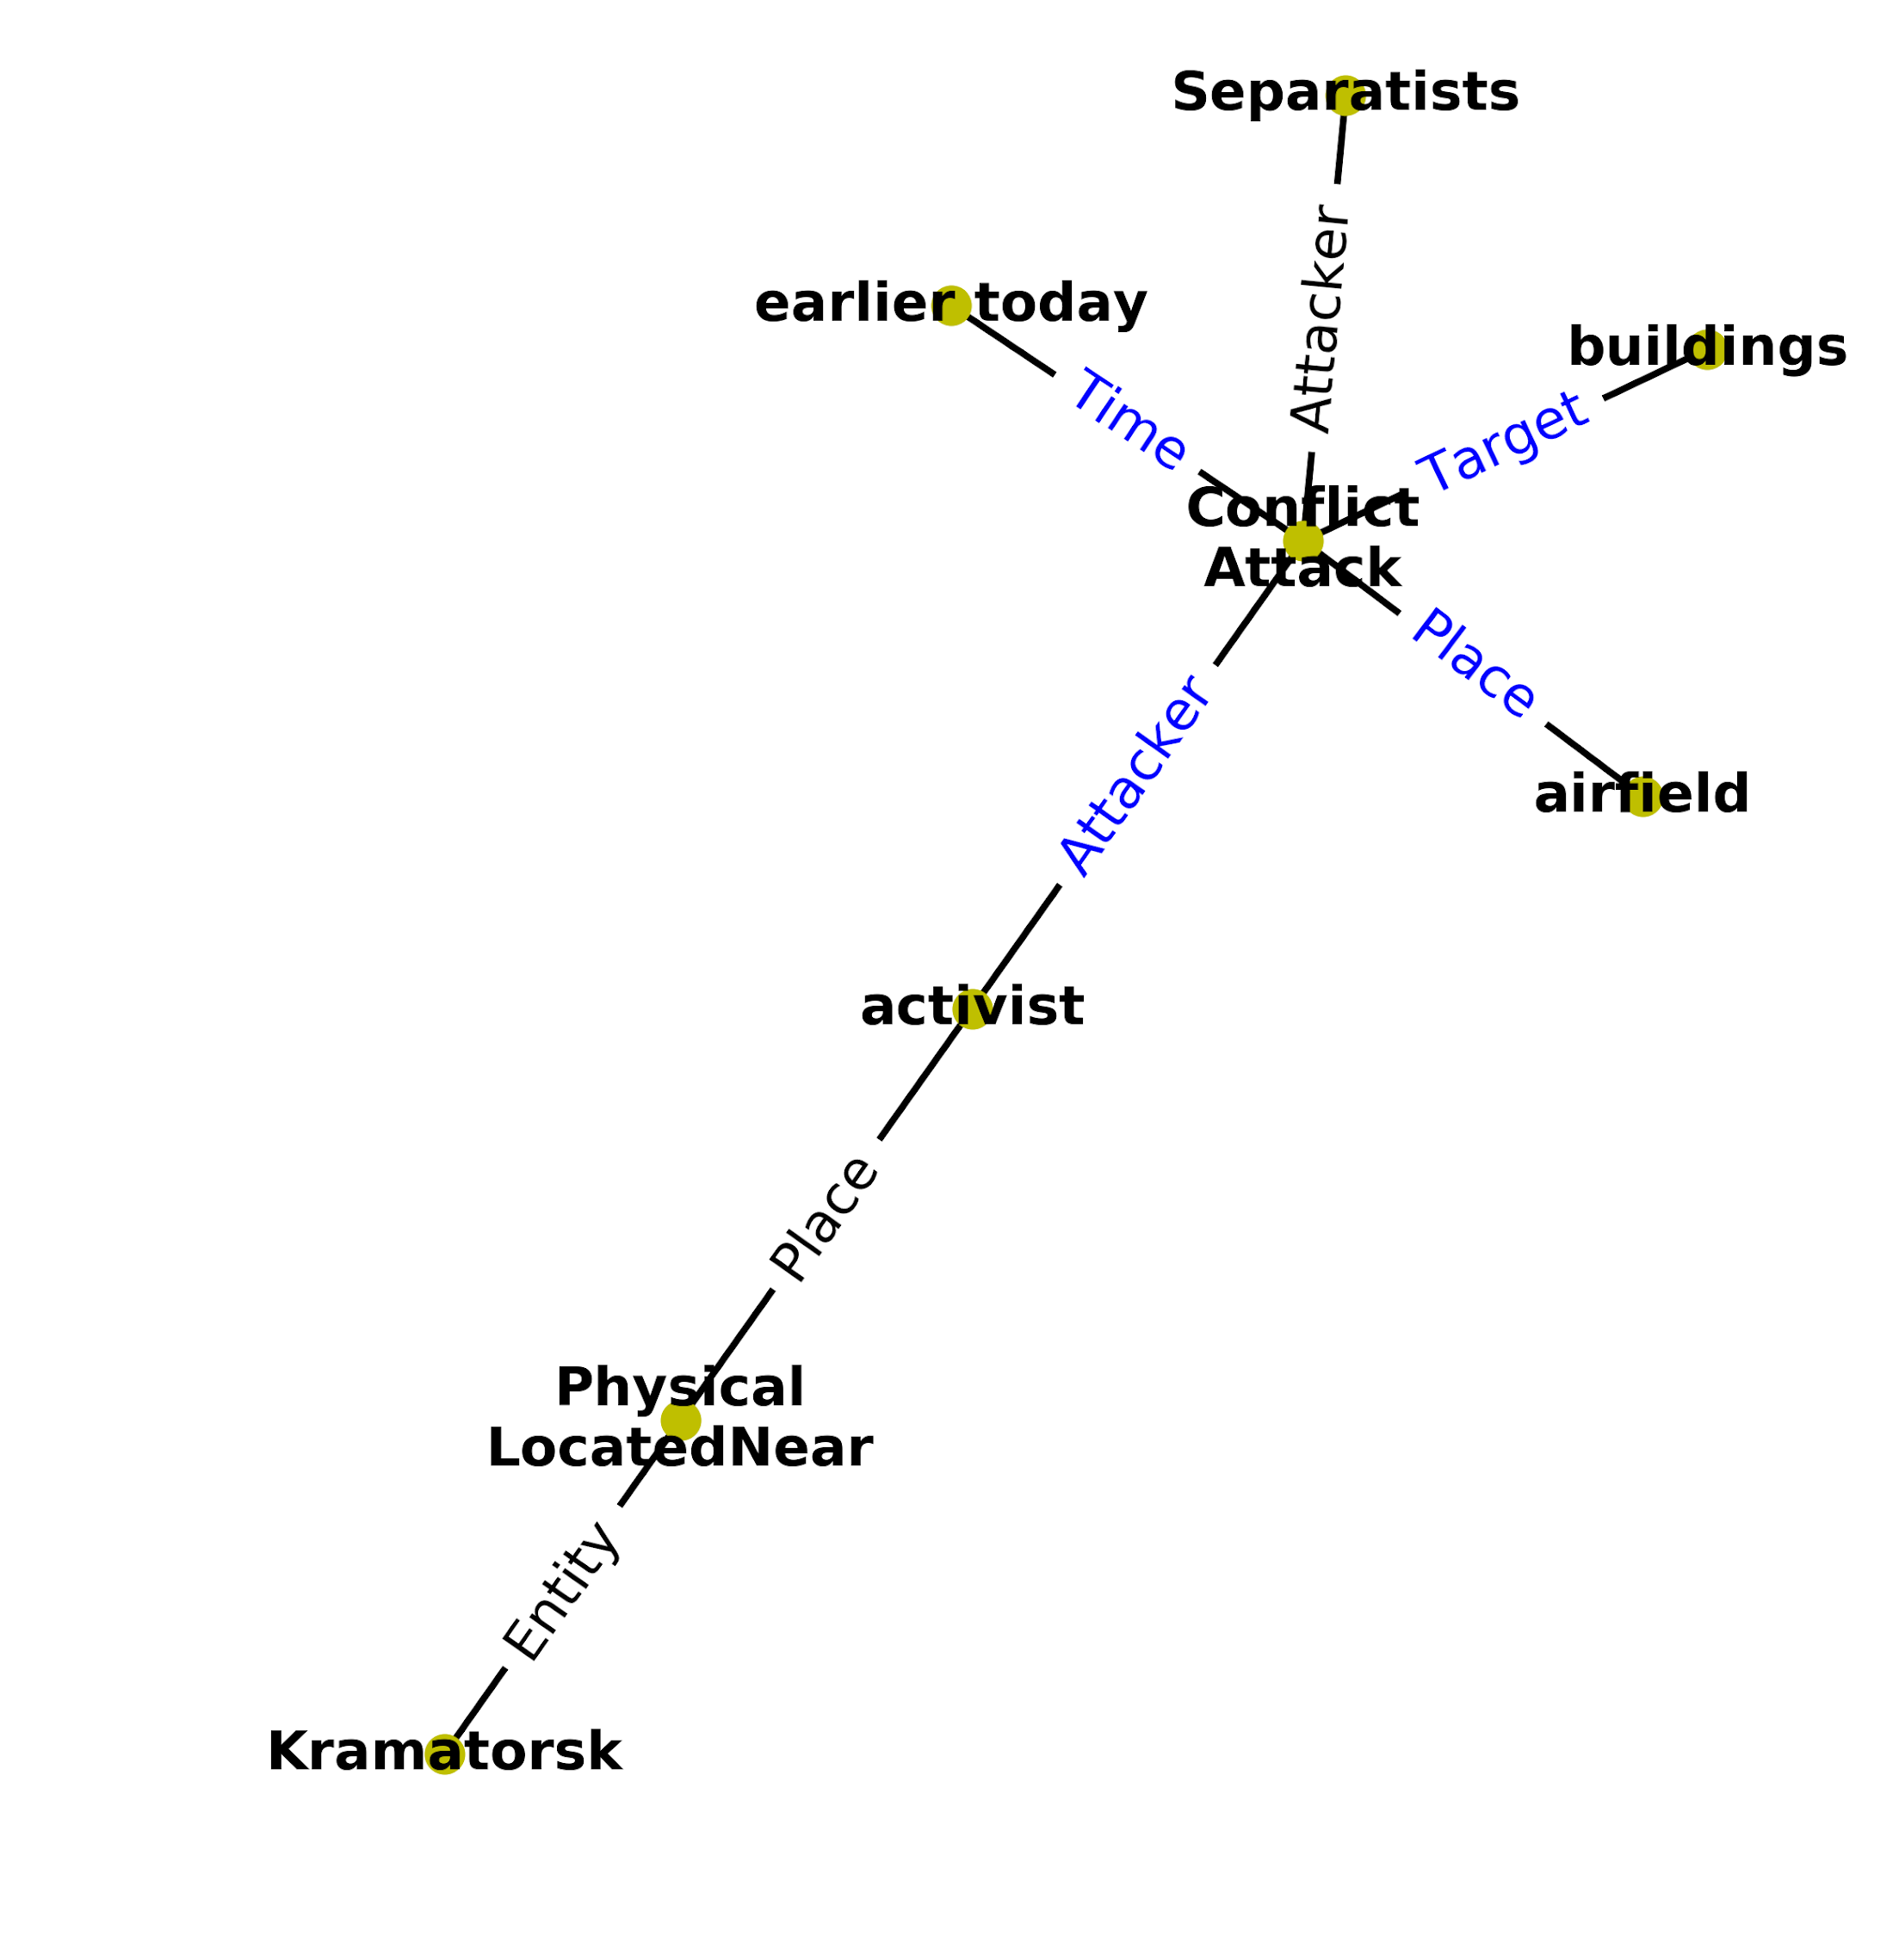
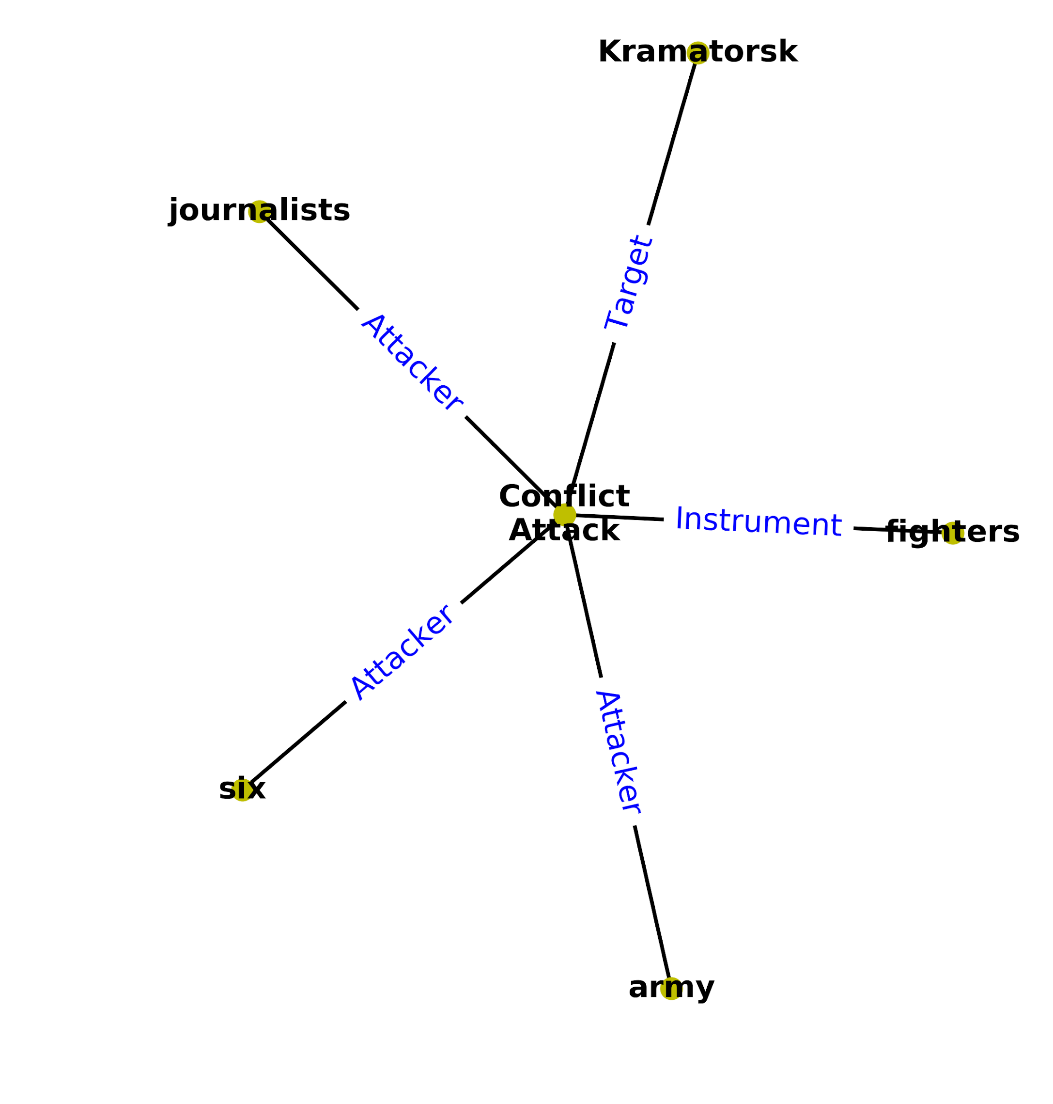
Examples: Event Edge Count
Query004
scorer_eec = 0.043
scorer_eec = 0.036

Slide 8
Progress - Logical Coherence
Application 1
Ontology Based Inconsistency Detection.
E.g. The GeoPolitical Entity “Ukraine” cannot appear as a Person argument for a GeneralAffiliation.MORE relationship.
Application 2
Event/Relationship-Wise Inconsistency Detection.
Use functional dependencies and hierarchical matching to find Logical Inconsistencies.

Slide 9
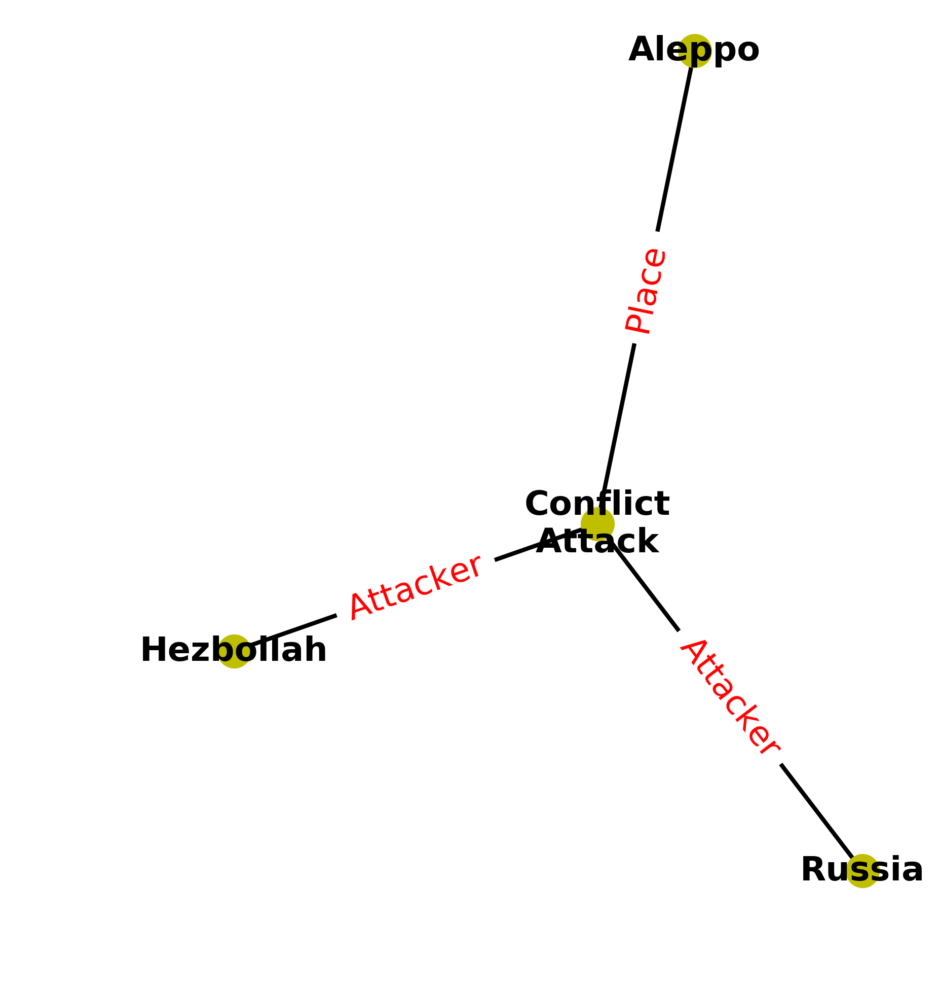
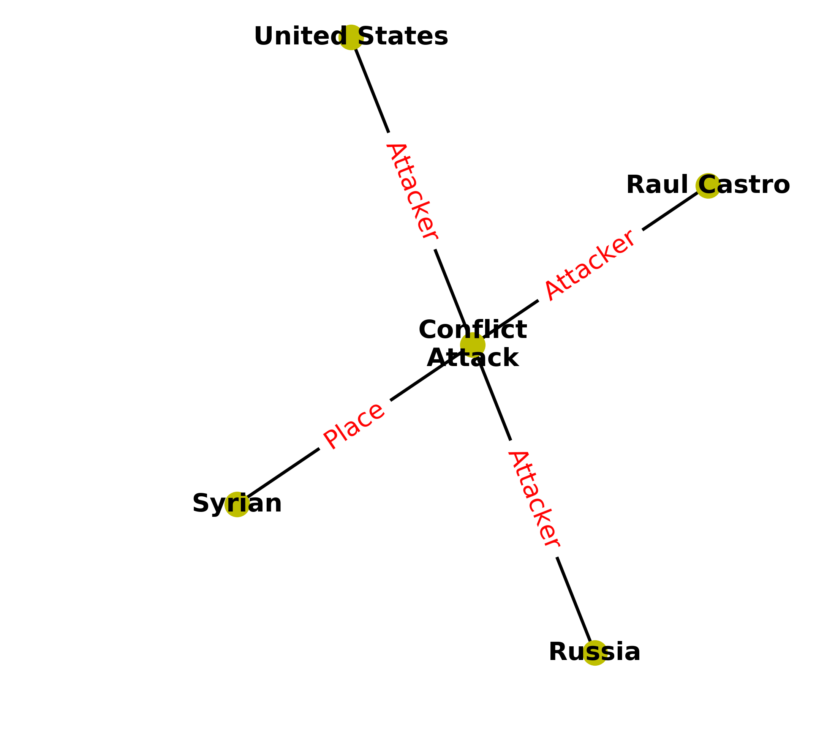
Logical Coherence Examples
Example FD: Conflict.Attack-Attacker attacker is unique.
Instances detected via this F.D

Slide 10
Extraction Errors leading to L.I.
Possible sources of inconsistencies due to extraction errors are:
Swapped Arguments:
“Organization Ukraine is affiliated with Arseny Iatsenuik” vs.“Person Ukraine is affiliated with Trucks”.
Unresolved Pronouns:
“Organization Sergei Grits is the employer of Ukraine” vs.“Organization your is the employer of Ukraine”
Reflexive Relationships:
“BUK 332 is affiliated with a truck” vs. “BUK 332 is affiliated to BUK 332”
The resolution of such errors will lead to a better hypothesis generation.

Slide 11
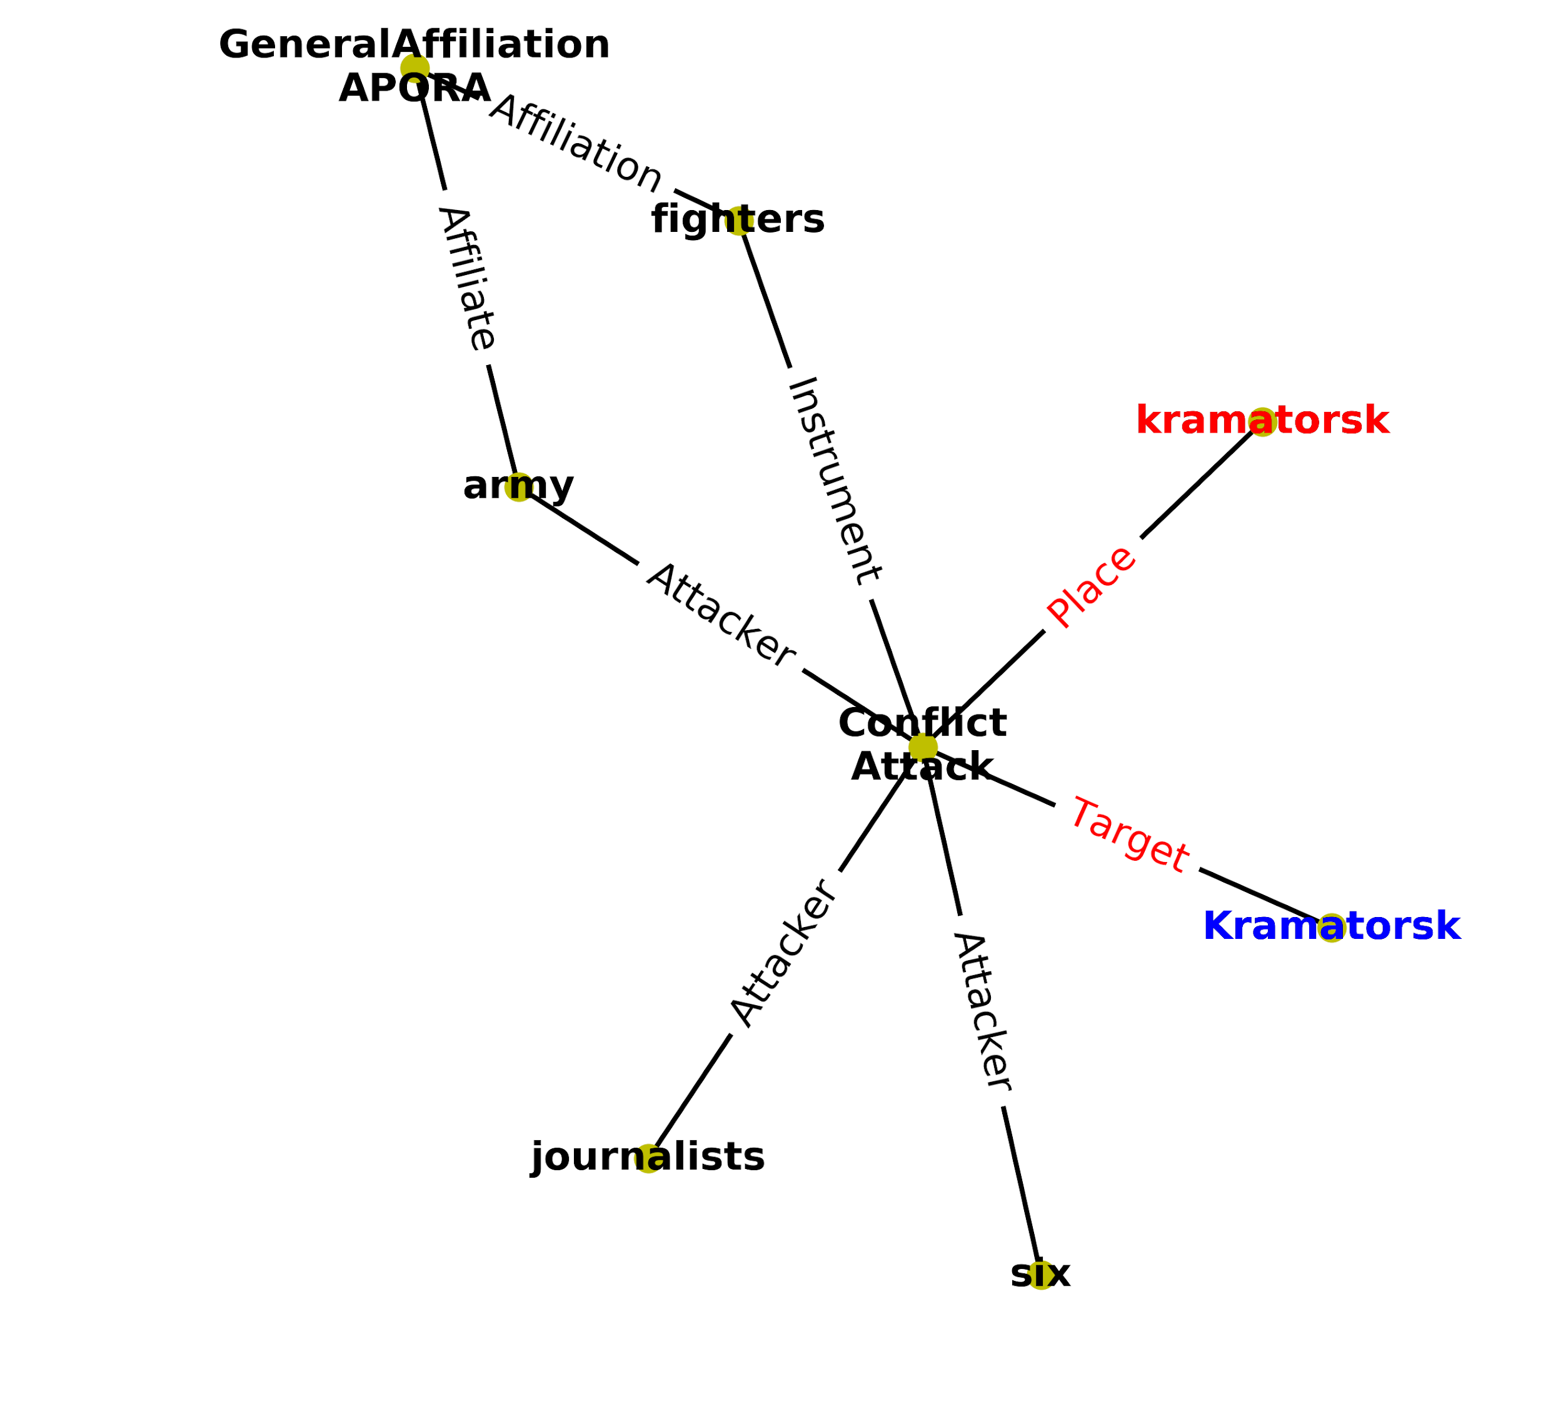
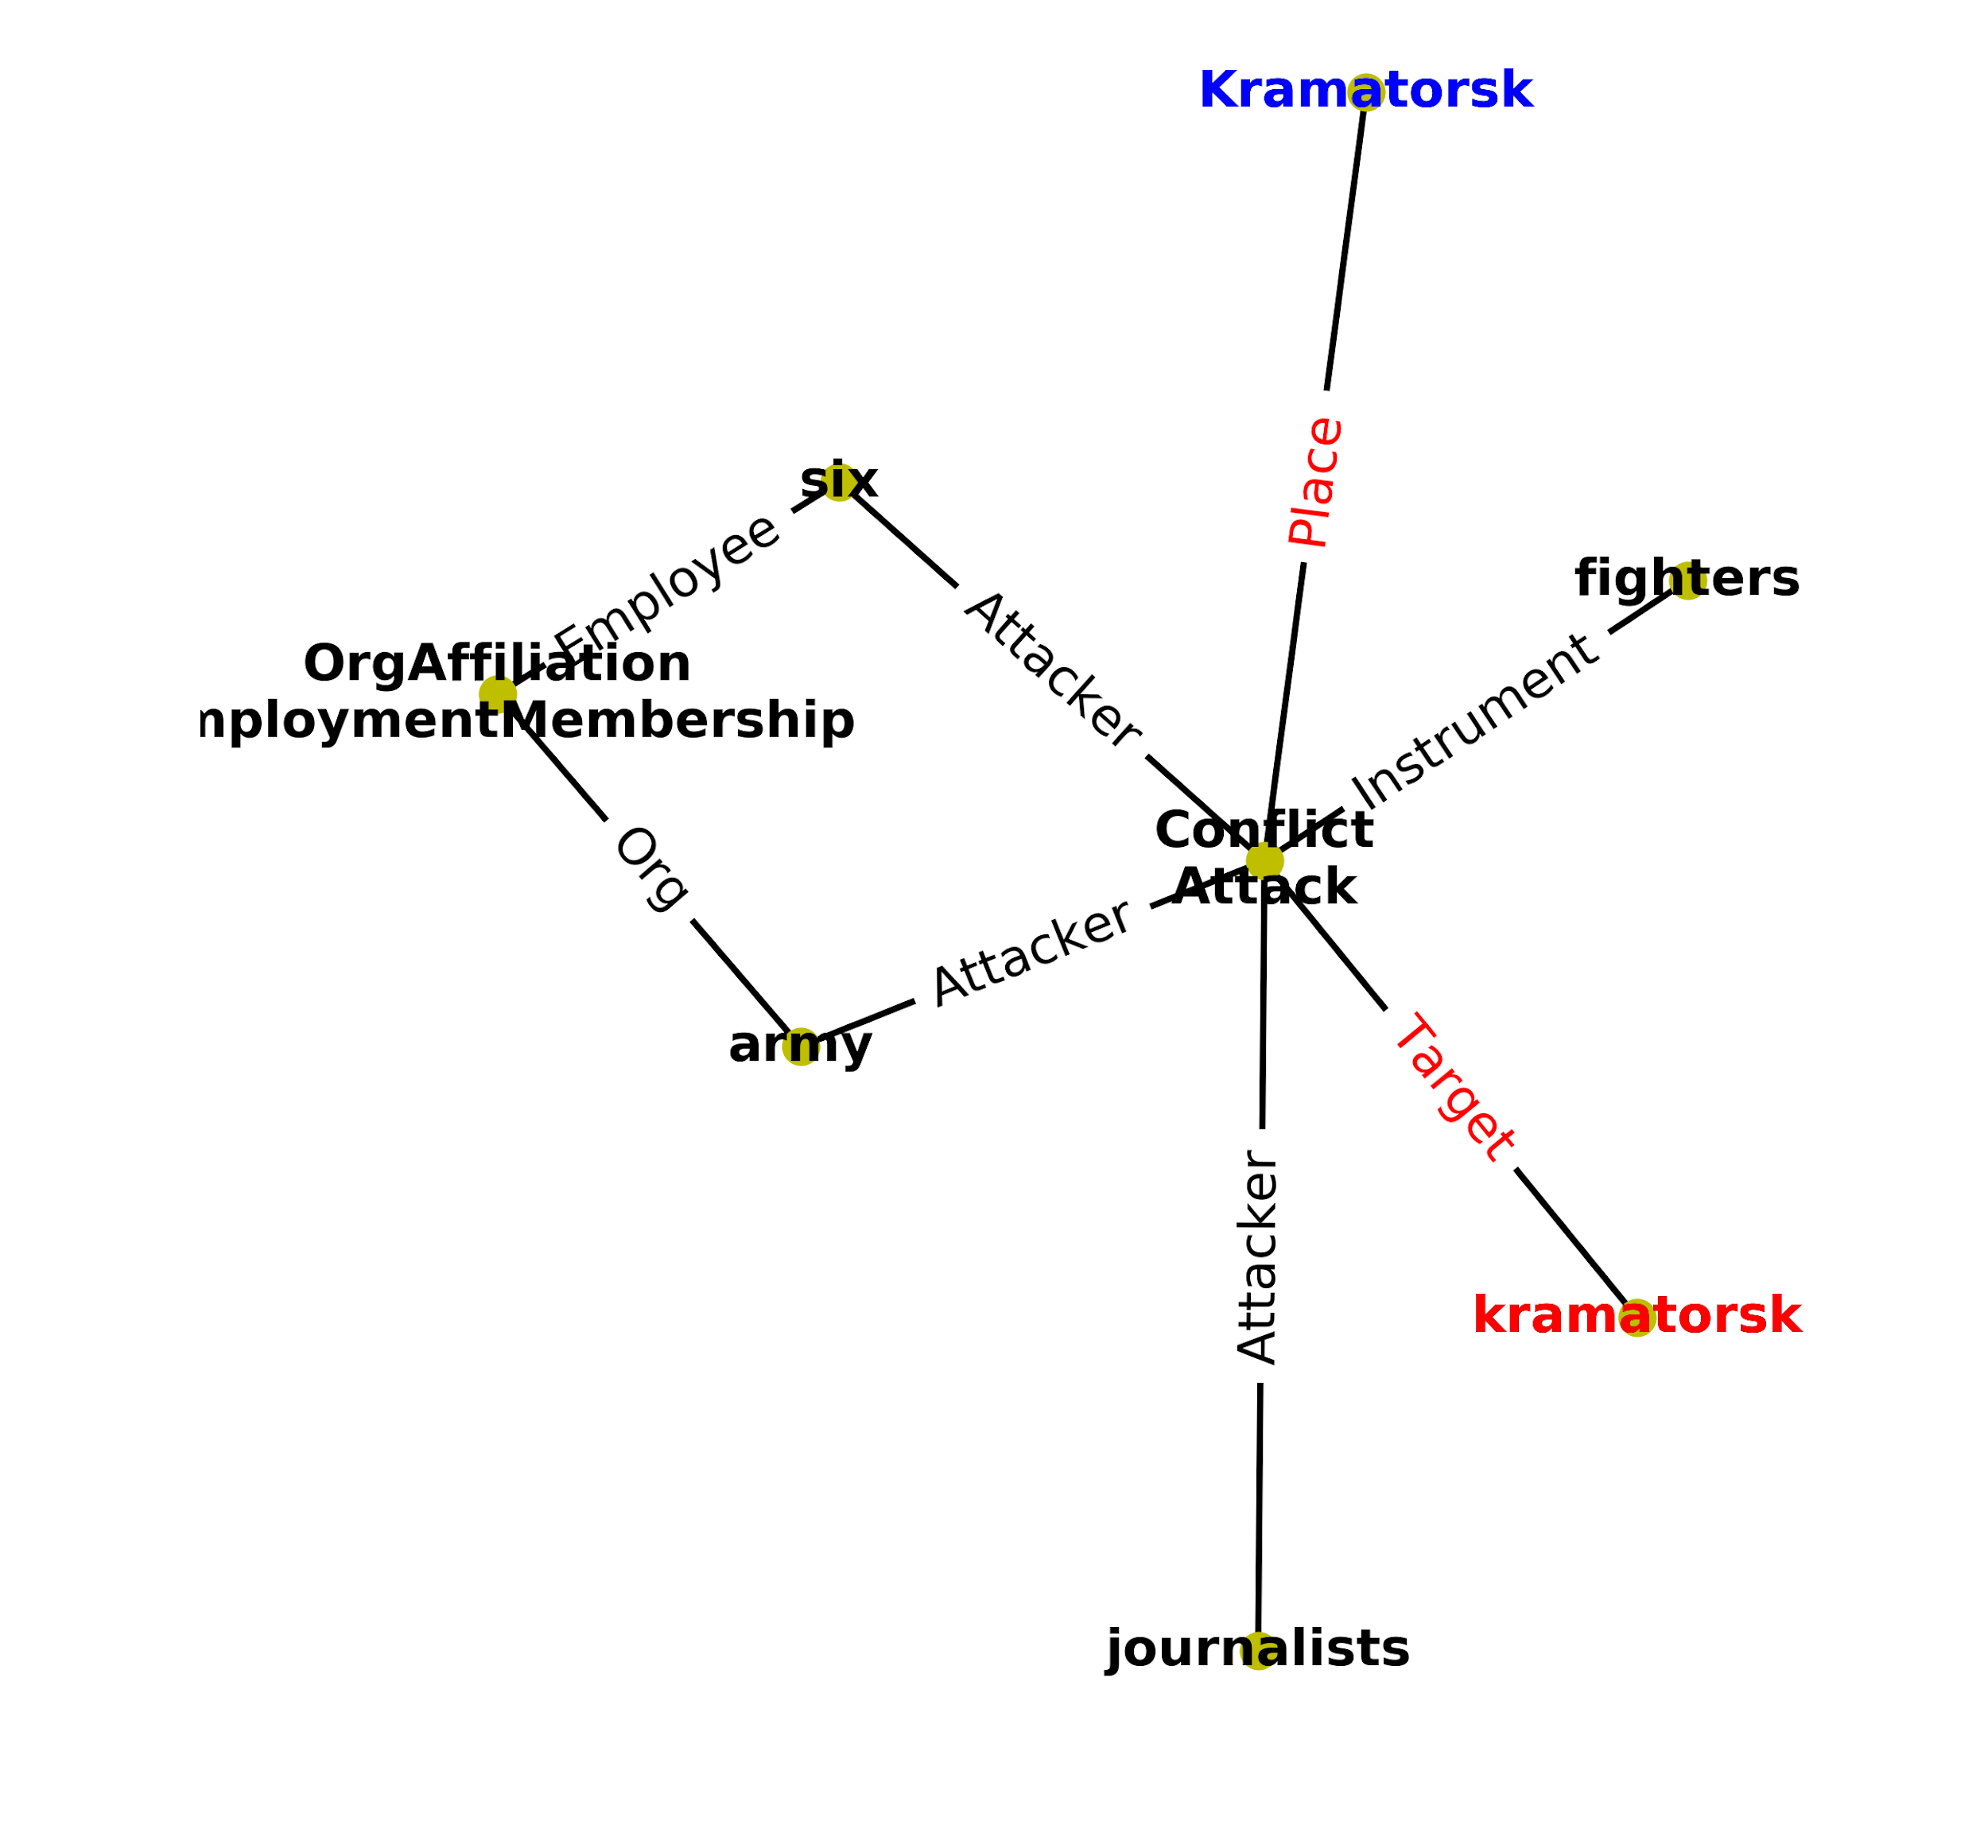
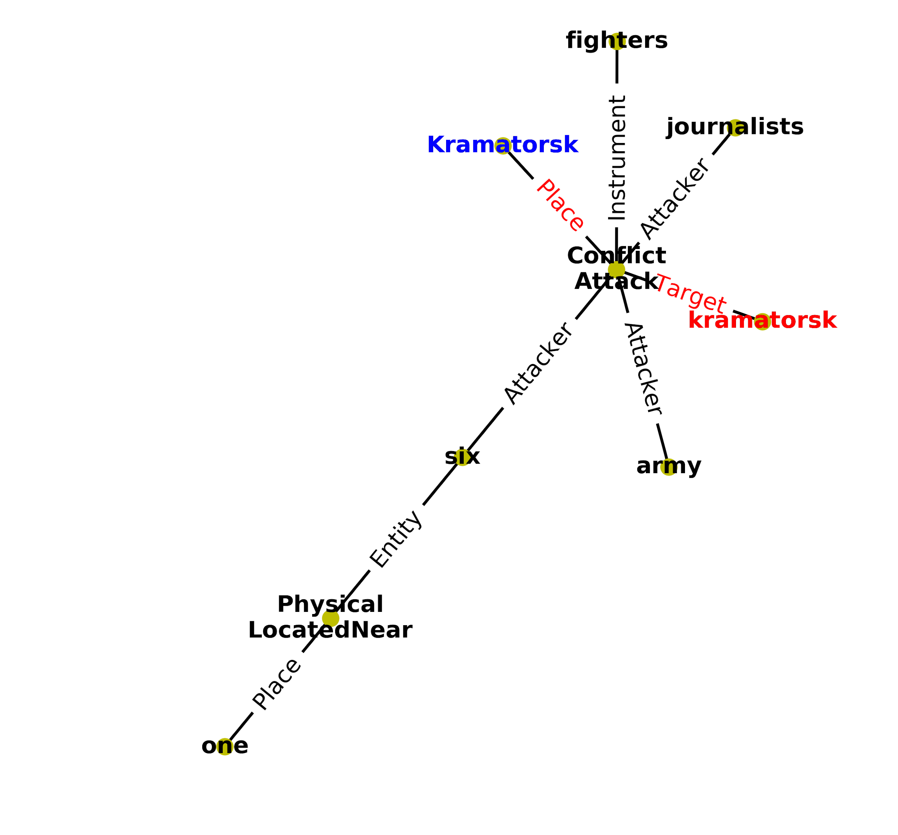
Progress - Hypothesis Clustering
String similarity based
Compute a similarity score for each pair of hypothesis based on the string representation of their entities and relations.
Cluster_id based
Use TA2 ent. clusters to cluster identical hypothesis .
Combine with string similarity for better performance.

Slide 12
Clustering Results: Top 3 No Clustering

Slide 13
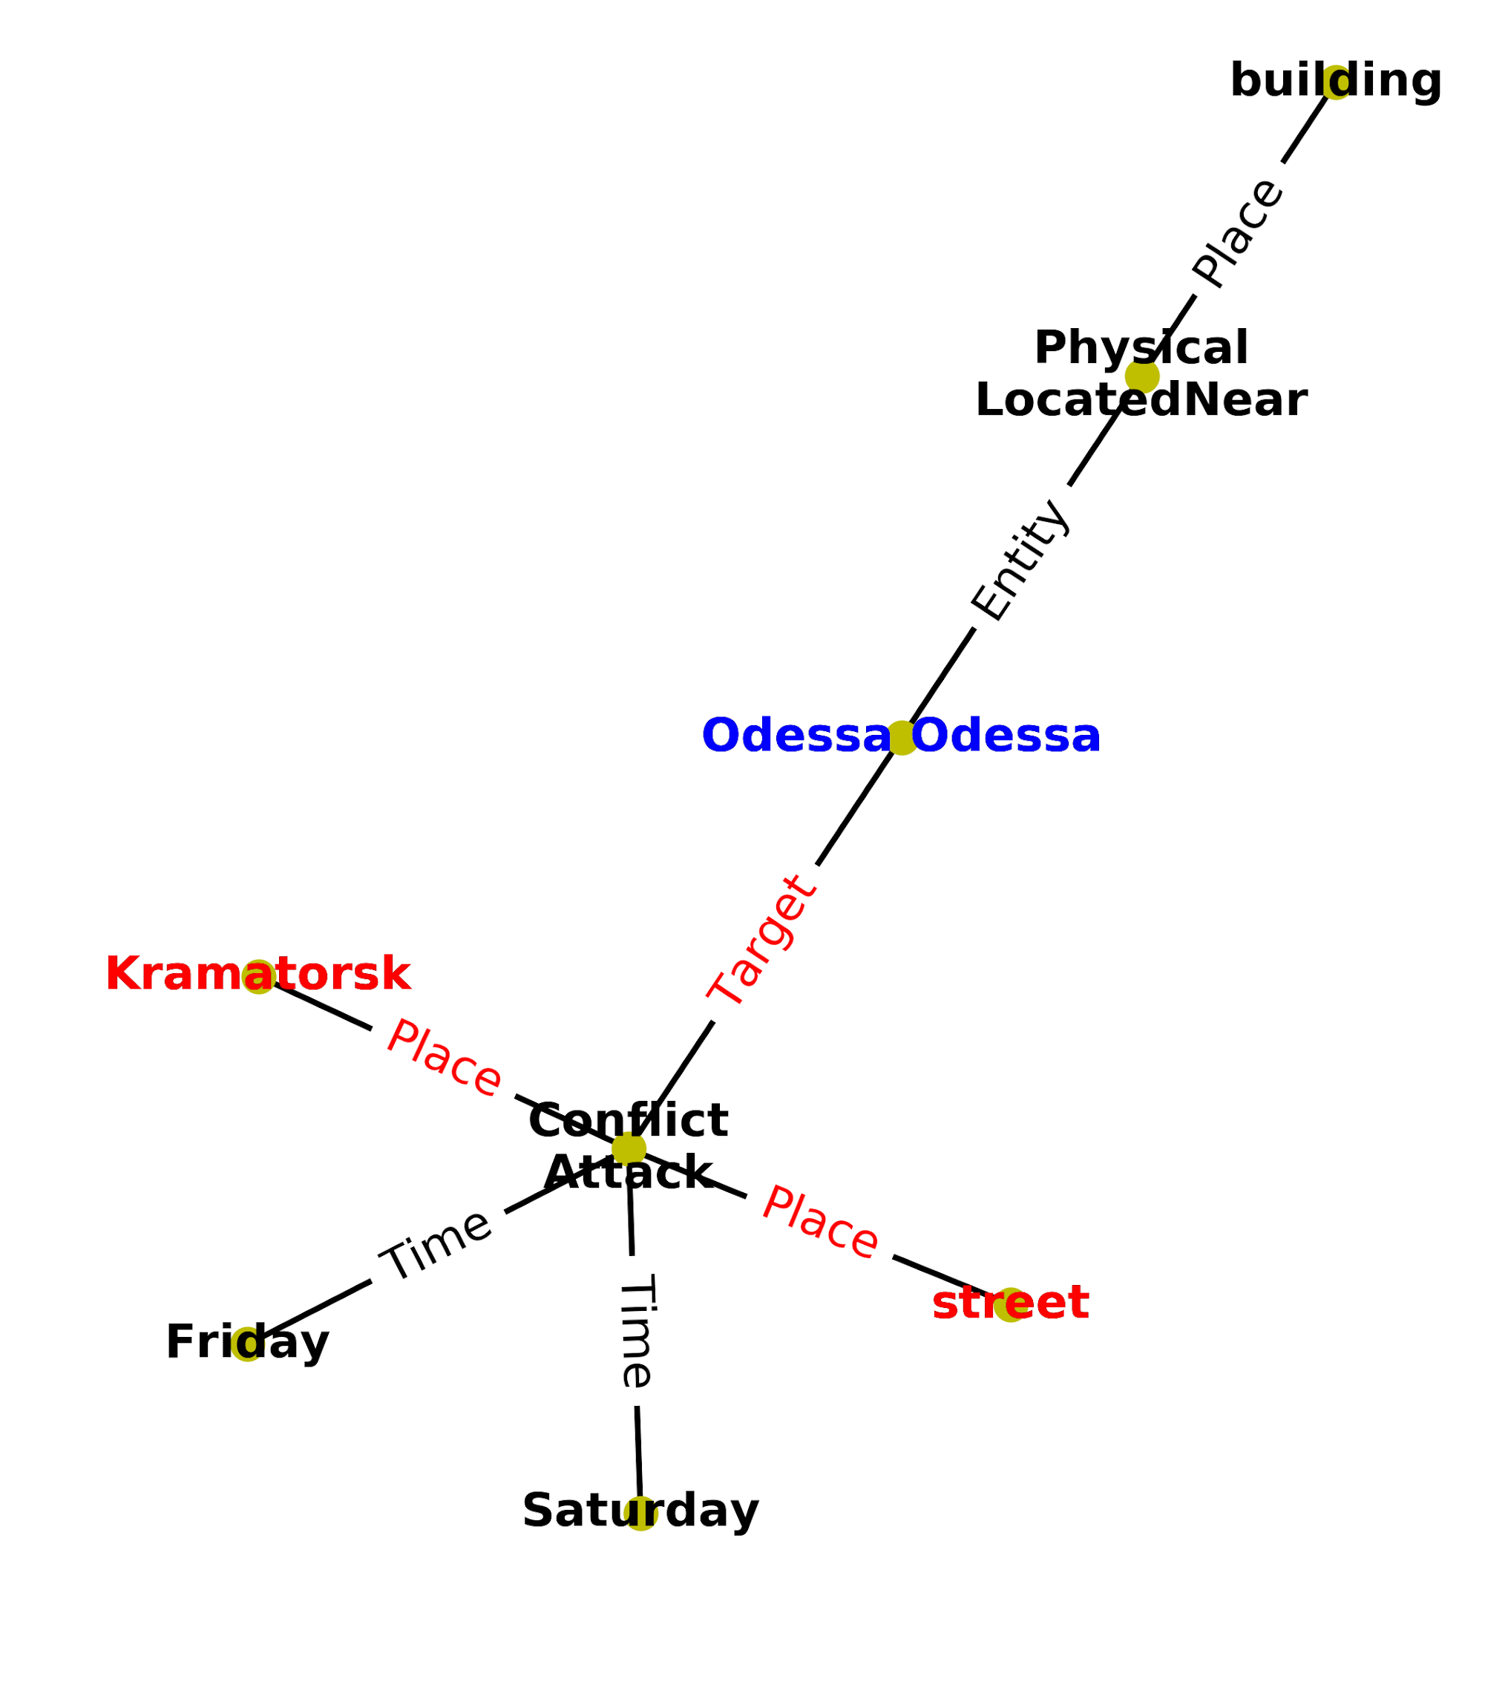
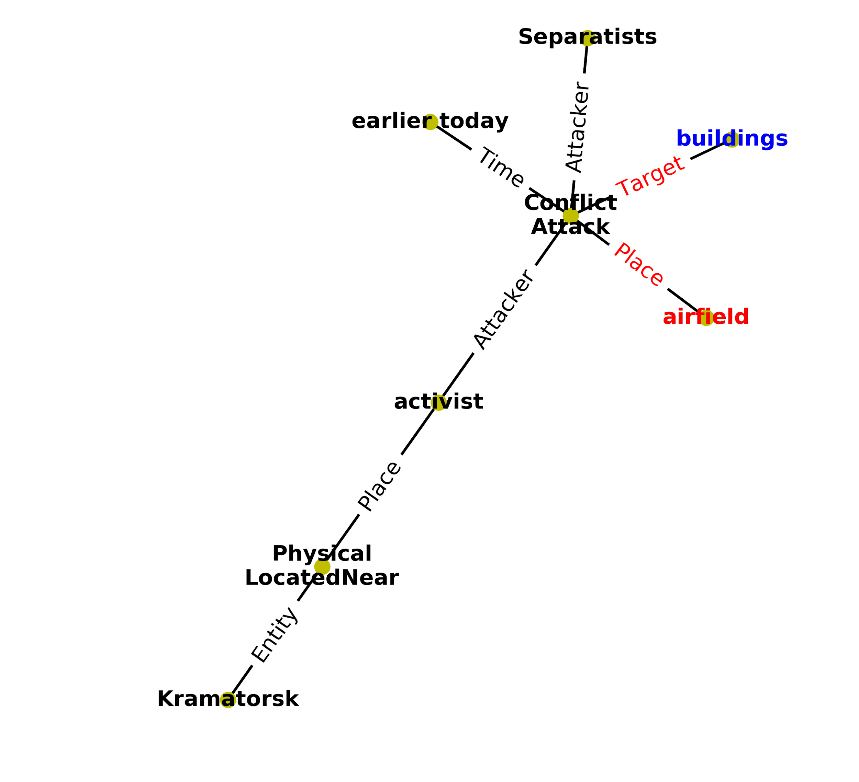
Clustering Results: Top 3 + Clustering

Slide 14
Progress - Hypothesis Clustering
String-similarity based
Clustering top 100 hypothesis with 10 cluster centers.
Hand labels | Clustering
A | 0
A | 0
A | 0
B | 0
A | 0
C (?:B) | 1
C (?:B) | 1
D | 2
E (?:C) | 3

Slide 15
HypoGator System Architecture
Query-Processor
Information need
String/offset Similarity Entry Point Extraction
Candidate Hypothesis Gen.
Inconsistency feature
Coherence feature
Local Graph Expansion
A* Algorithm
Hierarchical Logical Inconsistency Detection
Query Relevance
Edge Intensity
Entity Correlation
TA2 KB
Hypothesis Clustering
Confidence Computation
AIDA Hypothesis
String/offset Similarity Entry Point Extraction
Score calculation
Ensamblar

Slide 16
Pre-processing
The RDF data was flattened to obtain tuples of the form
<EventID, Role, EntityID, assertionID, event properties, entity properties>
Event properties include
Event document id, event cluster id, event type
Entity properties include
Entity string, entity string in english, entity type, entity start and end offset in the document

Slide 17
Post-processing
Hypotheses returned as a list of assertion IDs representing edes
Converted back to RDF form
Add subgraph/connected component for each assertion ID

Slide 18
Experiments
Run 1:
Weights and features set influenced by training data.
Run 2:
Manually tuned new weights.
New scorer_ps.
String similarity threshold: 0.7 -> 0.75.
Ordering: Sort on scorer_qer then on score_x.
Returning top 25 instead of top 10.
Run 3:
Similar to run 1 + inconsistency detection feature.
Features | Run1 | Run 2
scorer_nc | 0.01 | 0.01
scorer_nd | 0 | 0
scorer_er | 0 | 0
scorer_qer | 0.05 | 0.05
scorer_ps | 0.02 | 0.65
scorer_li | -0.1 | -0.5
scorer_hs | 0.03 | 0.03
scorer_ei | 0.01 | 0.01
scorer_eec | 0.03 | 0.005

Slide 19
Technical Challenges
Memory
Reading the knowledge graph
Runtime
Preprocessing of data to get internal format
Instantiating entry points from query
Generating subgraphs

Slide 20
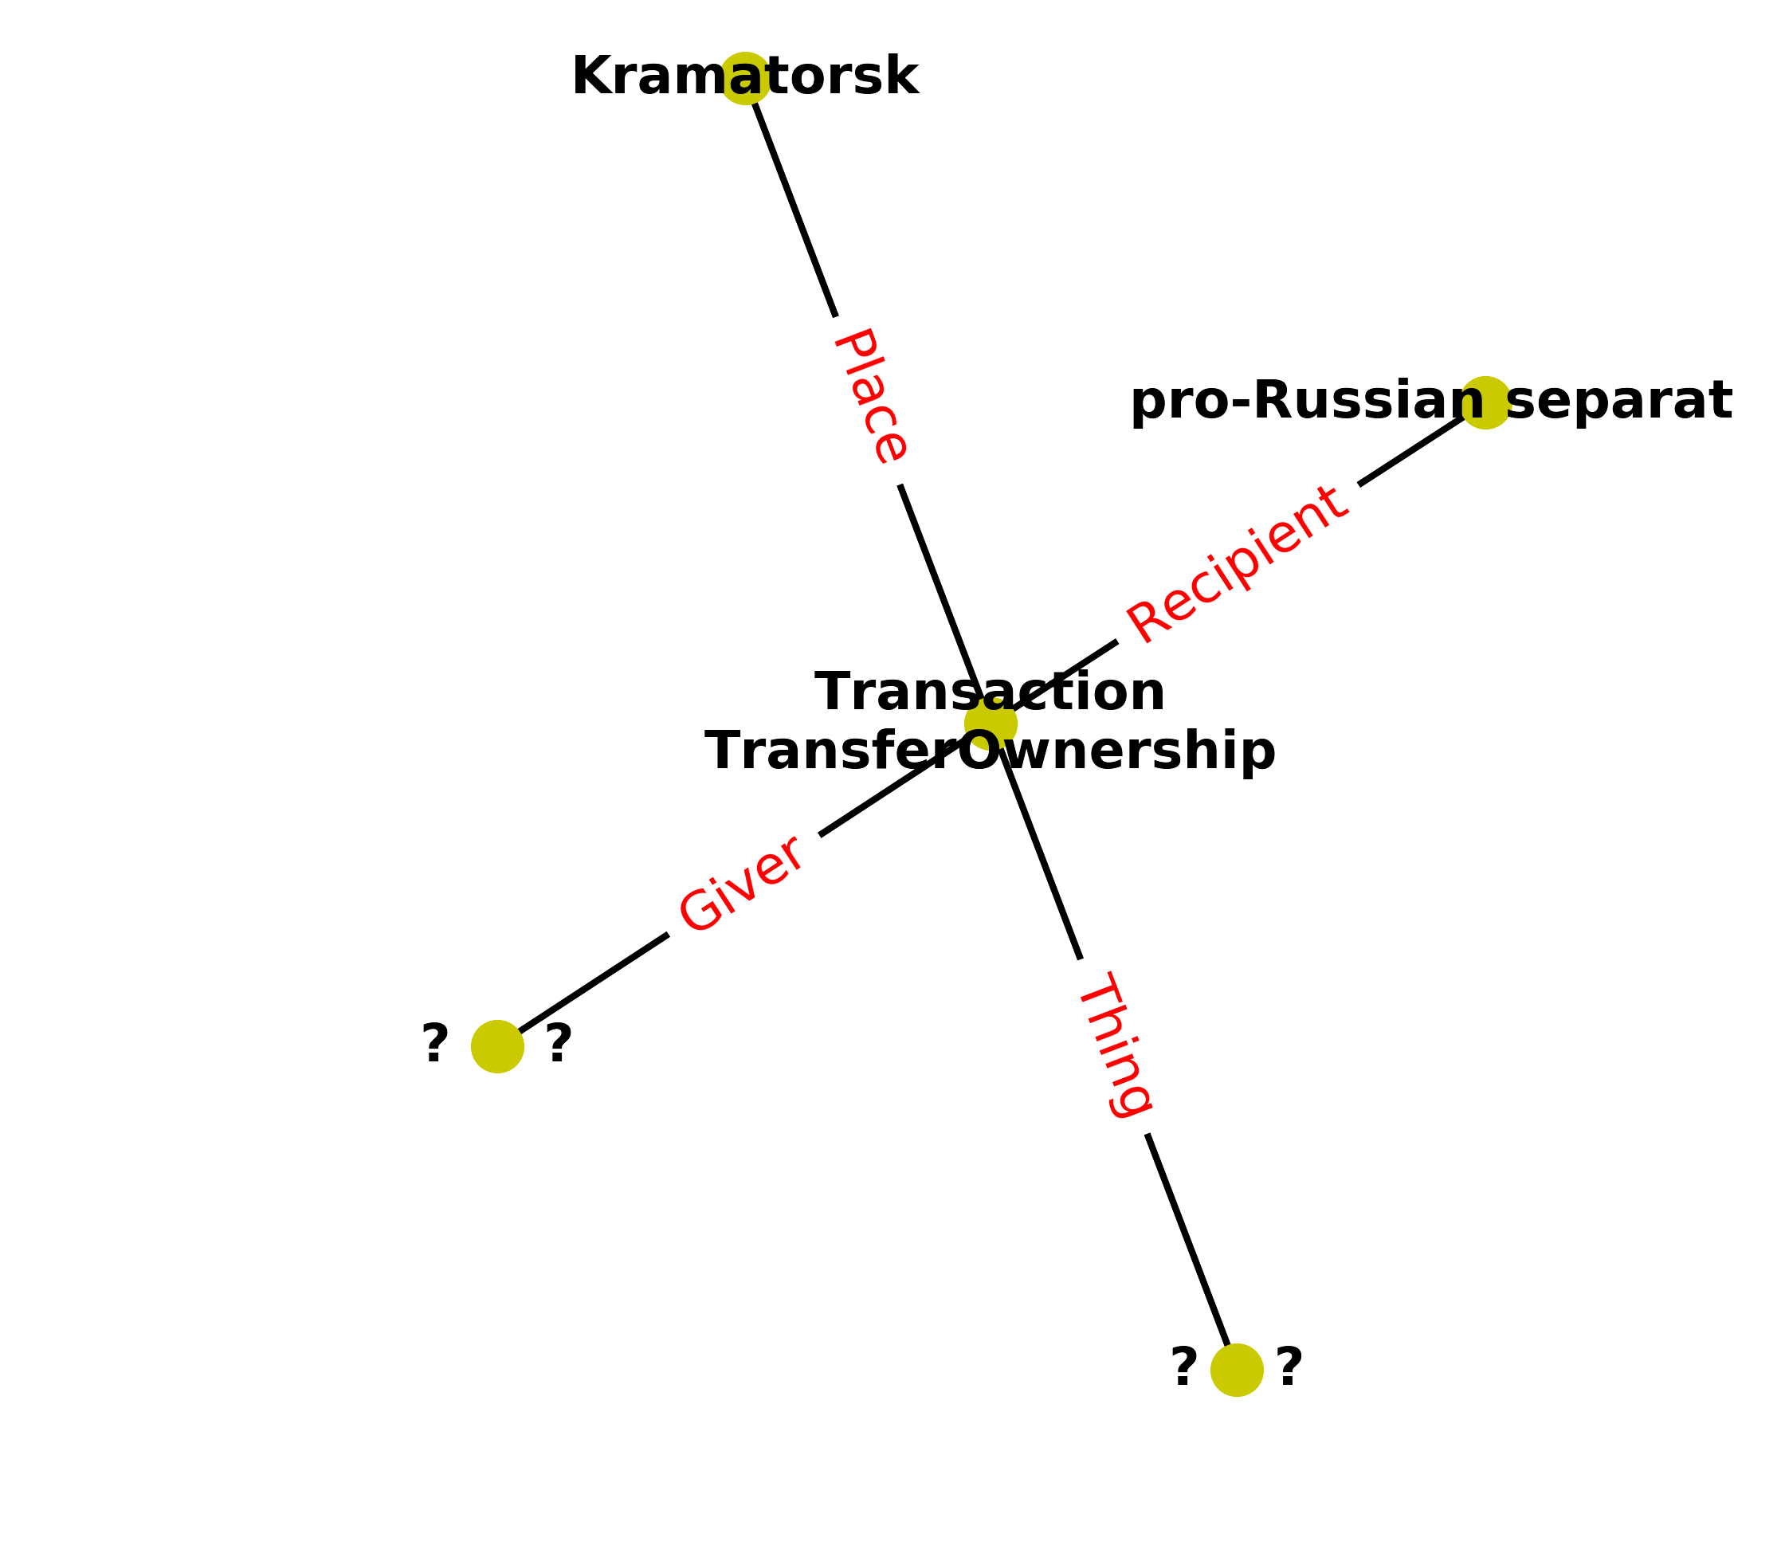
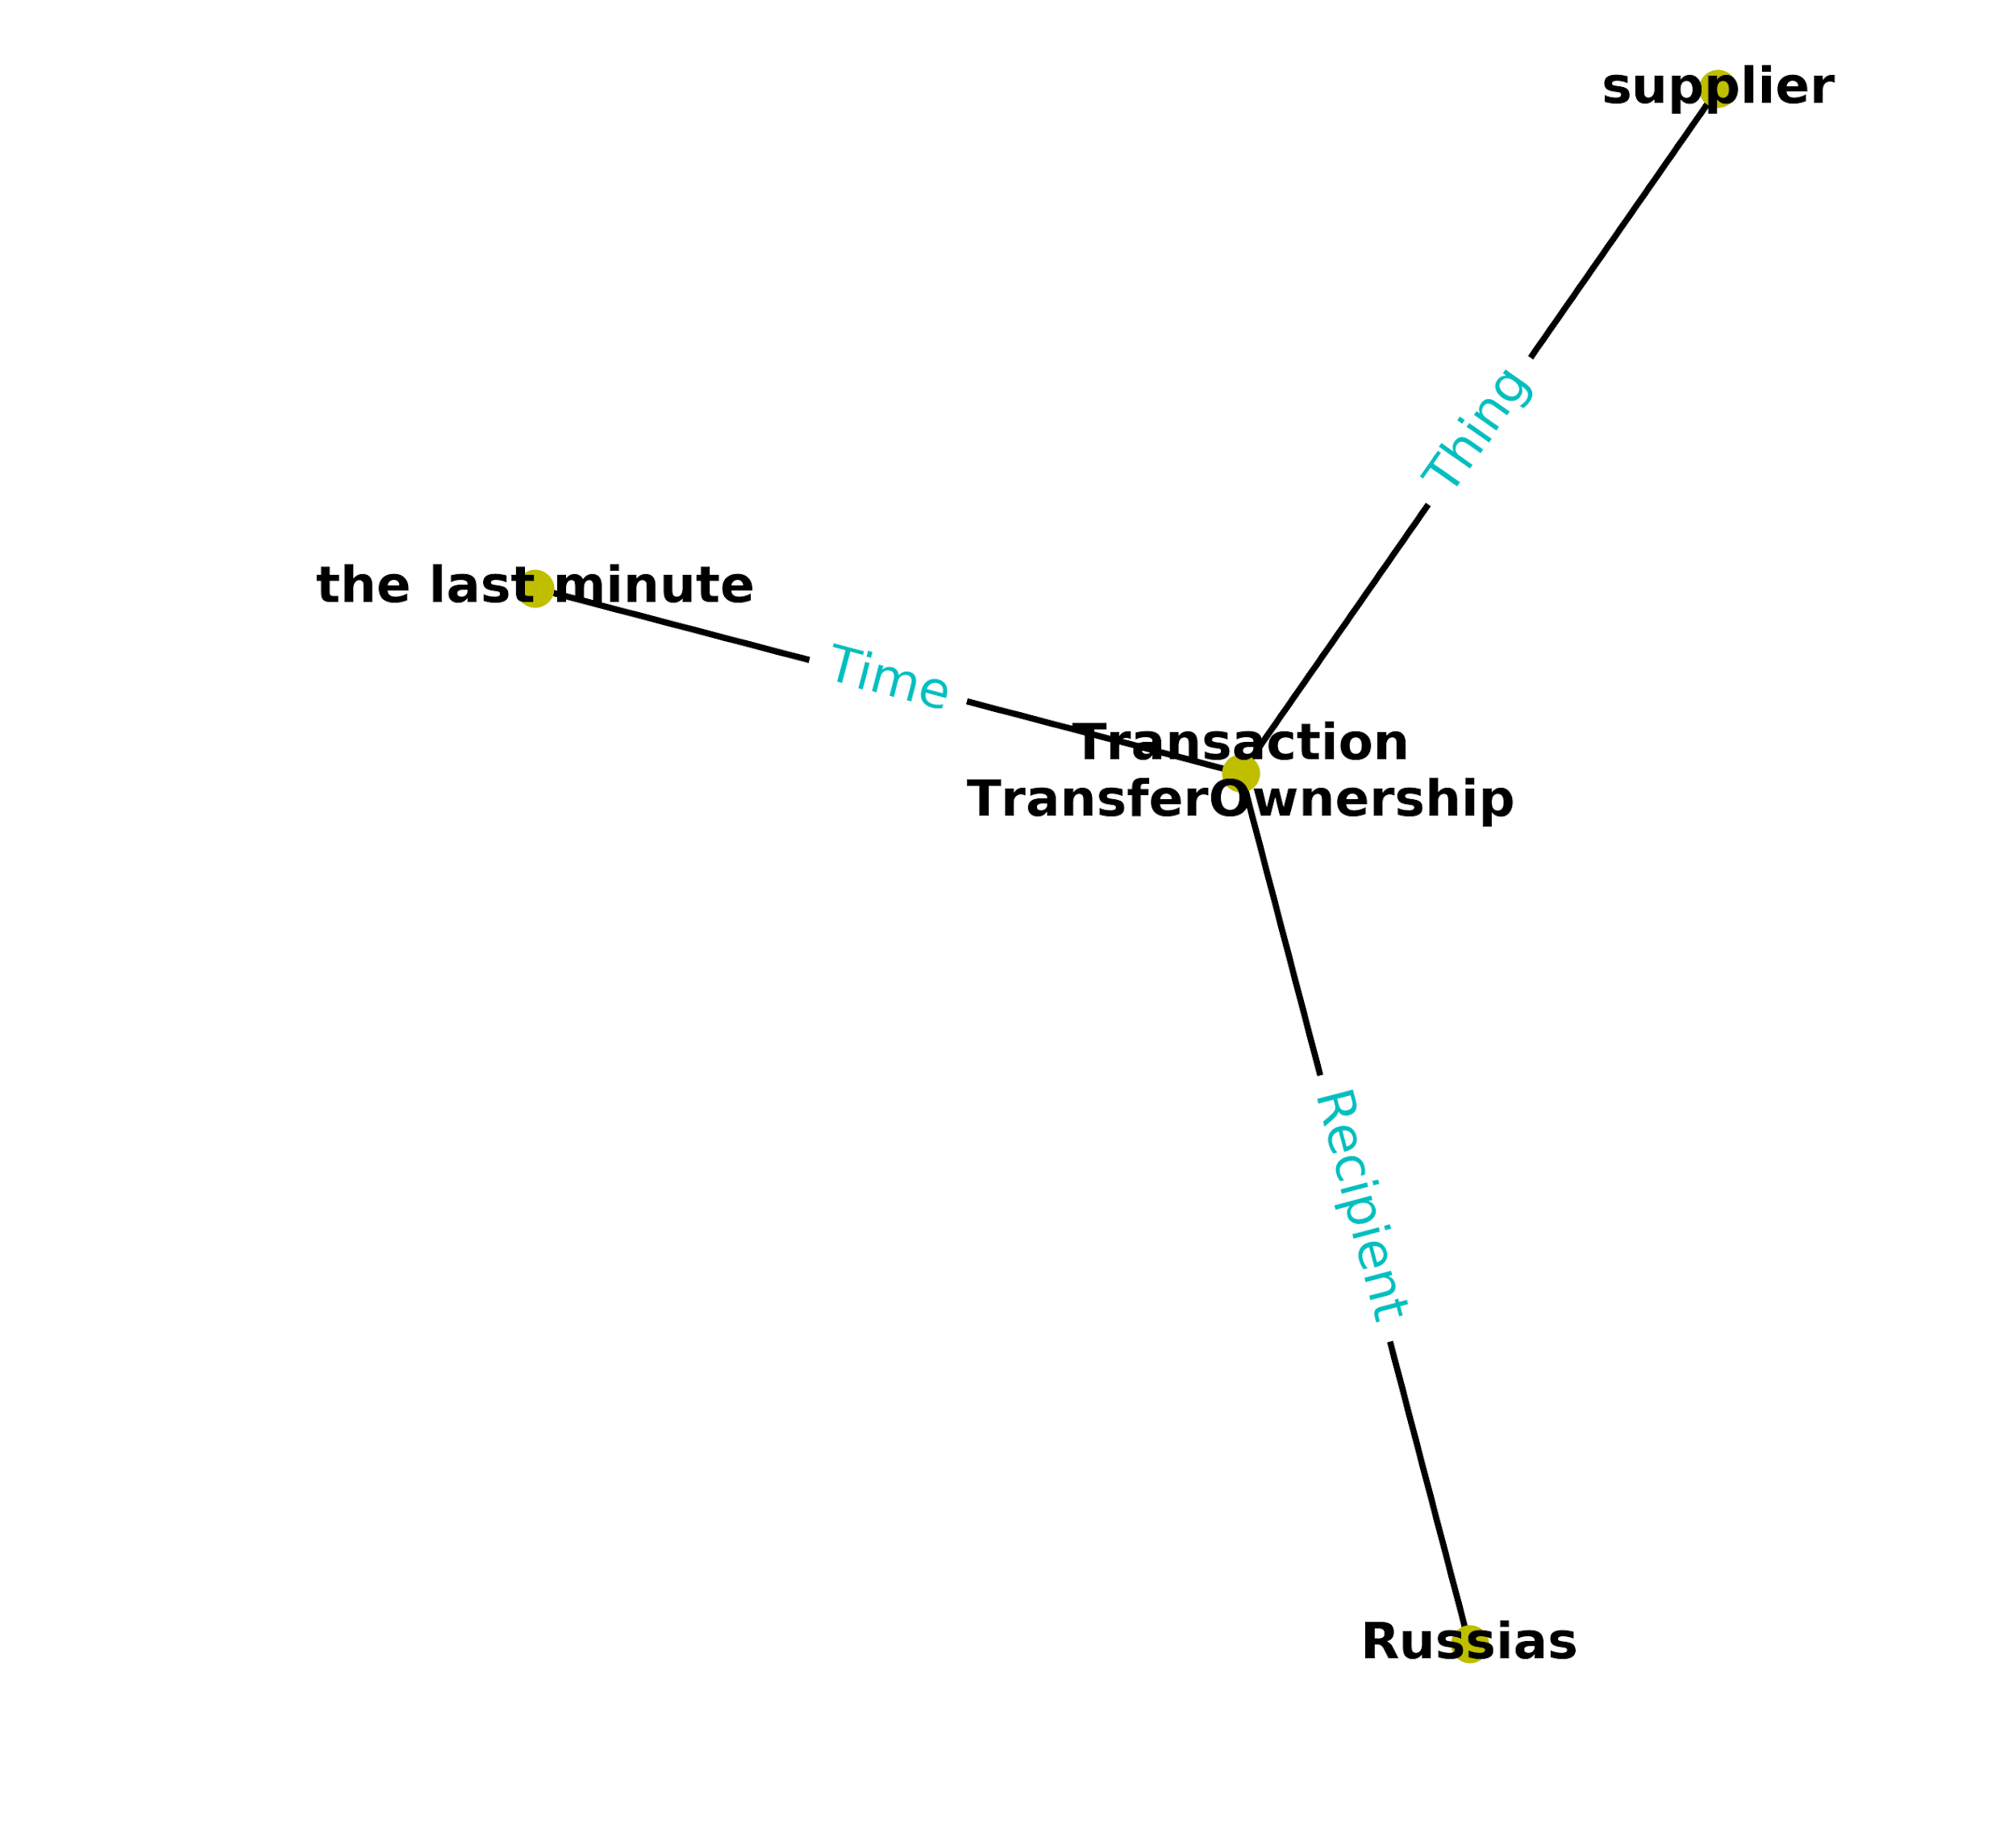
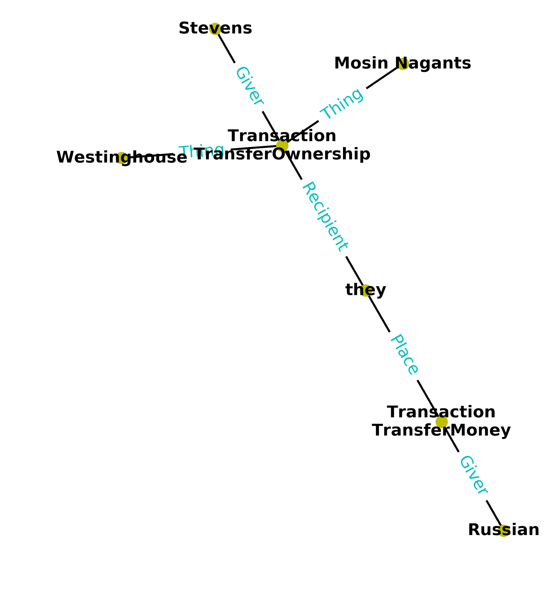
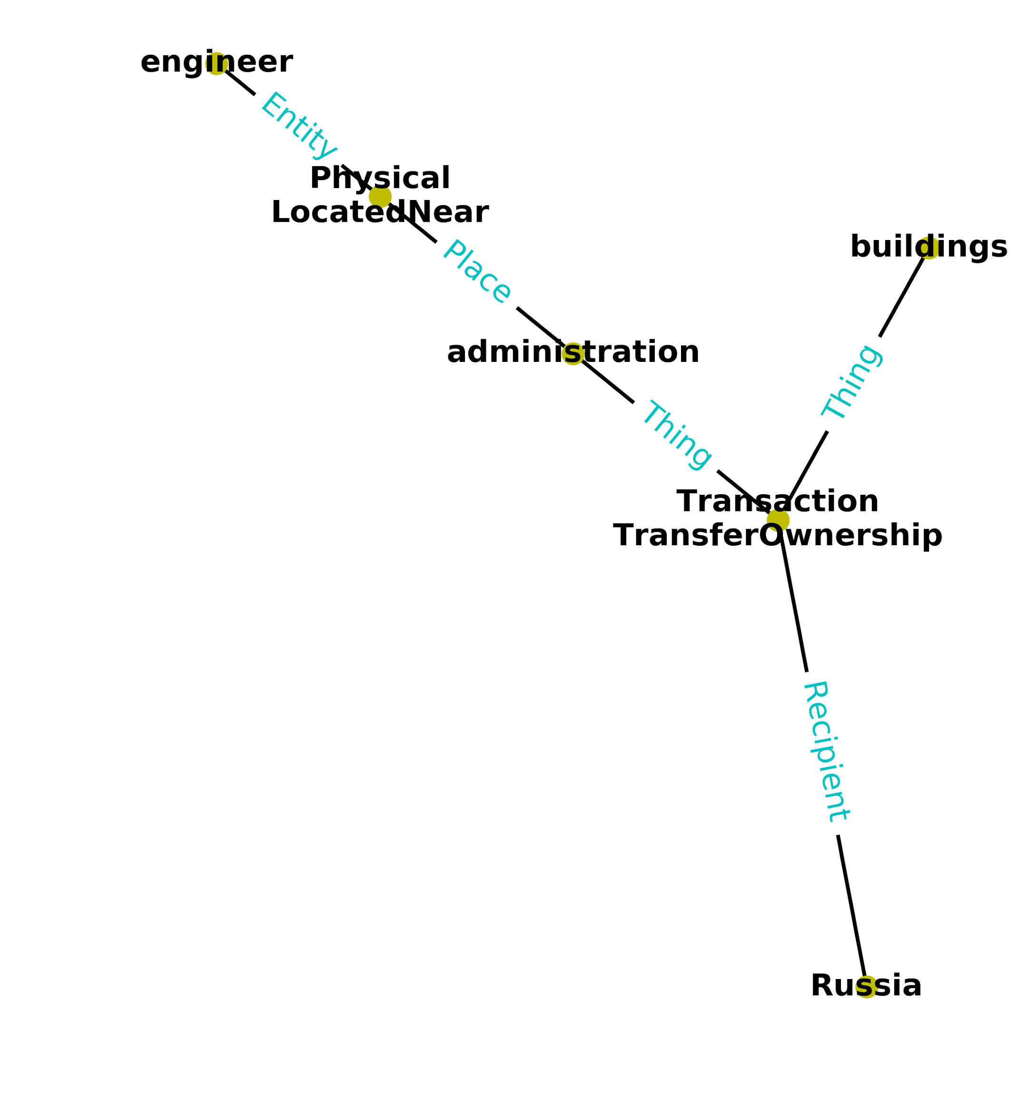
Top results - GAIA1 - F001Q002
Query 2

Slide 21
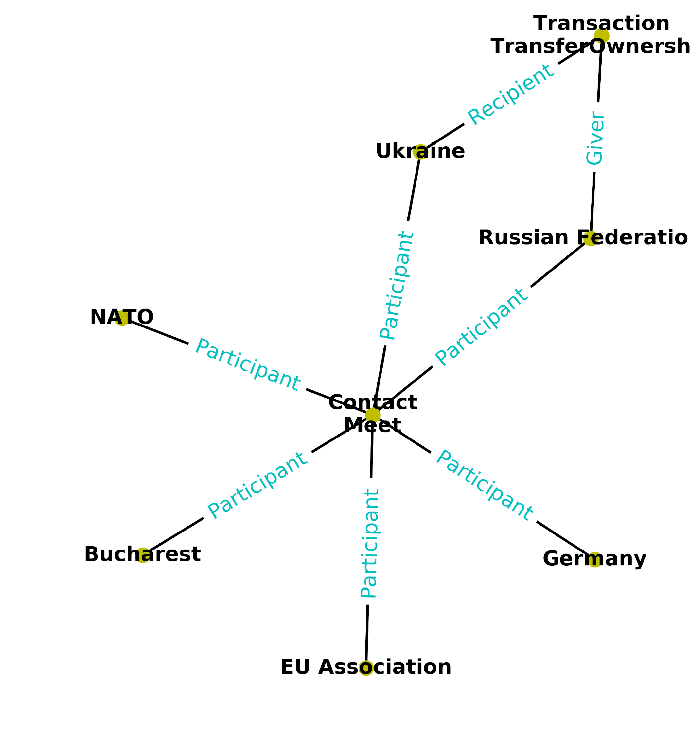
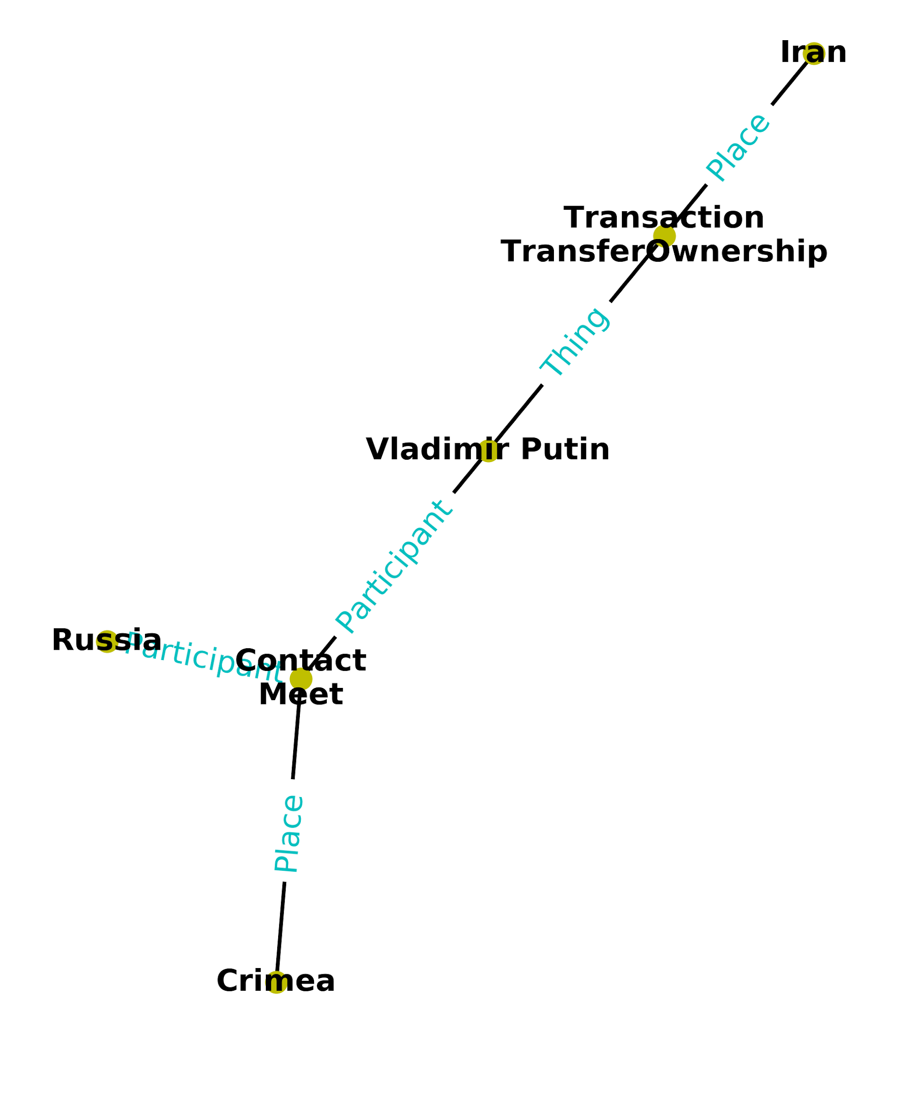
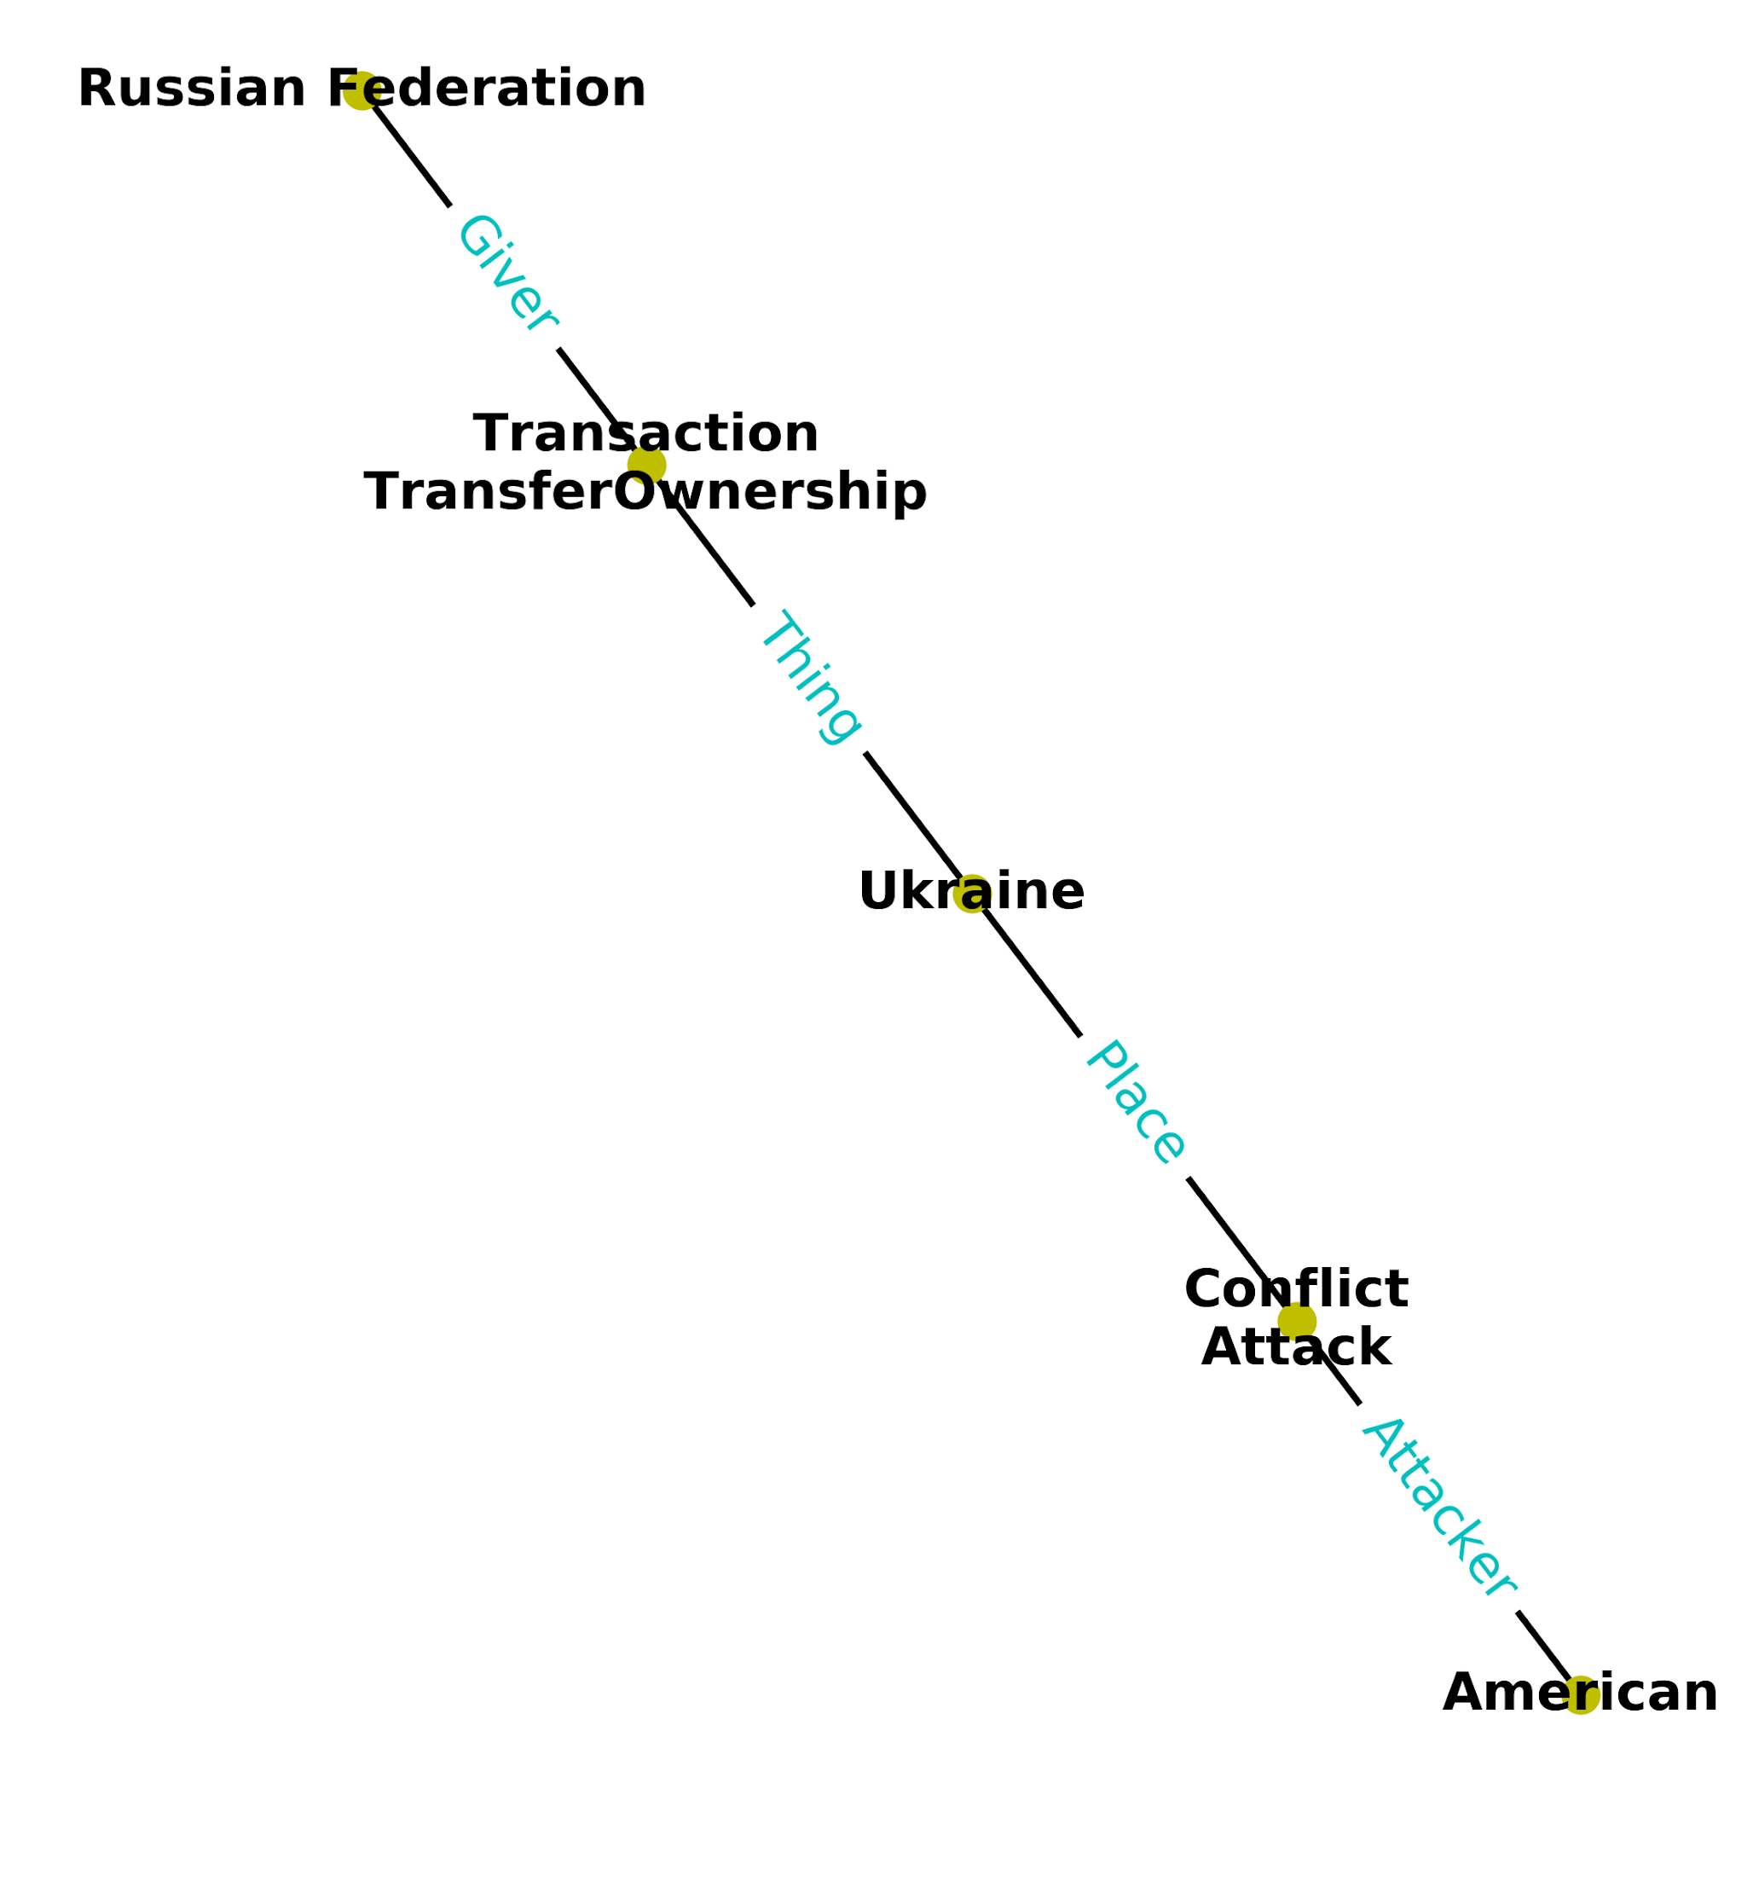
Top results - BBN - F001Q002

Slide 22
Takeaway
The properties of actual TA2 data differs extensively from Annotated data, direct training on the current annotations is not very useful.
Solutions?
Manually annotate TA2 data?
Novel methods that can take advantage of the current annotations?

Slide 23
Next steps
Refactoring and speed up
Cleaning the data folders and code, addressing TODOs.
Advanced Clustering
Graph/entity embeddings for clustering
Graph Attention Networks
Use for clustering or direct hypothesis mining.
Archimedes (Probabilistic Database)
Uncertainty, relational, logic (e.g., mutual
exclusion): Possible worlds and contradictions

Slide 24
Thank You!
Questions?

