Slide 1
IBM Research System at TAC 2017 Adverse Drug Reactions Extraction from Drug Labels
Bharath Dandala (bdand@us.ibm.com) Diwakar Mahajan (dmahaja@us.ibm.com) Murthy Devarakonda (mdev@us.ibm.com)

Slide 2
Introduction
Drug label data is one of many sources of medical information, and automatic extraction of ADRs from this corpus enables many clinical decision support applications.
Named Entity Recognition (NER) and Relation Extraction are two fundamental requirements in automatic ADR extraction for drug labels.
Our contributions are as follows:
State-of-the-art deep learning architectures for Named Entity Recognition and Relation Extraction for ADR extraction.
Novel deep-learning architecture for identifying disjoint(discontinuous and overlapping) concepts.

Slide 3
Datasets
Concepts:
15722 Concepts in training data
Characteristic 1: Skewed Distribution
(13795 Adverse Reactions, 934 Severity, , 602 Factor, 249 Drug Class, 98 Negation, 44 Animal).
Characteristic 2: Disjoint Concepts
7% of the concepts are disjoint concepts either with overlapping spans or discontinuous spans.
Swallowing and breathing difficulties -> Swallowing difficulties, breathing difficulties.
Relations:
3228 relations (1454 Effect, 1611 Hypothetical and 163 Negated) in training data
Characteristic 1: The relationship is always between adverse reactions and other concept types.
Characteristic 2: Task is relation extraction but not relation classification. Thus, the system should perform well on recognizing low frequency concept types.

Slide 4
Concept Extraction - Encoding
Typically, the named entities or concepts are continuous sequences of words.
Thus, in machine learning-based concept extraction systems, annotated data is encoded using BIO tagging, where each word is assigned into one of three labels: B means beginning, I means inside, and O means outside of a concept.
However, BIO encoding is not sufficient for disjoint concepts.
Tang et al., (2013 ; 2015 ) tried to address this problem by using alternative label encodings such as: BIOHD and BIOHD1234.
HB and HI refers to tokens that are shared by multiple concepts, DB and DI refers to tokens that belong to discontinuous concepts, B and I are used to label the tokens that belong to continuous concepts and O refers to tokens that are outside of concepts.

Slide 5
Concept Extraction – BIOHD Encoding
SENTENCE:
Swallowing and breathing difficulties can be life threatening and there have been reports of death related to the spread of toxin effects .
ENCODING:
Swallowing/DB_ADR and/O breathing/DB_ADR difficulties/HB_ADR can/B_Factor be/O
life/B_Severity threatening/I_Severity and/O there/O have/O been/O reports/O of/O death/B_ADR related/O to/O
the/O spread/B_ADR of/I_ADR toxin/I_ADR effects/I_ADR
CONCEPTS:
ADRs: Swallowing difficulties , breathing difficulties , death , spread of toxin effects
Factor: can
Severity: Life Threatening

Slide 6
Concept Extraction - Encoding
Tang et al., (2013 ; 2015 ) tried to address this problem by using alternative label encodings such as: BIOHD and BIOHD1234.
HB and HI refers to tokens that are shared by multiple concepts, DB and DI refers to tokens that belong to discontinuous concepts, B and I are used to label the tokens that belong to continuous concepts and O refers to tokens that are outside of concepts.
This encoding is still lossy, since the information on which parts constitute the same concept is lost when decoding.
Li et al. (2017 ) used BIOHD encoding and proposed a decoding scheme that is better suited for such an encoding.
Step 1: first identify continuous concepts and the components of disjoint concepts (head and discontinuous components) .
Step 2: construct a graph G = (V,E) , where the vertex set V represents all components and the edge set E represents the positive relations. The decoding objective is to extract find all complete sub-graphs in which every pair of distinct vertices is connected by a unique edge.

Slide 7
Concept Extraction – BIOHD Decoding
Sentence: Patients treated with TREANDA may also have changes in their creatinine levels .
Encoding: Patients/O treated/O with/O TREANDA/O may/B_Factor also/O have/O changes/DB_ADR in/DB_ADR their/O creatinine/DB_ADR levels/DR_ADR ./O
Changes in
may
Creatinine levels

Slide 8
Concept Extraction – BIOHD Decoding
Sentence: Patient has Chest pain, pressure, squeezing or tightness
Encoding: Patient/O has/O Chest/HB_ADR pain/DB_ADR ,/O pressure/DB_ADR ,/O squeezing/DB_ADR or/O_ADR tightness/DB_ADR
Pain
tightness
Chest
Squeezing
pressure

Slide 9
Concept Extraction Architecture
Our concept extraction architecture contains two sub-models, namely,
Sequence Labelling sub-model: A sequence labeling model labels each word of an input sentence using BILSTM-CRF . The labels are
X×Y={(x,y)|x∈X , y∈Y}
Where X is {B,D,I,O,H} and Y is {Adverse reaction, factor, severity, Animal, Factor, Drug Class , Negation}
Pre-trained word embeddings are obtained using unannotated adverse drug reaction documents released as part of the task.
We used character (50) , word (200) , part-of-speech (20) embeddings.

Slide 10
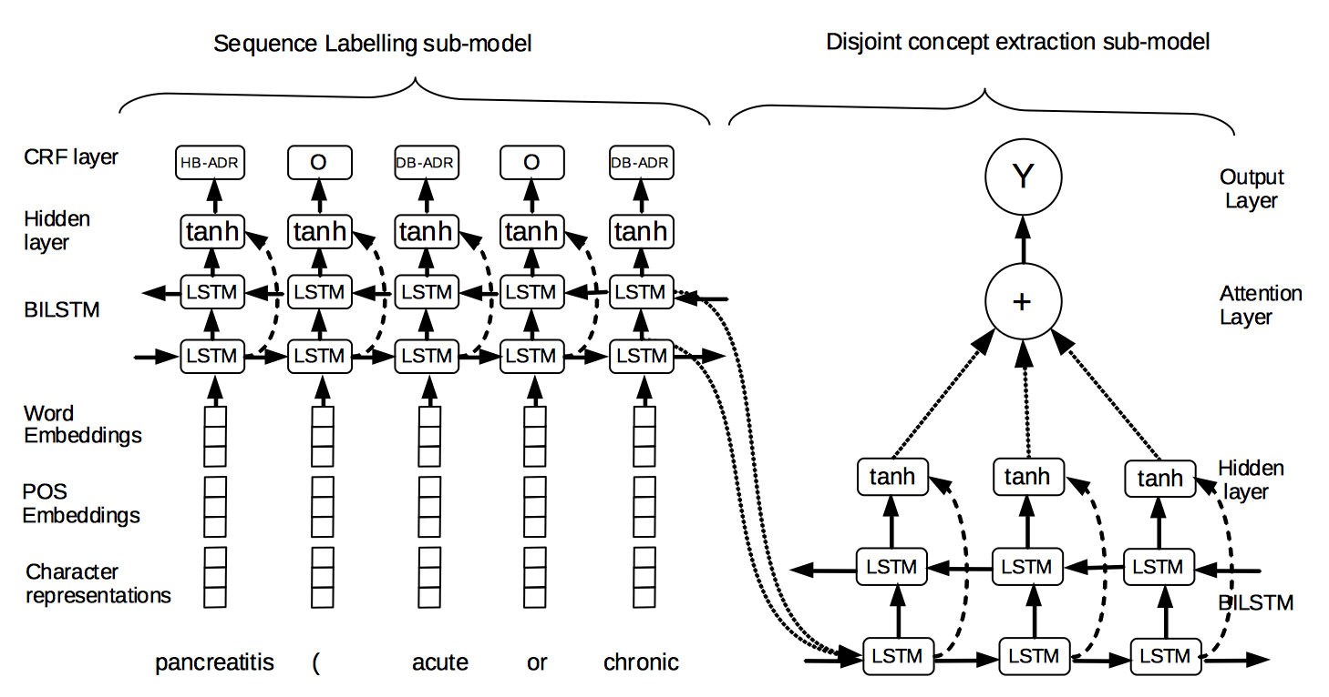
Concept Extraction Architecture

Slide 11
Concept Extraction Architecture
Our concept extraction architecture contains two sub-models, namely,
Sequence Labelling sub-model: A sequence labeling model that labels each word of an input sentence using BILSTM-CRF . The labels are
X×Y={(x,y)|x∈X,y∈Y}
Where X is {B,D,I,O,H} and Y is {Adverse reaction, factor, severity, Animal, Factor, Drug Class , Negation}
Disjoint concept extraction sub-model: Attention-based Bidirectional LSTM classification sub-model determines whether two components (discontinuous and header components) should be combined.
We insert positional indicators <TARGET></TARGET> around the target components.

Slide 12
Concept Extraction Architecture

Slide 13
Relation Extraction Architecture
We used Attention-BiLSTM architecture introduced by (Zhou et al. , 2016 ) for relation extraction.

Slide 14
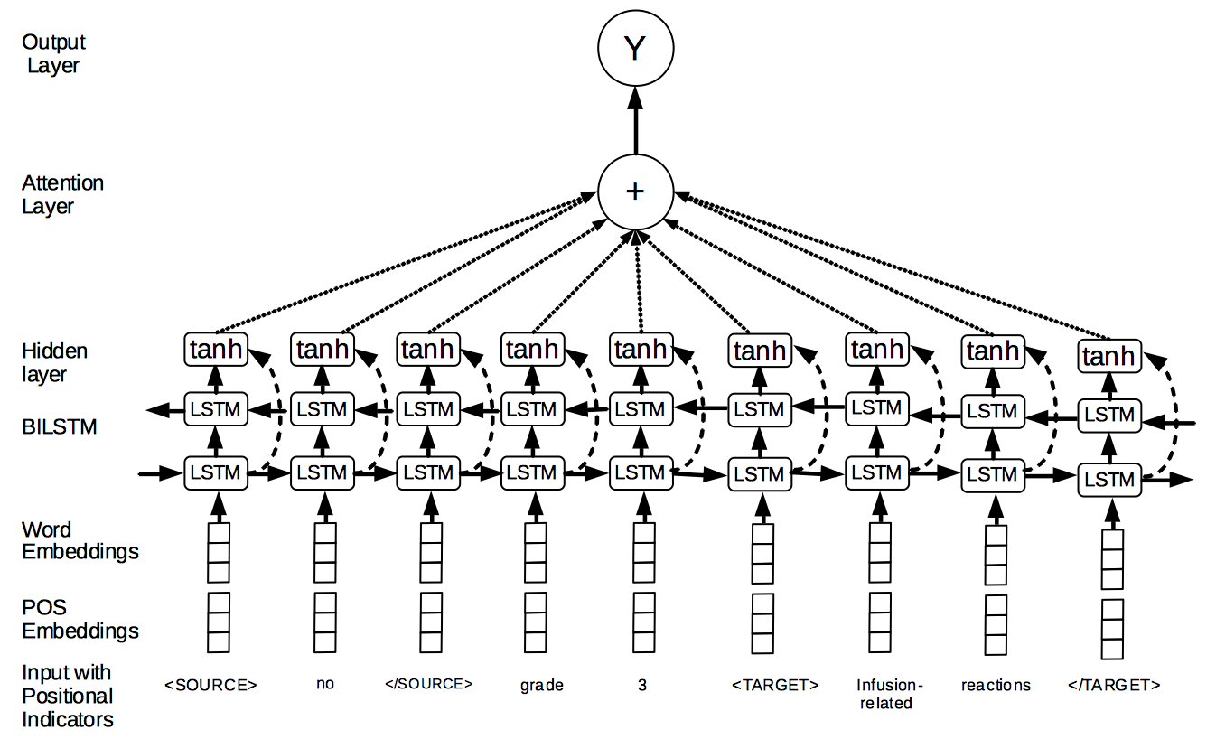
Relation Extraction Architecture

Slide 15
Relation Extraction Architecture
We used Attention-Bidirectional LSTM architecture introduced by (Zhou et al. , 2016 ) for relation extraction.
We reserved <TARGET>< /TARGET> positional indicators for adverse reactions and
<SOURCE></SOURCE> positional indicators for other concept types.
Pre-trained word embeddings(200) are obtained using unannotated adverse drug reaction documents released as part of the task.
Part-of-speech embeddings are initialized randomly.

Slide 16
Experimental Settings
We used 20% of released training data as development data.
We used early stopping(Graves , 2013 ) based on performance on development dataset. The best performance appear at around 20 epochs and 15 epochs for concept extraction and relation extraction.
Hyper-parameter tuning:
Concept Extraction
parameter | BIO | NerOne | OurSystem
dropout | 0.4 | 0.4 | 0.5
Learning rate | 0.02 | 0.03 | 0.03
regularization | 1e-7 | 1e-6 | 1e-6
Hidden layer size | 150 | 100 | 100
Relation Extraction
parameter | Extraction | Classification
dropout | 0.5 | 0.5
Learning rate | 0.01 | 0.01
regularization | 1e-7 | 1e-5
Hidden layer size | 100 | 100

Slide 17
Results
Concept Extraction (Task 1) – Comparison (Exact + type)
 | Precision | Recall | F1
BIO | 81.10 | 70.30 | 75.31
Nerone | 79.80 | 74.30 | 76.95
Our system | 80.90 | 75.30 | 78.00
Relation Classification
Binary | 90.06 | 92.38 | 86.75
Binary (+type) | 86.75 | 88.99 | 87.86
Full (-type) | 87.48 | 85.03 | 86.24
Full (+type) | 84.09 | 811.74 | 82.90
Concept Extraction (Task 1)
 | Precision | Recall | F1
Exact (-type) | 81.12 | 75.50 | 78.21
Exact (+type) | 80.90 | 75.30 | 78.00
Relation Extraction (Task 2)
Binary | 54.62 | 38.50 | 45.16
Binary (+type) | 53.94 | 38.02 | 44.60
Full (-type) | 48.64 | 32.89 | 39.24
Full (+type) | 48.13 | 32.54 | 38.83

Slide 18
Future Directions
Potential headroom for improvements:
Embeddings: Using PUBMED embeddings or embeddings trained on complete Drug Label Data.
Skewed distribution: Tackling rare concept types separately, specifically those participate in relations, by building a combination of rule-based/machine learning methodologies exploiting their properties.
Representation: Handling disjoint concepts with more advanced decoding schemes thus avoiding lossy representation. [Muis et. al 2016].
Semi-Structured nature of Drug label data: Drug-label data has rich semi-structured information such as sub-headings and tabular contents. In future, we plan to build cascading models which can also exploit the structure of the content.

Slide 19
Thank You

