Slide 1
Stanford at TAC KBP 2016: Sealing Pipeline Leaks; Understanding Chinese
Yuhao Zhang , Ashwin Paranajape, Danqi Chen, Arun Chaganty, Jason Bolton, Peng Qi, Christopher D. Manning

Slide 2
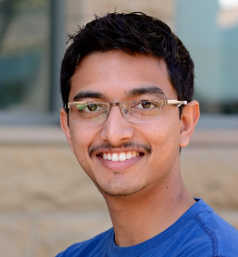
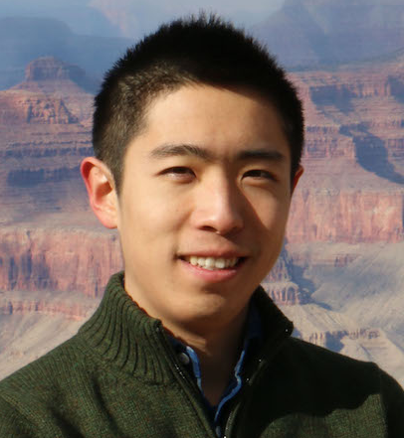
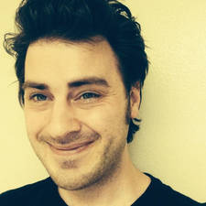
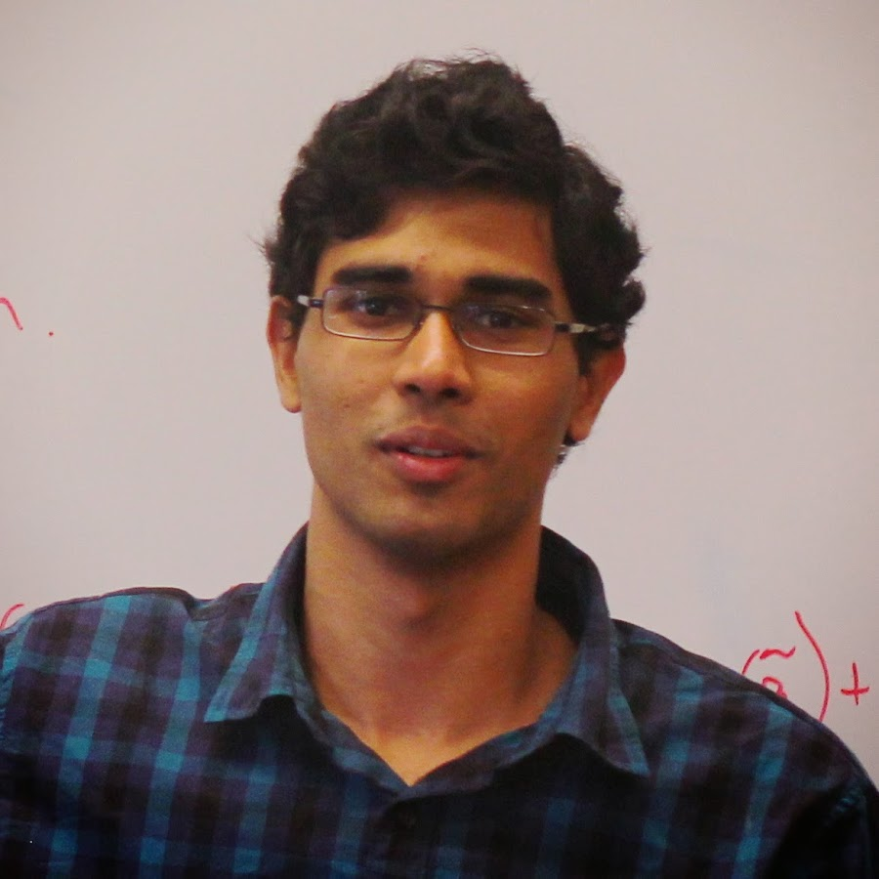
Stanford: early 2016
How would you like to
work on KBP this year?
Great! BTW, KBP is
cross-lingual this year!
It’s ok, we just need
to rerun the system...
Um... okay...
Notes:
Slide mostly included as a humorous ice-breaker.

Slide 3
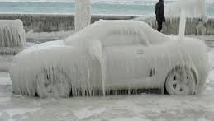
This talk
Finding low-hanging fruit, particularly with our English system
How to quickly roll your own Chinese system
Notes:
Key takeaways for this talk.
On the English side, we already have a fairly mature system so it was rather hard to find one obvious thing that needs to be improved. So one of the takeaways from our talk is how we used SQL to find low-hanging fruit.
The other of course is, how to quickly roll your own Chinese system, which Yuhao will be presenting.

Slide 4
Outline
English KBP
Chinese KBP
Conclusions / Future Directions
Notes:
Let’s start with an overview of our KBP system that has elements common to both our English and Chinese systems.

Slide 5
Ye ol’ KBP Pipeline (2014)
CoreNLP Annotators
Tokenization, POS tagging, parsing, etc.
Lucene
Entity Detection & Linking
NER, coref, entity linker (wikidict, Illinois Wikifier)
Low recall due to IR
SLOW
Relation Extractors
Pattern-based, statistical, neural network
Post-processors
Consistency and deduplication
Image credit: Setyo Ari Wibowo
Notes:
At the high level, we have a fairly standard pipeline.
All and well, BUT, pipeline errors can compound and take a while to run. And it is really slow!

Slide 6
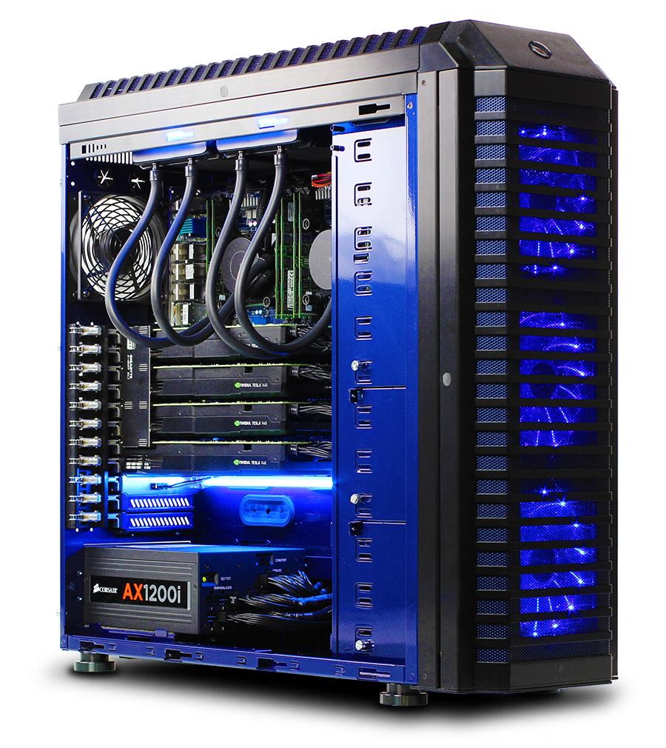
Ye new KBP Pipeline
$20K for 20 cores, 768GB RAM, 1.2TB SSD.
CoreNLP Annotators
Entity Detection & Linking
Higher recall
Quick iteration
Great for NLP!
Relation Extractors
Post-processors
Error analysis
Notes:
The different stages now are mediated through the database.
Highlight error analysis because everything is inside the database.

Slide 7
Big data can be better exploited with a big, fast database
All intermediate data stored in an in-memory Greenplum DB ($20k x 2 machines)
20 cores @ 2.2 Ghz
786 GB RAM @1866 Mhz
1.2TB PCI-E SSD (NVMe) @ 2.6gb/sec read
Separate database instances for English and Chinese systems
(Aside) Great for quick development on any other NLP task.

Slide 8
Outline
The Stanford KBP system
English KBP
Chinese KBP
Conclusions / Future Directions

Slide 9
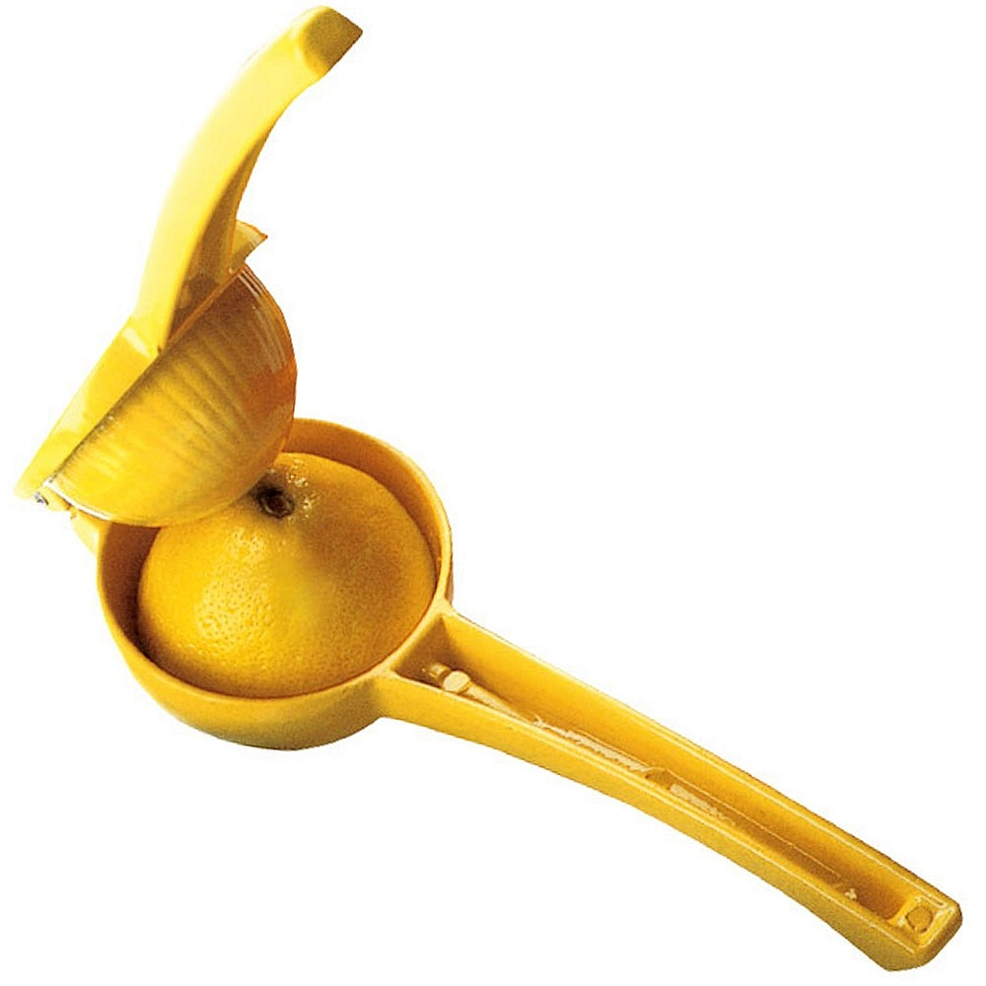
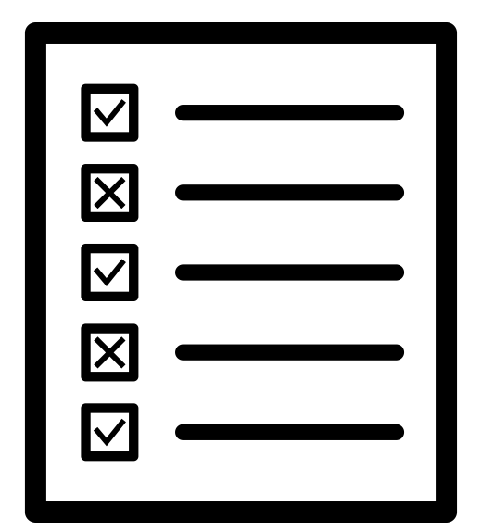
How do we squeeze more KBP from KBP?
Diagnose with 2015 evaluation data
Which mentions do we miss?
What is their type/slot distribution?
How many of them are correctly linked?
Which slotfills do we miss?
Notes:
* Point – SQL allows us to ask these questions.

Slide 10
Which mentions do we miss?
Titles: Induce an expanded gazetteer from earlier KBP corpora. (+1 F1)
Hyphenated locations (Seattle-born, London-raised, etc.)
GPEs inside mentions: University of Texas, Cambodia National Rescue Party (+1.3 F1)
Notes:
Hyphenated locations – our NER still relies on old LDC/Penn treebank tokenization.

Slide 11
Which slotfills do we miss?
Maximum scope for improvement: inverse relations
4 of the top 5 inverse relations involved GPEs.
Notes:
(This is one of BBN’s)

Slide 12
Inferring GPE relations
“US President Barack Obama, escorted … President Chuck Canterbury of Myrtle Beach, South Carolina…”
per:cities_of_residence
locatedInState

Slide 13
Inferring GPE relations
“US President Barack Obama, escorted … President Chuck Canterbury of Myrtle Beach, South Carolina…”
per:states_of_residence

Slide 14
Inferring GPE relations
“US President Barack Obama, escorted … President Chuck Canterbury of Myrtle Beach, South Carolina…”
“… despite efforts by Nashville Mayor Karl Dean and the leaders of other Tennessee cities to derail the legislation.”
Notes:
30%-50% precision; 300-1000 extractions

Slide 15
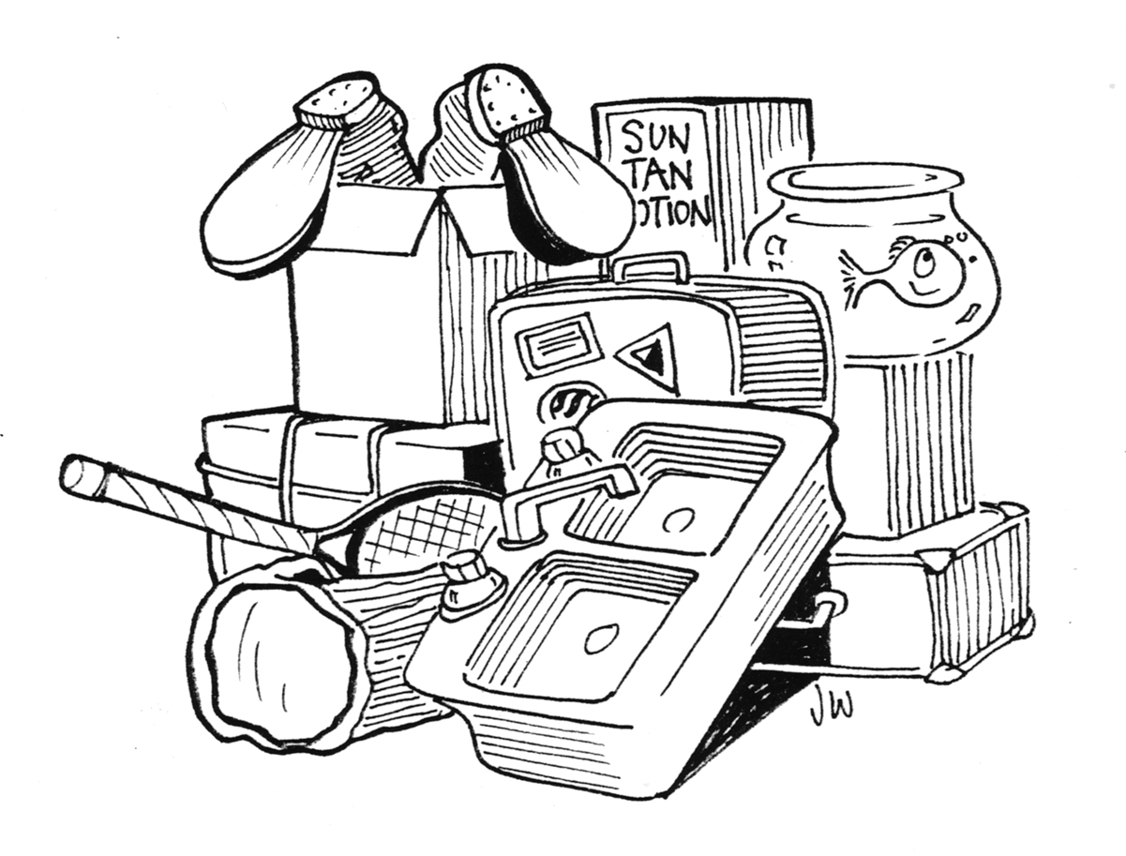
Other improvements
Model combination: Optimize for Recall@k instead of accuracy using SVM^{perf} [Joachims 2005]
Improved neural model: using convolutional LSTMs

Slide 16
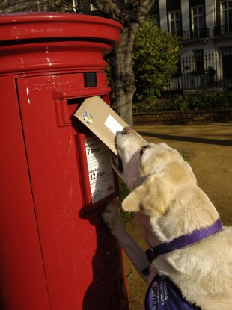
Our submissions
Improved titles gazette
Patterns + alternate names
GPE-mentions
Inferred relations
Supervised (30k sent.)
Neural model (~120k sent.)
+ Model combination on all the above.
High precision
Med prec.
High recall
Notes:
33k
New crowdsourcing dataset

Slide 17
How did we do?
Notes:
TODO: find and include LDC results as a comparison?
There are too many numbers being shown and this needs to be simplified. Maybe do Sf/KB results separately?
Basically our high recall do the best, followed by “medium precision”, union over a fewer elements, followed by model combination, followed by high precision.
The macro metric is very forgiving to high recall, poor precision systems.
However, the LDC-MAX metric is far more conservative and it turns out that the model combination system does best here.

Slide 18
How did we do?
Notes:
TODO: find and include LDC results as a comparison?
There are too many numbers being shown and this needs to be simplified. Maybe do Sf/KB results separately?
Basically our high recall do the best, followed by “medium precision”, union over a fewer elements, followed by model combination, followed by high precision.
The macro metric is very forgiving to high recall, poor precision systems.
However, the LDC-MAX metric is far more conservative and it turns out that the model combination system does best here.

Slide 19
How did we do?

Slide 20
Comparison of Relation Extractors
Extractor | Hop-0 |  |  | Hop-1 |  |  | Hop-all
 | P | R | F1 | P | R | F1 | P | R | F1
Rule-based | 60.9 | 18.0 | 27.8 | 46.0 | 6.7 | 11.7 | 56.8 | 12.6 | 20.6
Self-trained supervised | 28.6 | 22.5 | 25.2 | 12.6 | 13.2 | 12.9 | 19.7 | 18.1 | 18.9
Conv-LSTM | 30.7 | 27.7 | 29.1 | 9.0 | 13.5 | 10.8 | 17. | 20.8 | 19.0
Comparison of relation extractors on 2015 Dev set for both hops
Rule-based = Union of Patterns, GPE_mention, Alternate names and Websites
Conv-LSTM outperforms on hop-0 F1 score and is the highest recall system
Overall, performance of rule-based system is the best. This is probably because of lower precision hop-0 output from other systems

Slide 21
Outline
The Stanford KBP system
Error analysis with SQL
English KBP
Chinese KBP
Conclusions / Future Directions

Slide 22
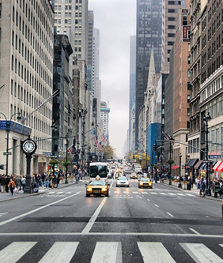
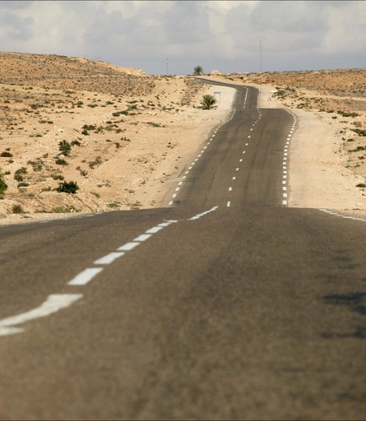
Landscape (when we started…)
English
Chinese
NER: 23 labels
Entity linker: Wikifier
Dataset: 2009-2015
Relation Extractors: 7
NER: 7 labels
Entity linker: …
Dataset: …
Relation Extractors: 0
Notes:
When we started KBP, our English system is a pretty mature pipeline.
While for Chinese, we need to build from scratch.

Slide 23
Shared Pipeline & Infrastructure
CoreNLP Annotators
Entity Detection & Linking
Relation Extractors
Post-processors
Error analysis
Notes:
In such context, a natural decision for us is to reuse the English pipeline and infrastructure/database for Chinese system.
Stanford CoreNLP already contains many annotator, our work in KBP was focused on entity detection & linking module and relations extractors.

Slide 24
Enhanced Chinese NER System
Retrained CRF-based NER (Stanford CoreNLP)
Augment OntoNotes5 by substituting in 450 additional Chinese names
Tuned for better recognition of (rare) Chinese names
+1.9 F1 on EDL2015 evaluation data
Notes:
Existing NER system:
very poorly on recognizing Chinese names.
Limited to 7 OntoNotes labels
We augment OntoNotes 5 by subsituting 450 additional Chinese names (+1.9 F1 on EDL)
New rule-based numeric NER
New gazetter-based fine grained NER for all 22 label

Slide 25
Enhanced Chinese NER System
Brand new rule-based Chinese numeric NER
Use normalized Arabic numerals as entity links
Brand new gazetteer-based fine-grained NER
NER as TokensRegex patterns
22 labels!

Slide 26
Simple Chinese Entity Linker
Entity linking with Chinese Wikidict [Spitkovsky & Chang 2012]
Simple, context-free mapping of strings to Wikipedia pages with likelihood
Uses Wikipedia URL as linked entity name
Same as English system
Enables shared use of knowledge bases
巴拉克·奥巴马
奥巴马
Barack_Obama
Barack Obama

Slide 27
Relation Extraction – Dataset
TAC KBP 2014 Chinese Regular Slot Filling Evaluation
103 query entities – 50% dev, 50% test
Problems:
Regular slot filling only has one hop queries
No GPE entities/slots
Keep calm and carry on…
Notes:
However this is the only dataset that we have when we started, so there is not much choice and we decided to use it.

Slide 28
Relation Extraction – Dataset
But we do not have any training data…
(And we have lazy grad students who do not want to spend time labelling data.)
Well, at least we have a large corpus, and an entity linker that can link to Wikipedia page URLs.
Distant Supervision!
Notes:
As we move on to build our relation extractors, we found another problem that we do not have any training data. This means that we cannot use any supervised methods.
However, the good news is that we do have a very large corpus that have ~ 80M sent, and we have an entity linker that can link to knowelege bases like Wikipedia. This gives us the opportunity to do Distant Supervision!

Slide 29
Relation Extraction – Distant Supervision
Knowledge bases (Freebase + KBP)
Training on 2014 Chinese corpus (~80M sent.)
Sampled ~80k positive instances balanced across relations.
Barack_Obama: per:country_of_birth: United_States
奥巴马 于1961年出生于 美国。
* Obama was born in the United States in 1961.
Notes:
Distant supervision is a technique where given a knowledge base with all known relation pairs, we identify all the co-occurrence of these pairs in the corpus and assume them to be positive examples for that relation.

Slide 30
Relation Extraction – Distant Supervision
Fundamental challenges:
Co-occurrence assumption too strong
“Obama and other US government officials”: country_of_birth?
Accumulated errors from linker
Hard to acquire balanced negative examples
Models | Precision | Recall | F1
Distant supervision (Mintz) | 21.8 | 29.8 | 25.2
Low precision!

Slide 31
What our timeline looks like
Chris: We need to do Chinese KBP…
1 week until
KBP deadline!
Pipeline development
(& procrastination)
Distant supervision & error analysis-driven improvement
Panic

Slide 32
Patterns to the rescue!
TokensRegex Patterns
A token-level regex that works on token/lemma/POS sequences and NER results
per:date_of_birth
( $ENTITY []{0,3} /出生|生/ /于|在/ $SLOT_VALUE )
(was born) (on)

Slide 33
Patterns to the rescue!
Semgrex Patterns
Patterns over dependency trees
Universal Dependencies (http://universaldependencies.org): universal taxonomy for dependencies across different languages
A new Chinese UD converter: from Chinese constituency trees to Chinese UD trees
出生
nsubjpass
nmod
奥巴马出生于1961年。
NER: PERSON
NER: DATE
Notes:
Another benefit of UD is that many UD structures are shared across languages, so this enabled us to reuse some Semgrex patterns from our English system. This significantly reduced our development time.

Slide 34
Patterns
Cheap and fast way for relation extraction
166 TokensRegex + 470 Semgrex patterns
~ 30 person-hours of work
High precision!
Easily control between precision and recall
Notes:
Some important things that we learned from the patterns system. First, we think it is a very cheap and fast way for doing relation extraction.
Another benefit. Easily control the tradeoff between precision and recall by adding increasingly aggressive patterns.

Slide 35
Rule-based Extractors
alternate-names
org-subsidiaries
coref
中国新闻社是一家国家通讯社……. 中新社是内地仅有的两家通讯社之一。
* Chinese News Service
* CNS
ORG
他曾任中国作家协会上海分会主席。
org:subsidiaries
ORG
* He used to be the president of China Writers Association Shanghai Branch.

Slide 36
Results

Slide 37
Results

Slide 38
Conclusions
System development in a database with ad-hoc querying (SQL) is very effective for finding the low-hanging fruit errors to fix.
An in-memory database allows fast iterations on patterns and distant supervision when building Chinese systems from scratch.
Notes:
popeye03

Slide 39
Future Directions
English
Better entity linking by ensembling EDL outputs
Deep learning methods
Chinese
Better entity linking
Supervised relation extractors
Better cross-lingual support
Notes:
popeye03

