Slide 1
FDA Adverse Event Track
NLM/FDA/NIST collaboration
Kirk Roberts, Ph.D.
Joe Tonning, M.D., M.P.H., R.Ph.
Dina Demner-Fushman, M.D., Ph.D.

Slide 2
signs and symptoms
changes in laboratory parameters
changes in measures of critical body function
(vital signs and ECG)
What is an Adverse Reaction?

Slide 3
Structured Product Labels (SPLs)
What is this challenge about?

Slide 4
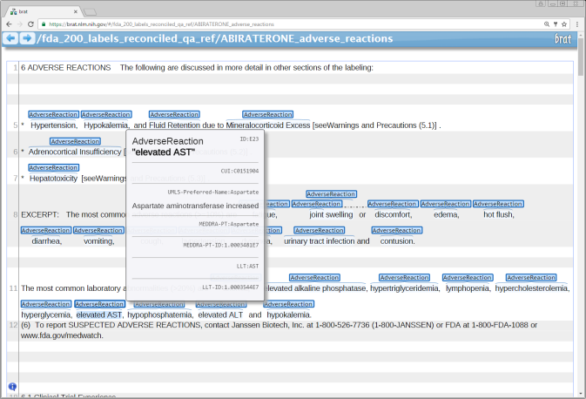
Training: ~100 SPLs Testing: ~2000 labels (~100 official)
Test collection

Slide 5
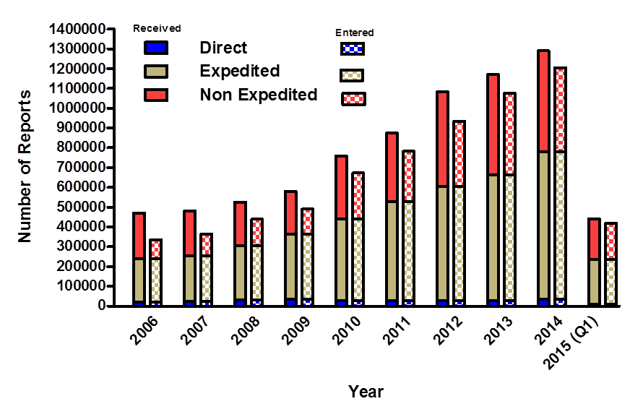
Use case: Are reported ARs labeled?

Slide 6
Reported ARs
Labeled ARs
Why is the challenge important for drug safety and research purposes?

Slide 7
There is currently no standardized, validated database of AR listings for FDA-approved drugs.
What makes pharmacovigilance hard?

Slide 8
ARs in different sections of SPLs text Not all Disorder terms are ARs Not all ARs can be mapped to terminologies
What makes standardization hard?

Slide 9
Respiratory, Thoracic and Mediastinal Disorders: non-infectious pneumonitis.
Non-AR Disorder terms in SPLs: Headers

Slide 10
Use caution when treating patients whose underlying medical conditions might be compromised by increases in blood pressure, hypokalemia or fluid retention, e.g., those with heart failure, recent myocardial infarction or ventricular arrhythmia
Non-AR Disorder terms in SPLs: pre-existing conditions administration instructions

Slide 11
No deaths clearly related to ZYTIGA were reported
Non-AR Disorder terms in SPLs: Negation

Slide 12
Arterial thromboembolic events are defined as nonfatal stroke, nonfatal myocardial infarction, or vascular death
Non-AR Disorder terms in SPLs: background information

Slide 13
Leukopenia, Neutropenia, and Agranulocytosis have been reported with antipsychotics
Hypothetical ARs: Class effect

Slide 14
Idelalisib is teratogenic in rats, at systemic exposures 12 times those reported in patients at the recommended dose
Hypothetical ARs: observed in animals

Slide 15
patients may experience substantial procedural pain
Hypothetical ARs: Hedging

Slide 16
Each label (3 sections) double-annotated by four annotators Exact matches mapped automatically, checked manually Other terms mapped manually Unmappable terms reported to MedDRA
Annotating and Mapping labels to UMLS and MedDRA

Slide 17
Interesting, challenging NLP task with immediate pharmacovigilance applications
A fully annotated collection of 200 labels ready to support evaluations of AR extraction tools Over 5100 distinct ARs
What pharmacovigilance applications could you imagine with this data?

Slide 18
Tasks
Task 1 Extract AdverseReactions and related entities (Severity, Factor, DrugClass, Negation, Animal).
Task 2 Identify the relations between AdverseReactions and related entities (i.e., Negated, Hypothetical, Effect, and Equiv).
Task 3 Identify the positive AdverseReaction entities in the labels.
Task 4 Normalize positive AdverseReaction entity (strings) to MedDRA PTs.

Slide 19
ddemner@mail.nih.gov

