Slide 1
Building an EDL System Overnight for a New X (X=Language, Domain)
Xiaoman Pan, Lifu Huang and Heng Ji
{panx2,huangl7,jih}@rpi.edu

Slide 2
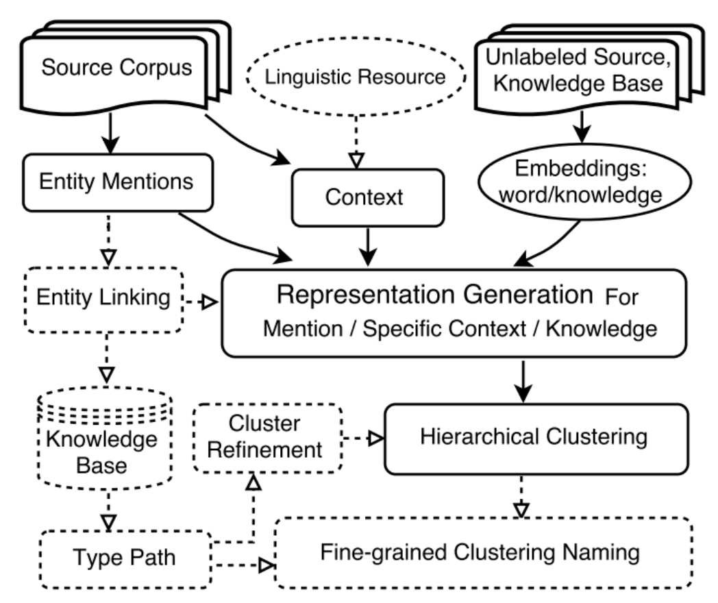
Liberal Knowledge Base Population

Slide 3
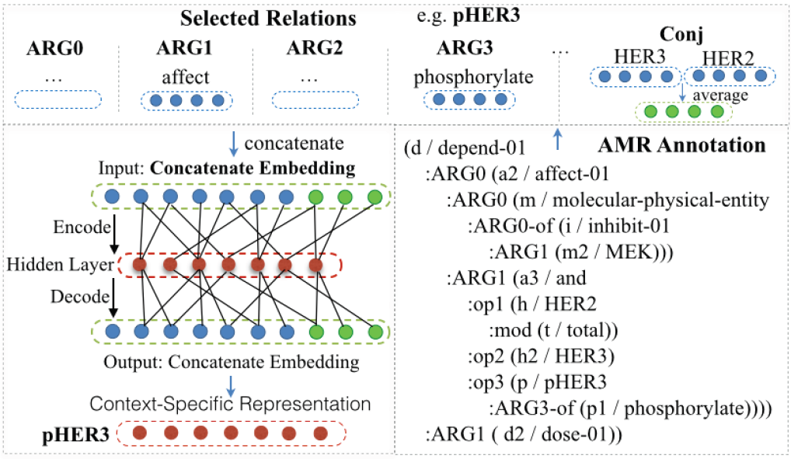
Fine-grained Entity Typing

Slide 4
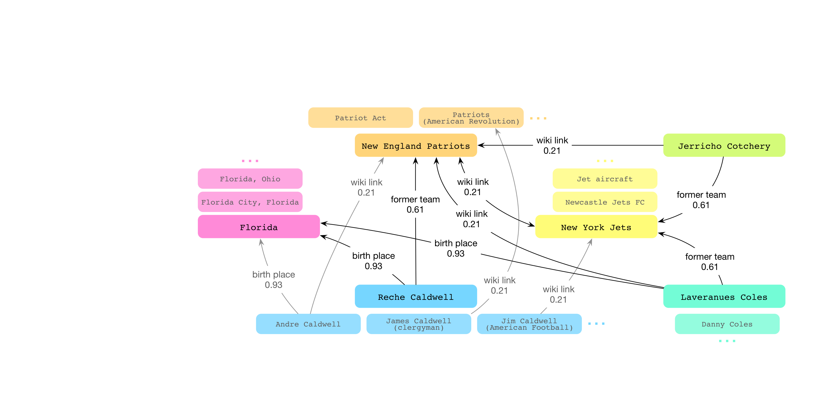
Unsupervised Entity Linking (Wang et al., 2015)
Unsupervised collective inference
Entropy based measure to quantify the discriminative power of various link types in KB

Slide 5
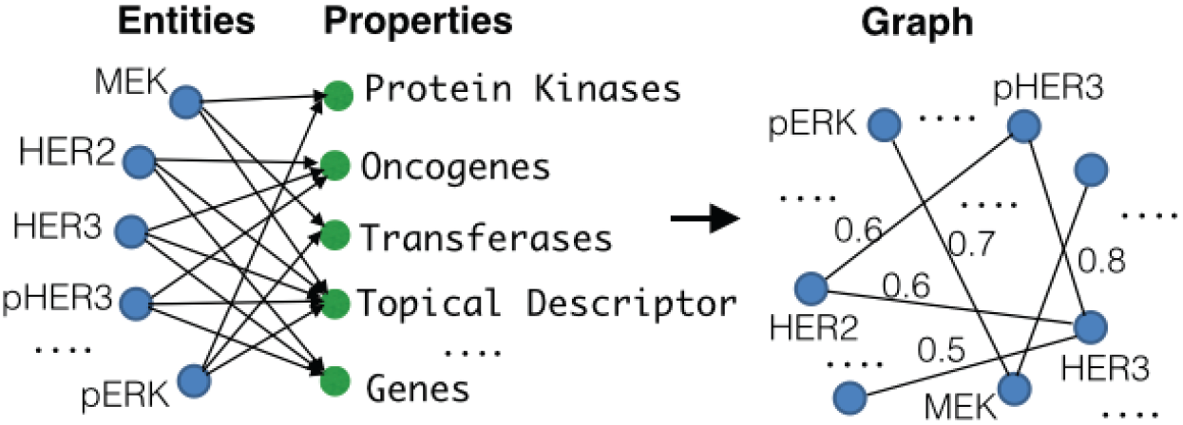
Joint Clustering, Linking and Typing
Link “HER2” to “ERBB2” in BioPortal and extract the type ‘Proto-Oncogenes→Oncogenes→Genes→Genome Components→Genome→Phenomena and Processes

Slide 6
Knowledge Graph From Source
(High Resource Language)
In the early morning of Thursday, 14 February 2013, “Blade Runner” Oscar Pistorius shot and killed South African model Reeva Steenkamp at his home in Pretoria. Pistorius acknowledged that he shot Steenkamp, causing her death, but said that he mistook her for a possible intruder… He said he had mistaken Steenkamp for an intruder hiding in the bathroom, but he was arrested and charged with murder. He received a five-year prison sentence for culpable homicide and a concurrent three-year suspended prison sentence for a separate reckless endangerment conviction.
NLP tools: AMR, IE, SRL, Dependency
Oscar Pistorius
Reeva Steenkamp
coreference
kill-01
coreference
Pistorius
Reeva
coreference
modify
die-01
modify
locate-01
Blade Runner
South Africa
Pretoria
model

Slide 7
Knowledge Graph From Source
(Low Resource Language)
• Chinese discussion forum post:
刀锋战士醒来发现女友不在身旁...刀锋战士以过失杀人罪被判处5年监禁。
(Blade Warrior found his girl friend was not beside him when he woke up...Blade Warrior received a five year prison sentence.)
• Chinese news document:
南非比勒陀利亚高等法院(The Pretoria High Court) 21日宣布判处南非残疾运动员皮斯托瑞斯(Oscar Pistorius) 5年有期徒刑。 皮斯托瑞斯是南非著名的残疾人田径选手，有”刀锋战士”之称。 (On the 21th, the Pretoria High Court of South Africa sentenced the disabled sportsman Pistorius 5 year prison. Pistorius is a famous runner in South Africa, also named as ”Blade Warrior”.)
奥斯卡·皮斯托瑞斯
(Oscar Pistorius)
瑞娃·斯廷坎普
(Reeva Steenkamp)
coreference
co-occurrence
coreference
皮斯托瑞斯
(Pistorius)
瑞娃
(Reeva)
coreference
co-occurrence
co-occurrence
co-occurrence
刀锋战士
(Blade Warrior)
南非
(South Africa)
co-occurrence
比勒陀利亚
(Pretoria)
模特
(model)

Slide 8
Fuse Multi-lingual Knowledge Graph from Source via Name Translation
Oscar Pistorius
Reeva Steenkamp
coreference
kill-01
coreference
Pistorius
Reeva
coreference
modify
die-01
modify
locate-01
Blade Runner
South Africa
Pretoria
model
奥斯卡·皮斯托瑞斯
(Oscar Pistorius)
瑞娃·斯廷坎普
(Reeva Steenkamp)
co-occurrence
coreference
皮斯托瑞斯
(Pistorius)
瑞娃
(Reeva)
coreference
coreference
co-occurrence
co-occurrence
co-occurrence
刀锋战士
(Blade Warrior)
南非
(South Africa)
co-occurrence
比勒陀利亚
(Pretoria)
模特
(model)

Slide 9
Cross-lingual Knowledge Transfer for Linking
南非
出生地
(birth
place)
国籍
(nationality)
langlink
瑞娃·斯廷坎普
langlink
hyperlink
deathPlace
奧斯卡·皮斯托利斯
Reeva_Steenkamp
South_Africa
hyperlink
langlink
victims
birthPlace
比勒陀利亚大学
Oscar_Pistorius
almaMater
rdf:type
langlink
University_of_Pretoria
Athlete

Slide 10
Demo
Nearly perfect typing for Hausa/Yoruba
Bottleneck on mention identification
Tri-lingual EDL system is integrated into BBN ADEPT

