Slide 1
Trilingual Entity Discovery and Linking
NIST TAC KBP 2015 TEDL Track
Nicolas Fauceglia, Xuezhe Ma, Yiu-Chang Lin and Eduard Hovy
Language Technologies Institute, Carnegie Mellon University

Slide 2
Outline
Task Description
System Architecture
Experiments

Slide 3
Task Description

Slide 4
Task Description
Two types of documents: newswire and discussion forum.
Extract named and nominal entity mentions from documents in English, Chinese and Spanish.
Infer entity type: PER, ORG, GPE, LOC, FAC, TTL.
Link them to an existing Knowledge Base (KB).
Freebase: 80 million entities and concepts, 290 million relations
Cluster mentions for NIL entities without corresponding KB entries.

Slide 5
System Architecture

Slide 6
System Architecture
Preparation
Semantic Signature computation
Execution
XML file parsing
Multi-Lingual Candidate Extraction
Lucene index
Stanford CoreNLP
Entity Linking
Semantic Interpretation Graph construction
Graph densification
Type inference (using Freebase ontology)
NIL clustering

Slide 7
Preparation

Slide 8
Freebase Graph: directed edges
Football Team Manager
France
Barack Obama
no edge
Arsene
Wenger
Thierry Henry
Midfielder
Arsenal F.C.

Slide 9
Freebase Graph: triangle weights
Football Team Manager
France
1
1
1
Barack Obama
0
Arsene
Wenger
Thierry Henry
2
1
3
2
Midfielder
2
Arsenal F.C.

Slide 10
Processing Freebase: Semantic Signature
Calculate Personlized PageRank with node-depedent restart.
Select nodes with rank score higher than a threshold (10⁻⁴).
Football Team Manager
France
Barack Obama
Arsene
Wenger
Thierry Henry
Midfielder
Arsenal F.C.

Slide 11
Semantic Signature
For each node, the semantic signature is a set of nodes which are closely related to it.
The PageRank scores are used as the relatedness measure between two entities or concepts.

Slide 12
Semantic Signature: example
 | France |  | Barack Obama
1 | Paris | 0.0145 | Election poll score | 0.0093
2 | Location | 0.0044 | US Pres. Elec. 2012 | 0.0051
3 | Male | 0.0038 | US Pres. Elec. 2008 | 0.0041
4 | 2012 Olympic Games | 0.0028 | Person | 0.0032
5 | Ile-de-France (Paris Region) | 0.0019 | USA | 0.0031

Slide 13
Execution

Slide 14
XML File Parsing
Newswire
Parse headline/paragraphs
Discussion forum
Parse headline/posts
Parse author of every post
Remove quotes from a post
Remove URLs from a post
Keep offsets at the same time

Slide 15
Multilingual Candidate Extraction
Base Candidate Extractor
Includes a Lucene Index from where to get possible entities (superstring matching)
input: paragraph, with offsets
output: List<Fragment>: each fragment (mention) has many possible entities attached to it
One Candidate Extractor for each language
Each language has its way of extracting candidates, i.e., what it means to be a good candidate:
e.g. at least one noun, not ending in prepositions/adjectives, etc.

Slide 16
Entity Linking
Semantic Interpretation Graph
A directed weighted graph G = (V, E)
Each node is a pair of fragment and candidate entity.
There is an edge from one node to another if the candidate entity of the latter one belongs to the semantic signature of the former one.

Slide 17
Semantic Interpretation Graph: example
(Osama Murata, osama)
( Osama Mcdonald, osama, )
( Osama bin Laden, osama)
( Barack Obama, obama)
( 9th Prince, saddam)
( Jeremy Ford, obama)
( Obama, Fukui, obama)
( Saddam Hussein, saddam)

Slide 18
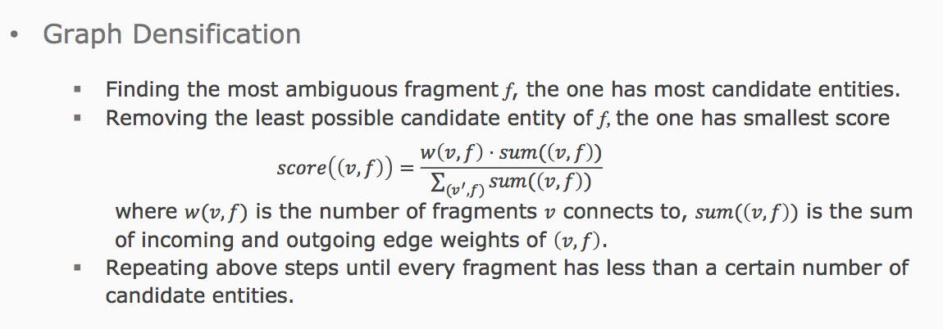
Entity Linking

Slide 19
Experiments

Slide 20
Results
 | Official
 | NER |  |  | Linking |  |  | Clustering
 | P | R | F1 | P | R | F1 | P | R | F1
Eng | 46.8 | 51.7 | 49.1 | 32.7 | 36.1 | 34.3 | 42.0 | 46.3 | 44.1
Eng | 50.9 | 56.0 | 53.3 | 42.1 | 46.3 | 44.1 | 49.1 | 54.0 | 51.5
Chn | 50.0 | 61.4 | 55.1 | 44.5 | 54.7 | 49.1 | 48.9 | 60.1 | 53.9
Spa | 60.2 | 60.8 | 60.5 | 47.3 | 47.7 | 47.5 | 54.1 | 54.5 | 54.3
All | 50.2 | 56.7 | 53.2 | 48.2 | 36.7 | 41.7 | 43.5 | 49.1 | 46.1

Slide 21
Analysis
Pros:
Our system leverages Ontology on Freebase.
Our system is able to not only discover and link entities, but also disambiguate concepts.
Cons:
Our system is lack of coreference information.
Can not handle misspelling names or nick names (not present in FB).
We did not use text of description in FB or other external resources.
Limited computing resources.

Slide 22
Thank You

