Slide 1
State-of-the-art Event Nugget Detection and Coreference
Yu Hong, Di Lu and Heng Ji
jih@rpi.edu
Nov 17 2015

Slide 2
Event Nugget Detection
Baseline: Maximum Entropy based Classification
Linguistic features
Word level
lemma, POS, prior type, brown cluster, reference, etc.
Context level
Co-occurred words or NE in the same chunk, text window, dependency tree
Dependency types
Neighbor grams
Modifiers for negation and certainty

Slide 3
Goals
Improve baseline classification
- Sufficient learning
- Effective cross-sample inference
- Disambiguation

Slide 4
Rich knowledge benefits learning
Add more homogeneous samples into training data
-Learn common attributes from the samples
attr.: context
UN puts the conflict’s [death] toll at over 67,000.
type: Die
make a decision
Classifier
learning
I urge you to take in a variety of sources in research the civilian [death] toll of the conflict.
type: Die

Slide 5
Diverse homogeneous samples
Automatic acquisition of brand-new homogeneous samples
- Criteria for brand-new samples
new candidate nuggets
rich contexts
- Approach
Collect new candidate nuggets which are semantically similar to the ground-truth
Search context sentences from KBP source collection

Slide 6
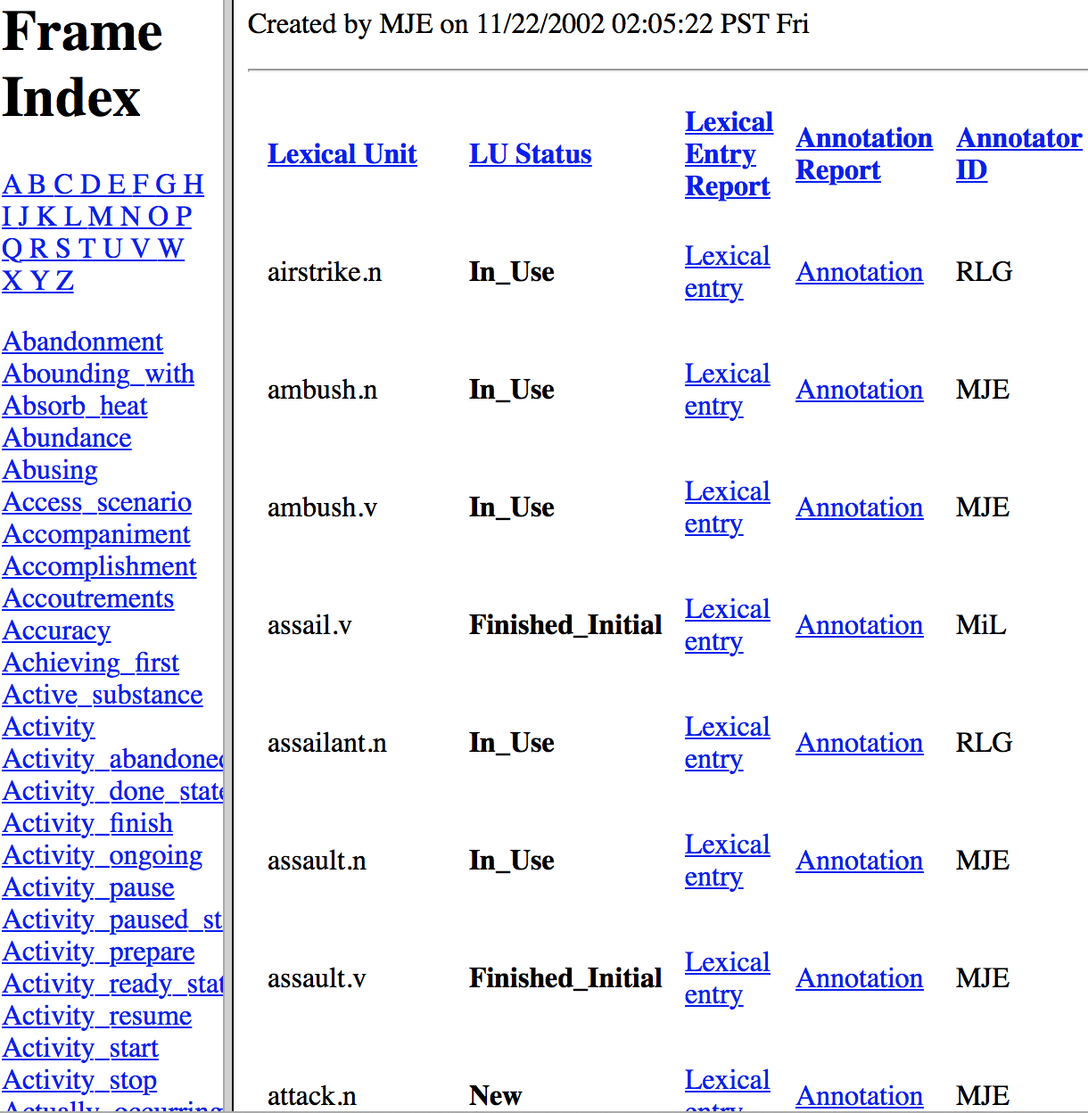
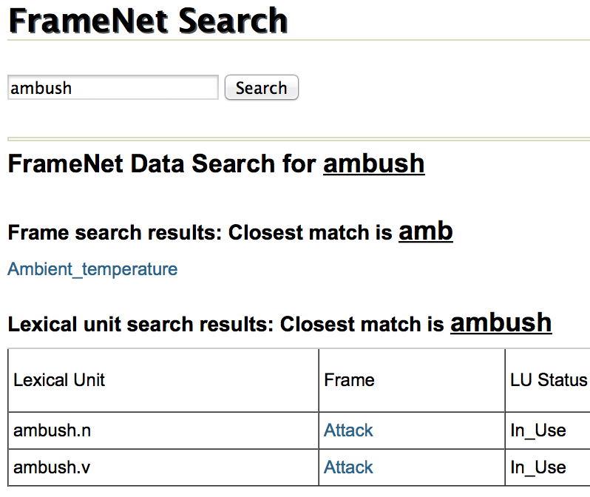
Semantically similar lexical units
Search the units in FrameNet (Baker etc., 1998, Fillmore etc., 2003, and Ruppenhofer tec., 2006)
ATTACK
airstrike/ ambush/ assail/ assailant assault/ attack/ attacker/ bomb/ bombard/ bombardment/ bombing/ charge/ fall/ fire/ hit/ incursion/ infiltrate/ infiltration/ lay into/ offensive/ onset/ onslaught/ raid/ SAF/ safire/ set upon/ small arms fire/ storm/ strike

Slide 7
Enrichment of homogenous samples
Retrieve contexts
- Search contexts for new candidate nuggets
Use a nugget as a query
Search clauses that contain the query in the source collection
Rank clauses in terms of document-level similarity
- Enrichment
a new nugget + a clause (context) = a brand-new sample
Add all brand-new samples into the training data

Slide 8
Improve cross-sample inference
Difficulty
-Semantically-similar context.
-Classifier rely on cross-sample inference in terms of similar content but not semantics.
Congress has a tradition of preventing its own members convicted of crimes from ever going to [prison].
?
Arrest-Jail
Classifier
learning
… legislators in corruption scandals often avoid [jail].
Arrest-Jail

Slide 9
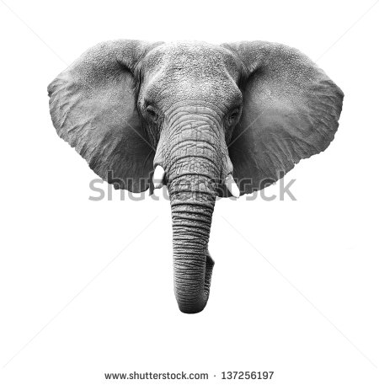
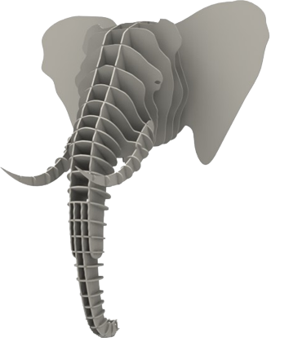
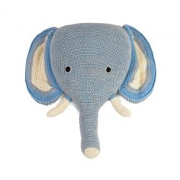
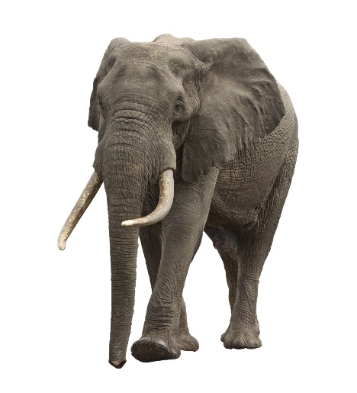
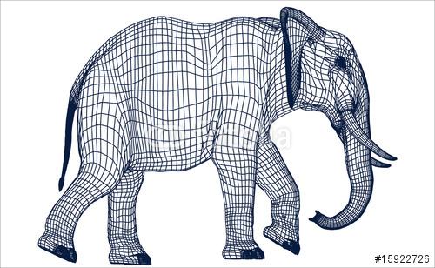
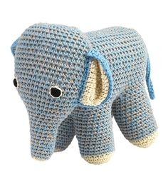
Concept based Transfer learning: General Framework
Training data
Concept
Test data
Conceptualization
Conceptualization
learning
learning
Make a decision
Conceptualization
Conceptualization

Slide 10
Apply to Nugget Detection
Congress has a tradition of preventing its own members convicted of crimes from ever going to [prison].
… legislators in corruption scandals often avoid [jail].
Training data
Concept
Test data
Conceptualization
Semantics
Leadership Preventing Custom
Conceptualization
Context
congress prevent tradition
Context
legislator avid often
learning
learning
Make a decision
Conceptualization
Conceptualization
Nugget
prison Type: Arrest-jail
Semantics
Being_incarcerated Type: Arrest-jail
Nugget
jail Type: ?

Slide 11
Concept based Transfer Learning
In practice
-Translate all tokens into semantic frames, in either training data or test.
Test data
Conceptualization
Classifier
Conceptualization
Training data

Slide 12
Negative impact of ambiguous nuggets
Ambiguous nuggets triggering multiple event types
-Misleading the learning process.
-Causing errors in practice.
E.g., the nugget “strike”
Sense 1: hit in a forceful way (Attack events)
Sense 2: stop work in order to force an employer to comply with demands (Demonstrate events)
Nugget | Type | Probability
strike | Demonstrate | 0.6364
strike | Attack | 0.2727
strike | Null | 0.0909
Distribution of “strike” nuggets in training data

Slide 13
Topic-event relation
Topic is able to reveal word sense
-E.g., “strike”
In topic “Libyan civil war”
Sense: hit in a forceful way (e.g., air strike)
In topic “Protest over police violence”
Sense 2: stop work in order to force an employer to comply with demands (e.g., general strike)
Key problem
-Measure the weight of topic-event relations

Slide 14
Topic-event relation weighting
What topic should be taken into consideration
-Document in which the target nugget occurs
-Topic of such a document
Key words
-Given a candidate type of the target nugget
topic
IR model
External doc set
Key words
Key words
Related docs
Target nugget & type
Probabilistic model
Weak nugget detection results
Relation weight
p(type|topic)

Slide 15
Propagation
Event type classification in a test document
- arg max p(type|topic)
Propagation
- All the mentions of the target nugget in a test document will be assigned the same event type
- rules
type_x, if arg max p(type|topic)
p(type|topic) > a threshold

Slide 16
Experiments
Four-fold cross-validation over training data
-evaluation metric
Micro Average P, R, F-score
-Systems
FTL: Concept based transfer learning
BN: Enrichment of diverse homogeneous samples
TND: Topic based disambiguation
system | plain | type | realis | type+realis
Baseline(bas) | 63.19 | 53.28 | 44.91 | 37.35
bas+FTL | 64.84 | 60.05 | 45.95 | 42.21
bas+BN | 67.68 | 62.01 | 47.25 | 42.99
Bas+TND | 68.16 | 63.09 | 47.57 | 43.34

Slide 17
Event Nugget Coreference
Classifier based on Maximum Entropy Model: computes the coreference confidence value between two event nuggets, , where
there are N event nuggets:
Hierarchical clustering: Map the N event nuggets into K event hoppers based on the coreference confidence
where are K event hoppers

Slide 18
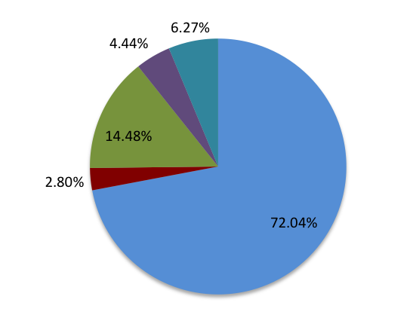
Pairwise MaxEnt Model
 | Features | Remarks (EN1: the first event nugget, EN2: the second event nugget)
Event Type | Type_subtype | 1 if the types and subtypes of the nuggets match
Lexicon | Exact_match | 1 if the spellings of triggers in EN1 and EN2 exactly match
 | Stem_macth | 1 if the stems of triggers in EN1 and EN2 match
 | trigger_sim_1 | quantized semantic similarity score (0-5) using WordNet resource
 | trigger_sim_2 | quantized semantic similarity score (0-5) using word2vec embedding
Realis | realis_conflict | 1 if the realis in EN1 and EN2 exactly match
Context | Sent_match | 1 if the sentences of EN1 and EN2 exactly match
 | context_match | 1 if the trigger words together with the words before and after match
Argument | argument_match | 1 if two sentences share the same words with POS tags ‘NNP’, ‘CD’
Contribution of each category
Table 1.Feature Set for Maximum Entropy Model

Slide 19
Hierarchical clustering
Apply Hierarchical clustering by varying K from 1 to N
EH1
EN2
EN1
EN5
EH2
Good clustering result should cut as many as non-coreferential edges and keep as many as coreferential edges
EN4
EN3
conflicting edges: 3
EH3
ε=
=0.3
Coreferential
total edges: 10
Non coreferential

Slide 20
Discussions on Evaluation Metrics
KBP2015 Event Nugget Training Data; Training data: 126 documents; Testing data: 32 documents
F-scores based on Muc and Blanc metrics are highly sensitive to the threshold δ
Impossible to optimize across data sets for MUC and BLANC metrics
Recommend to drop MUC and BLANC next year

Slide 21
Weakness of MUC and BLANC (Luo, 2013 )
MUC
Unable to measure singletons
Favor large entities
BLANC:
Blank Zone
All systems not having (5,6) link: F_{c}=0, Score<0.5
1
2
3
1
2
3
4
5
6
4
5
6
Key
Response
 |  | System
 |  | Coreference | Non-coreference
Gold | Coreference | 0 | 1
 | Non-coreference | 0 | 14
P_{c}=0 P_{n}=14/15
R_{c}=0 R_{n}=1
F_{c}=0 F_{n}=28/29
BLANC-F=14/29<0.5

Slide 22
Error Analysis: Non-coreferential Cases
Share no arguments, triggers are different (73%)
When you are concerned about paying your utility bill
When you are concerned about paying your utility bill for mortgage payment
Exactly the same trigger word(23%)
Iran hanged on Saturday two men
Last year at least 270 people were hanged
Share arguments (20%)
"At least 10 people were killed when US drones fired missiles at three vehicles," a senior security official told AFP.
"First a US drone fired missiles at a double-cabin pick-up truck
In the form of “Trigger1 and Trigger2” (2%)
He committed crimes in the US [orchestrating drug trafficking and illegal weapons deals on US soil]
Possible Solution: Dependency or AMR parsing to capture semantic distance
20%
23%
2%
73%

Slide 23
Error Analysis: Coreferential Cases
At least one of the triggers is a phrase (31%)
the Simon Property Group on Tuesday finally made an unsolicited $10 billion offer for General Growth Properties, its bankrupt rival
we are undertaking to explore all avenues to emerge from Chapter 11 and maximize value for all the Company's stakeholders
Realis overrule(15%)
A fugitive Nigerian former governor facing charges of siphoning off millions of dollars of state assets and money laundering has been arrested in Dubai. (Actual)
Abu Dhabi police departments said they had no information on Ibori having been arrested(Other)
Spelling Error(6%)
it would be legal for me to smuggle
Neither is smuggleing Gold.
Other(48%)
Possible Solutions: Scenario classification; Joint feature for MaxEnt Model; spelling correction as pre-processing
15%
48%
31%
6%

Slide 24
Feedback for Realis Improvement
Assumption:
The event nuggets that refer to the same event hopper are likely to have the same Realis
Colombia has asked the United States to send back a famous drug lord recently released from US prison, according to a statement released by the Ministry of Justice.
Generic
0.54
Actual
Earlier this year, El Tuso was released from US prison, after a reduced five-year sentence he received in exchange for cooperation with authorities.
Actual
1.00
MORE: Ex-drug lord El Tuso released from prison.
Actual
1.00

Slide 25
Feedback for Realis Improvement (Cont.)
Improve the realis precision from 0.418 to 0.42
The CEAFe F-score drops from 0.83 to 0.78 by removing the feature of “Realis_conflict”
The feedback improvement depends on the performance of the event nugget coreference system
Future Direction: joint system for nugget detection and nugget coreference

Slide 26
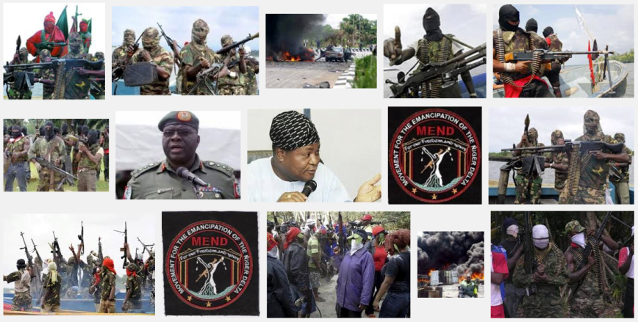
Future Work: Cross-Media Coreference
EN1: A militant group says it {attacked} an oil facility in the Niger Delta.
EN2: A statement sent to reporters from the Joint Revolutionary Council claims militants {attacked} the Agip facility early Wednesday morning.
Google Image Search
Using trigger phrase and arguments
Images/Videos are new KBs; language independent
Previous work (Zhang et al., 2015), F-score is boosted from 44.23% to 51.43% (cross-document, news videos)

Slide 27
Thanks!

