Slide 1
Linguistic Resources for the
2012 TAC KBP Slot Filling Evaluations
Joe Ellis (presenter),
Brendan Callahan, Jonathan Wright, Stephanie Strassel
Linguistic Data Consortium
University of Pennsylvania, USA

Slide 2
Outline
Linguistic Resources for 2012 Slot Filling
English and Spanish source data
Annotator and assessor guidelines
Labeled training and evaluation data
Annotation Tasks and Methodologies
Entity Selection
Slot Filling Annotation
Slot Filling Assessment

Slide 3
Source Corpora – 2012
Source Corpora
Notes:
-Additions made in order to broaden the overall epoch covered by the corpus; add Spanish documents to the pool; create greater overlap between the English, Chinese, and Spanish sets; expand on the web document component of the collection; and ease the creation of unique queries for all tasks.

Slide 4
SF Annotator/Assessor Guidelines
Entity Selection
Annotator GUI and pipeline revised to improve efficiency and quality over previous years
Enhanced annotators’ ability to select entities with rare slots
Slot Descriptions
15 slots revised after analysis of 2011 data
Slot Filling Annotation
Guidelines for justification, duplicate fillers, normalization updated for new pipeline and to address past challenges
Assessment guidelines also revised to account for justification
Available at:
http://www.nist.gov/tac/2012/KBP/task_guidelines/index.html

Slide 5
Existing SF Training Data (1)

Slide 6
Existing SF Training Data (2)
Notes:
11 corpora developed for SF from 2009-2011

Slide 7
New SF Training & Eval Data

Slide 8
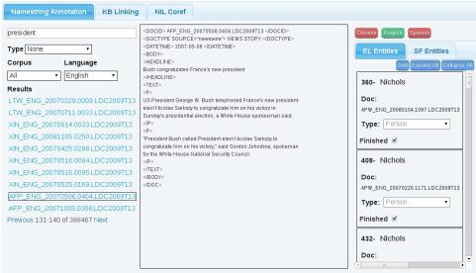
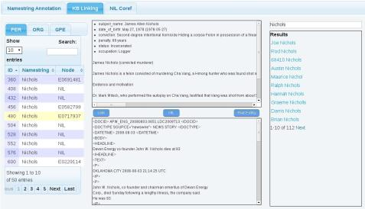
SF – Query Selection (1)
Stage 1: Select name strings and ref docs
Stage 2: Link namestrings to KB or mark as NIL

Slide 9
SF – Query Selection (2)
Run named entity taggers over source corpora*
Provides guided search through the corpus
Select entities and reference documents
Non-confusable, productive namestrings
Identifiable and appropriate for Wikipedia
Check KB node to ensure it wasn’t full
Rich entities (at least 2-3 fillers in the source corpus)
Unique entities (fillers for under-utilized slots)
per:cause_of_death, per:charges, org:dissolved
For Spanish queries, require mentions in both Spanish and English source corpora
*Thank you to the track coordinators for providing tagger output

Slide 10
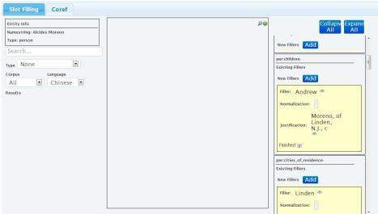
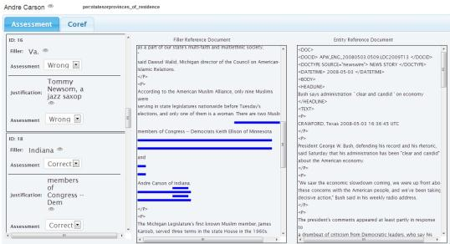
SF Annotator/Assessor GUIs
Assessment: Check validity of asserted fillers & justification, create equivalence classes
Annotation: For given entity, time-limited search for fillers in corpus

Slide 11
SF – Annotation/Assessment Approach
2012 Annotation
For each query annotator spends up to 2 hours searching corpus to identify fillers for targeted slot
Quality control pass to flag and adjudicate fillers without adequate source document justification and/or at variance with guidelines
Added justification and duplicate, co-referenced fillers to process
2012 Assessment
Assess validity of fillers and justification from humans and systems
Create equivalence classes from fillers assessed as correct
Quality control pass as with annotation

Slide 12
SF – Justification (1)
New requirement for 2012 SF annotation and assessment
Intended to assist assessment by not requiring humans to review whole documents to check validity of fillers
Correct Justification
Includes all three pieces of information necessary to justify the entity/slot/filler relation
Does not include too much extraneous text
President Obama and his wife, Michelle Obama
Barack Obama credits his family with his political success. Michelle Obama, now First Lady
Barack Obama credits his family with his political success…
…[three intervening, unrelated paragraphs]…
…Michelle Obama, now First Lady

Slide 13
SF – Justification (2)
Wrong Justification
No necessary information OR Slot Filler is wrong
Inexact Justification
Filler is correct but justification is missing pieces of information or includes too much extraneous text.
per/org:alternate_name
Alternate name plus identifying information
MTC Technologies <org:alternate_names> MTC
his wife, Michelle Obama
…[three unrelated paragraphs]…
Barack Obama and his wife, Michelle Obama
…[three more unrelated paragraphs]…
MTC, based in Dayton, Ohio, is a supplier of logistical services to the Dept of Defense

Slide 14
Conclusions
2012 Achievements
New language added
Additional source data
4 new corpora developed
Improved annotation pipeline and GUIs allows for richer and more unique queries with less annotator effort
2013 Goals
Further refine and improve pipeline and GUIs
Further develop guidelines for justification
Further discussion of desired query qualities to fully utilize new capabilities

