Slide 1
Collaborative Clustering for Entity Clustering
Zheng Chen and Heng Ji
Computer Science Department and Linguistics Department Queens College and Graduate Center
City University of New York
November 5, 2012
Notes:
1
1

Slide 2
Outline
Entity clustering and NIL entity clustering
A new clustering scheme: Collaborative Clustering(CC)
Theory:
Instance level CC (MiCC)
Clusterer level CC (MaCC)
Combination of instance level and clusterer level (MiMaCC)
What is wrong of CC in KBP nil clustering?
What is right of CC in a new dataset for entity clustering?

Slide 3
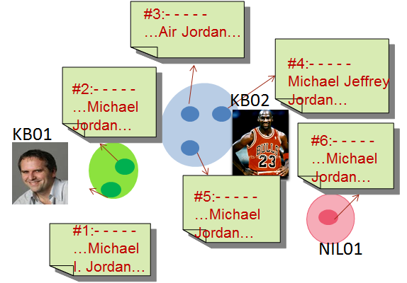
Entity clustering and NIL entity clustering
Instance: a query consisting of a name and its associated doc id
Entity clustering: group a set of instances into clusters such that each cluster indicates an unambiguous entity
Name variation: same entity using different name strings
Name disambiguation: different entities using the same name
View entity linking as a entity clustering problem
Clustering KB queries:
use KB id as cluster label
Clustering NIL queries:
use self-defined label, 1,2,…
Traditional approaches:
Cluster on data directly
Use one clustering algorithm
Our approaches:
Cluster on “extra” data
Integrate multiple clustering algorithms
Instance level collaborative clustering
Clusterer level collaborative clustering
Notes:
Clustering problem is known to suffer from little or no prior knowledge of underlying data population. Very often, the underlying instances in the dataset does not exhibit good clustering structure, or only partial instances show good clustering structure and others do not. So we are thinking that whether we can find some way that can recover hidden structure. Our solution is that by adding collaborative instances we hope that the clustering algorithm can leverage more information in those collaborative instances, and therefore it becomes easier to identify the hidden clustering.
Let me give two simple examples, we want cluster 1,2,3 , since 1 looks closer to 2, so a clustering algorithm probably is going to cluster 1 and 2 together which is unfortunately wrong, however, after adding more instances, the two clusters become more visible.
again in the second example, we want to cluster 1,2,3, since 2 and 3 looks closer, so it is probably likely to be clustered together, however, after adding collaborative instances, the cluster which contains 1 and 2 becomes clearer.

Slide 4
Micro collaborative clustering (MiCC)
MiCC = Instance level collaborative clustering
Motivations
Instance collaborators help recover clustering structure
1
2
3
1
2
3
Notes:
Clustering problem is known to suffer from little or no prior knowledge of underlying data population. Very often, the underlying instances in the dataset does not exhibit good clustering structure, or only partial instances show good clustering structure and others do not. So we are thinking that whether we can find some way that can recover hidden structure. Our solution is that by adding collaborative instances we hope that the clustering algorithm can leverage more information in those collaborative instances, and therefore it becomes easier to identify the hidden clustering.
Let me give two simple examples, we want cluster 1,2,3 , since 1 looks closer to 2, so a clustering algorithm probably is going to cluster 1 and 2 together which is unfortunately wrong, however, after adding more instances, the two clusters become more visible.
again in the second example, we want to cluster 1,2,3, since 2 and 3 looks closer, so it is probably likely to be clustered together, however, after adding collaborative instances, the cluster which contains 1 and 2 becomes clearer.

Slide 5
Micro collaborative clustering (MiCC)
Key Issues
A mechanism to populate potential collaborative instances
An internal measure to measure clustering quality
An approach to select collaborative instances
Algorithm
Instance generator
clustering instances
Potential
collaborative Instances
a clusterer
Random select N instances
Internal measure optimized?
collaborative instances
no
yes
A clustering on the expanded set of instances
A best set of collaborative instances
Notes:
In order to apply instance level collaborator clustering, we need three things:
First we need some internal clustering quality metric purely based on the data property among the instances, rather than external information (and we do not have such external information until the final step of clustering evaluation). The Silhouette coefficient is a good candidate which combines cohesion and separation as described in my proposal.
Second, we need some mechanism to populate collaborative instances. For pure clustering problem, since we do not know data distribution, so it is a hard problem. However when we come to specific applications, for example, name entity clustering, each instance is associated with a document, and candidate instance collaborators can be found by retrieving documents that contain the same name.
Third, we need some approach to rank collaborative instances, since we hypothesize that higher ranked instances contain more information to help find clustering structure because they probably located around the centroid of some cluster.
Our approach for MiCC is shown in the figure, actually we also use clustering ensemble here, we first use n clusterer to produce n clusterings on the original set of instances. We measure the n clusterings by the internal clustering quality metric such as Silhouette coefficient. If at least half of the voters consider that the original set of instances can produce somewhat good clustering, then it just quits the algorithm, and then go ahead to normal clustering. If fewer than half of voters consider good clustering structure exist in the original instances, we replenish the instance set by the ranked collaborative instances. The procedure iterates until some good clustering structure can be found or there are no more collaborative instances can be added in.
Once we settle down the final set of instances, we can produce a consensus clustering by applying clustering ensemble as will be discussed in the next slide.

Slide 6
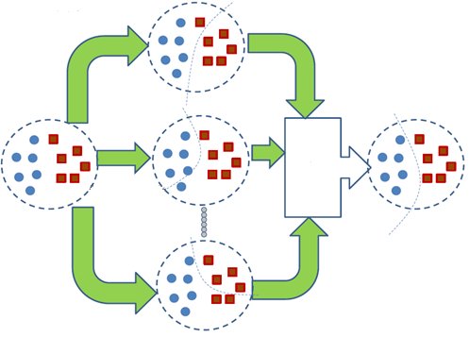
Macro collaborative clustering (MaCC)
MaCC = Clusterer level collaborative clustering
Creating diverse clusterers
Different clustering algorithms
Kmeans (MacQueen, 1967)
Aggl. clustering (single,complete, average) Manning et al., 2008
Aggl. Clustering ($I_{1},I_{2}$, $ε_{1}$, $G_{1}$, $H_{1}$, $H_{2}$)
Repeated bisection(${rI}_{1},{rI}_{2}$, ${rε}_{1}$, ${rG}_{1}$, ${rH}_{1}$, ${rH}_{2})$
Direct k-way(${dI}_{1},{dI}_{2}$, ${dε}_{1}$, ${dG}_{1}$, ${dH}_{1}$, ${dH}_{2})$
Settings of clustering algorithms
Initial centroids in Kmeans
Similarity/distance metrics
Zhao and Karypis, 2002
clustering1
Consensus functions
Using co-association matrix
(Fred and Jain,2002)
Three graph formulations
(Strehl and Ghosh, 2002; Fern and Brodley, 2004)
IBGF: instance-based
CBGF: cluster-based
HBGF: hybrid bipartite
final clustering
consensus
function
clusteringN
Notes:
For clusterer level, there are two major issues involved, one is clustering ensemble, which means we obtain multiple clustering results by diverse clusteres. In this thesis, we apply the following approaches that can obtain diverse clustering results, first, we can apply different clustering algorithms, including Kmeans, three linkage based agglomerative clustering, 6 agglomerative clustering algorithms that optimize the six internal measures respectively, 6 repeated bisection partitional clustering algorithm which optimize the 6 internal measure, and finally, the 6 direct k-way partitional clustering algorithms, second we can tune settings of clustering algorithms, in this thesis, we also get some clustering results by changing the initial centroids in kmeans algorithm. Third, we can apply different similarity or distance function.
The other issue involved in MaCC is consensus function which output one single solution based on the multiple clustering results.in this thesis, we applied four approaches, co-association matrix, and three graph based formulation as presented in previous work.

Slide 7
Micro-Macro collaborative clustering (MiMaCC)
Algorithm
Apply MiCC to obtain the best set of collaborative instances
Apply MaCC on the expanded set of instances by adding collaborative instances
Down-scale clustering by only looking at the cluster ids in the original dataset
Notes:
Micro-macro collaborative clustering is a natural extension to combine instance level and clusterer level. First we search the best set of collaborative instances, and then apply clusterer level on the expanded set. Finally, we down-scale the clustering result by only looking at the cluster ids of instances in the original dataset.

Slide 8
Impact of advanced clustering algorithms on KBP2012 NIL clustering
Only study NIL queries
Two simple baselines
One-in-one: assign each NIL query into a cluster
All-in-one: assign NIL queries with the same name into a cluster
Advanced clustering approaches:
21 clustering algorithms
Collaborative clustering approaches
Bcube+:0.937
Bcube+:0.640
baseline1: one-in-one 0.937 baseline2:all-in-one 0.640
 |  | Agglomerative Clustering |  |  |  |  |  |  |  |  | Partitional Clustering
 |  | linkage |  |  | optimizing internal measure |  |  |  |  |  | repeated bisection |  |  |  |  |  | direct k-way
 |  | slink | clink | alink
without variety detection | known K | 0.937 | 0.938 | 0.938 | 0.938 | 0.938 | 0.939 | 0.937 | 0.939 | 0.938 | 0.938 | 0.938 | 0.939 | 0.937 | 0.939 | 0.938 | 0.94 | 0.94 | 0.94 | 0.937 | 0.94 | 0.939
 | unknown K | 0.841 | 0.839 | 0.84 | 0.851 | 0.847 | 0.844 | 0.841 | 0.843 | 0.843 | 0.844 | 0.84 | 0.847 | 0.841 | 0.844 | 0.846 | 0.855 | 0.84 | 0.844 | 0.844 | 0.842 | 0.843
with variety detection | known K | 0.983 | 0.985 | 0.985 | 0.985 | 0.985 | 0.989 | 0.983 | 0.986 | 0.986 | 0.985 | 0.985 | 0.99 | 0.984 | 0.987 | 0.987 | 0.985 | 0.985 | 0.988 | 0.984 | 0.986 | 0.986
 | unknown K | 0.854 | 0.858 | 0.854 | 0.866 | 0.863 | 0.859 | 0.856 | 0.859 | 0.858 | 0.861 | 0.854 | 0.861 | 0.856 | 0.856 | 0.86 | 0.869 | 0.855 | 0.858 | 0.856 | 0.855 | 0.857
8

Slide 9
Impact of advanced clustering algorithms on KBP2012 NIL clustering
Best score in the 21 algorithms
One-in-one can beat any advanced clustering algorithms (unknown K)
1049 NIL queries dispersed in 510 names (every name has 2 NIL queries in average)
9

Slide 10
with our fancy clustering approach?

Slide 11
Discussions of KBP Query Selection: Ambiguity
ambiguous: a name is ambiguous if it can refer to more than one entity (cluster)
Major sources of ambiguity:
Person name: using last name as query
District Attorney Mitch Morrissey announced …that Willie Clark faces 39 counts …
"figure out what kicks off asthma symptoms," says Noreen Clark
Organization name: using acronym as query
…alliance Muttahida Majlis-e-Amal (MMA) for …in the northwest city of Peshawar
the Myanmar Medical Association (MMA) has appealed to…
GPE name: using city name as query
BRECKENRIDGE, Minn.
BRECKENRIDGE, Texas
query
query
query
11

Slide 12
Discussions of Query Selection: Ambiguity
Our solutions: reduce ambiguity by query reformulation:
Person name: within-document coreference resolution
Organization name: acronym expansion by pattern “full-name” (acronym) or “acronym (full-name)”
GPE name: GPE expansion by pattern “city-name, state-name”
or “city-name, country-name”
coreference resolution
Clark
Willie Clark
old query
new query
Acronym expansion
MMA
Muttahida Majlis-e-Amal
old query
new query
GPE expansion
BRECKENRIDGE
BRECKENRIDGE, Minn.
old query
new query
12

Slide 13
Discussions of Query Selection: Ambiguity
Impact of query reformulation
(a) All queries
(b) NIL queries
(c) Incremental impact of applying three
query reformulation approaches on All queries
(d) Incremental impact of applying three
query reformulation approaches on All queries
Ambiguity reduced
Performance increased

Slide 14
What is right with our fancy clustering approach?

Slide 15
A New Data Set for Entity Clustering
A new workbench (much more challenging) dataset for entity clustering
Combining queries from KBP2009,2010,2011, 6652 queries in 1379 names
Select ambiguous names (queries can be clustered into 2 or more)
Select names with more than 4 queries
Select names with consistent one entity type
Select names for which more than 5 relevant documents (excluding
context documents in queries) can be retrieved from source text Final dataset: 1686 instances (queries),106 names=21PER+67ORG+18GPE
Available upon request for KBP participants.
long tail effect II: most names have very
unbalanced class distribution
15
Notes:
Because of the above potential query selection problems, we constructed our own inhouse dataset in order to investigate whether our proposed clustering scheme can work.

Slide 16
A New Clustering Metric for NIL Clustering
Skewness (unbalance degree) of class distribution can be measured by
CV: Coefficient of Variance
CV statistics in dataset
Given ,
where ,
 | CV
max | 1.862
min | 0
ave | 0.849
std | 0.411
CV=0, most balanced; CV , skewness
A new clustering metric
V-measure (Rosenberg and Hirschberg,2007)
$$V=\frac{\left(1+β\right)∗h∗c}{β(h+c)}$$
h: homogeneity
c: completeness
16

Slide 17
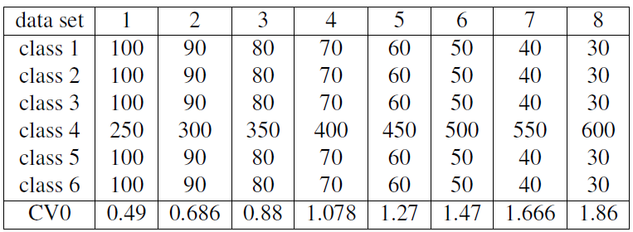
A New Clustering Metric for NIL Clustering
A good clustering scoring metric should penalize balanced clustering results (e.g., kmeans algorithm)for unbalanced dataset
external measure
system clustering
gold clustering
higher correlation, the better
Dataset
Result
17
winner

Slide 18
Impact of MiCC
18

Slide 19
Impact of MaCC
Ensemble generation: 84 clustering results
21 clustering algorithms
4 similarity functions: cos, cor, maxen, svm
Four incremental combination schemes:
macc-similarity: By similarity function: 21 cos+21 cor+21maxen+21svm
macc-algorithm: By algorithms : 24 rbr(6*4)+24direct(6*4)+36aggl(9*4)
macc-internal: Sort by internal measure SC (high to low), 21+21+21+21
macc-external: Sort by external measure V (high to low), 21+21+21+21
Four consensus functions:
co-association matrix
IBGF
CBGF
HBGF
compare with best (0.632) | compare with average (0.536)
-1.1% | 8.5%
-1.8% | 7.8%
1.4% | 10%
11.9% | 21.5%
compare with best (0.632) | compare with average (0.536)
11.9% | 21.5%
5.5% | 16.1%
8.6% | 18.2%
8.3% | 17.9%
performance gains by applying CC
Three key factors in MaCC: diversity, combination scheme, and consensus function
best baseline | MiCC (%) | MaCC (%)
0.632 | 1.8 | 11.9
19
Notes:
19

Slide 20
Conclusions
Collaborative Clustering is effective on a new workbench data set of entity clustering
Query Reformulation is effective for KBP Entity Clustering
KBP2012 NIL queries are too “simple” to discriminate sophisticated clustering algorithms vs. naïve baselines
Propose to use V-measure to evaluate NIL Clustering
Propose to improve query selection from two aspects:
increase variety: advanced name variation approaches and cross-document coreference resolution approaches can be compared and validated.
Add more challenging NIL queries for different names: advanced clustering approaches can be compared and validated.

Slide 21
Thank you!

Slide 22
Name Variation Problem
Classify a pair of names into variant or non-variant
Wikipedia redirect
checkpoint2
Wikipedia disambiguation page
checkpoint3
Expanded names for acronyms
checkpoint1
checkpoint4
Coreference names
checkpoint5
Other specific checking rules: string distance, overlapping tokens
45%
3%
14%
11%
2%
14%
F-measure
KBP2009 dataset
Type I error: classify variant as non-variant
Type II error: classify non-variant as variant

Slide 23
Name Disambiguation Problem
classify a pair of mentions into coref or non-coref
Approach: maximum entropy based classification model with 59 features (local features:
extracted around the target mention, global features: extracted document-wide
Experimental results:
global features and GPE related features are more helpful to disambiguate
GPE and ORG
2. local features and PER related features are more helpful to disambiguate PER
4.4%
0.5%
19.3%
9.1%
F-measure
KBP2009 dataset
3. separate models can perform better than single model for mixed types
4. The single model is biased to ORG due to its dominance in data
5. From the scores, GPE is easier than ORG and then PER

Slide 24
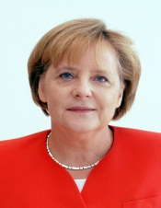
Discussions of Query Selection: Variety
various: an entity (cluster) is various if it has more than one name (class label)
Major sources of variety:
Person name: using full name, birth name, nickname, last name, etc.
Organization name: using acronym, full name, nickname
GPE name: current name, history existing name, names derived from different languages
Typos: e.g.,
Angela Merkel, Maggie Merkel, Angela Dorothea Kasner, Iron Lady
New York Rangers, NYR, Rangers
Ankara, Angora (historically known)
24
Angela Merkel, Angel Merkel (typo)

Slide 25
Discussions of Query Selection: Variety
Variety in different years
25

Slide 26
Impact of 21 baseline clustering algorithms
clustering with prior K
similarity function | Agglomerative Clustering |  |  |  |  |  |  |  |  | Partitional Clustering
 | linkage |  |  | optimizing internal measure |  |  |  |  |  | repeated bisection |  |  |  |  |  | direct k-way
 | slink | clink | alink
cos | 0.587 | 0.658 | 0.645 | 0.545 | 0.554 | 0.513 | 0.612 | 0.529 | 0.535 | 0.544 | 0.572 | 0.521 | 0.627 | 0.541 | 0.544 | 0.542 | 0.573 | 0.530 | 0.613 | 0.546 | 0.547
cor | 0.511 | 0.528 | 0.538 | 0.521 | 0.534 | 0.533 | 0.418 | 0.527 | 0.540 | 0.516 | 0.526 | 0.545 | 0.453 | 0.522 | 0.536 | 0.513 | 0.528 | 0.546 | 0.472 | 0.525 | 0.540
maxen | 0.602 | 0.557 | 0.660 | 0.626 | 0.615 | 0.616 | 0.615 | 0.570 | 0.568 | 0.587 | 0.591 | 0.561 | 0.609 | 0.566 | 0.566 | 0.580 | 0.586 | 0.561 | 0.596 | 0.570 | 0.569
svm | 0.603 | 0.567 | 0.647 | 0.644 | 0.643 | 0.614 | 0.561 | 0.567 | 0.561 | 0.585 | 0.596 | 0.575 | 0.586 | 0.576 | 0.575 | 0.575 | 0.584 | 0.578 | 0.591 | 0.570 | 0.565
clustering with unknown K
similarity function | Agglomerative Clustering |  |  |  |  |  |  |  |  | Partitional Clustering
 | linkage |  |  | optimizing internal measure |  |  |  |  |  | repeated bisection |  |  |  |  |  | direct k-way
 | slink | clink | alink
cos | 0.520 | 0.632 | 0.551 | 0.555 | 0.557 | 0.509 | 0.561 | 0.546 | 0.538 | 0.549 | 0.563 | 0.507 | 0.615 | 0.537 | 0.520 | 0.549 | 0.565 | 0.513 | 0.605 | 0.534 | 0.529
cor | 0.474 | 0.557 | 0.515 | 0.551 | 0.558 | 0.556 | 0.417 | 0.563 | 0.563 | 0.556 | 0.560 | 0.565 | 0.480 | 0.554 | 0.557 | 0.552 | 0.557 | 0.555 | 0.484 | 0.556 | 0.555
maxen | 0.525 | 0.493 | 0.545 | 0.532 | 0.537 | 0.537 | 0.515 | 0.537 | 0.540 | 0.536 | 0.528 | 0.525 | 0.498 | 0.536 | 0.536 | 0.531 | 0.524 | 0.520 | 0.510 | 0.531 | 0.531
svm | 0.511 | 0.508 | 0.552 | 0.549 | 0.553 | 0.528 | 0.524 | 0.533 | 0.534 | 0.536 | 0.533 | 0.510 | 0.525 | 0.530 | 0.523 | 0.530 | 0.533 | 0.518 | 0.532 | 0.534 | 0.530

Slide 27
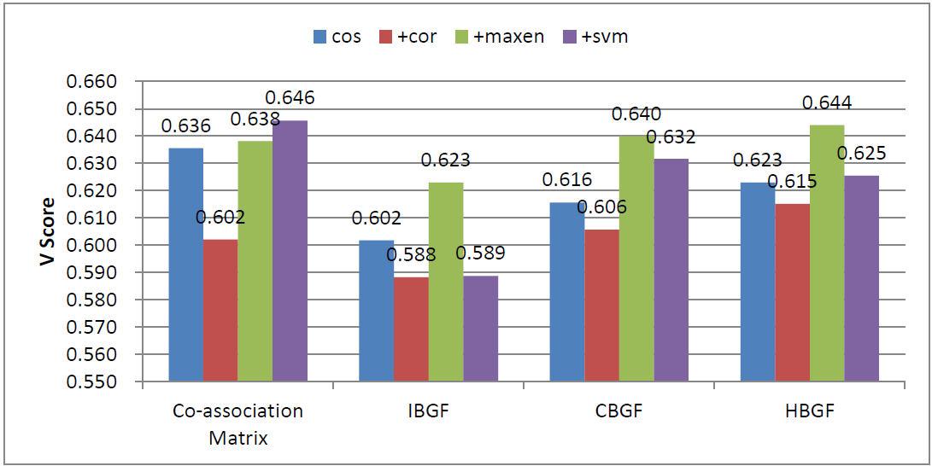
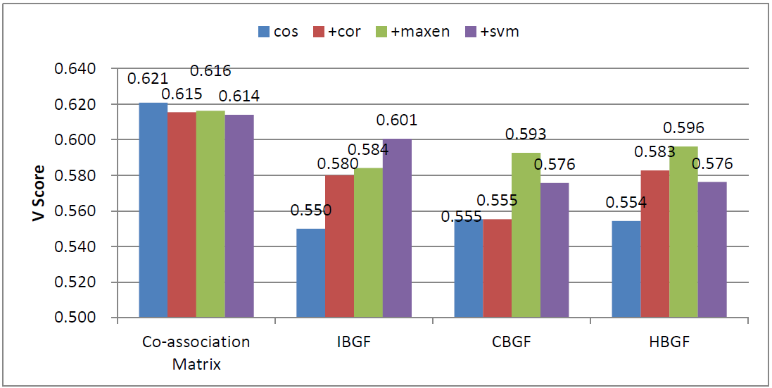
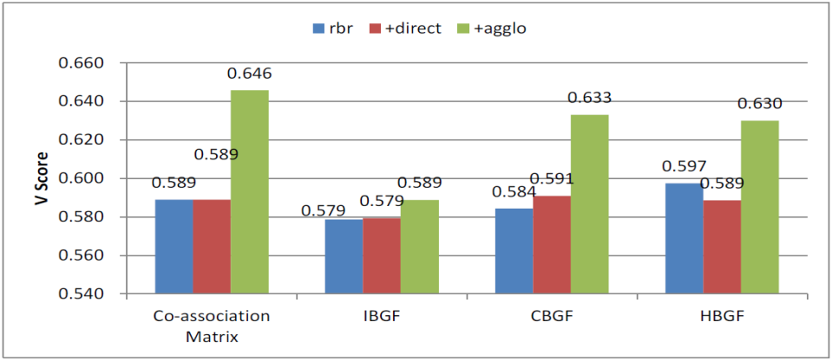
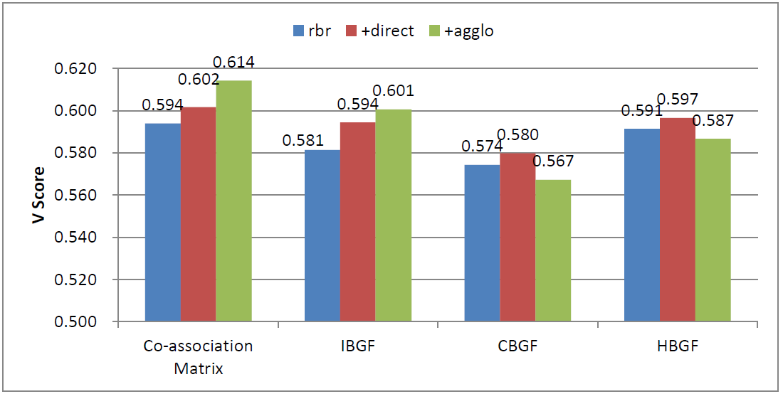
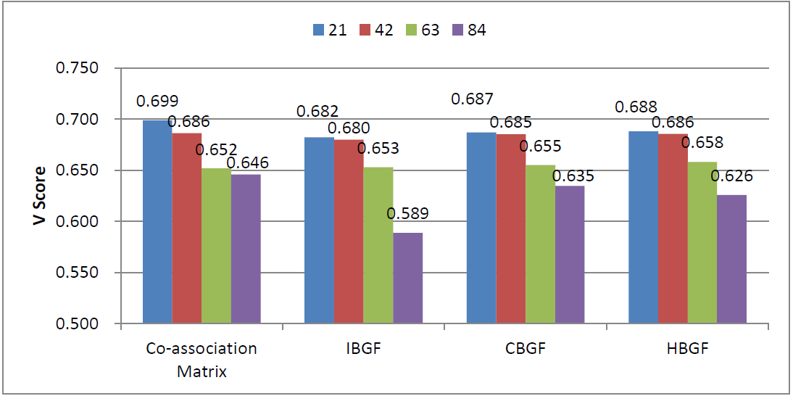
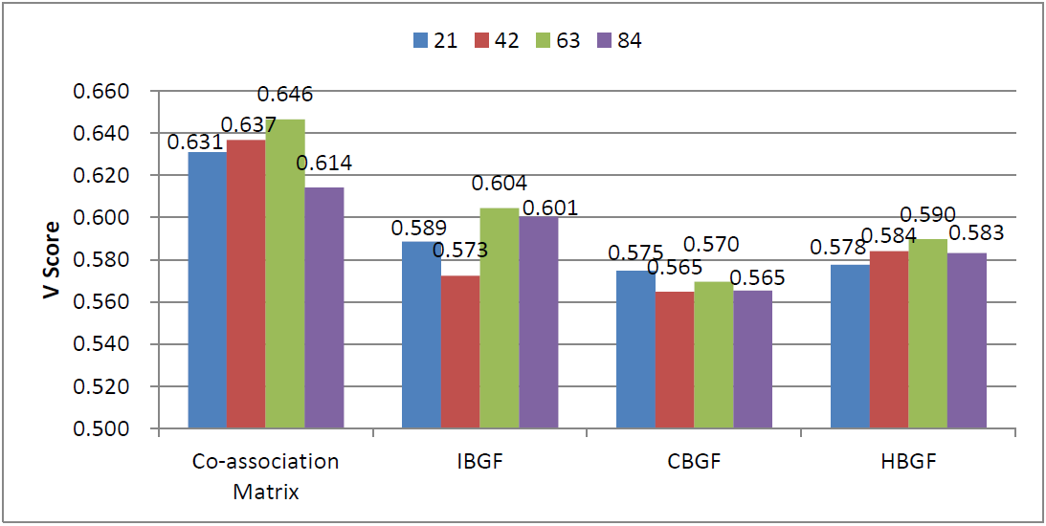
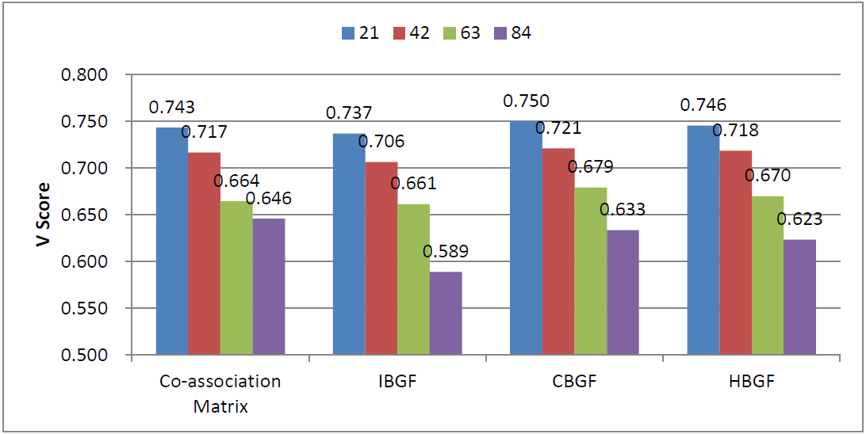
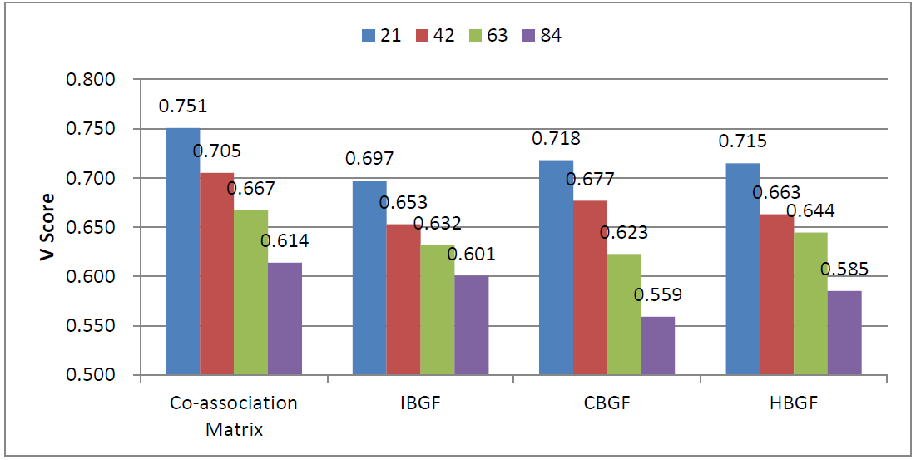
prior K
unknown K
macc-similarity
macc-algorithm
macc-internal
9% gains over best baseline
11.9% gains over best baseline
macc-external
27
Notes:
11.9
9.6

Slide 28
Impact of MiCC
Why MiCC fails in some cases?
1. added collaborators are within good clusters
2. added collaborators refer to a new entity
collaborators added here do not help much
collaborators do not help
at all (a new entity)
When MiCC succeeds?
1.added collaborators bridges well clustered
instances with false outliers
false “outlier”
good collaborators
28

