Slide 1
TAC 2011, NIST, Gaithersburg QA4MRE, Question Answering for Machine Reading Evaluation
Organization
Anselmo Peñas (UNED, Spain)
Eduard Hovy (USC-ISI, USA)
Pamela Forner (CELCT, Italy)
Álvaro Rodrigo (UNED, Spain)
Richard Sutcliffe (U. Limerick, Ireland)
Roser Morante (U. Antwerp, Belgium)
Walter Daelemans (U. Antwerp, Belgium)
Corina Forascu (UAIC, Romania)
Caroline Sporleder (U. Saarland, Germany)
Yassine Benajiba (Philips, USA)
Advisory Board 2011 (TBC 2012)
Ken Barker, (U. Texas at Austin, USA)
Johan Bos, (Rijksuniv. Groningen, Netherlands)
Peter Clark, (Vulcan Inc., USA)
Ido Dagan, (U. Bar-Ilan, Israel)
Bernardo Magnini, (FBK, Italy)
Dan Moldovan, (U. Texas at Dallas, USA)
Emanuele Pianta, (FBK and CELCT, Italy)
John Prager, (IBM, USA)
Dan Tufis, (RACAI, Romania)
Hoa Trang Dang, (NIST, USA)

Slide 2
Question Answering Track at CLEF
 | 2003 |  | 2004 | 2005 |  | 2006 | 2007 | 2008 | 2009 | 2010 | 2011 | 2012
QA Tasks | Multiple Language QA Main Task |  |  |  |  |  |  |  | ResPubliQA |  | QA4MRE
 |  | Temporal restrictions and lists |  |  |  | Answer Validation Exercise (AVE) |  |  | Giki CLEF |  | Negation and Modality
 |  |  |  |  |  | Real Time | QA over Speech Transcriptions (QAST) |  |  |  |  | Biomedical
 |  |  |  |  |  | WiQA |  | WSD QA

Slide 3
New setting: QA4MRE
QA over a single document:
Multiple Choice Reading Comprehension Tests
Forget about the IR step (for a while)
Focus on answering questions about a single text
Chose the correct answer
Why this new setting?

Slide 4
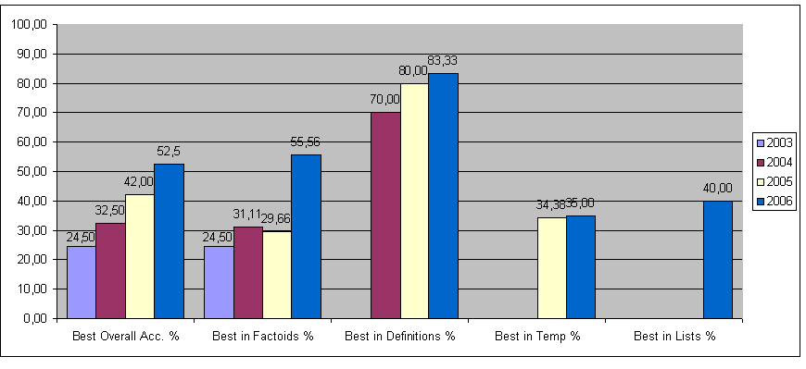
Systems performance
Upper bound of 60% accuracy
Overall
Best result
<60%
Definitions
Best result
>80%
NOT
IR approach

Slide 5
Pipeline Upper Bound
Question
Question
analysis
Passage
Retrieval
Answer
Extraction
Answer
Ranking
Answer
0.8
x
0.8
x
1.0
=
0.64
Not enough evidence
SOMETHING to break the pipeline: answer validation instead of re-ranking

Slide 6
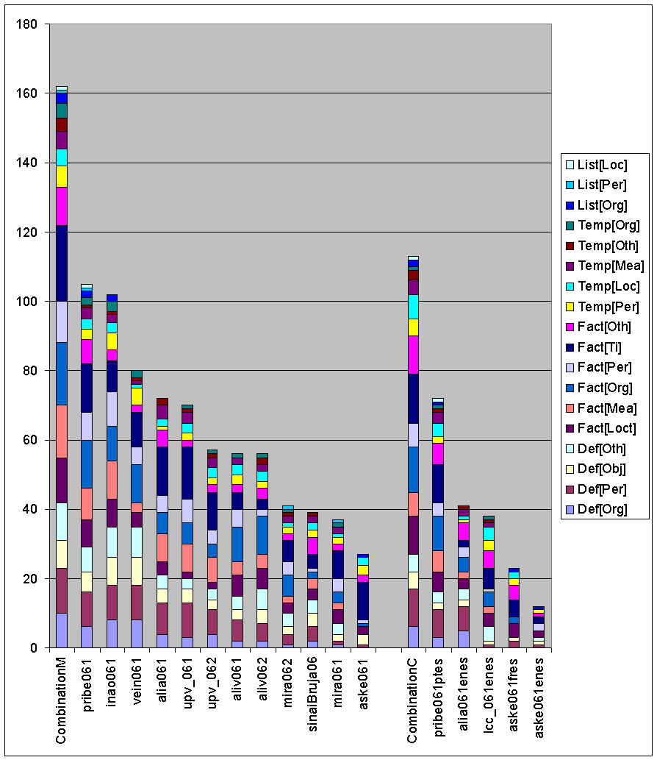
Multi-stream upper bound
Best with ORGANIZATION
Perfect combination
81%
Best with PERSON
Best with TIME
Best system 52,5%

Slide 7
Multi-stream architectures
Different systems response better different types of questions
Specialization
Collaboration
Question
QA sys₁
QA sys₂
SOMETHING for combining / selecting
Answer
QA sys₃
Candidate answers
QA sys_{n}

Slide 8
AVE 2006-2008
Answer Validation: decide whether to return the candidate answer or not
Answer Validation should help to improve QA
Introduce more content analysis
Use Machine Learning techniques
Able to break pipelines and combine streams

Slide 9
Hypothesis generation + validation
Answer
Searching space of candidate answers
Hypothesis generation functions
+
Answer validation functions
Question

Slide 10
ResPubliQA 2009 - 2010
Transfer AVE results to QA main task 2009 and 2010
Promote QA systems with better answer validation
QA evaluation setting assuming that
To leave a question unanswered has more value than to give a wrong answer

Slide 11
Evaluation measure (Peñas and Rodrigo, ACL 2011)
Reward systems that maintain accuracy but reduce the number of incorrect answers by leaving some questions unanswered
n: Number of questions
n_{R}: Number of correctly answered questions
n_{U}: Number of unanswered questions

Slide 12
Conclusions of ResPubliQA 2009 – 2010
This was not enough
We expected a bigger change in systems architecture
Validation is still in the pipeline
IR -> QA
No qualitative improvement in performance
Need of space to develop the technology

Slide 13
2011 campaign
Promote a bigger change in QA systems architecture
QA4MRE: Question Answering for Machine Reading Evaluation
Measure progress in two reading abilities
Answer questions about a single text
Capture knowledge from text collections

Slide 14
Reading test
Text
Coal seam gas drilling in Australia's Surat Basin has been halted by flooding.
Australia's Easternwell, being acquired by Transfield Services, has ceased drilling because of the flooding.
The company is drilling coal seam gas wells for Australia's Santos Ltd.
Santos said the impact was minimal.
Multiple choice test
According to the text…
What company owns wells in Surat Basin?
Australia
Coal seam gas wells
Easternwell
Transfield Services
Santos Ltd.
Ausam Energy Corporation
Queensland
Chinchilla

Slide 15
Knowledge gaps
drill
Australia
is part of
I
for
II
Queensland
is part of
Company A
Well C
Company B
own | P=0.8
Surat Basin
Texts always omit information
We need to fill the gaps
Acquire background knowledge from the reference collection

Slide 16
Knowledge - Understanding dependence
We “understand” because we “know”
We need a little more of both to answer questions
Capture ‘Background Knowledge’ from text collections
‘Understand’ language
Macro-Reading
Open Information Extraction
Distributional Semantics
… … …
Reading cycle

Slide 17
Control the variable of knowledge
The ability of making inferences about texts is correlated to the amount of knowledge considered
This variable has to be taken into account during evaluation
Otherwise it is very difficult to compare methods
How to control the variable of knowledge in a reading task?

Slide 18
Text as sources of knowledge
Text Collection
Big and diverse enough to acquire knowledge
Impossible for all possible topics at the same time
Define a scalable strategy: topic by topic
Reference collection per topic (20,000-100,000 docs.)
Several topics
Narrow enough to limit knowledge needed
AIDS
CLIMATE CHANGE
MUSIC & SOCIETY
ALZHEIMER (in 2012)

Slide 19
Evaluation tests (2011)
12 reading tests (4 docs per topic)
120 questions (10 questions per test)
600 choices (5 options per question)
Translated into 5 languages:
English, German, Spanish, Italian, Romanian
Plus Arabic in 2012
Questions are more difficult and realistic
100% reusable test sets

Slide 20
Evaluation tests
44 questions required background knowledge from the reference collection
38 required combine info from different paragraphs
Textual inferences
Lexical: acronyms, synonyms, hypernyms…
Syntactic: nominalizations, paraphrasing…
Discourse: correference, ellipsis…

Slide 21
Evaluation
QA perspective evaluation
c@1 over all 120 questions
Reading perspective evaluation
Aggregating results test by test
Task | Registered groups | Participant groups | Submitted Runs
QA4MRE 2011 | 25 | 12 | 62 runs

Slide 22
QA4MRE 2012 Main Task
Topics
AIDS
Music and Society
Climate Change
Alzheimer (divulgative sources: blogs, web, news, …)
Languages
English, German, Spanish, Italian, Romanian
Arabic
new
new

Slide 23
QA4MRE 2012 Pilots
Modality and Negation
Given an event in the text decide whether it is
Asserted (no negation and no speculation)
Negated (negation and no speculation)
Speculated
Roadmap
2012 as a separated pilot
2013 integrate modality and negation in the main task tests

Slide 24
QA4MRE 2012 Pilots
Biomedical domain
Same setting than main but
Scientific language (require domain adaptation)
Focus in one disease: Alzheimer (59,000 Medline abstracts)
Give participants the background collection already processed: Tok, Lem, POS, NER, Dependency parsing
Development set

Slide 25
QA4MRE 2012 in summary
Main task
Multiple Choice Reading Comprehension tests
Topics: AIDS, Music and Society, Climate Change, Alzheimer
English, German, Spanish, Italian, Romanian, Arabic
Two pilots
Modality and negation
Asserted, negated, speculated
Biomedical domain focus on Alzheimer disease
Same format as the main task

Slide 26
Thanks!

