Slide 1
New York University 2011 System for KBP Slot Filling
Ang Sun
Ralph Grishman
Wei Xu
Bonan Min
November 15, 2011
TAC 2011 Workshop
Gaithersburg, Maryland USA

Slide 2
Outline
Overview of 2011 System
Baseline: 2010 System
Distant Learning
Passage Retrieval (QA)
Result Analysis
Distant Learning for Slot Filling
Class Label Refinement
Undersampling the Majority Classes
Contribution of Coreference
Experimental Results

Slide 3
Overview of 2011 System
Baseline: 2010 System (three basic components)
Document Retrieval
Use Lucene to retrieve a maximum of 300 documents
Query: the query name and some minor name variants
Answer Extraction
Begins with text analysis: POS tagging, chunking, name tagging, time expression tagging, and coreference
Coreference is used to fill alternate_names slots
Other slots are filled using patterns (hand-coded and created semi-automatically using bootstrapping)
Merging
Combines answers from different documents and passages, and from different answer extraction procedures

Slide 4
Overview of 2011 System
Distant Learning (the general algorithm)
Map relations in knowledge bases to KBP slots
Search corpora for sentences that contain name pairs
Generate positive and negative training examples
Train classifiers using generated examples
Fill slots using trained classifiers

Slide 5
Overview of 2011 System
Distant Learning (some details of the NYU system)
Map 4.1M Freebase relation instances to 28 slots
Given a pair of names <i,j> occurring together in a sentence in the KBP corpus, treat it as a
positive example if it is a Freebase relation instance
negative example if <i,j> is not a Freebase instance but <i,j’> is an instance for some j'≠j.
Train classifiers using MaxEnt
Fill slots using trained classifiers, in parallel with other components of NYU system

Slide 6
Overview of 2011 System
Passage Retrieval (QA)
For each slot, a set of index terms is generated using distant supervision (using Freebase)
Terms are used to retrieve and rank passages for a specific slot
An answer is then selected based on name type and distance from the query name
Due to limitations of time, this procedure was only implemented for a few slots and was used as a fall-back strategy, if the other answer extraction components did not find any slot fill.

Slide 7
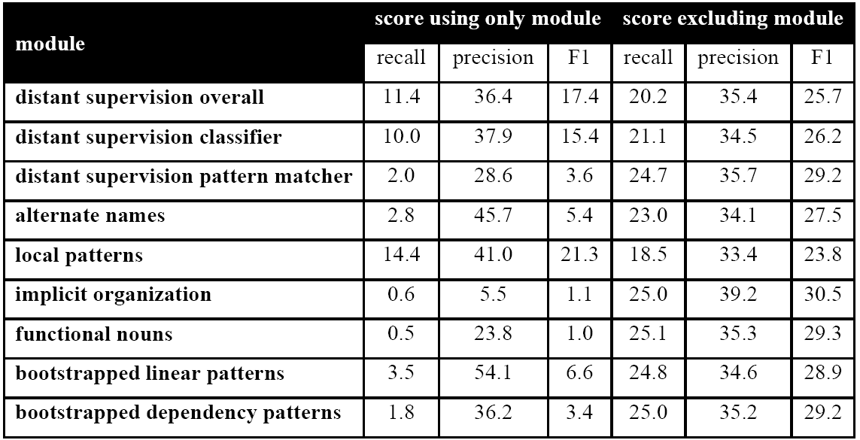
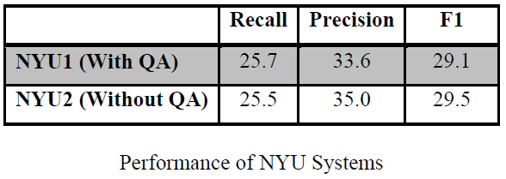
Overview of 2011 System
Result Analysis
(NYU2 R/P/F 25.5/35.0/29.5)

Slide 8
Distant Learning for Slot Filling
Problems
Problem 1: Class labels are noisy
Many False Positives because name pairs are often connected by non-relational contexts
FALSE
POSITIVES

Slide 9
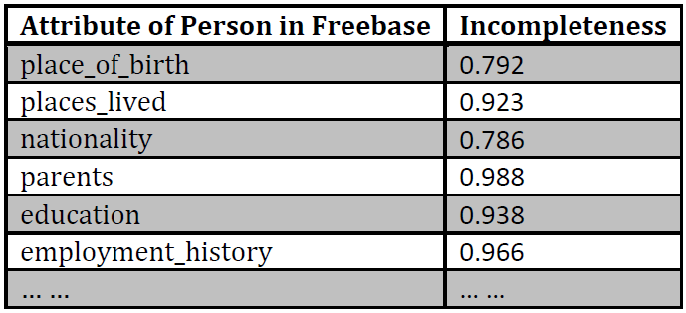
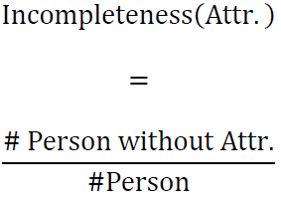
Distant Learning for Slot Filling
Problems
Problem 1: Class labels are noisy
Many False Negatives because of incompleteness of current knowledge bases

Slide 10
Distant Learning for Slot Filling
Problems
Problem 2: Class distribution is extremely unbalanced
Treat as negative if <i,j> is NOT a Freebase relation instance
Positive VS negative: 1:37
Treat as negative if
<i,j> is NOT a Freebase instance but <i,j’> is an instance for some j'≠j AND <i,j> is separated by no more than 12 tokens
Positive VS negative: 1:13
Trained classifiers will have low recall, biased towards negative

Slide 11
Distant Learning for Slot Filling
Problems
Problem 3: training ignores co-reference info
Training relies on full name match between Freebase and text
But partial names (Bill, Mr. Gates …) occur often in text
Use co-reference during training?
Co-reference module itself might be inaccurate and adds noise to training
But can it help during testing?

Slide 12
Distant Learning for Slot Filling
Solutions to Problems
Problem 1: Class labels are noisy
Refine class labels to reduce noise
Problem 2: Class distribution is extremely unbalanced
Undersample the majority classes
Problem 3: training ignores co-reference info
Incorporate coreference during testing

Slide 13
Class Label Refinement
The refinement algorithm
Represent a training instance by its dependency pattern, the shortest path connecting the two names in the dependency tree representation of the sentence
Estimate precision of the pattern
Precision of a pattern p for the class Ci is defined as
the number of occurrences of p in the class Ci divided by
the number of occurrences of p in any of the classes Cj
Assign the instance the class that its dependency pattern is most precise about

Slide 14
Class Label Refinement
The refinement algorithm (cont)
Examples
Example Sentence
Class
Jon Corzine, the former chairman and CEO of Goldman Sachs
PERSON:
Employee_of
PERSON:
Employee_of
appos chairman prep_of
PERSON:
Employee_of
William S. Paley , chairman of CBS … …
ORG:
Founded_by
appos chairman prep_of
prec(appos chairman prep_of, PERSON:Employee_of) = 0.754
prec(appos chairman prep_of, ORG:Founded_by) = 0.012

Slide 15
Undersampling the Majority Classes
Effort 1:
multiple n-way instead of single n-way classification
single n-way: an n-way classifier for all classes
Biased towards majority classes
multiple n-way: an n-way classifier for each pair of name types
A classifier for PERSON and PERSON
Another one for PERSON and ORGANIZATION
… …
On average (10 runs on 2011 evaluation data)
single n-way: 180 fills for 8 slots
multiple n-way: 240 fills for 15 slots

Slide 16
Undersampling the Majority Classes
Effort 2:
Even with multiple n-way classification approach
OTHER (not a defined KBP slot) is still the majority class for each such n-way classifier
Downsize OTHER by randomly selecting a subset of them

Slide 17
Contribution of Coreference
No use of co-reference during training
Run Jet (NYU IE toolkit) to get co-referred names of the query
Use these names when filling slots for the query
Co-reference is beneficial to our official system
P/R/F of the distant filler itself
With co-reference: 36.4/11.4/17.4
Without co-reference: 28.8/10.0/14.3

Slide 18
Experimental Results (2011 evaluation data)
Multiple n-way outperformed single n-way
Models with refinement:
higher performance
curves are much flatter
less sensitive to undersampling ratio
more robust to noise
Undersampling Ratio:
ratio between negatives and positives

Slide 19
Experimental Results (2011 evaluation data)
Models with refinement have better P, R
Multiple n-way outperforms single n-way
mainly through improved recall

Slide 20
Thanks!

Slide 21
?

