Slide 1
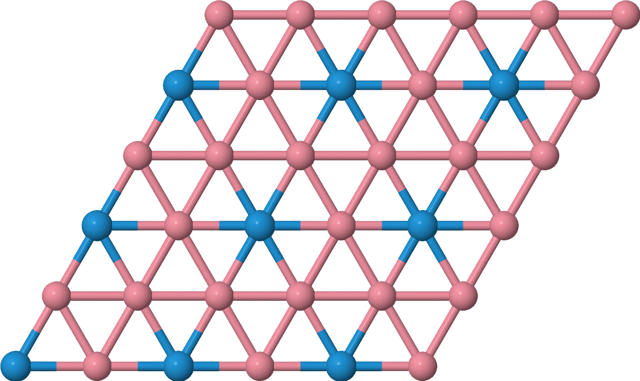
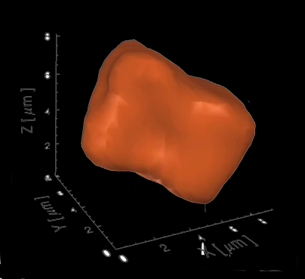

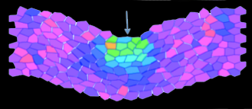
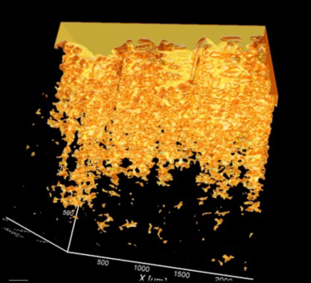
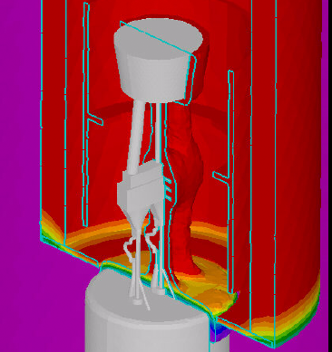
Lightweight and Structural Materials
Co-Chairs
  Brad Cowles (P&W, retired)
  Tresa Pollock (UCSB)
  Chuck Ward (AFRL)
Our Process
Vision
Grand Challenges
Metrics: What does Success Look Like?

Slide 2
Grand Challenges: Lightweight and Structural Materials
Our Process
(1) Needs / Priorities from Industry (Pull) and Research (Enable/Push) Side
  - Prioritize (vote)
  - Add quantitative goals
  What are the technical challenges/knowledge gaps to adopting an MGI approach, i.e. integrated theory/modeling and synthesis/characterization, for your materials sector? What are the challenges as they relate to theory, computation, material characterization, making or processing a material, and engineering application? How do these components come together to build a bridge between science and engineering?
(2) What are the most Urgent Infrastructural /Data/ Workforce / Capabilities?
  - Prioritize (vote)
  - Add quantitative goals
  What are the benefits and barriers to establishing and utilizing data and software infrastructure for your materials sector? (See the 2012 NIST workshop report “Building the Materials Innovation Infrastructure: Data and Standards”
(3) Group into High Level Grand Challenges

Slide 3
Structural and Lightweight Materials
Grand Challenges: Considerations
Design of Materials vs Design with Materials
Theory, computation, experiment, data, VVUQ, workforce
What can be accomplished vs what could be accomplished?
Capability-driven Grand Challenges: set quantitative goals for development of computational, experimental digital data tools and workforce

Slide 4
Need | Enable
Databases of multiscale structural information correlated with properties | New paradigms and descriptions of multiscale materials behavior
New analysis tools based on stochastic descriptions of materials behavior (rare events, ranges of behavior, etc.) coupled with databases | Predictions of materials response in an engineering setting AND forward/inverse modes
Materials, process, structure, properties to specify materials | Complete understanding of materials systems and properties
Standardize description of materials design/development challenges | Cross-disciplinary expertise can be engaged in addressing the very difficult challenges in ICME/MGI implementation
Data analytic tools for extracting executable process-structure-property linkages from large datasets | Inverse solutions to materials/process design problems
Statistics and tools to quantify and manage variance from process to microstructure to properties | Robust multiscale design integration of product design with manufacture

Slide 5
Need | Enable
Predict corrosion susceptibility and rates (at diff. temps and environ.) | Design structures with required durability in a corrosive environment
Predict ductility and toughness for different strain rates in different environments for metals and composites | Increase interest in low ductility types of materials for a broader range of applications
Durability assessments of materials with and without coatings | Systems-level design
Improved thermodynamic and kinetic databases, phase field (microevolution)
IP/Export/ITAR guidelines for model and data sharing
3D/4D characterization using NDE tools
Test that provides multiple properties
Better toolset for the conceptual design phase and a methodology for assessing extremes of structure properties
Design of materials as a variable (holistic design space). Materials not tied to a specification beyond the available materials database

Slide 6
Need | Enable
Quicker NDE assessment/image recognition techniques
Design manufacturing components with existing and new materials that meet the requirements for the entire intended life of the component
Deliver validated tools that will predict nominal and extreme materials response for those specific conditions
Develop optimized material systems validated/applicable to large-scale applications | Employ ultra-durable, damage tolerant, multifunctional materials
Provide validated and efficient computational tools throughout the length scales | Answer a multitude of “what if” questions throughout the design, manufacturing, certification, and lifecycle of a material and ultimately the vehicle system
Develop and validate models of materials using detailed experiments at the subcomponent level | May eliminate disconnects as one bridges length scales

Slide 7
Need | Enable
Predict performance/strength variability with processing variability | Predict structural knockdown or acceptance criteria for manufacturing anomalies and select material/manufacturing process combinations
Eliminate one-two iterations in materials scale-up process | Quantitative process – structure-property model, lab simulation with model -> full scale production
Define commercial composition limits at bench scale (typically not done until later during scale-up phase, potentially creating surprises) | Experimental and computational prediction of full-scale properties from bench-scale product
Manufacturing variation – tools that quantify variability in the process and permit sensitivity analyses
Develop models that can take into account the effects of chemistry and processing variations on mechanical properties | Develop new alloys better, faster, and cheaper
Software packages that are user friendly | Faster alloy development

Slide 8
Need | Enable
High throughput measurement techniques for properties of microscale constituents and interfaces (e.g. indentation methods)
ICME integration platforms
Industrial guidance as to highest return on investment in 3D data sets | Better handoff across the “valley of (MGI) death” to engineers for implementation
Better access to integrated product development teams (e.g. 1 month fellowships in industry?) | More realistic/useful models and tools
More highly defined, foundational engineering problems with $ behind them (like AFRL, ONR projects), but coming from industry | Guidance for critical data set and tool development

Slide 9
Need | Enable
Cross-functional/discipline integration to define FEPs
Tabulate a set of properties that need to be rapidly calculated and/or characterized
Develop tools that address multi-materials structures and their joining, recyclability
For properties where stochastic rare events govern, mechanistic-probabalistic theoretical frameworks | Predict properties that are of 10^6 failure prob, predict material variability or property variability; prediction of size effects, predict lifetimes which are beyond experimental data
Different way of ___ mechanisms, then characteristic length and time scales of a mechanism | Knowledge of what ___ to use, what ___ to measure, what ___ to design, what data to collect, what data to mine, knowledge of time dependence
Searchable repositories with data pedigree for single and multiphase property data | Reliable prediction of phase constitution and associated properties for microstructure and macroproperty modeling

Slide 10
Need | Enable
Easy-to-adopt and integratable packages Design WITH materials beyond Ashby (maybe a great textbook…for something we don’t know how to do? ☺) Case studies and modules Better linkages between curricula and real engineering problems faced by industry (www.innocentive.com) | A new generation of scientists who think first of MGI/ICME
Discovery of synthesis processes driven by (in bulk quantities) | Expand the types of microstructure we can make and types of properties we can attain
Make it easy/interesting/exciting to deal with data!!!!!!!!!!!
Understand interfaces at the level one can control mechanisms via interfaces | Introduce a new class of materials with tunable properties and have less dependence on properties of constituents
Common journal archiving policy for materials data

Slide 11
The MGI Vision for Lightweight and Structural Materials
Vision: Create a future that fully integrates materials with product design and manufacturing to accelerate revolutionary social, economic, and environmental benefits that advance energy, defense, healthcare, space and transportation.

Slide 12
The Grand Challenges
Create a Pervasive and Linked Computational Tool Set for Materials Design
  Spanning broad range of length scales and properties
Moving Beyond Picture-based and Story-based Experimental Characterization
  Rapid, Quantiative 3/D and 4/D
The Petadata Challenge: Create, Capture and Archive Diverse Materials Data
  Federated, Linkable, Adaptable, Usable by the Entire Community
Create an Infrastructure for Materials by Design
  Intra- and Interdisciplinary Integration
Develop a Skilled MGI Workforce
  The Current and Future Workforce, Curricula and Tools

Slide 13
Pervasive and Linked Computational Tool Set for Materials Design
Link domains quantitatively and develop workflows (computational and experimental):
  Thermodynamics, diffusion
  Process simulation
  Microstructural Length scales & Domains
  Property domains
  Product/component performance
  Experimental information where required

Slide 14
Within 5 years experts should be able to with 90% confidence do the following:
Quantitatively predict the corrosion behavior (aqueous, hot, CMAS, oxidation, pitting and SCC) of any metal alloy and predict its influence on properties
  A program that would accomplish this for aircraft and aircraft engine materials is an example of a FEP (Foundation Engineering Problem)
Quantitatively predict the influence polymer chemistry and lamination geometry on fracture toughness, delamination and disbonding of any polymeric composites
Quantitatively predict the failure modes of mixed metal joined components
Linked analytical tools have a computational turn-around time of 1 month
An important stepping stone is a well established and systematic approach and framework for building extensible hierarchical models (need to establish SMARTQ goals)
And In 10 years
Linked analytical tools are used by application analysts in industry and by undergrads in senior level capstone design courses

Slide 15
Moving Beyond Picture-based and Story-based Experimental Characterization
Goal: Rapid, quantitative 3D/4D characterization with uncertainty quantification
Develop real-time (in-situ, 4D) rapid characterization – including lowering barriers of access to facilities specializing in such techniques
Forward modeling of characterization instruments and develop techniques for fusion of multimodal data
Develop quantitative, statistical descriptions which capture the distribution of materials structure
Develop means of establishing a representative volume for higher length scale experiments, modeling, and design. (Investigate structure/response over the statistically relevant length, time, and temperature scale.)
Develop accelerated testing methods for structure/response assessment for extreme environments
Develop an intimate integration of experiments and modeling (co-validation) – modelers help design experiments & experimentalists perform work in support of modeling
Advanced non-destructive (and destructive) methods to rapidly interrogate materials microstructure and state for prognosis (quality control and damage assessment).

Slide 16
Examples of Successful Implementation
Within five years, demonstrate the ability to fully characterize 1 cm³ of a complex engineering alloy (phases, grains, pores, cracks, surfaces, interfaces, dislocations, point defects, and crystal structures) within 1 week.
Develop a representative set of case studies (steel/nickel/tPMC/etc. samples with known structure which can be used to validate the above claim).
Within five years, establish integrated experimental and modeling approach to non-destructively map (in 3D) the full tensorial residual stress field in a part with 10 μm resolution over a volume of 10 cm³ including depths up to 1 cm within one day.

Slide 17
The Petadata Challenge: Create, Capture and Archive Diverse Materials Data
Create, develop and operate federated databases covering all length scales and database tools for easy access to data including effective tools and standards for data exchange and links among databases
  Priorities: thermodynamics, kinetics, elastic constants, CTE, crystal structure, electric & thermal conductivity, plastic properties
Develop and implement common journal archiving policy
Develop minimum requirements for documenting pedigree and provenance for materials data
Develop analytical tools for efficient extraction of process-structure-property linkages from large datasets that can be executed with modest computational resources (desktop)

Slide 18
Infrastructure Vision for Materials by Design Toolbox
Goals (Inductive design)
Application
Performance Objectives
Design methods to ensure robust solution
Material Properties
(Physical, Mechanical, Corrosion, Electrical, Magnetic)
  Validation/ error propagation
(Constitutive laws, physics based models)
Structure/Property Processing/Structure Models
(scale bridging of models to transition to different length scales )
Evaluation of uncertainty in data extrapolations
Composition Dependent Databases
(e.g. Thermodynamics, Diffusion Mobility, Molar Volume)
Uncertainty analysis of input data
Atomic-Scale Models:
Ab-initio, MD, KMC, EAM
Experimental Input Data
(Crystal Structure, thermochemical, D*
Notes:
The hierarchy of models and experimental input used to define structure/property and processing/structure relationships.

Slide 19
Infrastructure for Materials by Design
Needs to Achieve Vision
Tools/schemas to pass data (information) to a structure design tools. (i.e location specific residual stress data from DEFORM into Ansys)
Develop better processing to structure composition and temperature dependent tools and models
At all length scales need to access the uncertainty of the data. (i.e. Uncertainty of a melting temperature prediction to a casting code or uncertainty associated FP calculation that used in CALPHAD assessment.)
Integration requires high fidelity multicomponent composition, temperature, pressure dependent databases that can be interfaced with a variety higher length scale tools (i.e DEFORM, FEM, CFD codes) – note also requires integration of first principles and atomistics and MD to develop databases.
  Need to define limitations of simulation code

Slide 20
Develop a Skilled MGI Workforce
In five years: have in place a complete curriculum and certificate programs to train materials scientists/engineers proficient in analytical, computational and statistical analysis and methods
  Create taskforce to identify core curriculum content
  Lower barrier to introduce computational content by development and dissemination of tools & packages
  Online resources: lectures (MOOC-style), reading material, problem sets
Degree programs
  Taskforce to identify industrial needs (content) and optimal formats (on-line, degree certificates, short courses) for training personnel

