Slide 1
Breakout Report on Organic Electronics
Identification of Grand Challenges

Slide 2
Leadership and Industrial Representation
Chair: Howard Katz, Johns Hopkins University
Speakers (Industry): Greg Whiting, PARC (industrial cochair); Darin Laird, Plextronics; Dave Giesen, Schrodinger; Noah Tremblay, Nanoterra
Other speakers: Dean Delongchamp, NIST; Tim Mueller, JHU; John Anthony, Kentucky; Dan Frisbie, Minnesota; Mark Hersam, Northwestern; Ana Arias, Berkeley; Vitaly Podzorov, Rutgers; Michael Chabinyc, UCSB; Lynn Loo, Princeton; George Schatz, Northwestern; Mark Stiles, NIST; Richard Vaia, WPAFB, Miqel Salmeron, Lawrence Berkeley

Slide 3
MGI State-of-the-art in Organic Electronics
The computational tools are useful for isolated molecular structures, but not predictive for van der Waals molecular solids, and may not even exist for interfaces.
System and device models are yet a further level of complexity, and which barely exist.
The experimental techniques and the quantity of data are extensive, but often are just as expected, and may not apply to the materials integrated into systems.
The sharing and integration culture between the computational and experimental efforts is strong in individual companies, but weaker among the members of the broader community.

Slide 4
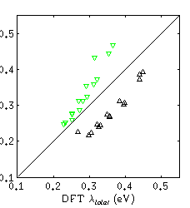
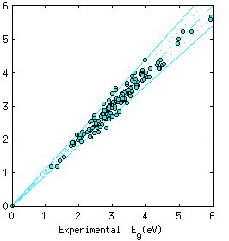
Estimation of electronic properties of organic molecules can be done in a matter of seconds
Calculated HOMO-LUMO gap
Tight-binding reorganization energy
Experimental HOMO-LUMO gap
DFT reorganization energy
T. Mueller, Johns Hopkins
Goals: First-pass prioritization, combinatorial optimization, interactive evaluation.

Slide 5
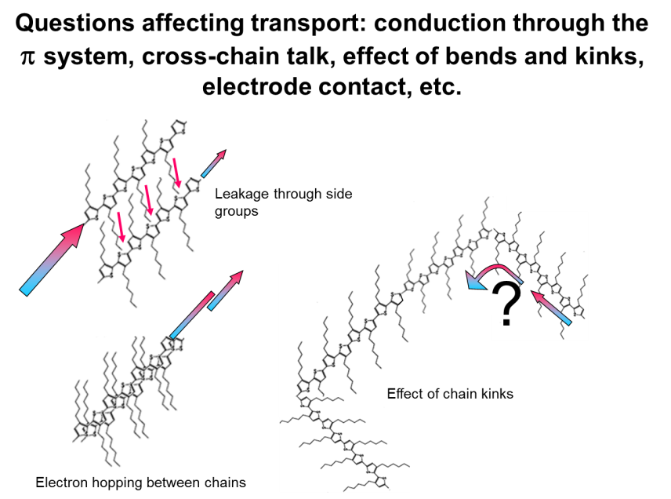
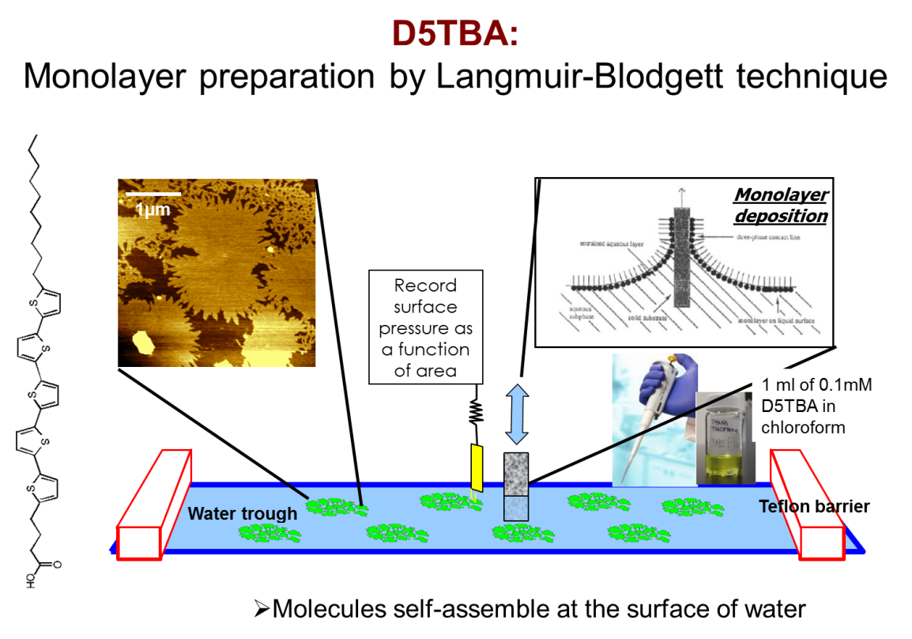
M. Salmeron,
Lawrence Berkeley Labs

Slide 6
Homogeneous Organics Show Heterogeneous Alignment
molecular packing
out-of-plane molecular orientation
in-plane molecular orientation
L
L
L
Electrode
lattice dimensions
film thickness
device channel length
10⁻¹⁰
10⁻⁹
10⁻⁸
10⁻⁷
10⁻⁶
10⁻⁵
10⁻⁴
characteristic length scale of ordering, L (meters)
Y.L. Loo, Princeton
Notes:
Three examples: PANI, TES ADT, HBC

Slide 7
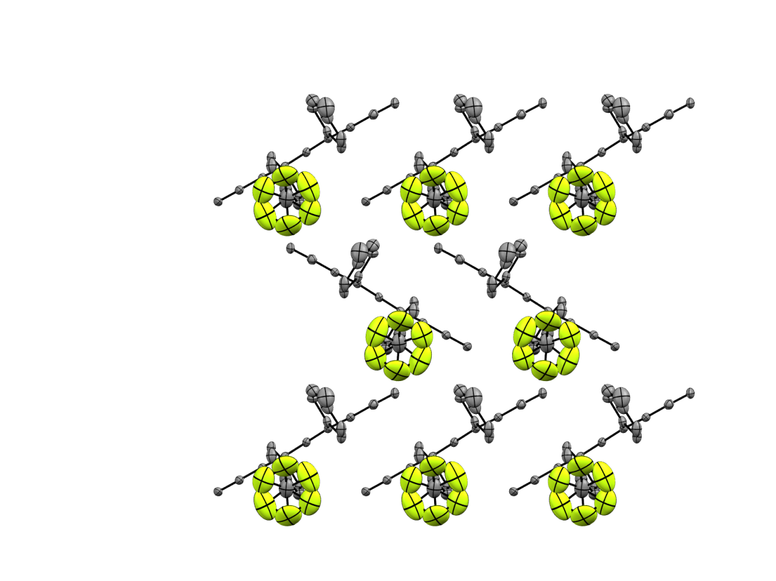
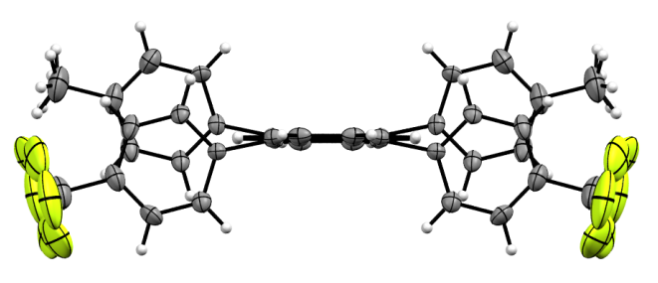
Prediction of Organic Solid State Packing
b-c plane
Crystal structure parameters
Growth | From vapor
Temperature | 173(2) K
Crystal system | Orthorhombic
Space group | Cmca
Unit cell dimensions | a = 34.197(6) Å
 | b = 7.1577(11) Å
 | c = 14.052(2) Å
 | α = 90°
 | β = 90°
 | γ = 90°
Volume | 3439.5(9) Å³
Slipped π-Stacks
Note head-to-tail dipoles!
C. D. Frisbie, Minnesota

Slide 8
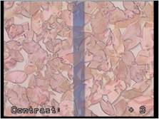
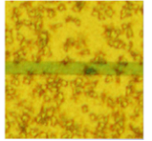
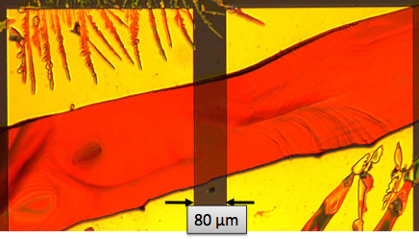
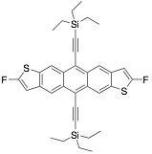
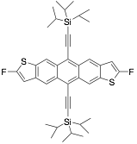
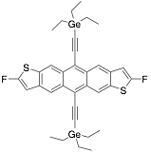


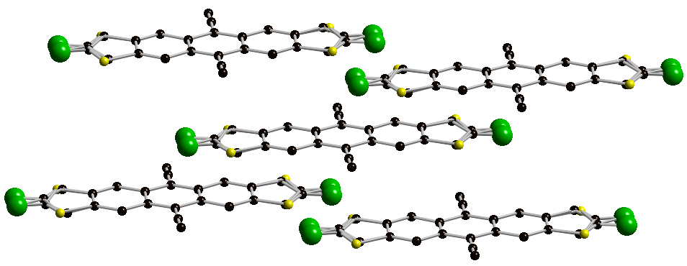
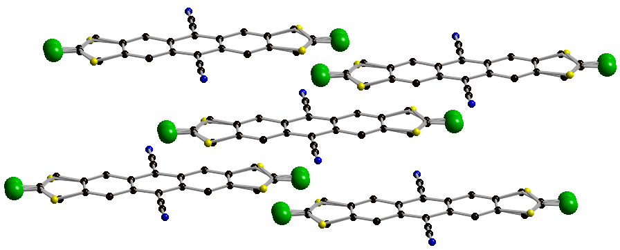
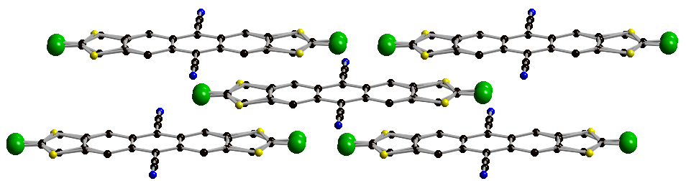
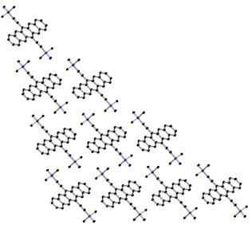
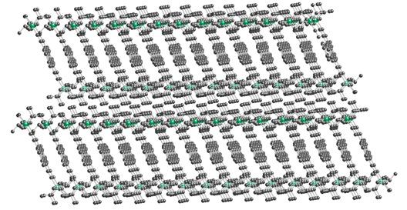
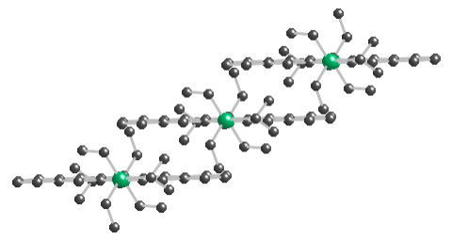
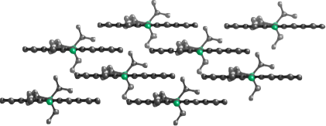

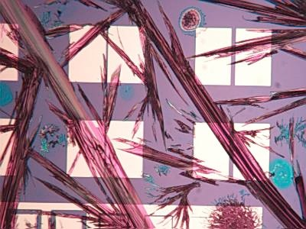
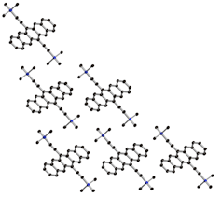
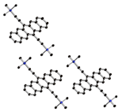

Inability to Predict Key Morphology by Computation
Drop-cast
µ_{FET} up to 4.5 cm² / Vs
Single crystal
µ_{FET} 6 cm² / Vs
Drop-cast
µ_{FET} 10⁻⁵ cm² / Vs
Single crystal
µ_{FET} 0.3 cm² / Vs
Spin-cast
µ_{FET} 1.5 cm² / Vs
Spray-cast
µ_{FET} 5.5 cm² / Vs
O. Jurescu,
Wake Forest
J. Anthony,
Kentucky
Both show strong calculated electronic coupling
μFET > 1 cm² / Vs
μFET ~ 10⁻³ cm² / Vs

Slide 9
Culture and Landscape
Publication and funding are driven by world record metrics that might not be the most relevant. Processing and stability/lifetime, and lower performing material explanations, are viewed as less scientific and less fundable, and it is difficult to place the required equipment/computational infrastructure in academic labs. More sustainable collaboration, perhaps through centers, is needed.
Discontinuous supply chain; multiple inputs to complex systems come from mutually proprietary sources. Communication about issues among companies is lacking, and competition for each part of the supply chain is fierce. Standards are not being generally set.
Do we need true benchmark performance before modeling can/should be done? Do we have sufficient benchmarks yet? How well can we rely on the results of calculations to make decisions?
There are no consensus workhorse materials or materials from a single, validated lot. If we chose a workhorse material set now, how would we know when to replace it?

Slide 10
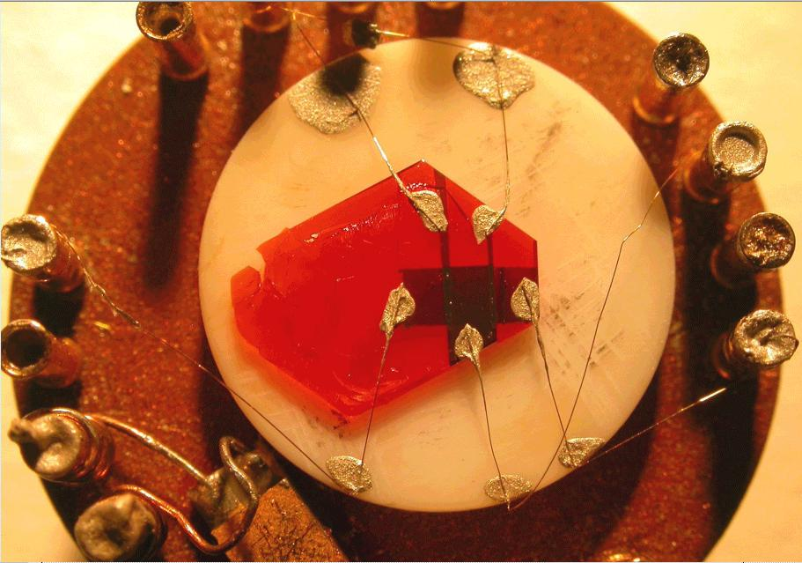
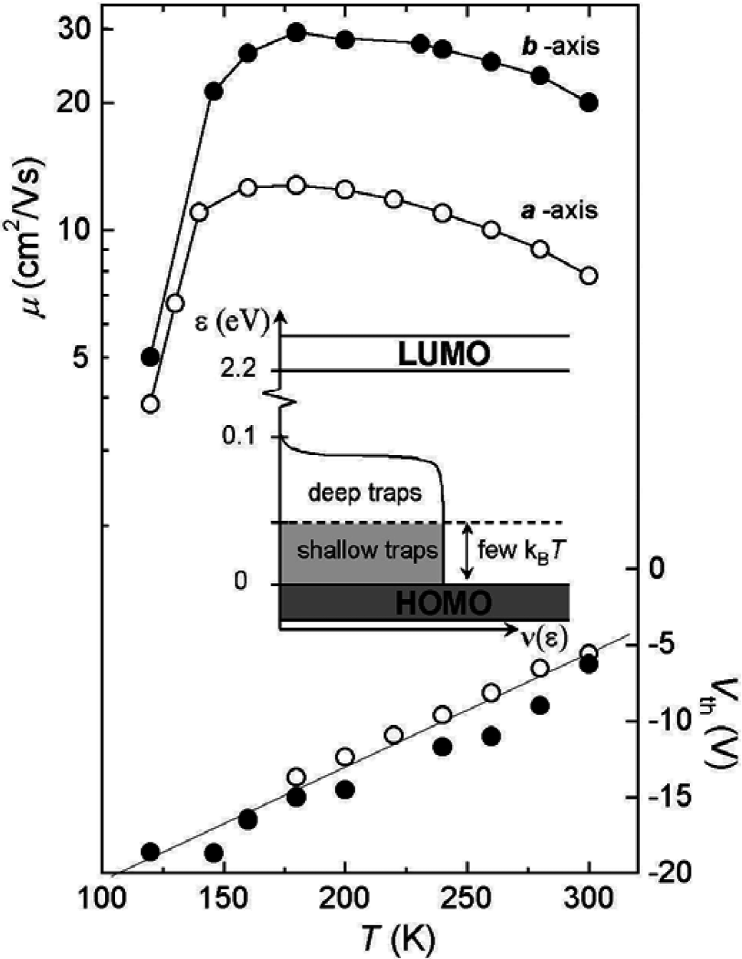
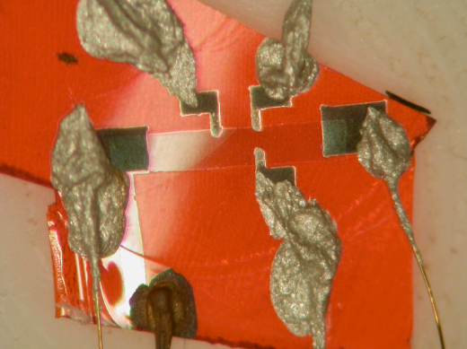
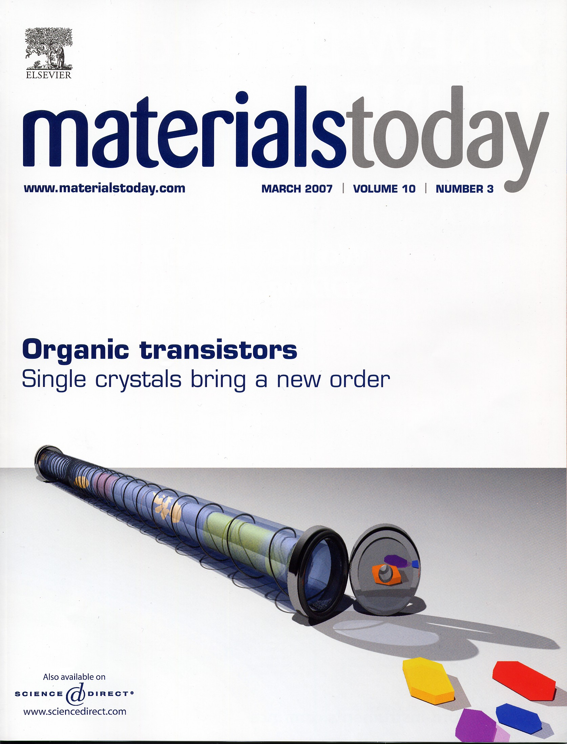
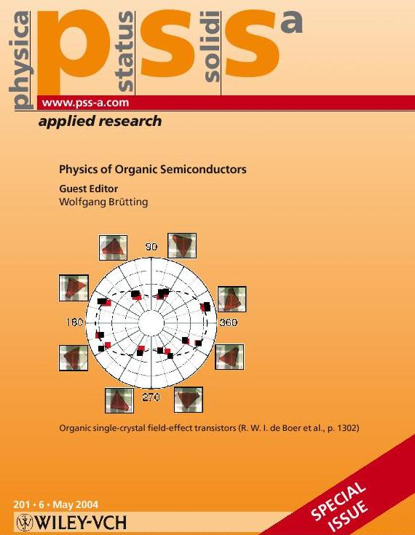
Highly relevant results were obtained with organic single-crystals devices
Single-crystal organic devices are recognized as a
powerful tool for the basic research in Organic Electronics
Some of the important results:
record high mobility in organic transistors
observation of non-activated transport and anisotropy of μ
observation of band-like semiconductor Hall effect
very large exciton diffusion length
Podzorov et al., APL 82, 1739 (2003)
Podzorov et al., APL 83, 3504 (2003)
Podzorov et al., PRL 93, 086602 (2004)
Sundar et al., Science 303, 1644 (2004)
Podzorov PRL (2005)
Takeya & Iwasa JJAP (2005)
Sekitani & Someya APL (2007)
Morpurgo Adv. Mater. (2012)
Najafov et al., Nature Mater. 9, 938-943 (2010).
Podzorov et al., (Rutgers)
PRL 95, 226601 (2005)
Bao & Reese,
Materials Today (2007)

Slide 11
Opportunities and Usefulness of Computation: Comprehensive Organic Device and Process Models are Needed, and They Require:
Predictive calculations of atomic to mesoscale structures and properties
Predicting transport (charges, excitons), with better theories, methods, codes
Calculation of interface and defect properties
Computational and experimental data organization
System scale modeling
Deposition, patterning, and resulting morphology modeling, kinetics and final characteristics

Slide 12
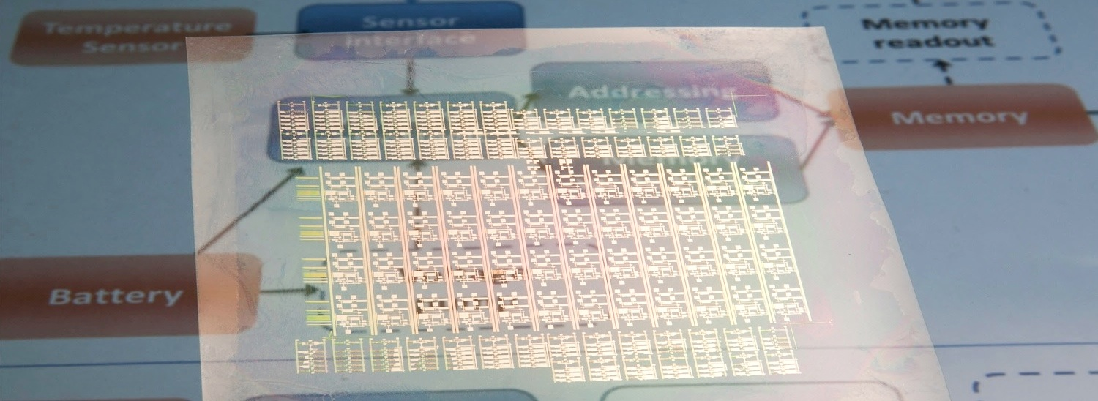
If we had the computational tools/information/integration, we would have:
Wearable, flexible, conformable systems; electronic skins
2D & 3D circuitry (passives, actives & interconnects)
Energy (solar, batteries, thermoelectrics, etc)
Distributed manufacturing (print shops for electronics)
Distributed sensor systems (smart tags)
In-vivo and bio-compatible electronic systems
G. Whiting, PARC

Slide 13
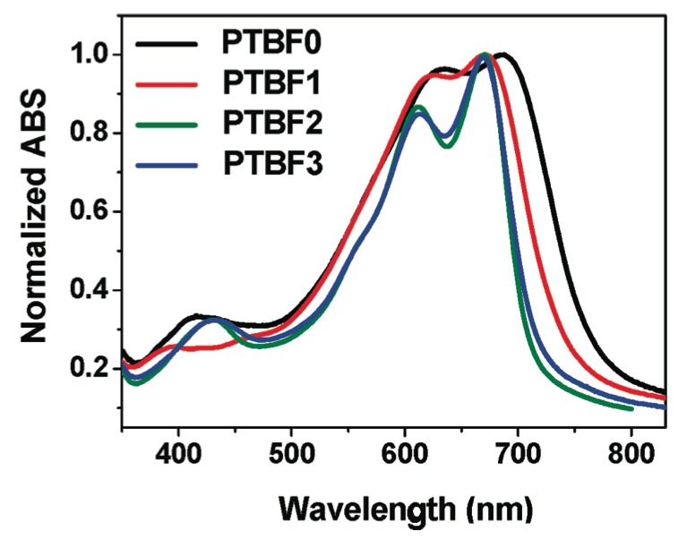
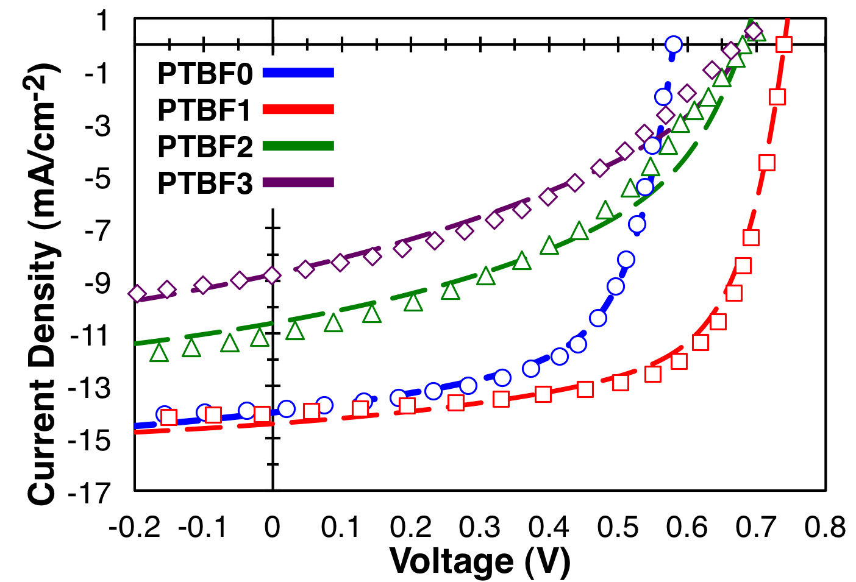
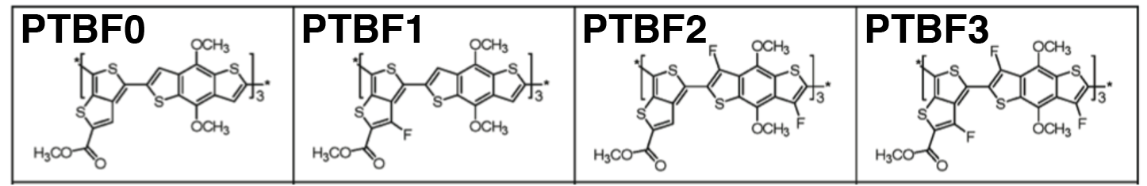
Slight Changes in Structure, Large Changes in Efficiency
Although the materials possess similar absorption spectra, they generate very different amounts of current.
Son et al. Synthesis of Fluorinated Polythienothiophene-co-benzodithiophenes and Effect of Fluorination on the Photovoltaic Properties. Journal of the Amer. Chem. Soc. 133, 1885 (2011)
Notes:
This PTBF series possess similar absorption properties (meaning they absorb similar amounts of light), yet they generate significantly different currents in device; what gives? Part of the problem is morphology, the F2 and F3 polymers have large domains(~100-200 nm).
The lines in the JV plot are fits to a model of mine. It isn’t important for the purposes of this slide.

Slide 14
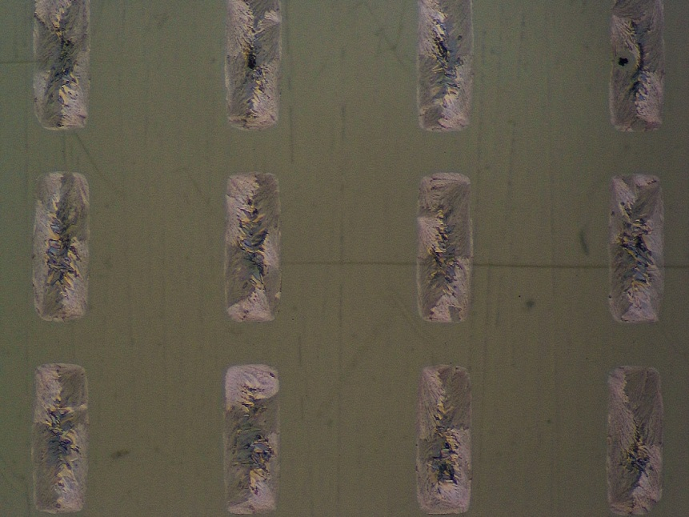
Technical Challenges and Gaps
There is an especially glaring deficiency in modeling related to manufacturing steps and processes. Remediating this deficiency will require:
Tools aimed at the impact of process on formation and evolution of microstructures and electronic properties; flow, solvation, wetting, and annealing process modeling; interfacial interaction modeling; and device modeling
Infrastructure: integration of computation and experiment
A.C. Arias, UC Berkeley

Slide 15
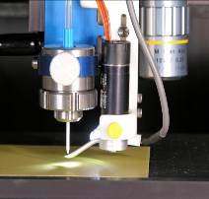
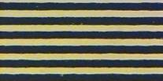

Process Modeling: e.g., aerosol jet printing
Dense Aerosol
Gas In
Sheath Gas In
Sheath Gas In
Various Nozzle Sizes
for Line Width Control
2 to 5 mm Standoff
Focused Beam
To < 10 µm
Substrate
Fine Line Capability
10 micron line width, 30 micron pitch
Ultrasonic Atomizer (pictured) :
  0.7 ~ 10 cP ink handling viscosity
Pneumatic Atomizer (also available) :
  1 ~ 2500 cP ink handling viscosity
Nozzle Output :
  Small Aerosol Droplets ~ 1 – 5 µm
  Up to 0.25 microliter/sec dispensing speed
  < 5 µm line width printing capability to > 1 mm
Mike Renn, C.D. Frisbie, Minnesota

Slide 16
Experiment-Computation Feedback
Solid state properties: Simple model systems (donor/acceptor interfaces, CNT including effects of chirality, single crystals, uniform heterojunctions). Doping in model systems (ionization efficiency, Fermi level control, thermoelectric effect, electrostatics at interfaces and near defects, chemical and physical sensing)
Phenomena: Spin, exciton, charge and phonon transport, spin states, Hall mobility, T-dependence of mobility, anisotropy; stability; sensitivity
Characterization: Advanced structural characterization (XRR, NS), advanced spectroscopy, including absorption and emission, nonlinear, hard and soft x-ray, and time-resolved, scanning probe microscopy, photocurrent spectroscopy
Massive data: role of machine learning/artificial intelligence, data mining, parameterization
Data from real devices fed into computation, including reliability and failure analysis

Slide 17
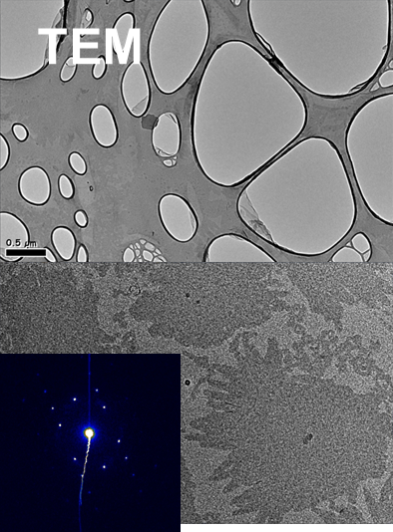
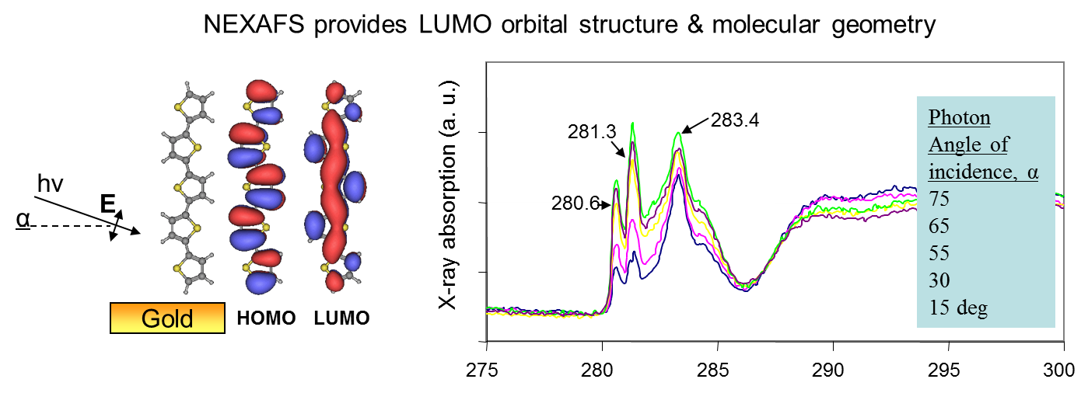
Tools: Examples
M. Salmeron,
Lawrence Berkeley Labs

Slide 18
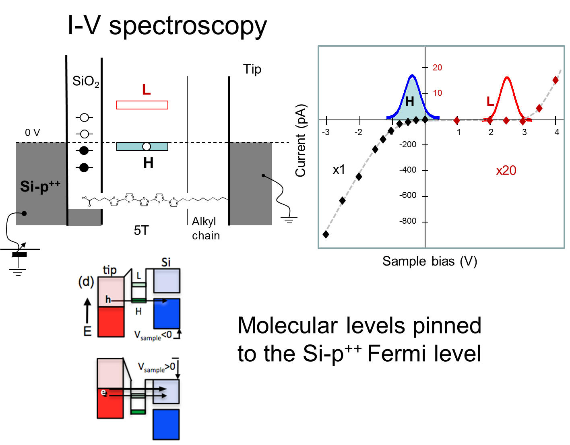
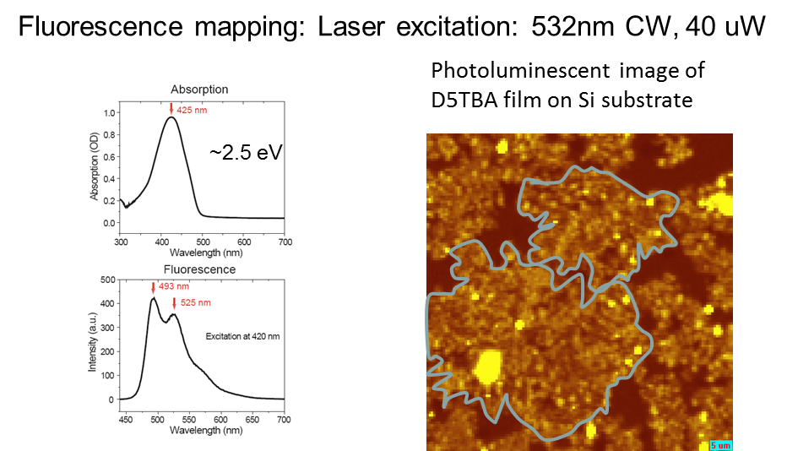
M. Salmeron,
Lawrence Berkeley Labs

Slide 19
Resonant Soft X-ray Scattering:
Domain Correlations
M. Chabinyc, UCSB

Slide 20
Technological Challenges
Process advancements are especially urgent, and complex to model
Reproducibility and tolerance of variability; lifetime magnitudes and matches (operation and storage) ; effect of oxygen, water, and heat
Material compatibility at interfaces; solvent orthogonality; interdiffusion between layers, especially from solution; effects of surfaces on properties of overlying materials
Crystal morphology seems highly unpredictable; intermolecular interactions need to be calculated to 0.1 Angstrom to have predictive value, but calculations on a wide range of larger length scales is needed
Traps prevent the isolation of intrinsic properties and limit predictive value of data; heterogeneity including defects and impurities; effects are noted even below detection limits
Downselecting the enormous number of material options, both semiconductors and passive materials
Improved printing resolution
Design of heterostructures, selection of elements of heterostructures, vast increase of combinations for heterostructures

Slide 21
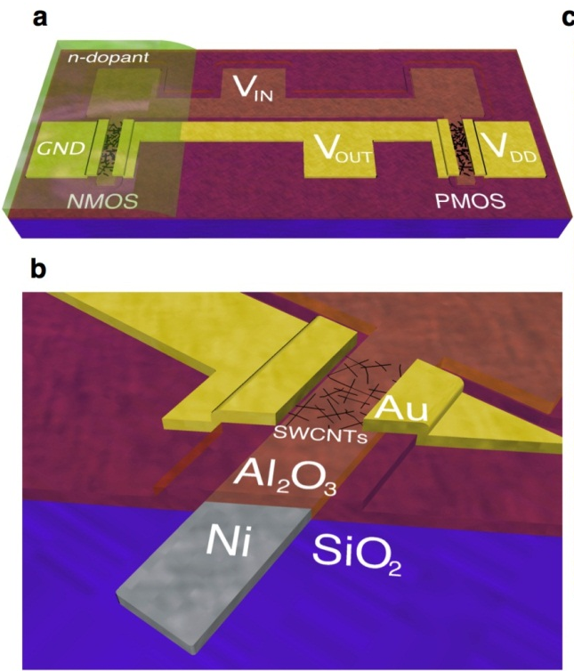
Carbon Material Integration
Ultralow power CNT CMOS
Nano Letters, 13, 4810 (2013).
M. Hersam

Slide 22
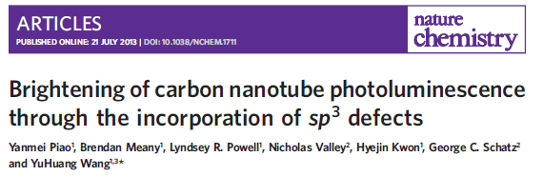
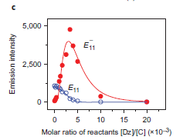
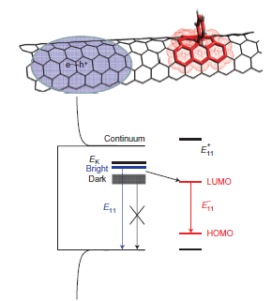
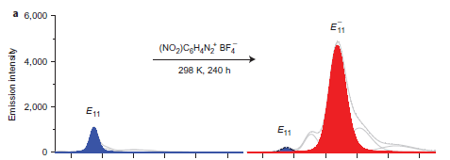
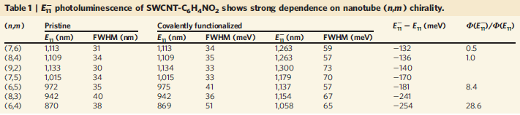
Nature Chem 5, 840 (2013)

Slide 23
Grand Challenge:
Prediction of molecular crystal structures and polymorphs
Tools are needed for accurate, precise prediction of crystal structures from molecular structure to better predict potential performance from single crystal devices thereby accelerating materials development activities

Slide 24
Grand Challenge:
Characterization and modeling at different magnitudes and combinations of length, time and dimensionality scales, including grain structures and mesoscale crystal/amorphous domain distributions
Molecular modeling alone often not predictive of device properties due to complex structuring in real films. Characterization methods and models to help understand and predict this complex ordering are essential.

Slide 25
Grand Challenge:
Creating a liquid-phase manufacturing paradigm
The big opportunity for this area is that carbon-based materials allow liquid-phase processing techniques (such as printing) to be used for manufacturing of electronics This new manufacturing method requires specific materials, equipment and models that are not currently available in a useful, integrated fashion

Slide 26
Grand Challenge:
Projecting device property evolution at the molecular scale
Performance of organic electronic devices are determined by the materials used and how they are processed. Better understanding of the evolution of molecular-scale structure during processing and it’s impact on device performance is essential

Slide 27
Grand Challenge:
Development of a comprehensive model for organic electronic-biological interfaces
A clear benefit of electronic systems based on soft mater is that they modulus match biological systems well, and so can be used to directly interface with organisms. Developing a model for these interfaces is needed for development of bio-compatible electronic systems

Slide 28
Grand Challenge:
Discovering markers for performance instability
Properties of electronic devices based on organic materials are typically not stable with respect to time, limiting the utility of devices in real systems. Better understanding of the critical markers that determine these instabilities are needed for commercialization of products relying on organic electronic systems

Slide 29
Grand Challenge:
Incentivization of industry to reinvest in research and development (with government partnership)
Greater industrial development is needed In order to accelerate development in this field. A lack of options for significant short-term products and dwindling resources for longer-term research reduces industrial involvement. Methods to incentivize industry to reinvest in this field as the research that will enable the long-term applications is being carried out is necessary.

