Slide 1
Materials Genome Initiative:
Grand Challenges Summit
CATALYSTS
Breakout Chairs:
Mark Barteau (U. Michigan)
Cathy Tway (The Dow Chemical Company)
Breakout Speakers:
  Plenary #1: Laura Gagliardi (U. Minnesota)
  Plenary #2: Cathy Tway (The Dow Chemical Company)

Slide 2
Catalysis Breakout Participants
Agnes Derecskei | Air Products
Anatoly Frenkel | Yeshiva University/Brookhaven
Andreas Heyden | U South Carolina
Chaitanya Narula | Oak Ridge National Lab
Dan Shantz | Sabic
Donghai Mei | Pacific Northwest National Lab
Eric Lowenthal | W.R. Grace
Friederike Jentoft | University of Oklahoma
Laura Gagliardi | University of Minnesota
Michael Janik | Pennsylvania State University
Michael G White | Brookhaven National Lab
Michael Wong | Rice University
Ned Corcoran | ExxonMobil
Perla Balbuena | Texas A&M University
Rampi Ramprasad | University of Connecticut
Sourav Sengupta | DuPont
Sriraj Srinivasan | Arkema
Susanne Opalka | UTC Power
Ye Xu | Oak Ridge National Lab/LSU

Slide 3
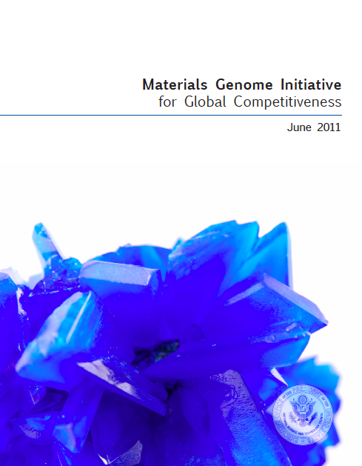

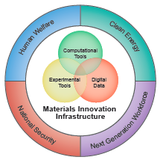
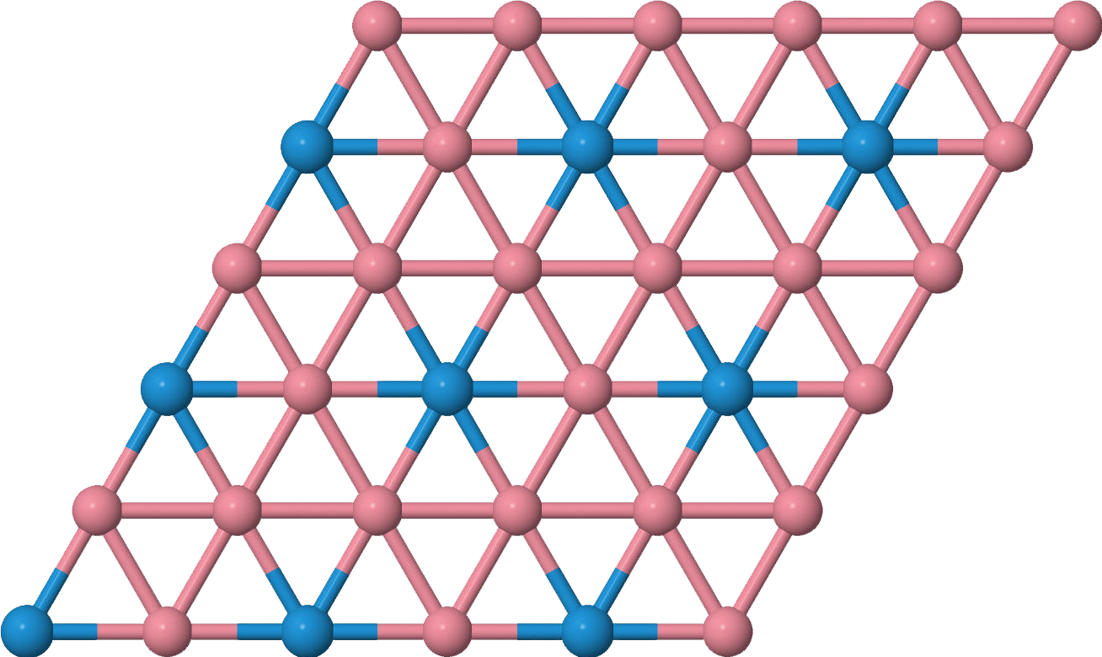
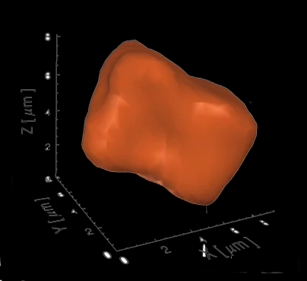

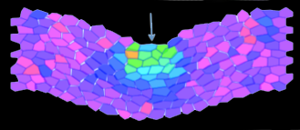
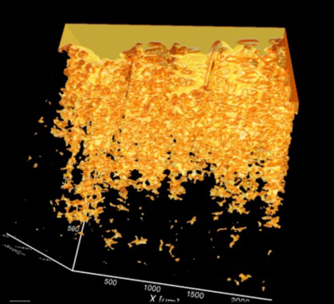
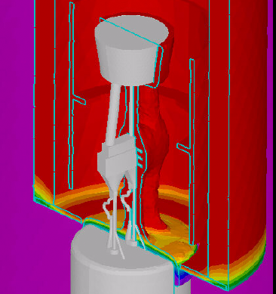
The Materials Genome Initiative
Develop new materials 2-3X faster at 50% of the cost
Will impact the full spectrum from discovery to development to deployment
Enabled by the convergence of digital data, new experimental tools and new computational capabilities
Comprehensive strategy for data, verification, validation

Slide 4
Need to Move Quickly to Reduce Commercialization Costs
333 Ideas
MGI Related Opportunities
$1
Refine lead identification through advanced data mining
Reduce time and expenditures for commercialization through advanced modeling & experimental techniques
23 original
6 patentable
2 commercial
1 successful product
$10
$100
Adapted from Zehner, W.B. The Emerging Technology Commercialization Degree, Integrated Design and Process Technology, IDPT-2005, June, 2005 and references therein.

Slide 5
Technology and Markets Impact Commercialization Time and Success
 | Established Market, Established Technology
 | New Market, Established Technology
 | Established Market, New Technology
 | New Market, New Technology
Commercialization time is from project launch & sales break even point
Success rate is % of projects with positive return on NPV basis, cost of capital with no risk adjustment
New technologies bring risk; new markets bring more due to complexity
Miremadl, M., Musso, C., Oxgaard, J. Chemical Innovation: An investment for the ages, May 2013, http://www.mckinsey.com/client_service/chemicals. Accessed Aug. 2, 2013.

Slide 6
Idea & Concept Assessment
Lab Scale Experiments
Translation to small-scale
  Crystallization, supported catalyst development
  Process parameter evaluation; by-products
Bench/Process Scale Experiments
Feasibility assessment
  Catalyst prototype development
  Process parameter defined
  By-products, separations, engineering design
Increasing Scale
Pilot Plant
Process demonstration
  Catalyst lifetime assessment
  Fully integrate process assessment
Production
Production scale-up: cost refinement; reliability assessment
Commercialization
Pre-Project
R&D Phase
Time to Recoup Costs
0
X
2-2.5X
Time
Harckham, A.E. Commercialization of R&D Results Lecture, Delivered to the 1998 APEC R&D Management Training Program, http://www.ordinoinc.com/Commercialization%20Lecture.pdf. Accessed Aug. 2, 2013
Miremadl, M., Musso, C., Oxgaard, J. Chemical Innovation: An investment for the ages, May 2013, http://www.mckinsey.com/client_service/chemicals. Accessed Aug. 2, 2013.

Slide 7

Catalysis is the enabling technology for energy, chemicals, pharmaceuticals…
New and improved catalysts can have an important impact on energy and the environment beyond the production, conversion and utilization of energy resources.
Improved catalysis for small molecules (Ammonia, methanol…) are critical to reducing energy consumption and CO2 emissions on a significant scale.

Slide 9
A few characteristics that distinguish catalysts from other materials to which the MGI approach might be applied:
Catalysts are reactive materials – the active site is critical!
Selectivity is an overarching issue.
Catalytic processes operate over a very wide range of conditions (temperature, pressure, chemical environment), but individual processes typically operate over a much narrower range of parameters (that may not be defined a priori.)
Complexity extends beyond the material itself

Slide 10
Framing the problem:
“The Catalyst Genome”, J.K. Nørskov and T. Bligaard, Angew. Chem. 52, 776 (2013)
What would the catalyst genome look like?
A map linking all possible catalyst structures to rates of all possible elementary reactions at all possible reaction conditions coupled with electronic structure and spectroscopic data characterizing the different intermediates.
Data and efficient methods to mine them.
Construct catalysts for any given catalytic reaction by first considering all possible reaction paths and then search for the material that would best catalyze the selected process.
We are very far from this dream scenario.
The amount of data would be enormous and the experimental work needed to obtain the data would be unfeasible.
Since all the approaches aimed at accelerating catalyst discovery are centered around the availability of large amounts of data, the catalyst genome is likely in the near future to reveal its form primarily as a database of calculated properties augmented with key experimental data for benchmarking and for establishing correlations.
The catalyst genome should be considered as much more than just the underlying data.
The catalyst genome is also a collection of relevant concepts, analysis tools, search methods, and learning algorithms to create data where none is yet present.

Slide 11
Earlier Perspectives on Catalyst Design
"Rational design of catalysts remains a pipe dream, because the experimental tools available for monitoring catalysts in action are still, by and large, too rudimentary.“
B. M. Weckhuysen, Nature 439, 548 (2006)
“Quantum Chemical methods for describing surface reactions have developed extensively during the past decade, and have now reached the point at which complete catalytic reactions can be described in some detail. The first examples in which such insight has been used to design catalysts have been reported.”
J. K. Nørskov and F. Abild-Pedersen, Nature 461, 1223 (2009)
The “Holy Grail” of Catalyst Design provides a powerful motivation for applying the Materials Genome approach to catalysis

Slide 12
Framing the Grand Challenges:
“If materials scientists could _______, then new pathways of materials discovery would be possible.”
“If materials scientists could _______, materials/product engineers would be able to _______.”
"Materials/product engineers need to be able to _______, which materials scientists could enable by ________."

Slide 13
Example Grand challenge statement
If materials scientists could identify the active site of a material under live, catalytic conditions,
then materials/product engineers would be able to design new structures (containing the active site or the 'pre-active site') and
design new materials chemistry routes towards these materials
Prof. Michael Wong, Rice University, Dept. Chemical and Biomolecular Engineering, Dept. Chemistry

Slide 14
  “If materials scientists could _______, then new pathways of CATALYTIC materials discovery would be possible.”
If materials scientists could ________ | Then catalyst design (by experimental and computational means) would be more feasible
Identify reactive sites by computation and experiment
Accurately calculate/predict key parameters (stable structure, energetics, active sites, intermediates)
Identify reliable, key descriptors, and knowing the limitations (e.g. certain materials classes) of their applications
Determine minimum accuracy requirements and improve the accuracy of computational methods
Seamlessly integrate multi-scale computational tools
Bridge the knowledge gap from small molecule catalysis to that of more complex chemistries
Establish best practices for developing and maintaining local AND national databases
Make better use of information science, Adapt data mining tools (e.g. machine learning & massively parallel computing) from other fields to identify leading candidates for catalytic materials.

Slide 15
Grand Challenge Themes
Catalysts by Design – structure and function
Discovery and lead generation, improvement targets
Model and measure
Make materials, from model to industrial scale, that incorporate multiple functions defined at the molecular level
Cross-cutting need for significantly advanced tools: computational, experimental, spectroscopic, etc.

Slide 16
Grand Challenge Themes
Catalysts by Design – structure and function
Discovery and lead generation, improvement targets
Model and measure
Make materials, from model to industrial scale, that incorporate multiple functions defined at the molecular level
Cross-cutting need for significantly advanced tools: computational, experimental, spectroscopic, etc.
Translation to technology
Realization of design – new synthesis strategies, scale up, aging, etc.
Realize benefits from the same tools for better understanding and scientific design
Modeling and characterization tools that advance the entire continuum from discovery, design and translation to practice
Reaching longer length and time scales with higher accuracy, representing complex environments, complex reaction networks, better uncertainty quantification
Build better science, experimental and computational definition of active sites and their function while accelerating application
Go significantly beyond what conventional DFT can do today
Database development and implementation as a key enabler of all of the above

Slide 17
  “If materials scientists could _______, materials/product engineers would be able to _______.
If materials scientists could ________ | Materials/product engineers would be able to _____
Design more tunable catalysts with wider operating conditions | Realize significant downstream gains (energy use in reactors, separations, )and enable the use of alternative materials and reactor/process designs.
Integrate and develop computational and experimental tools that transcend all relevant length and time scales | Scale up processes faster and with more confidence (shorter time to market) Translation to technology
Create and continue to grow databases containing the properties and performance of catalytic materials, especially well-defined model systems | Develop more accurate models and computational screening techniques. Narrow parameter space and more accurately inform experimental high throughput and combinatorial screening efforts. Databases
Develop the ability to predict catalytic properties of materials to the levels of accuracy commonly achieved by modeling tools available for more basic physical properties | -Embrace the inherent complexity of catalytic systems and the inherent need for a more interdisciplinary approach to modeling catalytic materials Design
More accurately predict the influences of the catalyst’s operating environment (pressure, temperature, liquid phase) on performance (conversion, selectivity, stability). | Rationally select appropriate environmental conditions for globally optimized catalytic process Translation
Better understand the influence of catalyst/ support interaction on electronic, physical, and chemical properties of the catalytic material | Rationally select support materials for optimal performance Design
Develop synthesis techniques and HT methods for atomic level structural control of catalysts | Translate promising lab scale leads to commercially relevant scales Translation

Slide 18
  "Materials/product engineers need to be able to _______, which materials scientists could enable by ________."
Materials/product engineers need to be able to ______ | Which materials scientists could enable by ______
Synthesize catalysts whose performance and critical properties meet or exceed requirements dictated by systems-level objectives | Computational screening of catalytic materials by filtering out those materials whose predicted critical properties/ performance metrics are below a threshold value Translation Developing tools based on thermodynamic/phase diagram information and/or data mining of literature to suggest appropriate synthesis techniques, conditions, and precursor materials .
know how an expected contaminant can affect catalyst performance | Understanding deactivation mechanisms and designing poison-tolerant catalysts Translation
Develop, optimize, and incorporate new/alternative catalytic materials into a process on a time scale that is less than those associated with the expected market value. | More accurate, stream-lined, multi-scale modeling making use of extensive data bases Many other factors.
Know the expected stability and associated lifetime of new candidate catalytic materials under expected operating conditions | More accurate, high throughput accelerated testing with clear correlation to real-time testing The development of multi-time scale computational methods to predict the evolution of structure and composition under operating conditions
Develop catalytic materials with high selectivity | Design

Slide 19
Grand Challenge Themes
Catalysts by Design – structure and function
Discovery and lead generation, improvement targets
Model and measure
Make materials, from model to industrial scale, that incorporate multiple functions defined at the molecular level
Cross-cutting need for significantly advanced tools: computational, experimental, spectroscopic, etc.
Translation to technology
Realization of design – new synthesis strategies, scale up, aging, etc.
Realize benefits from the same tools for better understanding and scientific design
Modeling and characterization tools that advance the entire continuum from discovery, design and translation to practice
Reaching longer length and time scales with higher accuracy, representing complex environments, complex reaction networks, better uncertainty quantification
Build better science, experimental and computational definition of active sites and their function while accelerating application
Go significantly beyond what conventional DFT can do today
Database development and implementation as a key enabler of all of the above

Slide 20
Grand Challenges ideas that were not significantly incorporated into the 3 framework questions on the previous slides
Establishing materials and testing standards for i.) evaluating and reporting catalytic performance (e.g. TOF) , ii) characterization protocols (e.g. BET measurements), and iii.) verifying identification of materials . This could include the possible creation of an ASTM-type organization for the maintenance of a catalytic materials library.
Accounting for the strong temporal dependence of material structure/properties and the inherent difficulties that this imparts on developing standards and reliable data for databases.
Computational modeling of amorphous materials
Open access & data bases (industrial contribution, export laws, who maintains?)
In-situ surface characterization in HTR studies
Using statistics to reconcile/correlate findings from characterization techniques at the local level with those at the macro-level
Local versus national databases.
Electrocatalysis: influence of applied electrochemical potential, electric double layer
Synthesis techniques with better size selectivity
“let’s not forget the importance/usefulness of simple/model surfaces”.
Significant need for advanced/new in-situ spectroscopic, microscopic techniques for evaluating catalyst structure/properties under real operating conditions
Changing research culture so that experiment and modeling are intimately integrated into the development of catalytic materials

Slide 21
Upon further reflection…
Advances are needed in all 3 pillars – computation, experiment and digital data – individually as well as in their integration
Advances need to be widely accessible, not just at the bleeding edge of capability
The database problem is a grand challenge in itself!
So is the “reduction” of tools and data to understanding
The catalyst genome is also a collection of relevant concepts, analysis tools, search methods, and learning algorithms to create KNOWLEDGE where none is yet present.

