Slide 1

IEEE P1622 Meeting
October 24-25, 2011
Guide to using OASIS EML v7.0 for UOCAVA Implementations
David RR Webber
Information Architect, Oracle
http://vote.nist.gov

Slide 2
Outline
Mapping of OASIS EML transactions to UOCAVA information exchange needs
Examining structure of EML transactions
EML v7 dictionary and models
Each of EML transactions examined
Using OASIS CAM templates
Test suites configuration and examples

Slide 3
UOCAVA Information Needs
Mapping of OASIS EML transactions to UOCAVA information exchange needs

Slide 4
Ballot Delivery System (BDS)
Many aspects to this need to be considered
  Web site and portal for voter access
  Supporting information and processes
  Ballot delivery, confirmation and return
  Security and traceability
  Voter privacy
We are not trying to design a BDS only anticipate the information it will need!

Slide 5
Ballot Web Site Considerations
Information can change dynamically to match legal and other informational needs as election unfolds
Voters need access various links to supporting information, official sites and help resources
Support for priority informational messages and alerts
Voting authorities addresses and contact information
Varied means to authenticate voters and required access checks
Tracking of web site usage and ballot delivery and returns
Voter privacy and security protections

Slide 6
Ballot Construction and Delivery
Two approaches – pre-built ballots and styles, or dynamic ballot generation from ballot templates and candidate/issues records
Voter needs to identify their voting district and precinct
System can either dynamically match ballot to voter, or retrieve from election voter registration record
Similarly return address information for voter to send completed ballot has to be matched
UOCAVA attestation statement questions have to be answered and results incorporated into ballot materials

Slide 7
Summarizing Information Needs
Qualified voter records
Election details: Federal, State, Local
Candidate / Issues details
Ballot formatting and rendering details
Ballot delivery, voter verification, return
UOCAVA web site content and managing

Slide 8
Mapping to OASIS EML V7.0
Elections Information = EML 110
Candidates Information = EML 230
Ballot Information = EML 410
Voter Election List = EML 330
Voter Ballot Delivery = EML 470
UOCAVA delivery = EML 505
  EML 505 can combine EML 110, 230, 410 data

Slide 9
The EML 505
Created to make it easier for states to start using EML schemas
Combines elements from other schemas:
  EML 110 Election Event: structures dealing with information about the elections
  EML 230 Candidate List: details for contests and candidates
  EML 410 Ballot List: structures for the contest ballots.
A basic 505 file can be created from a VIP feed file via an XSLT transform (samples available from Virginia 2010)

Slide 10
The EMLs 330 and 470
Used to facilitate ballot tracking as required in MOVE Act
EML 330 used for VRDB export:
  Can be loaded with UOCAVA voters and sent to a BDS.
  Can also include ballot status, i.e., accepted, rejected.
EML 470 used for ballot tracking:
  Can be sent from a BDS when voter downloads a ballot, sets up a ‘channel’ for the voter.
  When precinct receives the ballot, precinct can respond with the 330 using the channel.
* VRDB = Voter Record Database – subset only needed for UOCAVA needs

Slide 11
The EMLs 110, 230 and 410
EML 110 contains information about the elections and their management
Data constructs mirrored in EML 505
US precinct-aware structuring
EML 230 used for ballot candidate and issue information
  Can contain much more information than typical US usage demands
EML 410 used for ballot details and provides cross-referencing to candidate and election information
  Formal record of ballots to be used in the election

Slide 12
Example files
Example files included to show structures within EMLs 110, 230, 330, 470, 505, and SEAL structure.
Must download EMLv7 files, then unpack example files within EML directory.
EMLv7 available from OASIS, example files available from IEEE P1622 site.

Slide 13
Examining EML Schema
Examining the structure of the EML transactions and their make-up

Slide 14
Overview of EML schema
The EML schema provide a consistent approach to assembling the information exchange and its components
The EML core schema provides a common set of components across the entire EML schema
Each EML schema has a header and a body of components
Built-in capabilities such as digital signatures and seals are included in each schema
Packaging support allows information to be “chained” across sets of schema exchanges

Slide 15
External Schema and Standards
The EML schema use standard schema from other specifications and reference them as external component imports
  Geospatial information (GIS for OASIS), Digital Signatures (W3C), OASIS Time Stamps (used for digital signatures), Names and Addresses (OASIS CIQ)
The EML V7 schema have been enhanced to improve their NIEM consistency (NIEM = National Information Exchange Model approach – www.niem.gov)
OASIS CIQ V4 Schema provide significantly easier to use constructs for USA style names and address conventions
  Aligns with NIEM core names and addresses approach

Slide 16
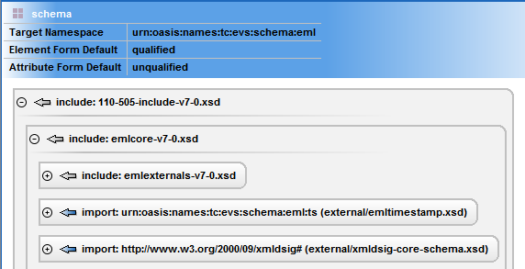
EML Schema Common Construct
Namespace declarations
Shared functional components
Universal core components
External functional components

Slide 17
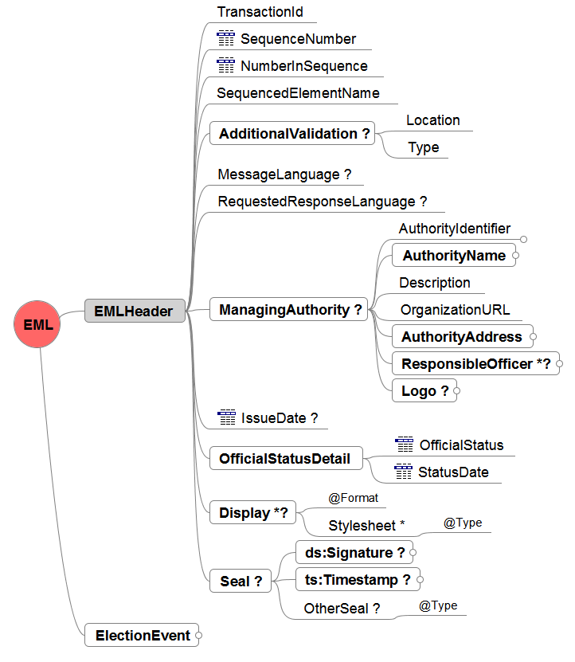
EML Schema Header Construct
Packaging
Optional CAM rules, XSLT, etc
Internationalization
Responsible authorities and authenticity
Versioning control
Rendering support
Verification and Security
Payload

Slide 18
EML dictionary and Models
Modelling tools available and Vocabulary alignment

Slide 19
EML dictionaries
Two dictionaries
  EML Core components
  Complete EML component reference
Can be viewed as Excel spreadsheet
Available as mind map models and XMI/UML physical components

Slide 20
Vocabulary Alignment
Definitions of EML Core components
  Significantly improved in V7
Not everything is documented in all schema – still more work needed to close the gap
Focus on providing essential definitions for UOCAVA mapping purposes

Slide 21
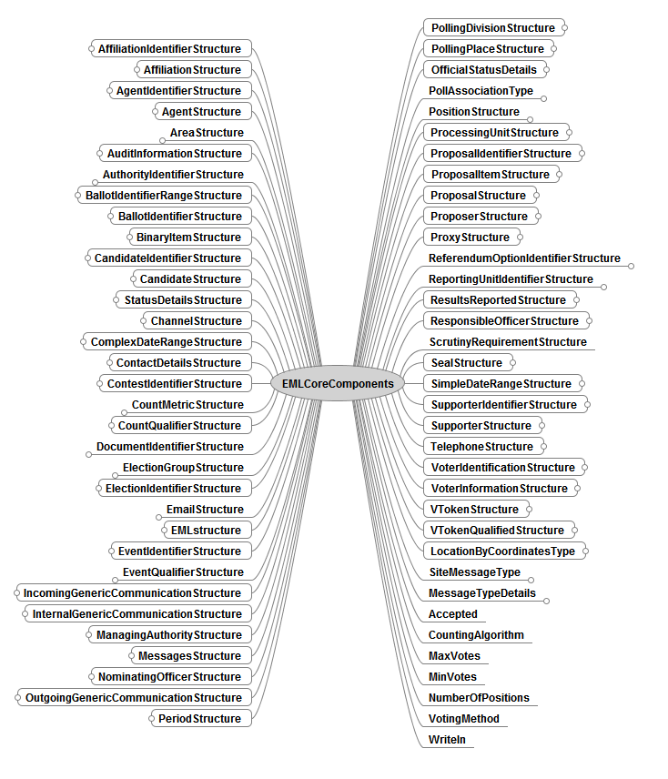
EML Core V7

Slide 22
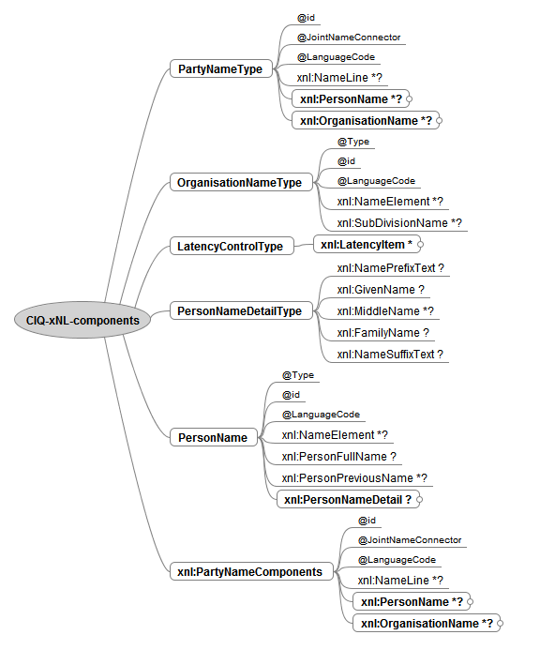
Person Name

Slide 23
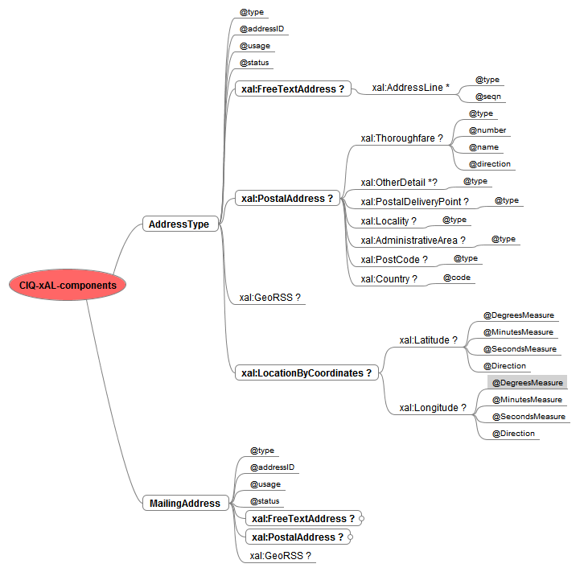
Address

Slide 24
The SEAL Structure
An EML element for holding digital signatures, i.e., for signing the EML file.
Based on W3C guidance for digital signatures.
The Manifest element can hold hash of objects referenced in <URL> element, e.g., a PDF ballot – to allow authentication of ballot binary objects and their correct delivery
Conformance requires ability to use a SEAL with EML transactions
See W3C documentation and links to NIST web site in P1622 specification for using digital signatures

Slide 25
EML Schema for UOCAVA
Drill-down of the structure of the EML transactions and their details

Slide 26
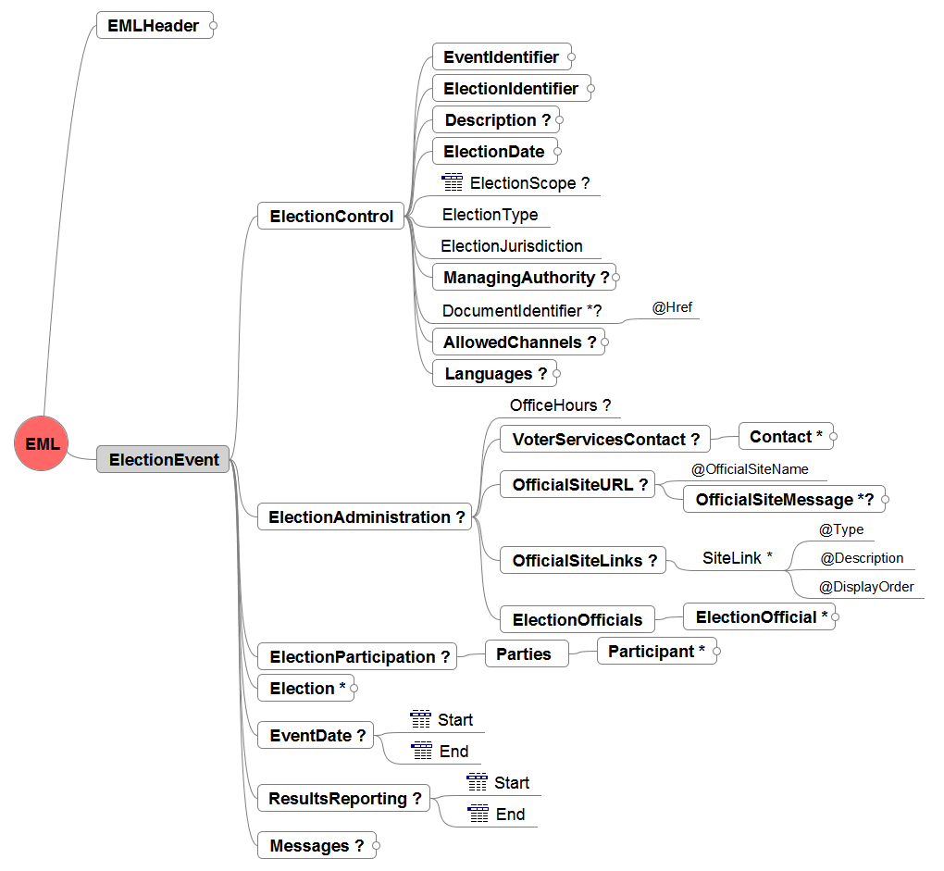
Election: EML 110

Slide 27
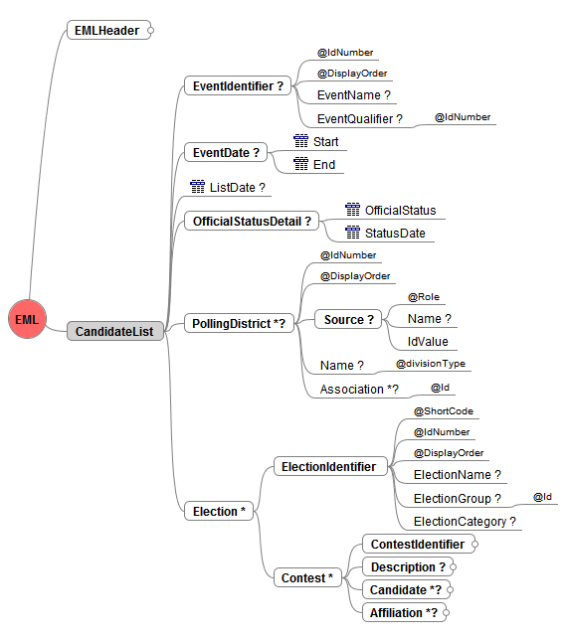
Candidates: EML 230

Slide 28
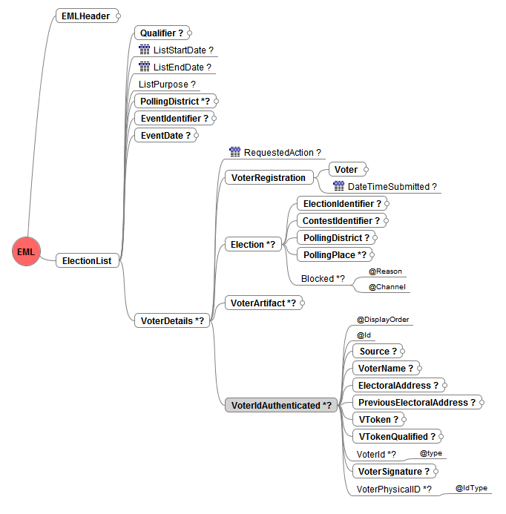
Voters: EML 330 (aka poll book)

Slide 29
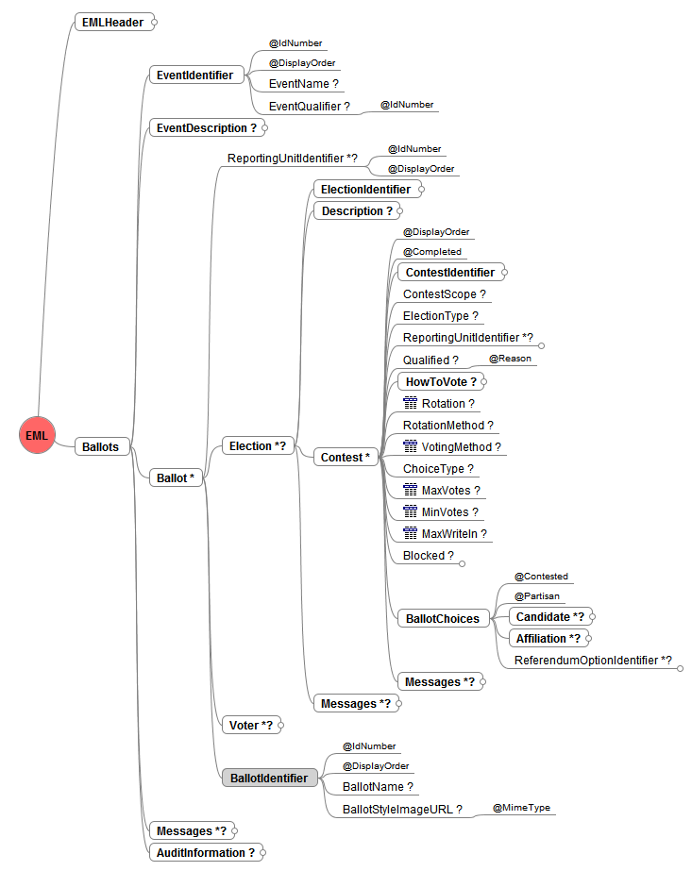
Ballots: EML 410

Slide 30
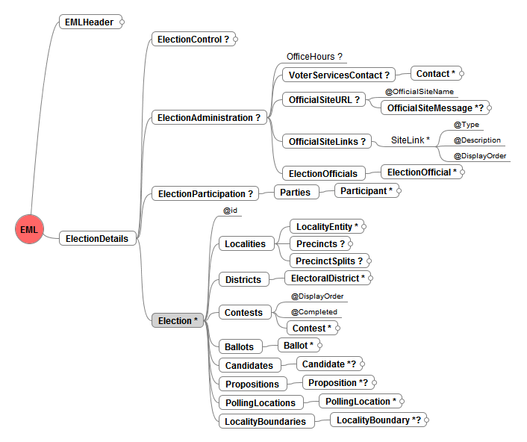
UOCAVA: EML 505

Slide 31
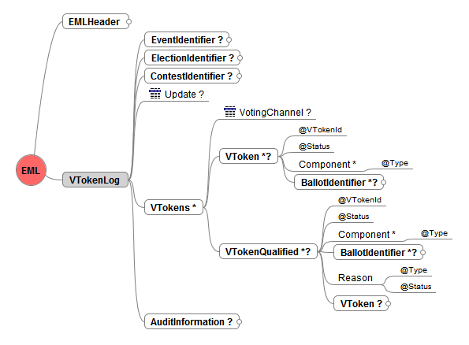
VToken: EML 470

Slide 32
Using OASIS CAM templates
Power tools for assembling XML transactions, examples, models, documentation, dictionaries and more…

Slide 33
Beyond XML and Schema
OASIS CAM templates provide enhanced capabilities:
  XPath validation rules and logic
  External Code Lists support
  SQL database lookup support
  XML test case generation
  Automated documentation generation
  Generation of models

Slide 34
Dictionary Tools
Ability to work with dictionaries of canonical components
Generate dictionaries from schema automatically
Verify dictionaries and component consistent
Compare to NIEM naming and design rules (NIEM NDR)

Slide 35
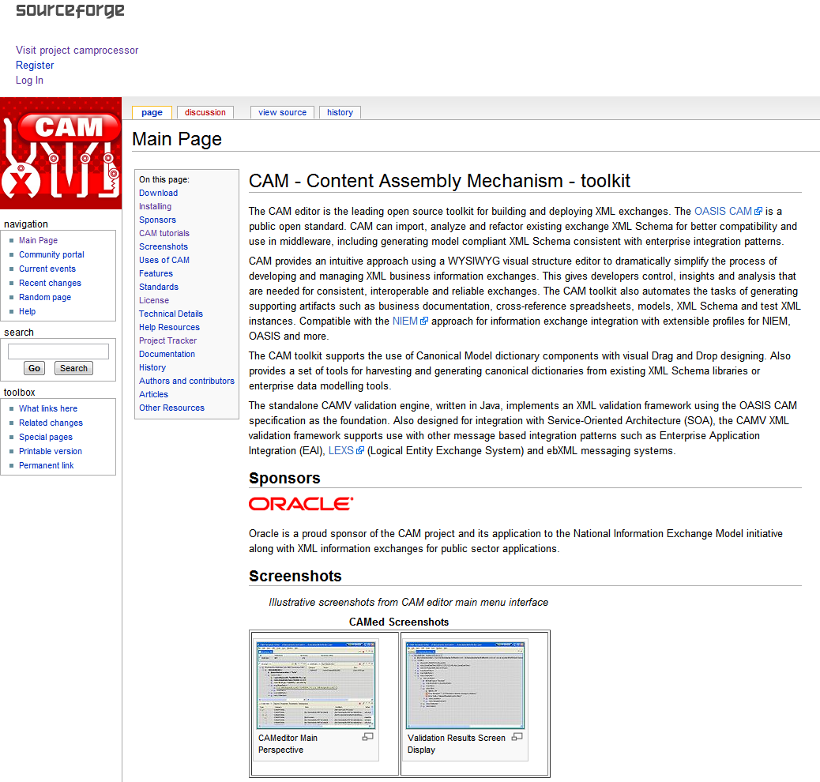
Available open source tools
Editor and CAMV validation engine – open platform
Download the CAM editor toolkit from:
http://www.cameditor.org

Slide 36
Using EML Test Suites
Accelerating conformance testing and examples verification

Slide 37
Test Suites Introduction
A key need in working with XML information exchanges, is developing examples and matching templates including rules, context, and roles for correctly managing information exchange content between partners. The W3C Schema by themselves are not sufficient.
Using open source tooling, XPath rules, and the OASIS CAM templates standard to create automated testing tools.
Integrating SQL table lookup validation rules
Ability to use external XML code list lookups
Pre-configured test suite available for EML UOCAVA examples:
  http://www.cameditor.org/#CAMV_Testing

Slide 38
EML Delivery Lifecycle
Component Dictionary
EML Schema Templates
Open source toolkit sponsored by Oracle
EML standard
updates
Design
Monitor
Map and
Test
EML Template
XML Samples
Deploy
XSD Schema
Test Suite
Log Results
XMI / UML Models
Compiled
Templates
Documentation

Slide 39
CAM Validation Framework
Structure
Rules
Code Lists
SQL Query
CAMV
XML instance
Database Lookup (optional)
Results XML
Template (compiled)
Java Handler Errors and Warnings

Slide 40
CAMV / ANT Test Suites Environment
CAM template
CAMV Control Script XML
Reports
XML Test
Instances
XSLT
ANT
2
XML Validation
Results
1
CAMV
Examples and instructions:
http://www.cameditor.org/#CAMV_Testing

Slide 41
CAMV Test Control Script XML
Multi-Test Folder Example
Test case name
<camvTestSuite>
<testCase>
<Example-Test-With-Folder>
<cxxfile>../samples/templates/EML-330-list-v7.cxx</cxxfile>
<testdir>../samples/XMLsamples/UOCAVA/330</testdir>
<verbose>true</verbose>
<inlineErrors>true</inlineErrors>
<parameters>
<abc>Param1</abc>
<cde>Param2</cde>
</parameters>
</Example-Test-With-Folder>
</testCase>
</camvTestSuite>
Validation Template
Test XML instances folder
Optional items

Slide 42
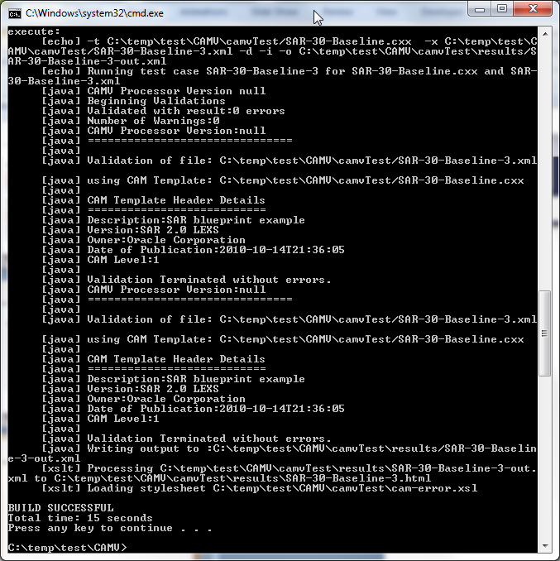
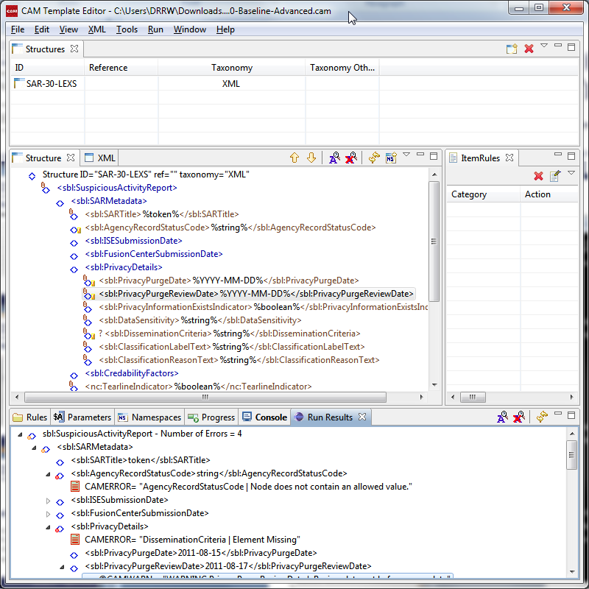
Running CAMV details
Batch Command Line Execution Window
Viewing Same Template in Visual Editor
From within the Test Suite folder on the command line execute > Ant runALL

Slide 43
Summary
OASIS EML V7.0 provides comprehensive standard for UOCAVA elections management and services
Complete suite of supporting tools available to assist implementers
  Dictionaries and Models for data alignment
  Test suite tools for accelerated verification
  Examples to guide usage
Open source and online resources
  http://www.cameditor.org & http://www.oasis-open.org

