Slide 1


NASA and Green Engineering
Ted Biess
January 18, 2012

Slide 2
Sustainability and Green Engineering
Sustainability
NASA's sustainability policy is to execute NASA’s mission without compromising our planet’s resources so that future generations can meet their needs. Sustainability involves taking action now to enable a future where the environment and living conditions are protected and enhanced.
Green Engineering
Green engineering is the design of materials, processes, systems, and devices with the objective of minimizing overall environmental impact over the entire life cycle while also meeting required performance, economic, and societal constraints.
Other Terms
Design for Environment
Life Cycle Approach
Green Chemistry
Ecodesign
Cradle to Cradle Design
Sustainable Design
Common theme – environment is considered within the design process

Slide 3
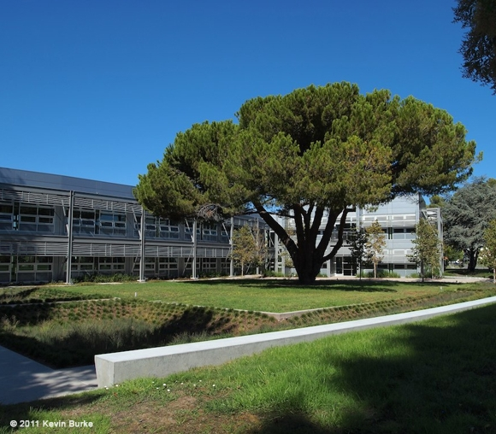
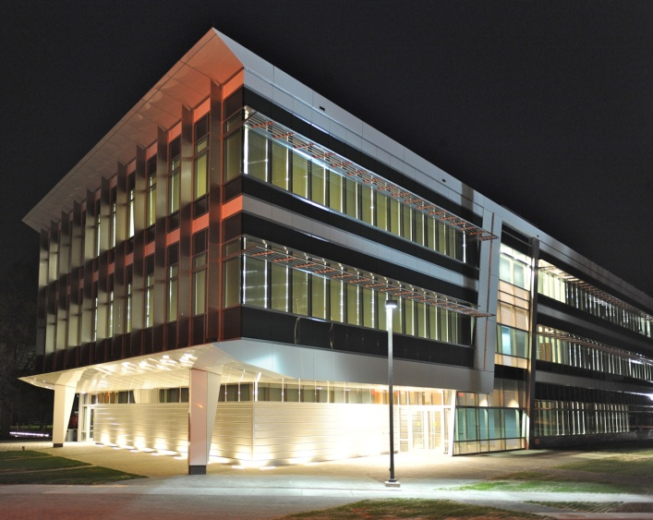
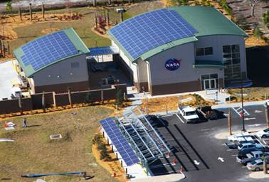
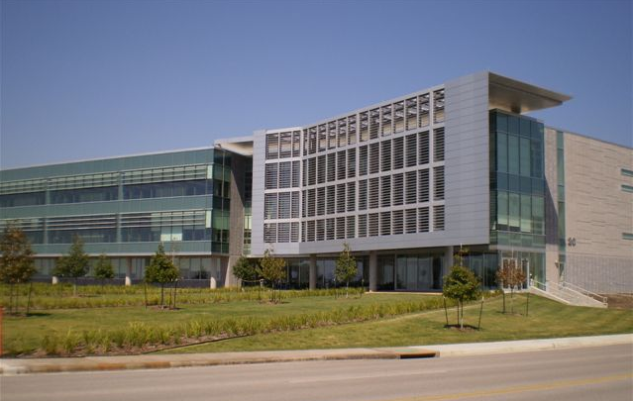
NASA Sustainable Facilities
Replacing aging, costly facilities
  Modernize
  Consolidate
  Improve efficiency
1,492,221 sf of sustainable facilities
  (Sept 2011)
1 Net Zero Energy Facility
Sustainability Base, ARC
Propellants North, Net Zero
Energy Facility, KSC
Consolidated Office Building, JSC
“New Town” Office Building, LaRC

Slide 4
Evolution of Environmental Requirements
Increased regulation means increased operational restrictions, mandated controls, cost uncertainty, and schedule delays

Slide 5
Highest Leverage is Early in Design
Lifecycle Cost
Operations and Support
System Acquisition
$
Production
System R&D
100
95
Lifecycle cost locked in
85
70
Lifecycle cost expended
50
Disposal Cost?
10%
60%
10
30%
Time
Concept Exploration
Production and Development
Initial Operational Capability
Out of Service
Concept and Validation
Full Scale Development
From W. J. Larson & L. K. Pranke (1999) Human Spaceflight: Mission Analysis and Design

Slide 6
Reconciling Mission and Environment
Traditionally, we have looked at…
Risks posed by the Program to the environment
Identified under NEPA through the Environmental Impact Statement (EIS) process prior to Program inception
The EIS describes programmatic options and addresses environmental considerations associated with each

Slide 7
Reconciling Mission and Environment
Now and in the future, we will need to look at…
Risks posed by the Program to the environment
Identified under NEPA through the Environmental Impact Statement (EIS) process prior to Program inception
The EIS describes programmatic options and addresses environmental considerations associated with each
Risks posed to the Program by environmentally-related drivers
Real-time risks from a new environmental driver
Real-time risks from configuration issues/changes that trigger an existing driver
Mission success is always the main driver within decision-making.

Slide 8
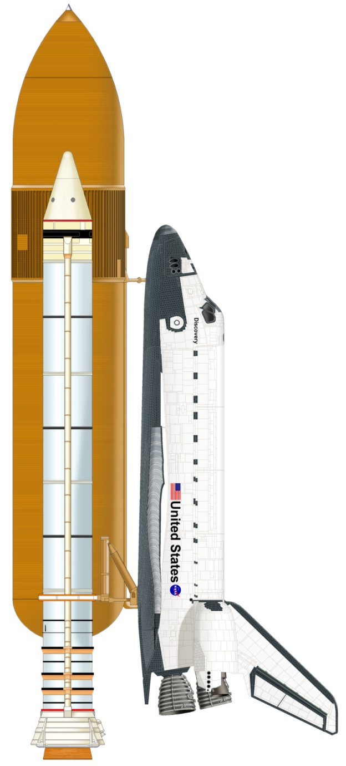
NASA Programs Impacts – Materials Obsolescence
Partial List of Materials and Processes of Concern
Shuttle elements where HCFC 141b was used
Trichloroethane
Precision Cleaning and Cleanliness Verification Processes Requiring ODSs (HCFC 225 and HCFC 225g)
TPS and Cryoinsulation Containing ODS (HCFC 141b)
Chromate Primers
Cadmium Plating
Hexavalent Chromium Conversion Coating
Paint Strippers Containing Methylene Chloride
Lead Based Solid Film Lubricants
Paints Containing Perchloroethylene
High-Level Volatile Organic Compound (VOC) Coatings
Alkaline Cleaners Containing Hexavalent Chromium
Hazardous Air Pollutant (HAP) Inks
Methyl Ethyl Ketone
Materials and Products Containing Perfluoroalkyl Sulfonates
Materials Containing Brominated Flame Retardants
Materials Requiring Perfluorooctanoic Acid (PFOA)
RSRM
External Tank
Orbiter - Main Propulsion System, Power Reactant Storage and Distribution System
30 years of service!
Notes:
30 years and 99 days

Slide 9
NASA Program Manager’s Focus –
Cost, Schedule, and Performance
Cost
Performance
Schedule
Notes:
We no longer hear ‘Better, Faster, Cheaper’ at NASA

Slide 10
NASA Program Manager’s Focus –
Cost, Schedule, and Performance
…
and Risk
Cost
Risk:
Material scarcity
Rare earths
Market pressures
Energy costs
Performance
Schedule
Risk:
Lack of material pedigree
Operational uncertainty
System failures
Risks:
Material qualification
Environmental compliance requirements
Waiver processing
The goal is to mitigate Cost, Schedule and Performance Risks through use of Green Engineering principles and methods.
Notes:
We no longer hear ‘Better, Faster, Cheaper’ at NASA

Slide 11
Draft Green Engineering Goals
1
Reduce Regulatory-Driven Risks to Mission. Ensure programs, projects, and mission support functions are able to meet their goals, objectives, and requirements without undue impacts from environmental and energy laws and regulations (US and international).
2
Reduce Health Risks to the Public, NASA Employees, and Support Contractors. Assess/analyze where toxic materials and hazardous processes create the greatest risks to the public, NASA employees, and support contractors, and minimize/mitigate these risks.
3
Communicate and Educate. Help NASA personnel understand, apply, and share green engineering techniques, methodologies, and tools.
Inspire, Motivate, and Incentivize. Facilitate a change in NASA's culture; managers, engineers, and designers start to ask each other questions about where the products originate, how much energy it uses, what materials it is made of, and where will it go after it is used.
4
5
Build Technical Capacity/Improve Decision Making in System Development. Promote the adoption, facilitate the use, and expand capability to apply green engineering methodologies within decision-making.
6
Supply Chain. Influence procurement actions and suppliers.
7
Progressive Policies. Improve and enhance NASA policies.
8
Collaborate and Share Resources. Collaborate and team with national and international organizations that use green engineering within the design and development of engineered systems - similar to those developed by NASA.

Slide 12
Green Engineering Course
Learning Objectives. After completing the course, students should be able to:
Identify and communicate NASA engineering challenges with respect to environmental impacts as well as future risks, requirements, and potential solutions
Explain the different phases for a product, process, or system over its entire life cycle and give examples of potential environmental impacts and risks in each
Design and develop materials, products, processes, hardware, and systems that are inherently safer, generate less waste, and use energy efficiently
Minimize impacts associated with environmentally-driven risks, especially through an understanding of policies, regulations, and other external requirements (US and international)
Course: 3-day survey course taught at the NASA Centers
Instructor: Dr. Sean McGinnis - Director – Virginia Tech Green Engineering
Sponsors: Office of the Chief Engineer and Environmental Management Div.
First course offered in January 2011; 5 offerings so far.

Slide 13
Design Changes Provide Most Significant Changes in Environmental Impact
IMPACTS
Atmosphere:
Global Warming
Ozone Depletion
Smog Formation
Acidification
Human Health
Hydrosphere:
Eutrophication
Acidification
Aquifer depletion
Ecotoxicity
Human Health
Biosphere:
Soil depletion
Deforestation
Resource Depletion
Ecotoxicity
Human Health
Design
Manufacturing
Inputs
Materials
Chemicals
Energy
Water
Outputs
Products
Solid Waste
Liquid Waste
Gaseous Waste
Heat
Extraction
Use
Disposal
Green Engineering is better design.
Results of LCA and other tools should influence decision-making in design.
Notes:
Move Upstream To Reduce Impacts

Slide 14
The Twelve Principles of Green Engineering
Inherent Rather Than Circumstantial. Designers need to strive to ensure that all materials and energy inputs and outputs are as inherently nonhazardous as possible.
Prevention Instead of Treatment. It is better to prevent waste than to treat or clean up waste after it is formed.
Design for Separation. Separation and purification operations should be designed to minimize energy consumption and materials use.
Maximize Efficiency. Products, processes, and systems should be designed to maximize mass, energy, space, and time efficiency.
Output-Pulled Versus Input-Pushed. Products, processes, and systems should be "output pulled" rather than "input pushed" through the use of energy and materials.
Conserve Complexity. Embedded entropy and complexity must be viewed as an investment when making design choices on recycle, reuse, or beneficial disposition.
Durability Rather Than Immortality. Targeted durability, not immortality, should be a design goal.
Meet Need, Minimize Excess. Design for unnecessary capacity or capability (e.g., "one size fits all") solutions should be considered a design flaw.
Minimize Material Diversity. Material diversity in multicomponent products should be minimized to promote disassembly and value retention.
Integrate Material and Energy Flows. Design of products, processes, and systems must include integration and interconnectivity with available energy and materials flows.
Design for Commercial "Afterlife". Products, processes, and systems should be designed for performance in a commercial "afterlife."
Renewable Rather Than Depleting. Material and energy inputs should be renewable rather than depleting.
* Anastas, P.T., and Zimmerman, J.B., "Design through the Twelve Principles of Green Engineering", Env. Sci. and Tech., 37, 5, 95 ? 101, 2003.
Notes:
* Anastas, P.T., and Zimmerman, J.B., "Design through the Twelve Principles of Green Engineering", Env. Sci. and Tech., 37, 5, 95 ? 101, 2003.

Slide 15

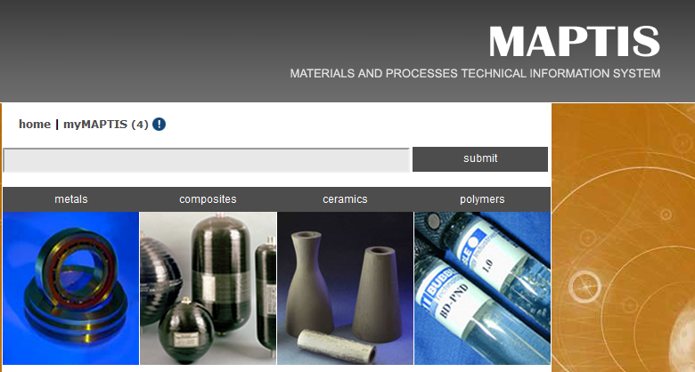
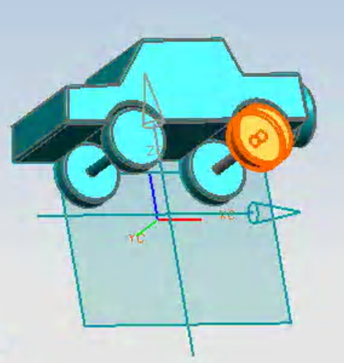
NASA’s Materials Management Tool
NASA’s Materials Science & Materials Engineering Portal:
used to locate design problems before they become product problems.
used to find the right materials and the right manufacturing processes for the right applications and to give the right performance to minimize or eliminate human health and environmental impacts.

Slide 16
Understanding and Managing Regulatory Risk
Mission. Regulatory Risk Analysis and Communication Principal Center (RRAC) provides centralized, agency-wide leadership and management of NASA’s environmental regulatory change management process with an overarching goal to reduce mission risk and reduce life-cycle cost for all NASA efforts.
Supports NASA Programs and Projects by:
Monitoring emerging regulatory changes
Identifying and communicating potential adverse impacts
Assisting in developing risk mitigation options
Advocating for program concerns and facilitating negotiations with regulatory agencies
Obtaining/maintaining regulatory exemptions & waivers, as required
*RRAC PC = NASA Principal Center for Regulatory Risk Analysis and Communication

Slide 17
EU Regulation - Registration, Evaluation, Authorisation, and Restriction of Chemicals (REACH)
Description | Potential Element/Process Impacts
European Union regulation to track or control >30,000 substances Affects global supply chain, limiting availability of Substances of Very High Concern (SVHCs) Substances considered for restriction & possible authorization on a continuing basis Similar actions underway in Asia | Formulation changes could be unannounced or not assigned new stock numbers Substances listed as SVHCs that may be restricted: Hydrazine (propellant) Trichloroethylene (LOX cleaning) Several chromates (corrosion inhibitors) Several phthalates (used in many nonmetallics and elastomers) Many others…
Timing |  | Possible Mitigation Actions
Ongoing | Process of addition and evaluation substances; additions to lists for authorization or restriction | Review SVHC list periodically to be aware of specific obsolescence risks Strengthen communication pathways with suppliers of critical materials Consider fingerprinting critical materials at risk of unannounced reformulation

Slide 18
Evaluating Technical Solutions to Environmentally-Driven Risks
Mission. The Technology Evaluation for Environmental Risk Mitigation (TEERM) Principal Center limits risk to NASA’s mission caused by environmental drivers.
Method. Projects and activities are designed to evaluate, in an unbiased fashion, technological solutions to environmentally-driven risks impacting NASA customers.
Focus Areas
Materials Management and Substitution
Recycling and Pollution Control Strategies
Remediation and Cleanup
Renewable and Alternative Energy
Adaptive Response to Climate Change
Typical Projects
evaluate hexavalent chromium-free coatings
evaluate lead-free solder alloys in electronics
evaluate zinc-free coatings on various surfaces of live launch pads
evaluate isocyanate-free , low-VOC coatings

Slide 19
Benefits of Embracing Green Engineering
Reduced health risk for NASA employees and contractors
Less risk for operations and maintenance
Reduced life cycle costs
More robust systems
Increased public buy-in for NASA mission
Incentive for new employee recruitment
Opportunities for innovation and greater creativity

Slide 20
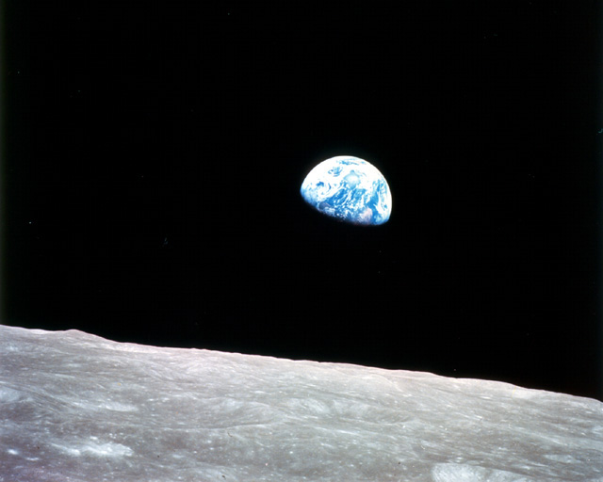
Ted Biess
Theodore.Biess-1@nasa.gov
(202) 358-2272

Slide 21
BACKUP

Slide 22
NASA Mission
Drive advances in science, technology, and exploration to enhance knowledge, education, innovation, economic vitality, and stewardship of Earth.
Goal 1: Extend and sustain human activities across the solar system.
Goal 2: Expand scientific understanding of the Earth and the universe in which we live.
Goal 3: Create the innovative new space technologies for our exploration, science, and economic future.
Goal 4: Advance aeronautics research for societal benefit.
Goal 5: Enable program and institutional capabilities to conduct NASA's aeronautics and space activities.
Goal 6: Share NASA with the public, educators, and students to provide opportunities to participate in our Mission, foster innovation, and contribute to a strong national economy.
Notes:
This is the mission of NASA. The fun stuff.
This list does not contain anything about sustainability or green engineering.

Slide 23
International Influences on Material Selection and Availability
Multilateral Environmental Agreements (MEAs)
Persistent Organic Pollutants (POPs)
Long-Range Transboundary Air Pollution (LRTAP)
European Union
Registration, Evaluation, and Authorization of Chemicals (REACH)
Restriction of Hazardous Substances (RoHS)
Waste Electrical and Electronic Equipment (WEEE)
Asia
Emerging RoHS-like laws in China and Korea
International regulations and agreements can impact availability of materials in the US.

