Slide 1
The Science of Color
Science Afternoons at NIST
November 14, 2011
Toni Litorja
Research Chemist
Optical Radiation Group
Sensor Science Division, Physical Measurements Laboratory
National Institute of Standards and Technology
Notes:
This is narrow in scope, touching only color vision. It does not touch on other aspects of vision such as stereo vision and depth perception and motion. As far as optical phenomena, this is mainly about reflectance and absorbance and does not touch on other aspects such as scattering, polarization and other interesting optical phenomena. That will be a topic for another day.

Slide 2
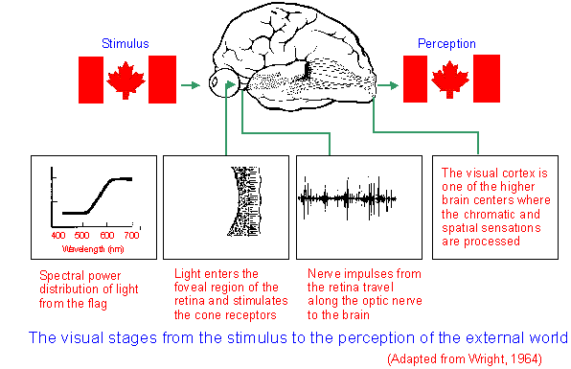
What is Color?
Source of figure: http://www.yorku.ca/eye/thejoy.htm
Notes:
Color is a property of the light stimulus. It enters through the eye, and its spectral property is sensed by the photopigments in the retina, transformed into electrical signals which is then processed by the brain.

Slide 3
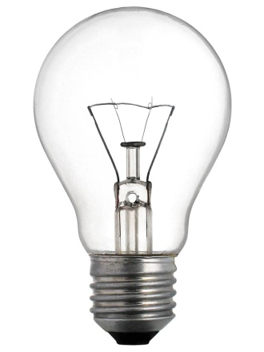
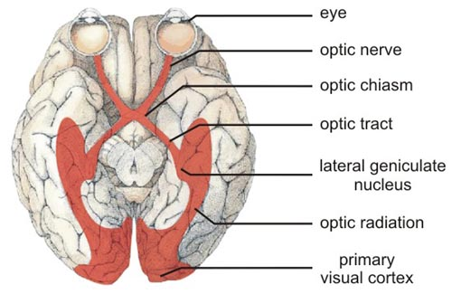
“Color Science” by Wyszecki & Stiles (1982)
Color is that aspect of visual perception by which an observer may distinguish differences between two structure-free fields of views of the same size and shape, such as may be caused by differences in the spectral composition of the radiant energy concerned in the observation.
The perception of color requires:
Light
The human visual system
Notes:
There are two requirements for perceiving color—light and the human visual system consisting of the eye and the brain.
Photometry—branch of science dealing with light measurements strictly in that human visual range of 380-720 nm

Slide 4
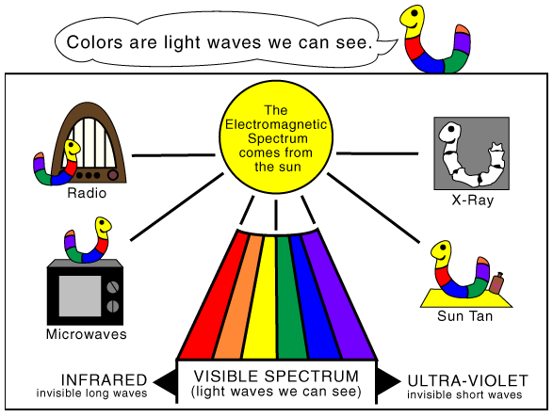
Visible Light
Notes:
That portion of the electromagnetic spectrum which we can “see” is called the visible region of the spectrum. There are other regions (wavelengths) that we use in everyday living other than the visible region.

Slide 5
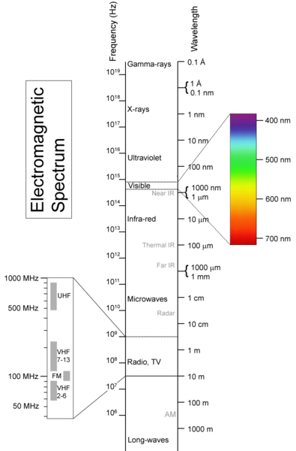
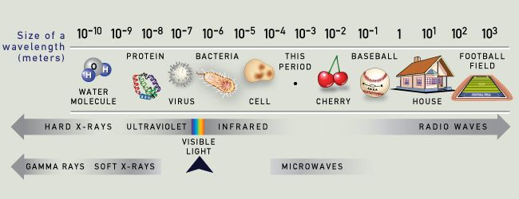
The electromagnetic spectrum
http://www.webexhibits.org/causesofcolor/1.html
The “optical or visible light spectrum” is the range 380-720 nm
http://en.wikipedia.org/wiki/Electromagnetic_spectrum
Notes:
Here are two representations of the electromagnetic spectrum (lifted from web sources). The visible region is a very small slice of the whole spectrum.

Slide 6
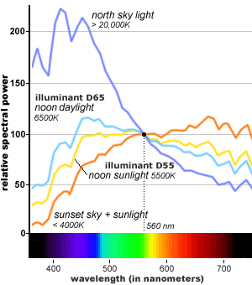
Spectral Power Distribution
How light varies with wavelength is called spectral power distribution
Notes:
From here on, you will see many graphs presented in the manner: with wavelength on the X axis and some measure of light on the Y axis—this may be intensity, radiance, luminance, power. The latter are various units of light measurement.

Slide 7
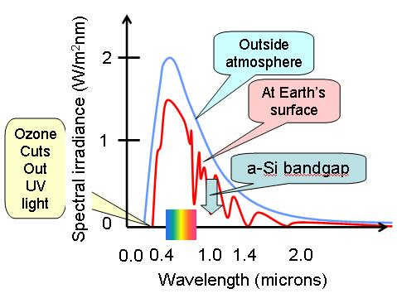
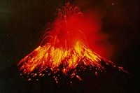
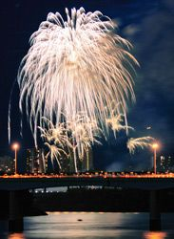
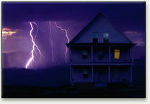
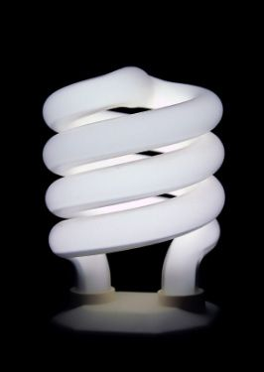
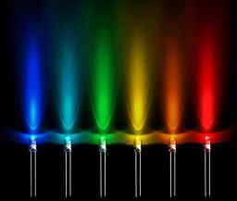
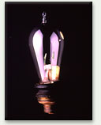
Different Light Sources
The Sun
Chemical reactions
Rocks at high temperatures
nanopedia.case.edu/image/solar.spectrum.jpg
Fluorescent lamps
Light emitting diodes (LED)
Edison light bulb
Electric field excites the gas inside the bulb. Upon relaxation, photns are released. These strike the fluorescent coating to produce white light
Electrons and holes created by an electric field in a semiconductor material recombine to produce light
Filament in vacuum emits light when heated
Notes:
These are illustrations of various common light sources. The sun is our main source of light. The amount of light that the earth receives is called the solar constant—it is about 1367 watts per square meter.
Other sources are produced from incandescence, such as in molten rock (volcanoes) where the rock at high temperature gives off its thermal energy in radiative form. Lightning and fireworks give off light from the interaction between electric field and gas molecules. We have harnessed these concepts in the form of the incandescent light bulb where a metal is heated to very high temperature and it gives off light as it reaches a certain temperature. Fluorescent lamps give off light from the interaction between the electric field and the mercury vapor inside the tube. Newer lighting called light emitting diodes or LEDs are produced from semiconductor materials. An electric field induces electrons to migrate, leaving “holes” (the region the electrons vacated). When these come back together, light is emitted.

Slide 8

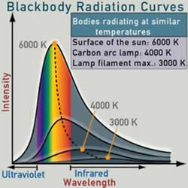
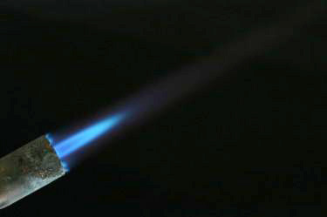
Color Temperature
Color Temperature—a numerical description of the light color (red-hot, blue-hot)
Expressed in Kelvin units
Common labels:
Color Temperature
Color coordinated temperature
CCT
Incandescent light bulb: 2700 K
LED lamps: 5000 K
Oxyacetylene torch flame,
>3000 ° C
Note that our everyday description:
Warm lighting—tends towards red
Cool lighting- tends towards blue
…is opposite to the spectrum!
Planck’s radiation law
Notes:
Color temperature is a metric used to describe the color of the light. It is expressed in units of Kelvin (temperature). This is from Plank’s law of radiation. Matter emits radiation and the peak wavelength at which it emits is called the color temperature. You have seen the thermal imagers that firefighters use, or the ear thermometer! These work in that principle of emission of light. These just happen to be in the infrared (8000 nm to 14,000 nm for thermal imagers) and the color temperature of the objects is at ambient.

Slide 9
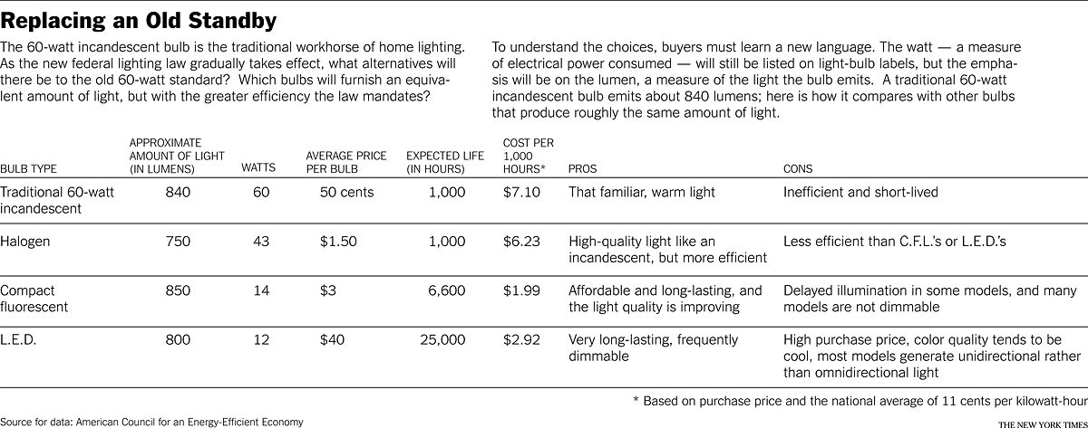
Common Light Sources in the Market
http://www.nytimes.com/2011/08/11/garden/almost-time-to-change-the-light-bulb.html?pagewanted=all
Notes:
This is just from a news article. As you can see, the new metric for light sources is lumens rather than watts. So when you buy bulbs, you compare their lumens output.

Slide 10
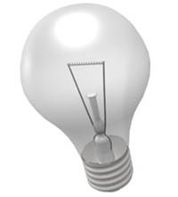
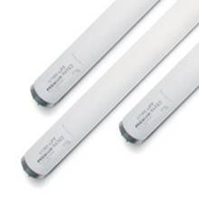
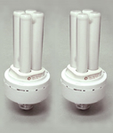
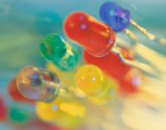
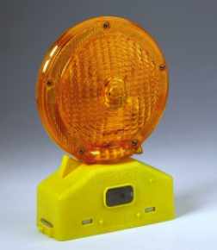
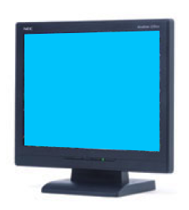
Colorimetry of Light Sources
All light sources:
Chromaticity coordinates (x,y), (u’, v’)
White light sources:
Correlated color temperature T_{c}(K)
Distribution temperature T_{d}(K)
Color Rendering Index (CRI)
Narrow-band sources (LEDs):
Dominant wavelength λ_{d} (nm)
Notes:
This slide just shows the measurement of light sources that industrial producers have to comply. Color temperature of most bulbs are 2700 K for incandescent, about 4000 K for a computer monitor, 6000 K for the sun. Color rendering index is a measure of how well a light source performs against standard color patches. A rating of 80 and above is good. That yellow parking light has very poor color rendering index– it takes you a while to recognize your car.

Slide 11
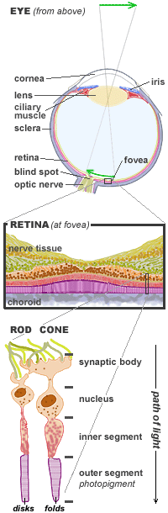
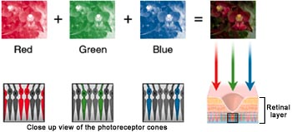
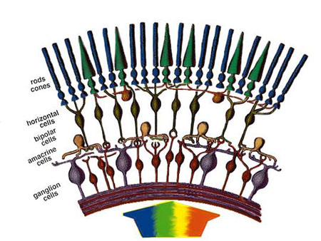
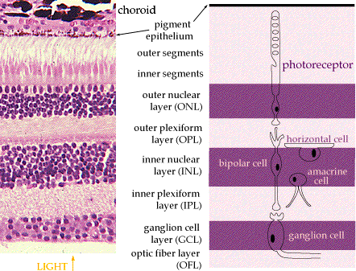
The Human Eye
Reproduced from www.handprint.com
The seven layers of the retina
Notes:
These are illustrations of the anatomy of the eye and some basic mechanism of how light is received. It comes through the lens, focused into the retina (the screen at the back of the eye). The most sensitive portion is the fovea. It has a characteristic dip where it becomes very thin. There are three color sensitive cones for red green and blue. These are also called S M and L for short, medium and long wavelengths.

Slide 12
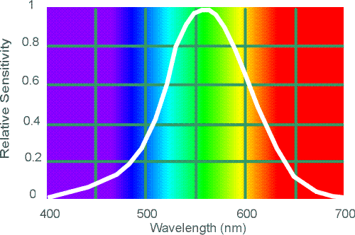
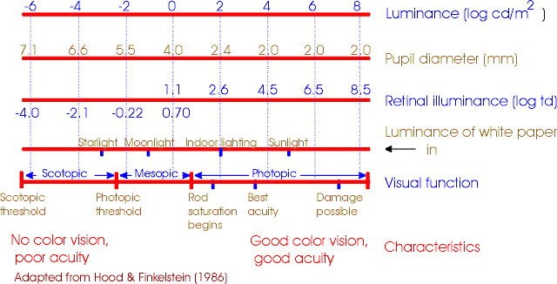
Color Sensitivity Characteristics
This is called the V-λ or photopic curve
Luminance levels of human vision
Notes:
The above curve is called the V lambda curve. This is the spectral sensitivity of the eye. This is the spectral characteristic of the filter they put in cameras to mimic the eye. The lower chart shows the sensitivity of the human eye. It has 14 decades of dynamic range (range of light levels at which it can sense light). Hence, we can see at night with very little light (scotopic vision).

Slide 13
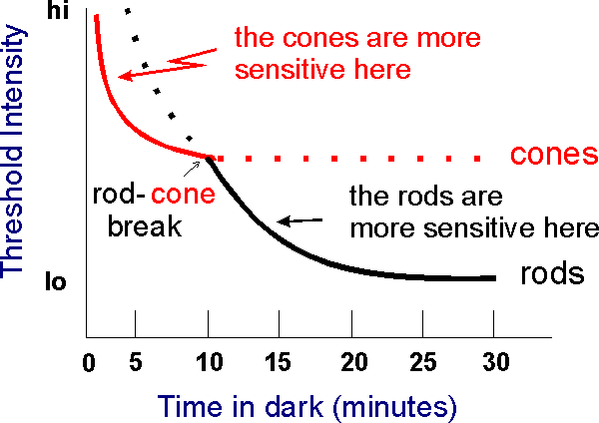
Notes:
This is an illustration of the sensitivities of the rods and cones—the light sensitive pigments in the eye.

Slide 14
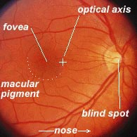
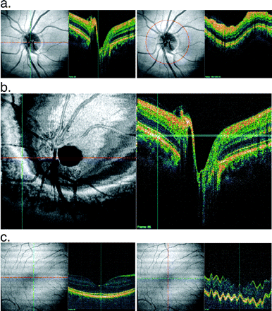
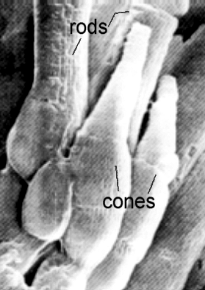
Image of the Retina
Image of the human eye retina by Optical Coherence Tomography
through a fundus camera
microscopic
Image of rods and cones
http://www.phys.ufl.edu/~avery/course/3400/vision/rod_cone_microscope.gif
Ishikawa, H. et al, IOVS, March 2009, Vol. 50, No. 3
Notes:
These are actual images of the retina. On the left is an optical coherence tomography image. The round disc is the optic disk. The lines radiating out of it are blood vessels. The false color images on the right of each image is a 2 dimensional slice showing the variation in depth or vertical axis. See that dip in the fovea (image c).
The other photo is from a fundus camera, such as what you get when you go to the eye doctor. Below on the right is a microscopic image of the rods and cones taken with an electron microscope.

Slide 15
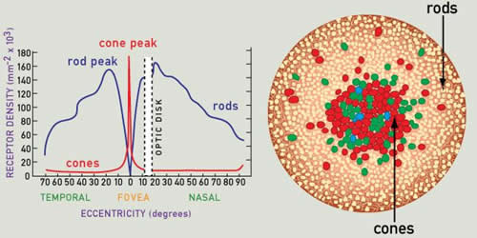
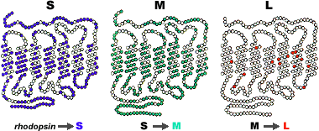
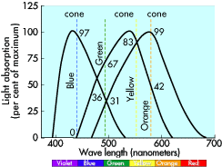
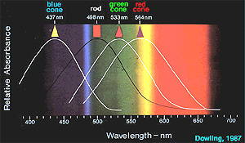
Biology of Color Vision
The cones in the retina are responsible for our response to color
Notes:
These are various illustrations of the color sensitivity of the cones. This is what is responsible for our color vision. There are millions of them surrounded by the rods. They are made of proteins called opsins and they vary slightly in chemical composition. The graphs show the spectral absorption characteristics of the three types of cones.

Slide 16
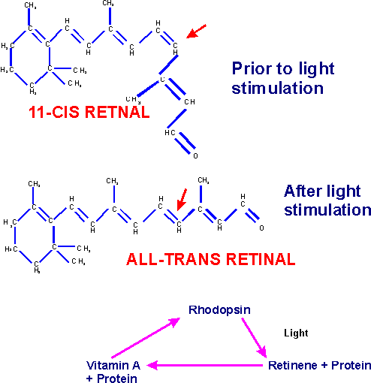
Biochemical Process of photopigment sensing light
Notes:
This is the portion of the protein showing what happens when light hits it. It changes from one structure to another. Eventually, it relaxes as the stimulus goes away.

Slide 17
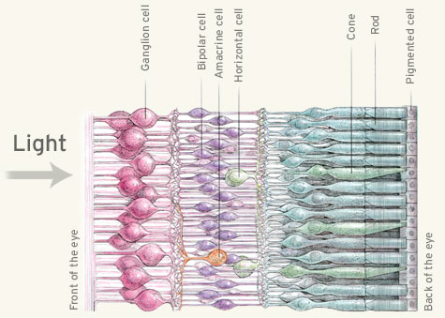
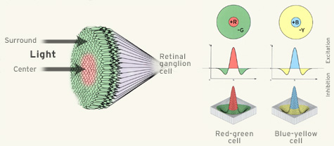
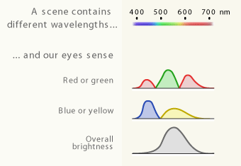
Ganglion cells compare signals from various cones
3 signals sent to the brain:
Amount of red-green
Amount of blue-yellow
Brightness (or luminance)
Notes:
This is an illustration of the mechanism of how we see color. There are millions of these cones. The other cells in the retina are responsible for the signal pre processing. The ganglion cells compare signals from various cones and so only three signals are sent to the brain—amount of red-green, amount of blue-yellow and the brightness of the light.

Slide 18
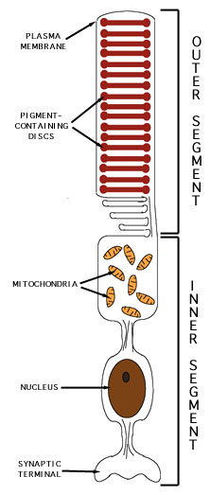
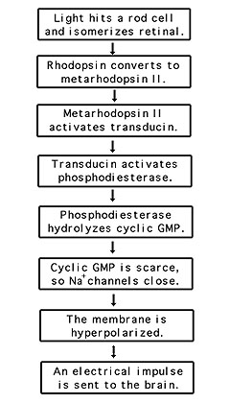
Signal Processing by the Brain for Color Vision
Figure 3 This is a schematic diagram of a rod cell. The stacked disks contain rhodopsin, the complex of opsin protein and 11-cis-retinal. At the synaptic body, the potential difference generated as the ultimate result of the retinal isomerization is passed along to a connecting nerve cell, creating an electrical impulse that will be transmitted to the brain and interpreted as visual information. | Figure 4 This is a flowchart outlining the major steps in the vision signal transduction cascade which occurs between the isomerization of retinal (which leads to the formation of metarhodopsin II, the first reactant in the process outlined in this figure) and the interpretation of a visual image by the brain. The steps in this cascade are discussed in the section entitled "Signal Transduction Cascade to Generate a Nerve Impulse", below.
Notes:
This is a figure showing how the signal is processed.

Slide 19

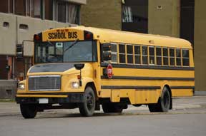
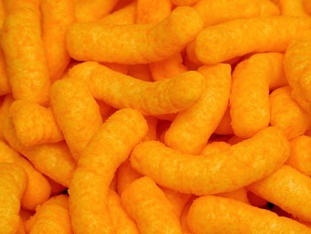
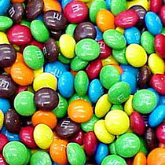
Measuring Color
Color
Color
Notes:
Most things produced commercially have reproducible color. Cheetos are always that shade of yellow, M and Ms are always those shades of color.

Slide 20
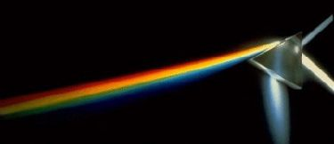
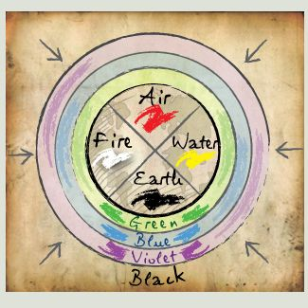
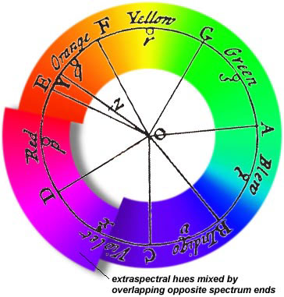
Color Theory
Aristotle developed the first theory of color
Newton’s experiment using prisms
http://www.webexhibits.org/causesofcolor/1B.html
Notes:
Aristotle formulated the first theory of color, to go with his elements. But it was Newton who introduced what we know as modern optics---that there was no such thing as colored light. He formulated the first color wheel, putting the red-violet to overlap the ends of the light spectrum. Many many researches from Newton to the 19th century studied light and what we know today is an agglomeration of all those contributions—too many to name. You will see many representations of the color wheel in science/philosophy history.

Slide 21
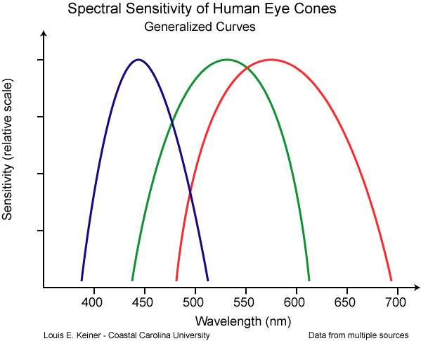
The Measurement of Color
Colorimetry- branch of color science concerned with specifying numerically the color of a physically defined visual stimulus
Principle of Trichromacy
(Grassman’s Laws)
There are 3 cone photopigments in the human retina
Any color can be specified with just three numbers
This is known from Color Matching Experiments (1850’s)
Three independent variables (tristimulus values) are necessary and sufficient to specify a color match.
Notes:
Colorimetry is that branch of science that specifies numerically the color of the visual stimulus. Grassman (1850s) formulated the Trichromacy laws—that we only need to know three numbers to specify a color. This was learned through Color matching experiments.

Slide 22
Color Spaces
follow Grassman’s laws.
Tristimulus
values
R, G, B
Continuous functions
are the color matching functions
Color is specified as a combination of the tristimulus values:
Notes:
This is just to show you the color matching functions. Color is a continuous function from 380 nm to 720 nm and a combination of the tristimulus values.

Slide 23
CIE 1931 XYZ Color Matching Functions
CIE 1931 Standard Colorimetric Observer
Tristimulus values
Notes:
This is the CIE Standard Observer. To standardize color and color measurement, a standards body, the CIE (http://www.cie.co.at/) created the Standard Colorimetric Observery. These are the graphs created for the standard observer. Although it has changed somewhat since 1931, this is basically what is used by industry to measure and produce color in lights and consumer products. Instead of humans, we now use cameras or light detectors using filters with these spectral curves.

Slide 24

CIE 1931 Chromaticity Diagram
Spectrum locus
Color mixing example:
if two points are connected by a line, any chromaticity that line passes through can be created by a mixture of the two endpoints.
Purple line
Encompasses all physically-realizable chromaticities
Notes:
This is called a chromaticity diagram for a light source.

Slide 25

Color Difference Measurement
Until ~1950’s, “experienced color matchers” were used for quality control of product color. The advent of color measuring instruments enabled automated systems to replace the human observer.
Complete automation was hampered by the lack of a reliable formula to correlate instrument readings with the observer’s visual judgments of color differences.
vs
Notes:
They used to use humans to do quality control on production of just about anything that had color.

Slide 26


Light Color vs. Object Color
}
Two-dimensional diagrams
Only for light color
No black, grey, or brown
Object color needs another axis: black—white
Object color needs a 3-dimensional diagram
Notes:
There are two charts for color—one for light sources and one for objects. Light color has only white in the middle and no black. The color chart or 3-dimensional color space for object color looks different from this.

Slide 27




Color Addition and Subtraction
Primary Colors of Light: Red, Green, Blue
Adding light colors generate new colors on the color wheel and becomes lighter as more color is added.
Additive mixing of colors is what is operational in any colored display device (TV, computer monitor)
Subtracting red, green and blue from white light gives you cyan, magenta and yellow. Mixing these colors gives you the colors on the color wheel. As you add more and more of cyan, magenta and yellow, the mixture turns darker towards black. This is operational in paints, pigments and printing.
http://www.webexhibits.org/causesofcolor/1BA.html
Mixing pigments and mixing light have very different color outcomes
Notes:
This is an illustration of color addition and color subtraction. For light, as you add colors, it becomes lighter because it becomes brighter. For pigments, as you add colors, it becomes darker because the pigments become thicker and the light coming out becomes weaker and weaker (hence goes towards black). This illustrates the principle behind computer and TV displays as opposed to printing and painting.

Slide 28

http://www.webexhibits.org/causesofcolor/1BA.html
Notes:
Mixing the same colors have different outcomes for light and pigments as they are additive and subtractive respectively.

Slide 29


Slide 30

Web Demo
http://www.michaelbach.de/ot/col_mix/index.html
Notes:
This is from Prof Bach’s website on color mixing. IT’s fun for kids to do. You can also do this with two flashlights with different cellophane colors for filters.

Slide 31

Why is a rose red?
Notes:
What we see as the color of an object is the light that that object did not absorb.

Slide 32


Color of Light + Color of Surfaces
NIST video on solid state lighting
http://www.youtube.com/watch?v=TjZwECokbwE
Notes:
Click on the youtube video to see the NIST video on color lighting.
The choice of the colors of the light source influences the color appearance of the object. Above are two light source spectral distributions and how the objects appear. On the left is a light source with equal distribution across the visible spectrum. On the right, the light peaks around 460 and 570 nm but no power in the other wavelengths. The same objects appear with different colors.

Slide 33


Object Color Measurement
Reflection =
S(λ) • R(λ)
Relative power
Relative reflection
Wavelength (nm)
Wavelength (nm)
S(λ)
or
R(λ)
(reflectance factor)
detector
Relative reflectance
sample
Wavelength (nm)
Notes:
The observed color of an object is a convolution of the light source distribution and the intrinsic color properties of the object itself.

Slide 34

CIE 1976 (L* a* b*) Color Space
(CIELAB color space)
: Object color
: White reference (perfect diffuser)
Illuminated by a reference source, typically Standard Illuminant D65 or Illuminant A (described later).
Notes:
This is the CIELAB color space (pronounced seelab) that many in the color industry use. Illuminant D65 is your typical computer monitor. Illuminant A is your standard incandescent light bulb. These are used as standard light sources.

Slide 35

Object Color Spaces
Three attributes of color are hue, chroma (saturation), and lightness, and are expressed in a three dimensional space.
To allow accurate specification of object colors and color differences, CIE recommended CIELAB and CIELUV in 1976.
white
Lightness
Chroma
Hue
black
Notes:
This is the object color space. Up and down arrows are for lightness and darkness, around the wheel is the hue (or what we refer to as color) and chroma is the saturation (shade).

Slide 36

Opponent-Color Theory
Three opponent channels:
black vs. white (luminance)
red vs. green
blue vs. yellow
-no perception of reddish-green or bluish-yellow
-opponent afterimages
Notes:
Opponent color theory was proposed by Hering.
The following slides are optical illusions examples that are catchy and fun to do. This illustrates how scientists developed the theory of trichromacy and opponent color theory—on how we perceive color.
The website of Prof Michael Bach is full of optical illusions. Each one tells you what to do, what to look for and a short explanation of what you’re seeing. Most of these examples explore what is called afterimage. We all experience this—when we turn off the light, we still see the image of the lightbulb after the light has gone off.

Slide 37

Complementary Afterimage
Notes:
Stare at the white dot on the left image then after 30 seconds shift your gaze to the black dot on the right and check. What do you see? You will see the complementary colors of the squares on the left.

Slide 38

Notes:
This is another example of complementary afterimage.

Slide 39

Chromatic Afterimage
Image from http://www.cybersisman.com/psych1a/unit6/unit6notes.html
Notes:
And another one

Slide 40

Hinton’s lilac chaser
http://www.michaelbach.de/ot/col_lilacChaser/index.html

Slide 41

http://www.huevaluechroma.com/033.php
Notes:
Fixate on the center of the wheel in A and shift to B. What do you see?
Then fixate on A again and shift to C. What do you see?

Slide 42

Chromatic Adaptation
Notes:
Look at this picture. The colors seem off.

Slide 43
Notes:
You may have heard the phrase “chromatic adaptation” tossed around before. I’ll show a demonstration, and then explain what’s going on.
Just fixate the center black dot during at the top of the slide. Then after 30 seconds, shift your gaze down to the photo.
****Quiet…just remind them to keep staring****
The photo should appear normal in coloration. That is because, during the adaptation period, the visual system accepted the blue on the left as “normal” as well as the yellow on the right.
The human visual is remarkably good at extracting the spectral content that does not change over space and time and considering it to be caused by the illuminant (and therefore a white surface within a scene would reflect that same spectrum). The really cool thing is that the visual system is then able to “subtract” the contribution of the illuminant from everything in the scene (thereby “discounting the illuminant,” as us vision folks tend to say). After such a subtraction all you’d be left with is the reflective properties of objects (which is what you want to know about in order to see colors). This is chromatic adaptation and it is why so many lamps are able to be good color renderers. Without this happening, every difference in lamp spectra would affect color perception.

Slide 44
Chromatic Contrast
Notes:
The chromatic saturation of the surrounding elements can influence a stimulus’ apparent color. For most people, the center square surrounded by the light blue appears darker than the center square surrounded by the bright blue. In reality, they are both identical.
Chromatic Induction
The actual color of a color may appear to change based on its surrounding colors.
Surrounding colors can influence the way you see a color. They can give the color the appearance of being tinged with the complementary hue of the surrounding area. Colors that are the same may appear to be different, and colors that are different may appear the same. The effect is called chromatic induction.

Slide 45

Notes:
The two inner squares are different shades of brown but we see them as the same because of the surrounding. Also an example of chromatic contrast.

Slide 46
Luminance Contrast
Notes:
Just like chromatic saturation and hue, the luminance of the surrounding elements can alter color perception.
Most people see the colors outlined by black lines to be brighter and more saturated.
In this display, the pink surrounded by dark grey appears bright and the pink surrounded by light appears dim to most people. They are, however, identical.
Painters and artists know this and are guided by these principles.

Slide 47

Check out the http://www.webexhibits.org/
Chapter on Color Vision and Art for various exhibits on contrast
Notes:
For more art and vision exhibits, check the website webexhibits.org. They have various sliders showing how contrast changes the way we perceive an object color.

Slide 48

Object Color and Spectra
http://www.art-si.org/
Demonstration of multispectral imaging
Light reflected from the painting is separated into bands using a liquid crystal tunable filter
Instead of conventional single point spectroscopy, one can see spectra of each pixel of the whole image
Notes:
Demo here: Access http://www.art-si.org/
Click on this link to see how a multispectral imager works. This is the new way to measure color of objects. It is also referred to as imaging spectroscopy.

Slide 49


Multispectral Imaging in Art
Multispectral Imaging of Paintings in the Infrared to Detect and Map Blue Pigments
Delaney, J.K. et al.
Visible image
Short wave infrared image
(Sackler NAS Colloquium) Scientific Examination of Art: Modern Techniques in Conservation and Analysis (2005)
Proceedings of the National Academy of Sciences (PNAS)
Notes:
This is from a special issue on Scientific Examination of Art in the Proceedings of the National Academy of Sciences. Scientists are studying the composition of pigments used in Old Masters artworks.
FIGURE 3 Vincent van Gogh’s La Mousmé (1888). (Left) Visible light image. (Right) Shortwave infrared spectral band ratio image creaed from two infrared composite images captured at 1.2 microns and at 1.6 microns. The bright areas are regions where the reflectance of the painting is higher at 1.6 microns than at 1.2 microns, and thus indicate both the probable presence of Prussian blue and where it occurs in high concentration within the painting. Each IRR composite comprises a mosaic of 24 flat-field-corrected images.
FIGURE 4 Multispectral image analysis of a detail of La Mousmé showing the presence of two different blue pigments. The multispectral image cube consists of 11 spectral bands from the visible through the SWIR. (Left) Visible color composite of spectral images obtained at 0.65, 0.55, 0.45 microns. Along the bottom, from left to right, are black and white reflectance standards (2 and 98 percent Spectralon standards) and blue pigment test panels: cobalt (two swatches), Prussian blue, and lapis lazuli. (Right) A. Plots of reflectance, derived from the multispectral images of the reference panels: high reflectance 98 percent Spectralon (open circles), cobalt blue swatch (solid blue diamonds), Prussian blue (solid black circles), and lapis lazuli (blue squares). The blue and black lines are scaled diffuse spectra. B. Plots of reflectance derived from the multispectral images of the sites 1 to 4 in the detail image. Sites 1 and 2 (black circles and triangles) are in the chair. Sites 3 and 4 are in the blue stripes on the blouse.
image (Figure 3) of La Mousmé. The image-derived spectra of the bright

Slide 50

Multispectral Imaging in Art
Through multispectral imaging, scientists uncover hidden drawings underneath what’s visible
Pablo Picasso
Le Gourmet, 1901
Chester Dale Collection
1963.10.52
http://www.nga.gov/resources/scienceresearch/analyticalimg.shtm
Notes:
Check on this link to view the movie of the multispectral images of this Picasso painting. One can see the drawings Picasso made that is underneath the visible painting.

Slide 51
Links and References
G. Wyszecki and W. S. Stiles, “Color Science: Concepts and Methods, Quantitative Data and Formulae,” John Wiley and Sons, New York, 1982.
http://www.yorku.ca/eye/thejoy.htm
http://www.imaging.org/ist/resources/tutorials.cfm
http://www.michaelbach.de/ot/
http://www.acnr.co.uk/pdfs/volume6issue2/v6i2visual.pdf
http://www.cis.rit.edu/mcsl/
http://www.webexhibits.org/about/about.html
http://faculty.washington.edu/chudler/eyecol.html
http://www.chemistry.wustl.edu/~edudev/LabTutorials/Vision/Vision.html
http://brainconnection.positscience.com/topics/?main=anat/vision-work
http://www.nytimes.com/2011/08/11/garden/almost-time-to-change-the-light-bulb.html?pagewanted=all
http://handprint.com/HP/WCL/color1.html#spectrum
http://www.huevaluechroma.com/061.php
http://webvision.med.utah.edu/

Slide 52
Introducing the topic of color
Start with art images (science of visual perception)
artwork, graphics, advertisements
concept of color wheel and color theory
history of pigments, artist’s views on color
http://www.art-si.org/
Start with “How Stuff Works” (physical science)
cameras and digital photographs
computer displays
color printers
how consumer products always have the same color (standards)
(e.g., buying paint to match what you want at Home Depot)
Start with Optical Illusions (bit of both)
  http://www.michaelbach.de/ot/
Notes:
Color is not a difficult topic to introduce to kids or anyone, for that matter. It is part of our everyday experience. We marvel at sunsets and rainbows, beautiful artwork, dishes assembled which are colorful and appealing. We make purchase judgments based on color. According to my colleague Maria Nadal, who is our expert on Object color and Appearance, (to be distinguished from Light color) it costs the automotive industry billions of dollars annually when cars do not sell because the color is not appealing. There is always the fashion trend and what colors are “in” this season.

Slide 53

Notes:
Green rim on the setting sun. Watch out for it!

Slide 54

Why Water is Blue
Notes:
Water really has an intrinsic blue color due to the fourth overtone of a vibrational transition. Vibrational transitions are due to small motions of the atoms bound together—in this case, Oxygen and hydrogen. These are small motions and therefore very weak low in intensity. Which is why we don’t see water as blue in a glass or pitcher but only when there are vast amounts of it—such as in a large swimming pool or large body of water. Lakes are often too murky from particulates that they drown out that blue color and all you see is sort of a muddy color. Or they can have other color imparting particles such as ground rocks and algae that give it other colors such as green.
Because the absorption that gives water its color is in the red end of the visible spectrum, one sees blue, the complementary color of orange, when observing light that has passed through several meters of water. Snow and ice has the same intense blue color, scattered back from deep holes in fresh snow.
Blue water is the only known example of a natural color caused by vibrational transitions. In most other cases, color is caused by the interaction of photons of light with electrons. Some of these mechanisms are resonant interactions, such as absorption, emission, and selective reflection. Others are non-resonant, including Rayleigh scattering, interference, diffraction, and refraction. Unlike with water, these mechanisms rely primarily on the interaction of photons with electrons.

Slide 55

Notes:
The blueness of water is more apparent when you are submerged.

