Slide 1
Priority Action Report
Seized Drugs Subcommittee
SAC Chemistry/Instrumental Analysis
Sandra E. Rodriguez-Cruz, Ph.D. – Chair
February 23, 2016

Slide 2
Subcommittee Leadership
Position | Name | Organization | Term | Email
Chair | Sandra E. Rodriguez-Cruz, Ph.D. | Drug Enforcement Administration | 2 | Sandra.E.Rodriguez-Cruz @usdoj.gov
Vice Chair | David K. Gouldthorpe | Las Vegas Metropolitan Police Department Forensic Laboratory | 3 | d13317g@lvmpd.com
Executive Secretary | Agnes D. Winokur | Drug Enforcement Administration | 2 | Agnes.D.Winokur@usdoj.gov

Slide 3
Subcommittee Members
# | Name | Organization | Term | Email
1 | Georgiy V. Bobashev, Ph.D. | RTI International | 4 | bobashev@rti.org
2 | Jason Bory | US Customs and Border Protection | 4 | jason.bory@dhs.gov
3 | Thomas A. Brettell, Ph.D. | Cedar Crest College | 3 | Tabrette@cedarcrest.edu
4 | Claire M. Dragovich | DuPage County Forensic Science Center | 4 | claire.dragovich@dupagesheriff.org
5 | Garth Glassburg | Northeastern Illinois Regional Crime Laboratory | 2 | gglassburg@nircl.org
6 | Thomas J. Gluodenis Jr., Ph.D. | Agilent Technologies | 3 | tom_gluodenis@agilent.com
7 | Glen P. Jackson, Ph.D. | West Virginia University | 3 | glen.jackson@mail.wvu.edu
8 | David J. Koppenhaver | Virginia Department of Forensic Science | 3 | david.koppenhaver@dfs.virginia.gov
9 | Elzbieta “Ella” Kubicz , Ph.D. | Wyoming State Crime Laboratory | 4 | ella.kubicz@wyo.gov

Slide 4
Subcommittee Members
# | Name | Organization | Term | Email
10 | Benny J. Lum | Broward County Sheriff’s Office Crime Laboratory | 4 | benny_lum@sheriff.org
11 | Christian C. Matchett | US Defense Forensic Science Center | 2 | christian.c.matchett2.civ@mail.mil
12 | Gina Nano | University of Massachusetts Medical School, Drugs of Abuse Laboratory | 3 | gina.nano@umassmed.edu
13 | Richard A. Paulas | Illinois State Police, Division of Forensic Services - Retired | 2 | rapaulas@gmail.com
14 | Eric C. Person, Ph.D. | California State University, Fresno | 4 | eperson@csufresno.edu
15 | Tiffany A. Ribadeneyra | Nassau County Office of the Medical Examiner | 3 | tribadeneyra@nassaucountyny.gov
16 | Sandra B. Sachs, Ph.D. | Oakland Police Department Criminalistics Laboratory | 2 | ssachs@oaklandnet.com
17 | Travis J. Worst, Ph.D. | Ohio Bureau of Criminal Investigation | 2 | travis.worst@ohioattorneygeneral.gov

Slide 5
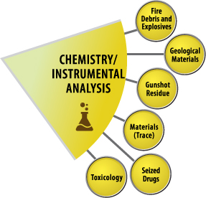
Discipline Description
The Seized Drugs Subcommittee will focus on standards and guidelines related to the examination of evidence to identify drugs and related substances.

Slide 6
Subcommittee Liaisons
Position | Name
QIC Liaison | Thomas A. Brettell, Ph.D.
HFC Liaison | Eric C. Person, Ph.D.
LRC Liaison | Garth Glassburg
KAVI Liaison | Tiffany A. Ribadeneyra
ASTM Liaison | Agnes D. Winokur

Slide 7
Summary of Standards/Guidelines Priority Actions
Priority | Working Title of Document
1 | E2548-11 Standard Guide for Sampling Seized Drugs for Qualitative and Quantitative Analysis
2 | E2327-15 Standard Practice for Quality Assurance of Laboratories Performing Seized-Drug Analysis
3 | E2882-12 Standard Guide for Analysis of Clandestine Drug Laboratory Evidence

Slide 8
Standards/Guidelines Development Priority 1 Document
Document Title: E2548-11 Standard Guide for Sampling Seized Drugs for Qualitative and Quantitative Analysis
Scope: Covers minimum considerations regarding the sampling of seized-drug evidence prior to analysis
Rationale: By developing sampling strategies and implementing appropriate sampling schemes, laboratories will minimize the number of units requiring analysis while at the same time ensuring that all relevant legal and scientific requirements are met.
Issues/Concerns: - Incorrect application of sampling approaches
- Incorrect population inferences

Slide 9
Standards/Guidelines Development Priority 1 Document
Key Components of Standard:
Establishes minimum criteria for laboratory sampling procedures
Discusses different sampling issues:
Statistical vs non-statistical
Statutory limits and jurisdictions
Population inferences

Slide 10
Task Group/Subcommittee Action Plan
Priority 1: Sampling Seized Drugs
Planned Actions | OSAC Process Stage | Assignee | Estimated Completion Date
Registry forms to FSSB | RA-1600 | SAC | Spring/Summer 2016
FSSB approval | RA-1700 | FSSB
Public appeals process | RA-1800
Registry forms & approval to QIC | RA-2000
OSAC Registry of Approved Standards | RA-2100 | QIC
* A revised version of this document is pending SDO approval

Slide 11
Standards/Guidelines Development Priority 2 Document
Document Title: E2327-15 Standard Practice for Quality Assurance of Laboratories Performing Seized-Drug Analysis
Scope: Covers quality assurance issues in forensic laboratories performing drug analysis
Objective: To be used by forensic analysts and supported by laboratory management
Goal: To provide a framework of quality in the processing of drug evidence
Task Group Name: Quality Assurance (QA)
Technical Contact: Tiffany Ribadeneyra
Technical Contact Information: tribadeneyra@nassaucountyny.gov
Date of Last Task Group Meeting: January 2016

Slide 12
Standards/Guidelines Development Priority 2 Document
Key Components of Standard:
Evidence handling
Analytical procedures
Report writing
Method validation
Documentation
Proficiency testing
Audits
Health and safety

Slide 13
Task Group/Subcommittee Action Plan
Priority 2: Quality Assurance
Planned Actions | OSAC Process Stage | Assignee | Estimated Completion Date
SAC Review & Vote | RA-200/300 | SAC | Spring 2016
Notice of Intent & Public Comment Period | RA-400/500
RC Review & Comments | RA-600 | RC
Comments Adjudication | RA-700 | Seized Drugs | Summer 2016

Slide 14
Standards/Guidelines Development Priority 3 Document
Document Title: E2882-12 Standard Guide for Analysis of Clandestine Drug Laboratory Evidence
Scope: Provides guidance on the chemical analysis of items and samples related to suspected clandestine laboratories
Objective: To ensure selected analytical schemes are fit for purpose and provide reliable results
Issues: - Understanding of clandestine synthetic routes
- CL analysis may require non-routine approaches
Task Group Name: Clandestine Lab Analysis
Technical Contact: Christian Matchett
Technical Contact Information: christian.c.matchett2.civ@mail.mil
Date of Last Task Group Meeting: January 2016

Slide 15
Standards/Guidelines Development Priority 3 Document
Key Components of Standard:
Terminology
Safety issues
Sampling of CL evidence
Analysis
Yield and capacity calculations
Conclusions and reporting
Training

Slide 16
Task Group/Subcommittee Action Plan
Priority 3: Clan Lab Analysis
Planned Actions | OSAC Process Stage | Assignee | Estimated Completion Date
Complete Registry Forms | RA-100 | Seized Drugs | Spring 2016
SAC Review & Vote | RA-200/300 | SAC | Summer 2016
Notice of Intent & Public Comment Period | RA-400/500
RC Review & Comments | RA-600 | RC
Comments Adjudication | RA-700 | Seized Drugs | Fall 2016

Slide 17
Summary of Standards/Guidelines Priority Actions
Priority | Working Title of Document
1 | E2548-11 Standard Guide for Sampling Seized Drugs for Qualitative and Quantitative Analysis
2 | E2327-15 Standard Practice for Quality Assurance of Laboratories Performing Seized-Drug Analysis
3 | E2882-12 Standard Guide for Analysis of Clandestine Drug Laboratory Evidence

Slide 18
Standards/Guidelines Reviewed For Technical Merit
Title | Developing Organization | Status* | OSAC Process Stage
E2764-11: Standard Practice for Uncertainty Assessment in the Context of Seized-Drug Analysis | ASTM | SDO revision | ---
E1968-11: Standard Guide for Microcrystal Testing in Forensic Analysis of Cocaine | ASTM | SDO revision | ---
E1969-11: Standard Guide for Microcrystal Testing in Forensic Analysis of Methamphetamine and Amphetamine | ASTM | Evaluation | ---
E2125-11: Standard Guide for Microcrystal Testing in Forensic Analysis of Phencyclidine and Its Analogues | ASTM | Evaluation | ---

Slide 19
Research Gaps Identified
Acceptance Criteria for Instrumental Data related to Qualitative Seized Drug Analysis
Goal: To standardize acceptance criteria and develop an interpretation strategy that allows consistent conclusions to be drawn from qualitative instrumental data
Chromatography, Spectrometry, Spectroscopy
Result: To improve analysts’ ability to render conclusions based upon objectively interpreted data

Slide 20
Research Gaps Identified
Error rates in Qualitative Methods of Analysis
Goal: To quantitatively evaluate error rates associated with individual qualitative methods of analysis, as well as with analytical schemes that combine multiple methods of analysis
Issues: How does the quality of data influences false positive and false negative identification rate in seized drug analysis?
Result: Better communication of results to triers of fact

Slide 21
Future Task Groups
Acceptance Criteria – Evaluation of current resources/documents
Mass spectrometry
IR spectroscopy
Error Rates
Instrumental Reference Libraries

Slide 22
Additional Items of Interest
First year:
First OSAC Registry Standard (E2329)
> 12 virtual SC/TG meetings
> 15 ballots
Seized Drugs Representatives to SAC Interdisciplinary Groups :
Terminology – Ella Kubicz
Proficiency Testing – Claire Dragovich
Education/Training – Eric Person
Quality Assurance – Tiffany Ribadeneyra

Slide 23
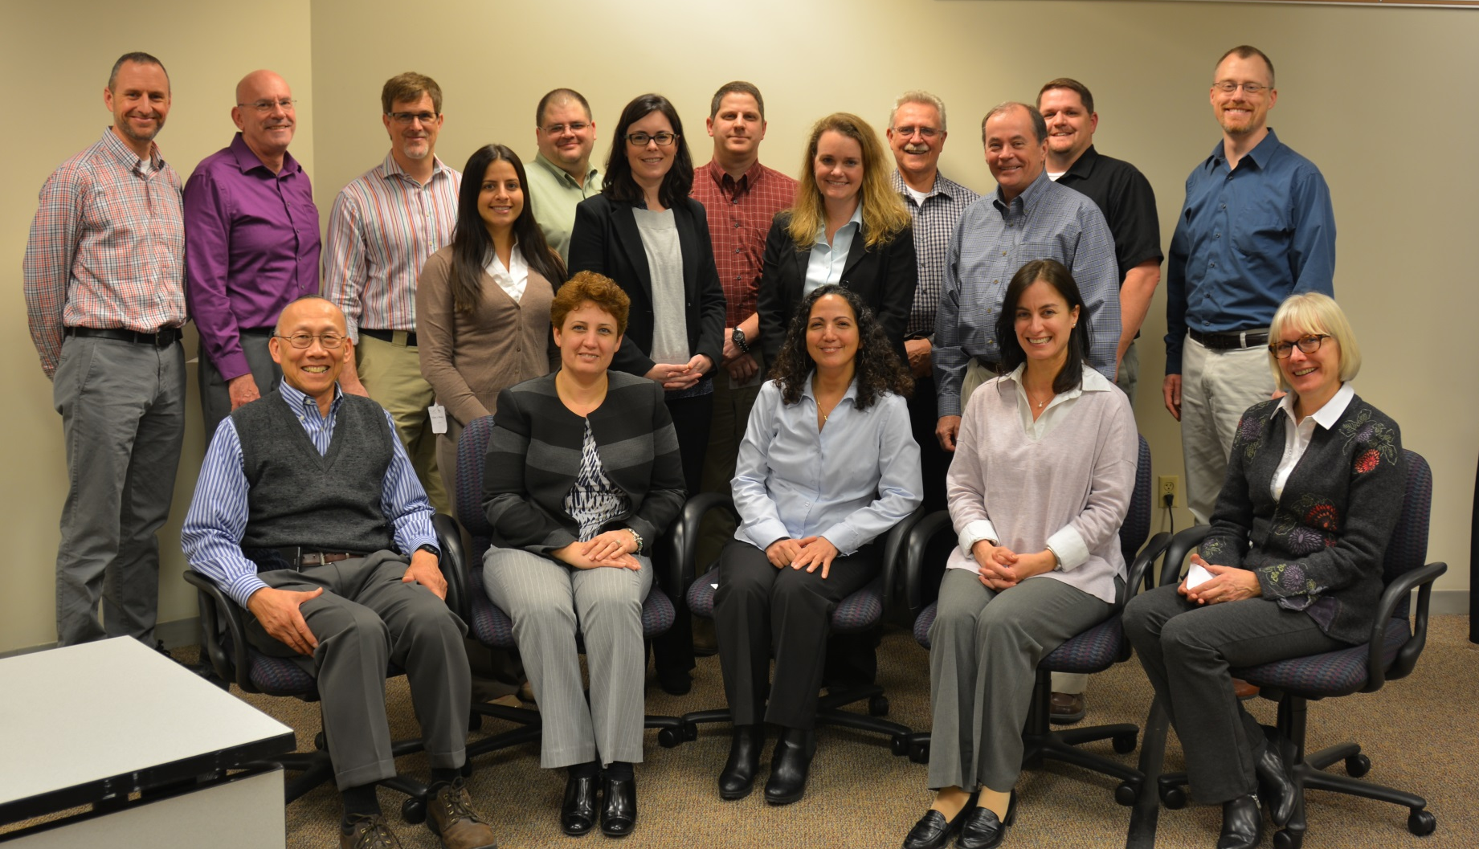

Slide 24
Priority Action Report
Seized Drugs Subcommittee
SAC Chemistry/Instrumental Analysis
Sandra E. Rodriguez-Cruz, Ph.D. - Chair
February 23, 2016

