Slide 1
Writing High-Quality Feedback for 2016 Baldrige Award Applicants

Slide 2
Baldrige Comment Guidelines
Actionable: The applicant can take action based on the comment and understand the potential benefit.
Aligned: The comment reflects the Criteria and reflects the scoring range you have chosen.
Accurate: The facts and data are correct.
Appropriate: The tone is professional and polite.
Aim for “Straight A’s”!

Slide 3
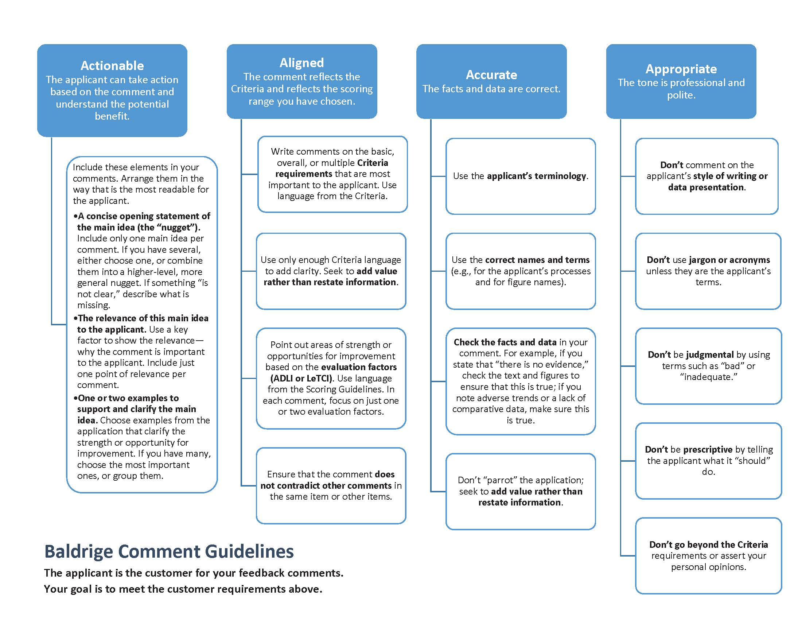

Slide 4
Actionable

Slide 5
Aligned

Slide 6
Accurate

Slide 7
Appropriate

Slide 8
Elements of an Actionable Comment
A comment contains*
a concise opening statement of the main idea
the relevance of this main idea to the applicant
one or two examples
*with these elements arranged in the most readable way for the applicant
Call to Action
Comment

Slide 9
Sample Process Strength
1.1a(1)
The strategic advantage of a focus on continuous improvement and the elements of the organization’s integrated Leadership System guide the Leadership Team in setting direction and aligning the workforce towards achievement of the vision. The Leadership System (Figure 1.1-1) incorporates planning, measurement, reward/recognition, and learning in a cycle of continuous improvement; it also aligns the organization through strategic objectives, performance reviews, and Quarterly Coaching Plans.

Slide 10
Sample Process Strength
Relevance
Nugget
1.1a(1)
The strategic advantage of a focus on continuous improvement and the elements of the organization’s integrated Leadership System guide the Leadership Team in setting direction and aligning the workforce towards achievement of the vision. The Leadership System (Figure 1.1-1) incorporates planning, measurement, reward/recognition, and learning in a cycle of continuous improvement; it also aligns the organization through strategic objectives, performance reviews, and Quarterly Coaching Plans.
Examples

Slide 11
Sample Process OFI
1.1b(1)
It is unclear how Leadership Team (LT) members personally communicate with all of the organization’s key customers to build on its core competency of relationships. For example, there is no indication of how LT members communicate with two identified key stakeholders: customers and the Advisory Board, which represents the customer base.

Slide 12
Sample Process OFI
Nugget
1.1b(1)
It is unclear how Leadership Team (LT) members personally communicate with all of the organization’s key customers to build on its core competency of relationships. For example, there is no indication of how LT members communicate with two identified key stakeholders: customers and the Advisory Board, which represents the customer base.
Relevance
Examples

Slide 13
Sample Results Strength
7.3a(3)
The company's workforce engagement results indicate that it is building its strategic advantage of highly engaged team members. Overall engagement has increased from approximately 71% to 82% from FY2010 through FY2015, and has exceeded the Guppol Best Practice (top-decile) benchmark for the past two years (Figure 7.3-12). Segmented results by team member tenure also indicate favorable trends for all five cohorts presented, most significantly with engagement by team members with less than a one-year tenure, which increased from approximately 63% to 81% (Figure 7.3-13).

Slide 14
Sample Results Strength
Nugget
Relevance
7.3a(3)
The company's workforce engagement results indicate that it is building its strategic advantage of highly engaged team members. Overall engagement has increased from approximately 71% to 82% from FY2010 through FY2015, and has exceeded the Guppol Best Practice (top-decile) benchmark for the past two years (Figure 7.3-12). Segmented results by team member tenure also indicate favorable trends for all five cohorts presented, most significantly with engagement by team members with less than a one-year tenure, which increased from approximately 63% to 81% (Figure 7.3-13).
Examples

Slide 15
Sample Results OFI
7.3a(1,2,4)
Several workforce-related measures are not segmented to demonstrate the relative performance of various work groups. Segmentation by work groups is not provided for retention (Figure 7.3-1), unscheduled absences (Figure 7.3-4), overtime as a percentage of payroll (Figure 7.3-5), team member injury rate (Figure 7.3-7), workers' compensation (Figure 7.3-8), WellFit participation (Figure 7.3-21), or average training hours per full-time equivalent (FTE; Figure 7.3-25). A lack of segmentation may make it difficult for the applicant to demonstrate the relative performance for all workforce segments, including for warehouse/fulfillment personnel.

Slide 16
Sample Results OFI
Nugget
7.3a(1,2,4)
Several workforce-related measures are not segmented to demonstrate the relative performance of various work groups. Segmentation by work groups is not provided for retention (Figure 7.3-1), unscheduled absences (Figure 7.3-4), overtime as a percentage of payroll (Figure 7.3-5), team member injury rate (Figure 7.3-7), workers' compensation (Figure 7.3-8), WellFit participation (Figure 7.3-21), or average training hours per full-time equivalent (FTE; Figure 7.3-25). A lack of segmentation may make it difficult for the applicant to demonstrate the relative performance for all workforce segments, including for warehouse/fulfillment personnel.
Examples
Relevance

Slide 17

Be the applicant!
This super-observant examiner transforms himself into the applicant to understand the organization’s perspective.

Slide 18
Step 5: Comment Writing—Pair Activity
Choose one strength comment and one OFI comment from your prework for item 4.1.
Pair up with another examiner at your table.
Ask your partner to evaluate your comments using the 4 As. Discuss.
Switch roles.
15
Notes:
Note: Beyond the Examiner Preparation course, you can access a series of resources on comment writing (formatted as PowerPoint presentations) on the Advanced Comment Writing and Tech Editing page of the Examiner Resource Center of the Baldrige Program’s website. The four “Polishing Your Comments” presentations provide examples showing how to refine Baldrige feedback report comments. They are available at this URL: http://www.nist.gov/baldrige/examiners/resource_center/tech_edit.cfm

