Slide 1
Producing “Straight A” Feedback for Baldrige Applicants
2016 Presentation for Senior and Alumni Examiners

Slide 2
Objectives
Understand customer requirements (and preview updated Comment Guidelines)
Determine best practices
Be familiar with expectations and resources

Slide 3
What do you think are the key customer expectations/requirements for Baldrige feedback reports?

Slide 4
Customer Requirements
Actionable comments
Aligned comments/scoring
Accurate comments
Appropriate comments

Slide 5
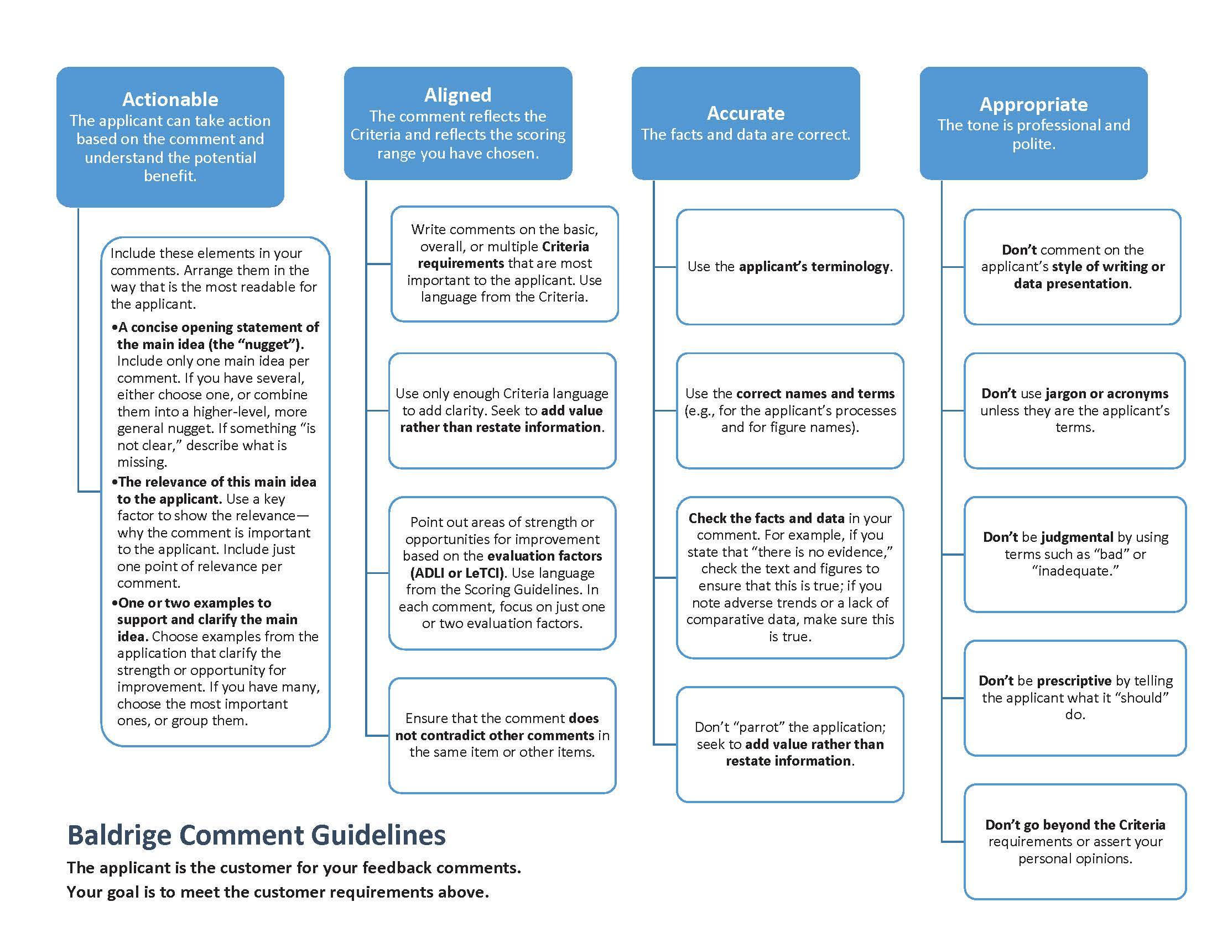
“Straight A” Feedback Comments

Slide 6
Comments from Baldrige Award Applicants (Strengths)
“The rating scale doesn't go any higher :)”
“I am a firm believer in use of the Baldrige Criteria and will continue to champion their use wherever I can!”
“[The feedback report] was well-written and a quality piece of work.”
“Site visit was both a good experience and valuable for the organization.”
“Pertinent, actionable comments that we will address to further our performance excellence journey.”

Slide 7
Comments from Baldrige Award Applicants (Opportunities)
“I felt we did some things that we were not given credit. Perhaps we should have been more clear.”
“We received an OFI which listed as examples the items which we thought we had clearly stated were available on site.
Defining what is specific to our processes versus the processes of [our] system is a challenge, … evident in parts of the feedback report [where] the examiners were [not] able to pick up on nuances.”
“We were a little surprised at some of the lower scores given to parts of category 7 that seemed exceptional.”

Slide 8
How can you ensure that examiner teams meet the customer requirements?

Slide 9
Expectations for Team Members and Leaders
Everyone is an active participant in both completing work and providing feedback.
No one (including new examiners) should be afraid to provide feedback or ask questions about his/her own or other’s work.
This is a team effort. Item leads and backups collaborate.
If someone is struggling or not meeting deadlines, address the issue ASAP.

Slide 10
Expectations for Team Members and Leaders (continued)
Experienced teams members play the role of mentor to new examiners. Share your tips, tricks, or insights.
Pay close attention to comments that conflict and the balance of comments to the score.
Remember who is the customer of your feedback.
Others?

Slide 11
What About the Tech Editor?
Supports a team but does not participate in team’s evaluation.
Uses the 2016 Comment Guidelines to review a team’s comments in-process (usually just before consensus call), as well as final scorebook comments.
Provides an outside perspective—carefully considering view of the applicant.

Slide 12
Resources for Producing “Straight A” Feedback Comments
Process Facilitator
Tech Editor
Item Backup Checklist
Comment and Scoring Guidelines
Consensus Review Step-by-Step (Step 9)
Sample Comments in Examiner Resource Center
Presentations on Advanced Comment Editing Web Page (within Examiner Resource Center)

