Slide 1


INNOVATION AND INDUSTRY SERVICES
Baldrige Performance Excellence Program
Program Review
Mission, Priorities and Metrics

Slide 2
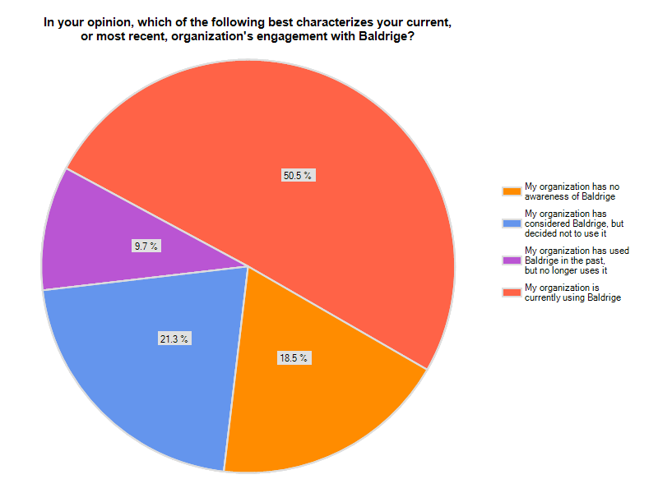
2009 & 2010 Board of Examiners

Slide 3
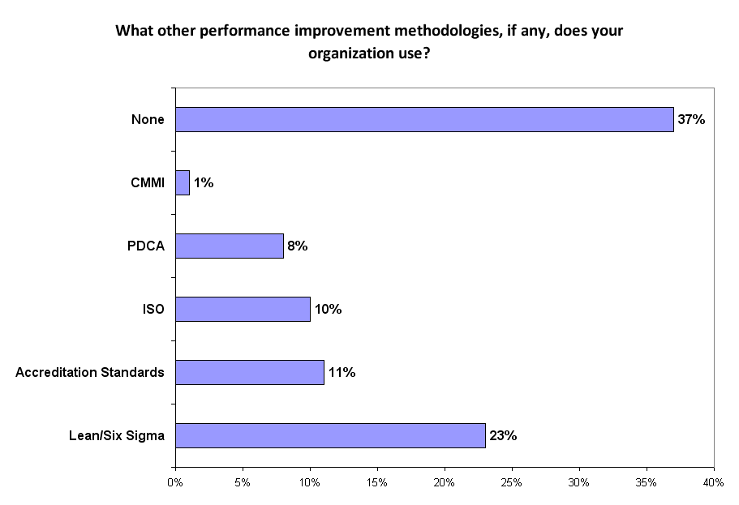
2009 & 2010 Board of Examiners - Answering “No Knowledge” (N = 59)

Slide 4
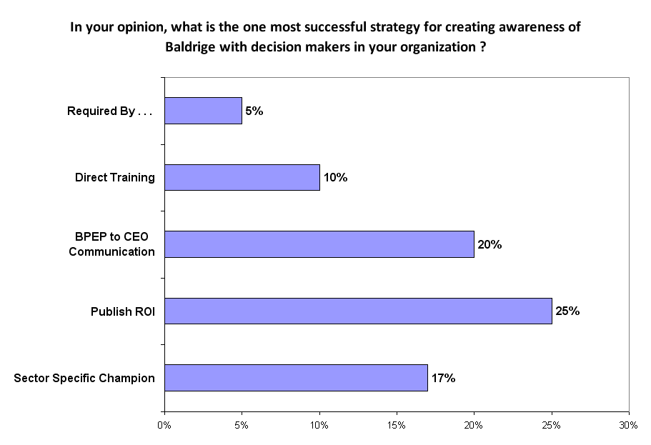
2009 & 2010 Board of Examiners - Answering “No Knowledge” (N = 59)

Slide 5
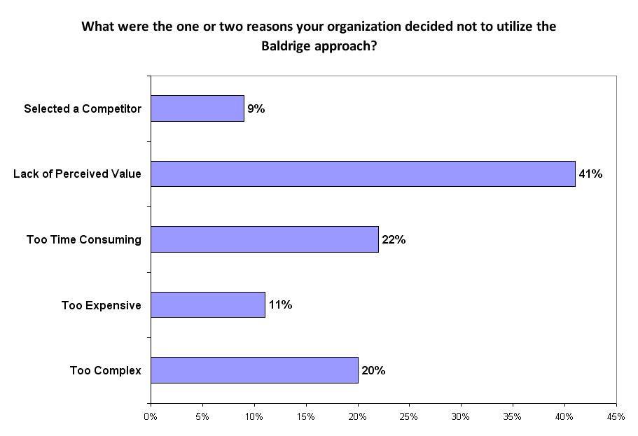
2009 & 2010 Board of Examiners - Answering “Considered - Rejected” (N = 63)

Slide 6
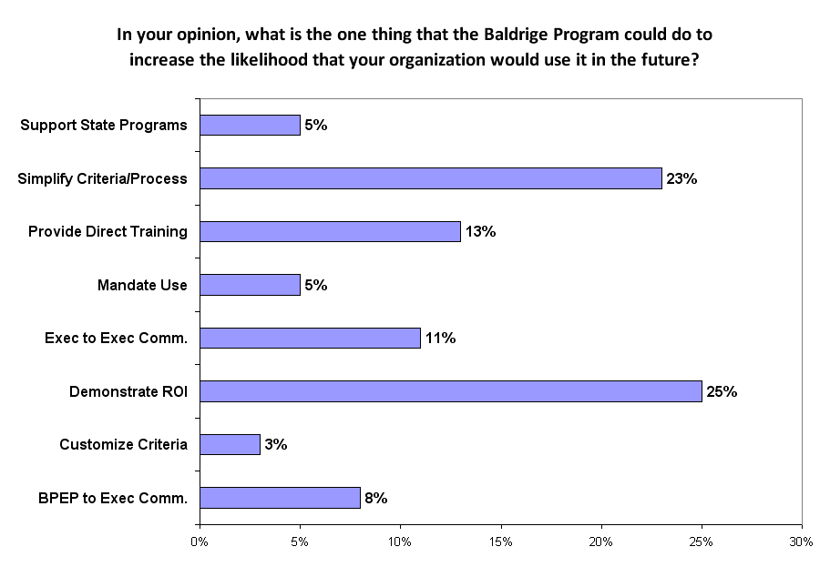
2009 & 2010 Board of Examiners - Answering “Considered - Rejected” (N = 63)

Slide 7
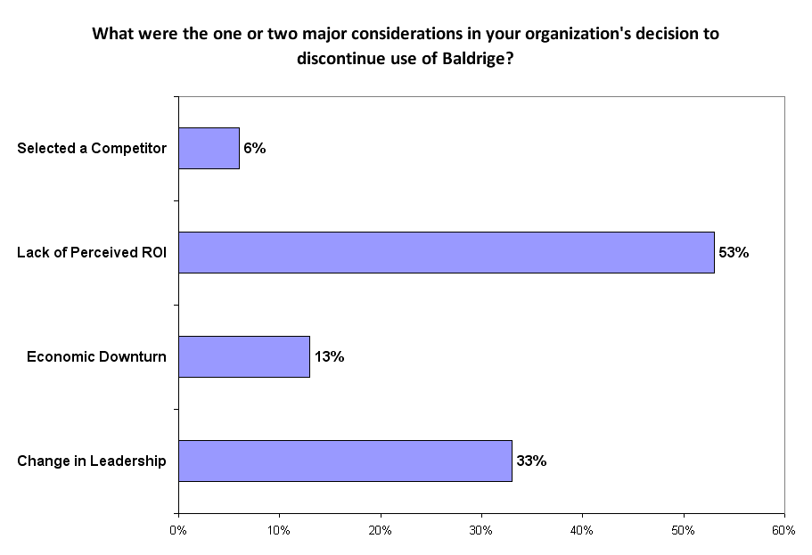
2009 & 2010 Board of Examiners - Answering “Used - Dropped” (N = 30)

Slide 8
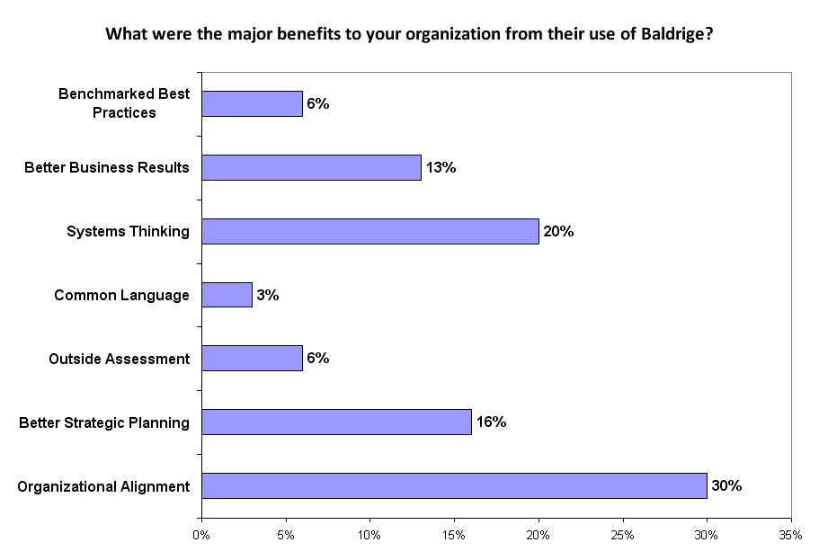
2009 & 2010 Board of Examiners - Answering “Used - Dropped” (N = 30)

Slide 9
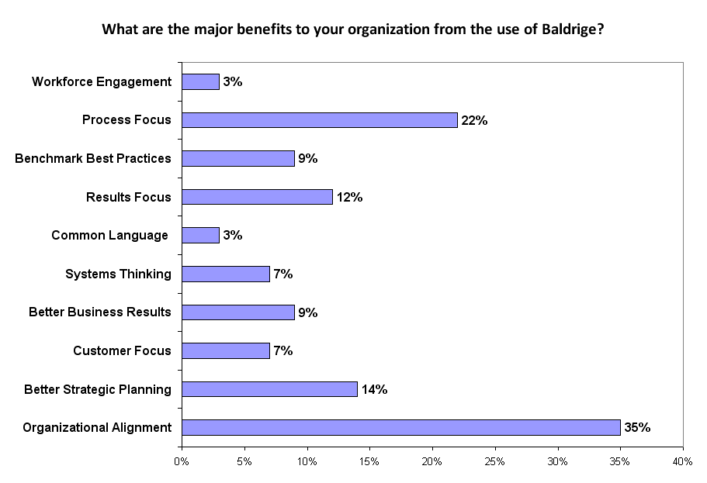
2009 & 2010 Board of Examiners - Answering “Currently Using” (N = 155)

Slide 10
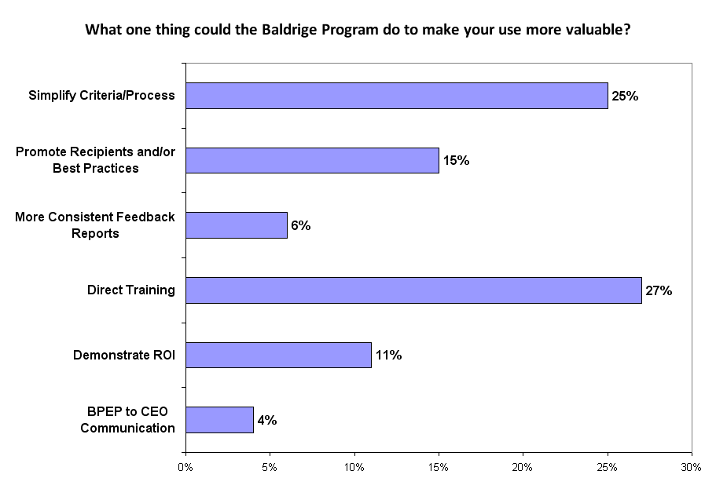
2009 & 2010 Board of Examiners - Answering “Currently Using” (N = 155)

Slide 11
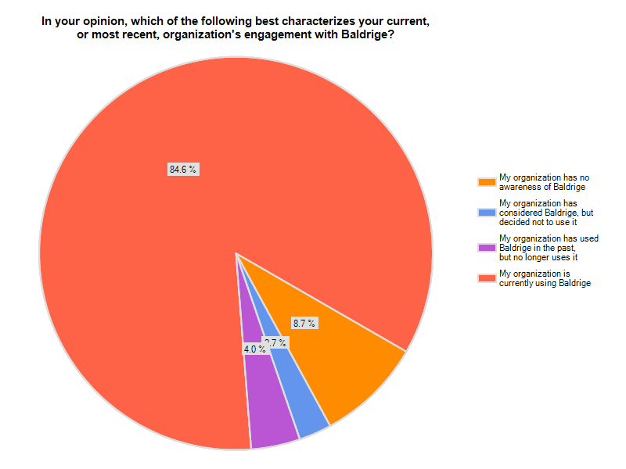
2011 Quest Attendees

Slide 12
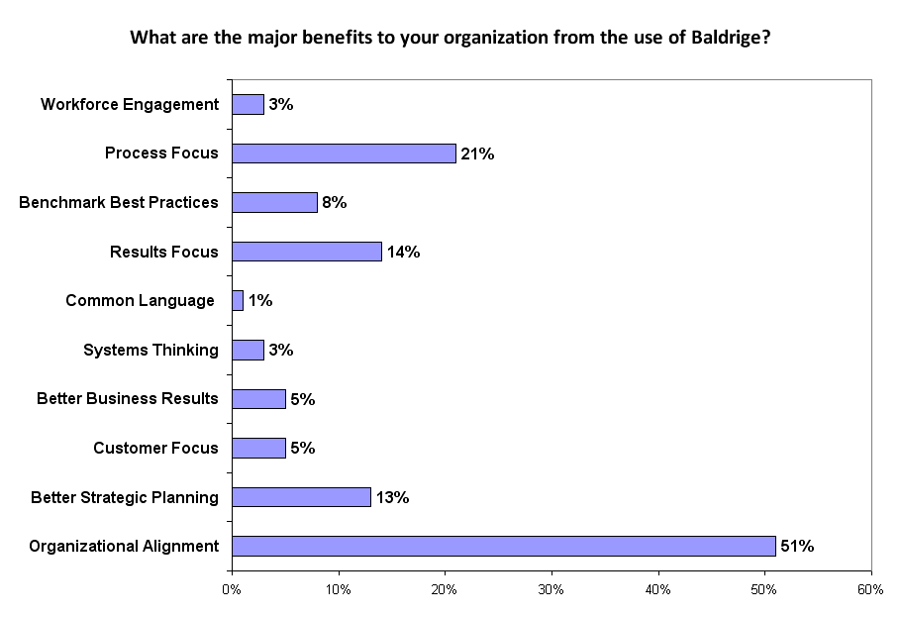
2011 Quest Attendees - Answering “Currently Using” (N = 108)

Slide 13
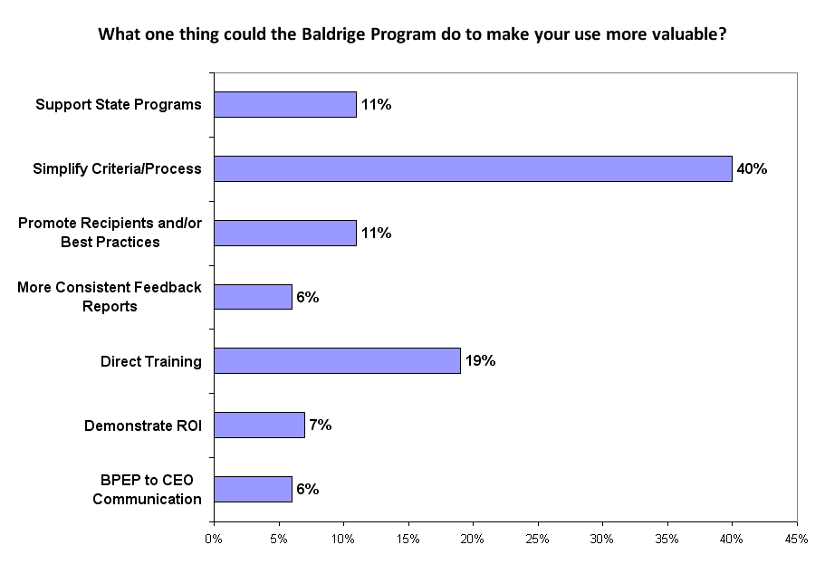
2011 Quest Attendees - Answering “Currently Using” (N = 108)

