Slide 1

Baldrige Performance Excellence Program | 2016
Baldrige Excellence Framework
A systems approach to improving your organization

Slide 2
Manufacturing Leaders on the Criteria
The Baldrige Criteria challenged us to become leaders by any measure, and we succeeded—seeing productivity, customer loyalty, employee engagement, and financial returns.
Samuel Liang, president/CEO,
two-time Baldrige Award winner MEDRAD, Inc.
The Baldrige opportunity . . . was a way for us to get a very disciplined, external perspective, an examination of our business, of how we manage our business. … That’s a very valuable thing.
Patrick McGinnis, president/CEO,
Baldrige Award winner Nestlé Purina PetCare Americas
Notes:
More quotes:
If you’re considering your own Baldrige quest, please do that. I would encourage you to get your team and your leadership behind such a journey. It’s a very rewarding journey. It really brings your team together, all of your employees. It builds upon success and allows you to strive for continuous improvement in delivering for your customer and then internally driving employee satisfaction and engagement.
—Anthony Brancato III, president, Baldrige Award winner Honeywell Federal Manufacturing & Technologies
Because of Baldrige, because of our ability to manage shareholder expectations, customer satisfaction, and [because of] continuing to keep our employees happy and satisfied, the company has continued to thrive.
—Samuel Liang, president and CEO, two-time Baldrige Award winner MEDRAD
The Baldrige Criteria teach us how to put processes in place that allow us to actualize the things that are most important in driving our business success.
—Alan Willets, president and business unit leader, Baldrige Award winner Cargill Corn Milling

Slide 3
Manufacturing Leaders on the Criteria
It amazes me that U.S. businesses spend so much money on “how to” books and coursework to teach leaders how to build successful organizations.
My recommendation: implement the Baldrige-based Criteria into your business. No other single document can help build a long-term successful organization.
—Jerry R. Rose,
Former Corporate Vice President, Cargill Inc.

Slide 4
Service Industry Leaders on the Criteria
We continuously improve. . . not because of me or anyone here. It’s because we work the Criteria. If we use the Criteria, sooner or later we will beat our competition. . . . The whole Criteria unequivocally works.
—Horst Schulze, former president and COO, two-time Baldrige Award winner Ritz-Carlton Hotel Company, L.L.C.
When you look at the Baldrige Criteria, what a great road map to say if you can do the things in all these categories and do them well, you’re going to be a well-run company.
—Robert F. Pence, president and CEO,
Baldrige Award winner Freese and Nichols, Inc.
Notes:
More quotes:
Our sales are up over 20 percent per year over the last five years. Our profits are up over 40 percent per year for that same time. Customer satisfaction at 93 percent is at an all-time high. Employee satisfaction, at 82 percent, is at an all-time high also. All the winds are blowing in the right direction at MidwayUSA, and it’s all because of our efforts in engaging the Baldrige Criteria.
—Larry Potterfield, CEO of 2009 and 2015 Baldrige Award recipient MidwayUSA
For seven years in a row we improved customer satisfaction, we improved occupancy, we improved employee satisfaction, we lowered employee departures [and] turnover, and we improved annually our profit.
—Horst Schulze, president/CEO of 1999 Baldrige Award recipient The Ritz-Carlton Hotel Company, L.L.C.

Slide 5
Small Business Leaders on the Criteria
MidwayUSA has benefited tremendously from the Baldrige Criteria: Our sales are up over 20% per year over the last five years. Our profits are up over 40% . . . . Customer satisfaction at 93% is at an all-time high. Employee satisfaction at 82% is at an all-time high.
—Larry Potterfield, CEO, Baldrige Award winner MidwayUSA
What Baldrige did for us is get us a business management model. [The Criteria] identify the key things to an organization’s success.
—Terry May, president,
two-time Baldrige Award winner MESA
Notes:
More quotes:
Baldrige involvement increased employee buy-in, providing terrific professional development and personal learning and achievement opportunities.
—Roger B. Quayle, executive vice president, quality and technology,
Baldrige Award winner OMI, Inc.
We’re a small hot dog and hamburger operation in the hills of Tennessee, but we can effectively apply the Criteria and have tremendous success.
—Thomas Crosby, President/CEO, Baldrige Award winner Pal's Sudden Service

Slide 6
Nonprofit/Government Leaders on the Criteria
People ask, “Why Baldrige?” My answer is very simple:
triple-A bond rating on Wall Street from all three rating agencies,
bringing capital projects in on time and within budget,
a 96% business satisfaction rating,
a 94% resident satisfaction rating,
an overall quality rating of 95%,
and an employee satisfaction rating of 97%
. . . that’s why we’re involved with Baldrige.
—Michael Levinson, city manager,
Baldrige Award winner City of Coral Springs, Florida
Notes:
More quotes:
[The men and women of ARDEC] have earned distinction for our organization, the new high-technology Army, and the Department of Defense by embracing the Baldrige Criteria. . . . We [adopted the Baldrige Criteria] in order to become the best organization we can possibly be and provide the best products and support we can to the U.S. Warfighter.
—Dr. Joseph A. Lannon, director,
Baldrige Award winner U.S. Army Armament Research, Development, and Engineering Center
In the past few years, we have seen a complete transformation of the book publishing industry. Despite this challenging landscape with the rapid-fire addition of new channels and business models, Concordia Publishing House continues to thrive. Our agility and flexibility during these times is due in great part to the guidance of the Criteria and the invaluable feedback from the examiners.
—Bruce G. Kintz, President & CEO,
Baldrige Award winner Concordia Publishing House
I’ve seen a culture develop within the Center that is a culture of doing the right thing. It’s a culture of everyone standing up and trying to make our products and services the best they can be, and Baldrige has helped us along that line.
—Kathy Boardman, project director,
Baldrige Award winner VA Cooperative Studies Program Clinical Research Pharmacy Coordinating Center

Slide 7
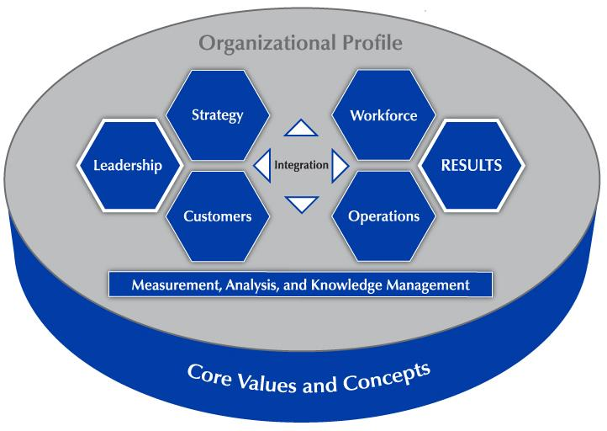
The Baldrige Approach in 3 Questions
Is your organization doing as well as it could?
How do you know?
What and how should your organization improve or change?
Notes:
These three questions sum up what using the Baldrige framework can tell you about your organization.

Slide 8
A systems perspective
Core values and concepts
Criteria for Performance Excellence
Scoring system
Notes:
The Baldrige Excellence Framework promotes a systems perspective. It helps you see your organization as a system with interdependent parts.
The framework consists of a set of core values and concepts, the Criteria for Performance Excellence, and a scoring system to use in evaluating your organization.

Slide 9
A Systems Perspective
Notes:
This overview shows how the Criteria provide a systems perspective for managing your organization. The Organizational Profile sets the context for your organization. It serves as the background for all you do.
The performance system consists of the six categories in the center of the figure. These categories define your processes and the results you achieve.
Performance excellence requires strong Leadership and is demonstrated through outstanding Results. Those categories are highlighted in the figure. The word “integration” at the center of the figure shows that all the elements of the system are interrelated.
The center horizontal arrowheads show the critical linkage between the leadership triad and the results triad and the central relationship between the Leadership and Results categories.
The leadership triad (Leadership, Strategy, and Customers) emphasizes the importance of a leadership focus on strategy and customers.
The results triad (Workforce, Operations, and Results) includes your workforce-focused processes, your key operational processes, and the performance results they yield.
The center vertical arrowheads point to and from the system foundation, which provides information on and feedback to key processes and the organizational environment.
The system foundation (Measurement, Analysis, and Knowledge Management) is critical to effective management and to a fact-based, knowledge-driven, agile system for improving performance and competitiveness.
The basis of the Criteria is a set of Core Values and Concepts that are embedded in high-performing organizations.
All actions lead to Results—a composite of product and process, customer-focused, workforce-focused, leadership and governance, and financial and market results.

Slide 10
Criteria Categories
Leadership
Strategy
Customers
Measurement, Analysis, and Knowledge Management
Workforce
Operations
Results
Notes:
The Baldrige Criteria are a set of questions divided into an Organizational Profile and the seven categories in the diagram on the previous slide. Each category represents a critical aspect of managing and performing as an organization.
Each category is subdivided into items. There are 17 items, each focusing on an aspect of your organization.
These questions reflect a set of core values and concepts..

Slide 11
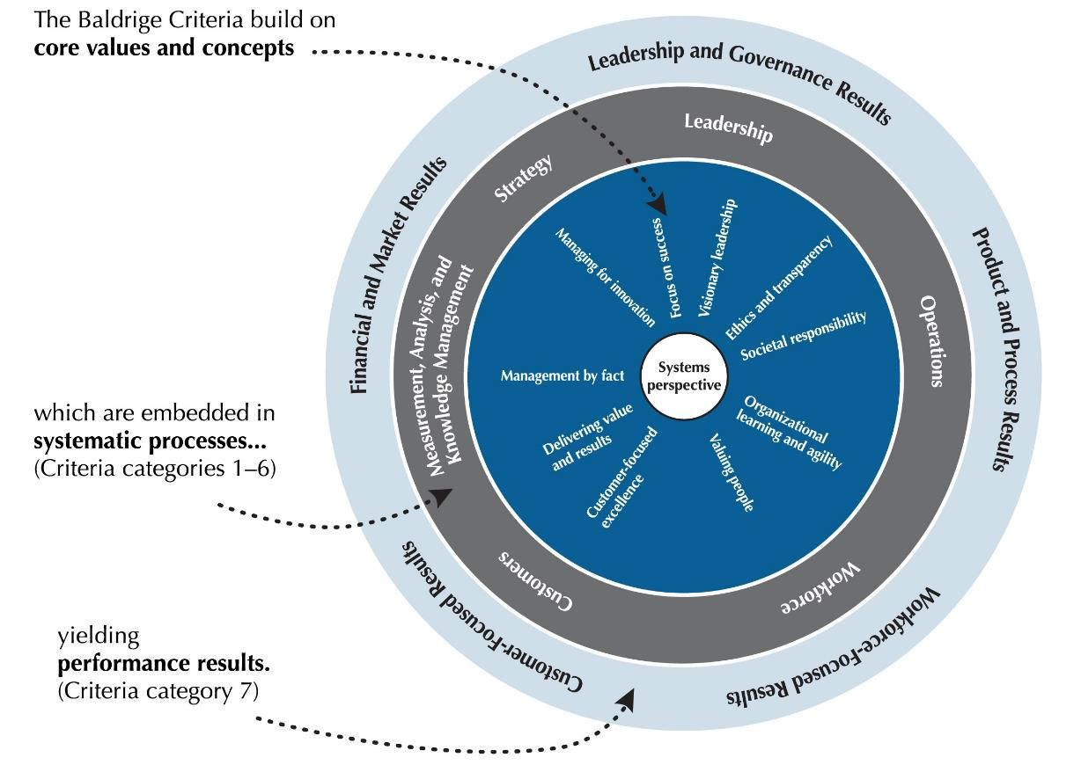
The Role of Core Values and Concepts
Notes:
The Criteria are built on a number of interrelated core values and concepts. These are beliefs and behaviors found in high-performing organizations.
Systems perspective is the value at the center of the figure. The next layer shows the other core values and concepts that are embedded in Criteria categories 1 through 6. These categories are the next layer in the figure. Systematic processes in those areas yield the performance results found in Criteria category 7, represented by the outermost layer.
Let’s take a closer look at these core values and concepts.

Slide 12
Core Values and Concepts
Customer-focused excellence
Valuing people
Organizational learning and agility
Focus on success
Managing for innovation
Management by fact
Societal responsibility
Systems perspective
Visionary leadership
Ethics and transparency
Delivering value and results
Notes:
First and foremost, Baldrige provides a systems perspective that requires visionary leadership—the first two core values.
The next seven core values are the hows of an effective system.
The final two core values, ethics and transparency and delivering value and results, are the outcome of using Baldrige as a guide.

Slide 13
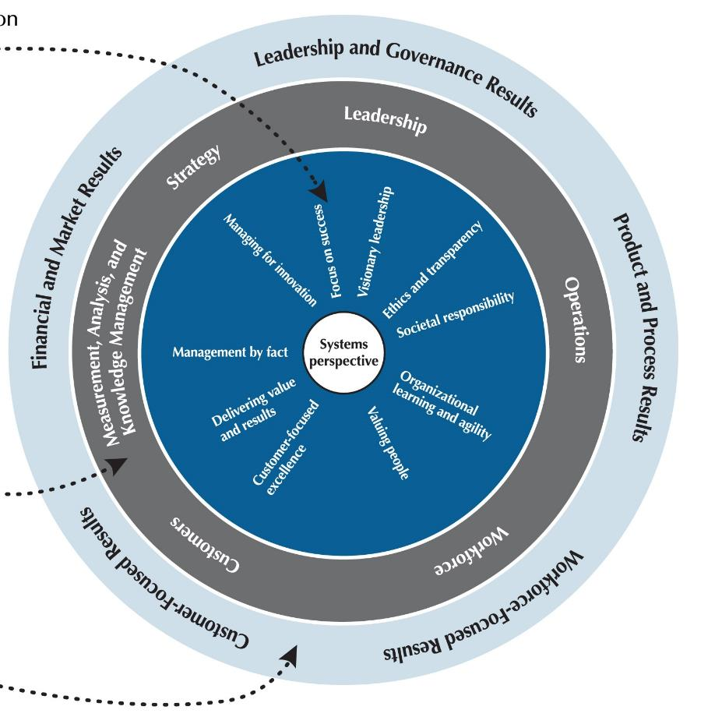
Visionary leadership
Systems perspective
Customer-focused
excellence
Valuing people
Notes:
Systems perspective: A systems perspective means managing all the parts of your organization as a unified whole to achieve your mission. It means ensuring that your plans, processes, measures, and actions are consistent. And it means ensuring that the individual parts of your organization’s management system work together in a fully interconnected, unified, and mutually beneficial manner.
Visionary leadership: Your organization’s senior leaders should set a vision for the organization, create a customer focus, demonstrate clear and visible organizational values and ethics, and set high expectations for the workforce. The vision, values, and expectations should balance the needs of all your stakeholders.
Customer-driven excellence: Your customers are the ultimate judges of performance and quality. Thus, your organization must take into account all product and service features and characteristics and all modes of customer access and support that contribute value to your customers.
Valuing people: A successful organization values all people who have a stake in the organization, including customers, community members, stockholders, and other people affected by the organization’s actions. Your organization’s success depends on an engaged workforce that benefits from meaningful work, clear organizational direction, the opportunity to learn, and accountability for performance. That engaged workforce must also have a safe, trusting, and cooperative environment.

Slide 14
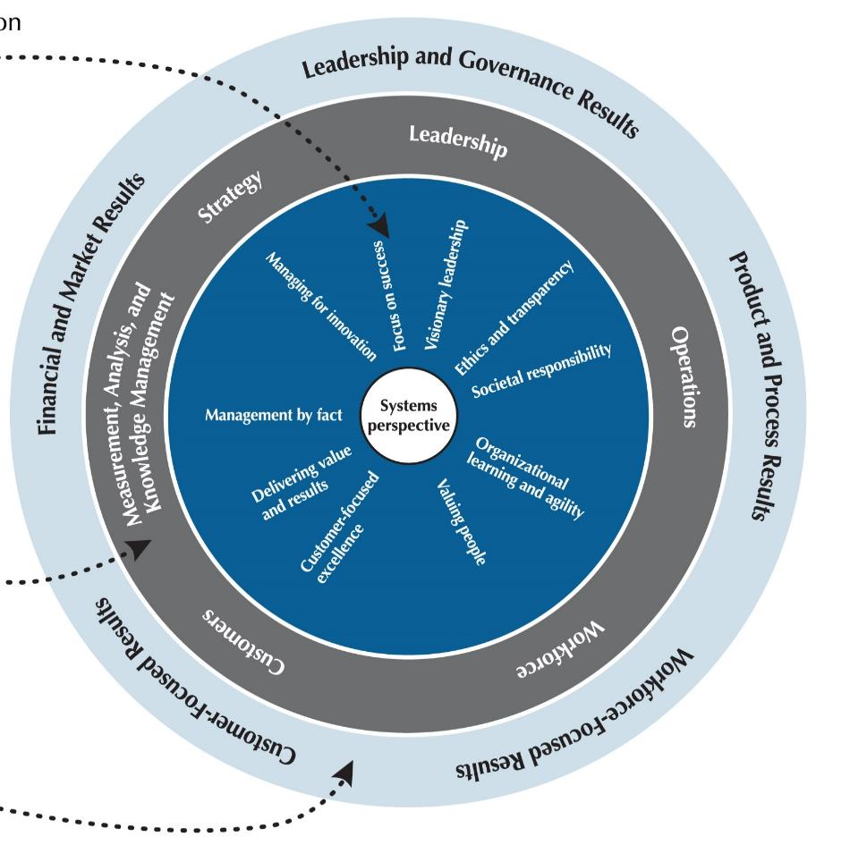
Focus on success
Managing for innovation
Management by fact
Organizational learning and agility
Notes:
Organizational learning and agility: Success in today’s ever-changing, globally competitive environment demands continual organizational learning and agility. Agility requires a capacity for rapid change and for flexibility in operations. Organizational learning includes both continuous improvement of existing approaches and significant change or innovation, leading to new goals, approaches, products, and markets.
Focus on success: Ensuring your organization’s success now and in the future requires an understanding of the short- and longer-term factors that affect your organization and its marketplace. Ensuring this ongoing success requires managing uncertainty in the environment, as well as balancing some stakeholders’ short-term demands with the organization’s and stakeholders’ needs to invest in long-term success.
Managing for innovation: Innovation is no longer strictly the purview of research and development departments. Organizations should be led and managed so that innovation becomes part of the learning culture, is integrated into daily work, and reaches across the entire organization. Innovation should lead the organization to new dimensions of performance.
Management by fact: Performance improvement requires measurement and analysis. The measures selected should best represent the factors that lead to improved customer, operational, societal, and financial performance. Analysis supports a variety of purposes, such as planning, reviewing your overall performance, improving operations, accomplishing change management, and comparing your performance with competitors’ or with best-practice benchmarks.

Slide 15
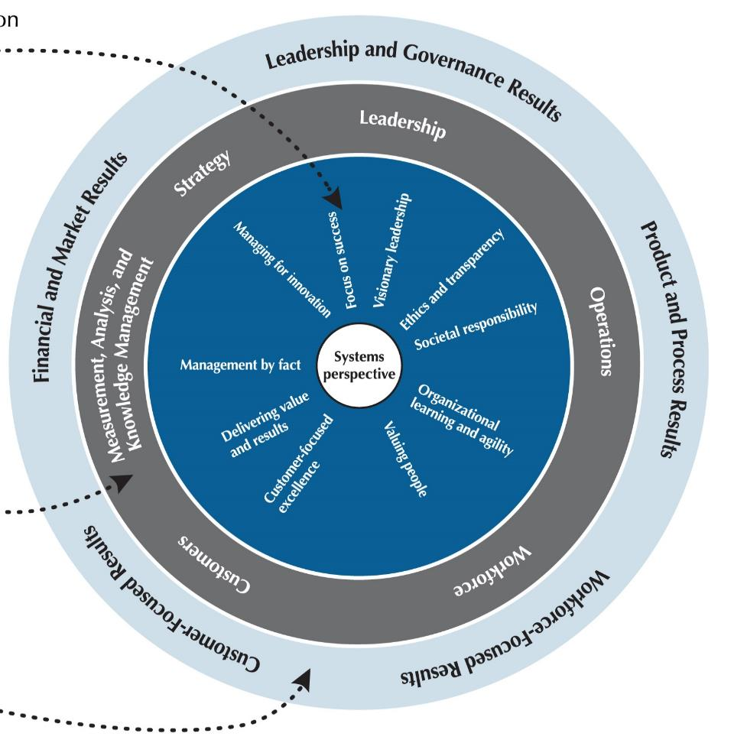
Delivering value and results
Ethics and transparency
Societal responsibility
Notes:
Societal responsibility: Leaders should stress responsibilities to the public, ethical behavior, and the need to consider societal well-being and benefit, which refers to leadership in and support—within the limits of an organization’s resources—of the environmental, social, and economic systems in the organization’s sphere of influence.
Ethics and transparency: Ethical behavior and transparency build trust in the organization and a belief in its fairness and integrity that is valued by all key stakeholders. Your organization should stress ethical behavior in all stakeholders transactions and interactions. Transparency is characterized by consistently candid and open communication on the part of leadership and management and by the sharing of clear and accurate information.
Delivering value and results: By delivering value to key stakeholders, your organization builds loyalty, contributes to growing the economy, and contributes to society. Results should be used to deliver and balance value for your key stakeholders—your customers, workforce, stockholders, suppliers, and partners; the public; and the community. Thus results need to be a composite of measures that include not just financial results, but also product and process results; customer and workforce satisfaction and engagement results; and leadership, strategy, and societal performance.

Slide 16
Item Format
Notes:
As previously mentioned, there are 17 items under the seven Baldrige Criteria categories. Let’s take a look at what an item looks like in the Baldrige Excellence Framework booklet. In this graphic of item 7.5, Financial and Market Results, you can see that the basic requirements are presented in the item title (“What are your financial and market results?”). There are 17 Criteria items (plus 2 in the Organizational Profile), each with a particular focus.
Each item includes one or more areas to address (labeled a, b, c, and so on).
Item requirements are expressed as questions or statements on three levels:
Basic requirements are expressed in the title question.
Overall requirements are expressed in the questions in boldface in the shaded box. These leading questions are the starting point for responding to the requirements.
Multiple requirements are the individual questions under each area to address, including the question in boldface. That first question expresses the most important one in that group.
Terms in small caps are defined in the Glossary of Key Terms.
15

Slide 17
Notes
Notes:
Item notes serve three purposes: (1) to clarify key terms or requirements, (2) to give instructions and examples for responding to the item requirements, and (3) to indicate key linkages to other items.
Notes also provide additional guidance specifically for nonprofit organizations. These nonprofit-specific notes are shown in italics.
At the end of each item is a link to additional examples and guidance (free on the Baldrige website).

Slide 18
Organizational Profile
P.1 Organizational Description
P.2 Organizational Situation
Starting point for self-assessment
and application preparation
Basis for early action planning
Notes:
The Organizational Profile provides a snapshot of your organization, the key influences on how it operates, and the key challenges it faces. Your responses set the context for responding to the Criteria items. The Organizational Profile helps everyone (e.g., organizations using the Criteria for self-assessment, application writers, and reviewers) understand what is most relevant and important to the your business and to performance.
The Organizational Profile is the best starting point for assessment. If you identify topics for which conflicting, little, or no information is available, you can use these topics for action planning. By addressing the questions in the Organizational Profile, you can identify potential gaps in key information and bring into focus areas that affect key performance requirements and results.
P.1, Organizational Description, asks, “What are your key organizational characteristics?” It asks you to describe your organization’s operating environment, including identifying its core competencies, and its key relationships with customers, stakeholders, suppliers, and partners. It also asks for a description of your governance system.
P.2, Organizational Situation, asks, “What is your organization’s strategic situation?” It asks you to describe your competitive environment, key strategic challenges and advantages, and system for performance improvement. It includes a request to identify available sources of comparative and competitive data to emphasize the need for these sources and to provide a context for later responses.

Slide 19
1. Leadership (120 pts.)
Senior leaders’ actions, organizational governance, and societal responsibilities
1.1 Senior Leadership (70 pts.)
1.2 Governance and Societal Responsibilities (50 pts.)
Notes:
Category 1 (Leadership) asks how senior leaders’ personal actions and your governance system guide and sustain your organization.
1.1, Senior Leadership, asks about the key aspects of your senior leaders’ responsibilities, with the aim of creating an organization that is successful now and in the future.
1.2, Governance and Societal Responsibilities, asks about key aspects of your organization’s governance system, including the improvement of leadership. It also asks how your organization ensures that everyone in the organization behaves legally and ethically and how it fulfills its societal responsibilities.

Slide 20
2. Strategy (85 pts.)
Strategic and action planning
Implementation of plans
2.1 Strategy Development (45 pts.)
2.2 Strategy Implementation (40 pts.)
Notes:
Category 2 (Strategy) asks how your organization develops strategic objectives and action plans, implements them, changes them if circumstances require, and measures progress.
The category stresses that your organization’s long‐term success and competitive environment are key strategic issues that need to be integral parts of your overall planning. Making decisions about your organization’s core competencies and work systems is an integral part of ensuring your organization’s success now and in the future, and these decisions are therefore key strategic decisions.
2.1, Strategy Development, asks how your organization establishes a strategy to address its challenges and leverage its advantages and how it makes decisions about key work systems and core competencies. It also asks about your key strategic objectives and their related goals. The aim is to strengthen your overall performance, competitiveness, and future success.
2.2, Strategy Implementation, asks how your organization converts your strategic objectives into action plans to accomplish the objectives and how your organization assesses progress relative to these action plans. The aim is to ensure that you deploy your strategies successfully and achieve your goals.

Slide 21
3. Customers (85 pts.)
Listening to the voice of the customer
and engaging customers
3.1 Voice of the Customer (40 pts.)
3.2 Customer Engagement (45 pts.)
Notes:
Category 3 (Customers) asks how your organization listens to the voice of the customer, builds customer relationships, and uses customer information to improve and to identify opportunities for innovation.
The category stresses customer engagement as an important outcome of an overall learning and performance excellence strategy..
3.1, Voice of the Customer, asks about your organization’s processes for listening to your customers and determining their satisfaction, dissatisfaction, and engagement. The aim is to capture meaningful information in order to exceed your customers’ expectations.
3.2, Customer Engagement, asks about your organization’s processes for determining and customizing product offerings that serve your customers and markets; for enabling customers to seek information and support; and for identifying customer groups and market segments. The item also asks how you build relationships with your customers and manage complaints. The aim of these efforts is to improve marketing, build a more customer‐focused culture, and enhance customer loyalty.

Slide 22
4. Measurement, Analysis, and Knowledge Management (90 pts.)
Analysis, review, and improvement of
organizational performance
Management of information, knowledge,
and information technology
4.1 Measurement, Analysis, and Improvement of Organizational Performance (45 pts.)
4.2 Knowledge Management, Information, and Information Technology (45 pts.)
Notes:
Category 4 (Measurement, Analysis, and Knowledge Management) is the main point within the Criteria for all key information about effectively measuring, analyzing, and improving performance and managing organizational knowledge to drive improvement, innovation, and organizational competitiveness. In the simplest terms, category 4 is the “brain center” for aligning of your organization’s operations with its strategic objectives.
4.1, Measurement, Analysis, and Improvement of Organizational Performance, asks how your organization selects and uses data and information for performance measurement, analysis, and review in support of organizational planning and performance improvement. The aim is to guide your organization’s process management toward the achievement of key organizational results and strategic objectives, to anticipate and respond to rapid or unexpected organizational or external changes, and to identify best practices to share.
4.2, Knowledge Management, Information, and Information Technology, asks how your organization builds and manages its knowledge assets and how it ensures the quality, security, and availability of data, information, software, and hardware, normally and in the event of an emergency. The aim of this item is to improve organizational efficiency and effectiveness and to stimulate innovation.

Slide 23
5. Workforce (85 pts.)
Building an effective workforce environment Engaging, developing, and managing your workforce
5.1 Workforce Environment (40 pts.)
5.2 Workforce Engagement (45 pts.)
Notes:
Category 5 (Workforce) addresses key workforce practices—those directed toward creating and maintaining a high‐performance work environment and toward engaging your workforce to enable it and your organization to adapt to change and to succeed.
5.1, Workforce Environment, asks about your workforce capability and capacity needs, how you meet those needs to accomplish your organization’s work, and how you ensure a supportive work climate. The aim is to build an effective environment for accomplishing your work and supporting your workforce.
5.2, Workforce Engagement, asks about your organization’s systems for managing workforce performance and developing your workforce members to enable and encourage all workforce members to contribute effectively and to the best of their ability. These systems are intended to foster high performance, to address your core competencies, and to help accomplish your action plans and ensure organizational success now and in the future.

Slide 24
6. Operations (85 pts.)
Designing, managing, and improving work processes
Improving operational effectiveness
6.1 Work Processes (45 pts.)
6.2 Operational Effectiveness (40 pts.)
Notes:
Category 6 (Operations) This category asks how your organization designs, manages, and improves its products and work process. It also asks how you improve operational effectiveness.
Item 6.1, Work Processes, asks about the management of your key products and work processes, with the aim of creating value for your customers and achieving organizational success now and in the future.
Item 6.2, Operational Effectiveness, asks how you ensure efficient and effective operations in order to have a safe workplace environment and deliver customer value. It also asks how you manage your supply chain.

Slide 25
7. Results (450 pts.)
Performance and improvement in all key areas
Performance levels, trends, and comparative data
7.1 Product and Process Results (120 pts.)
7.2 Customer-Focused Results (80 pts.)
7.3 Workforce-Focused Results (80 pts.)
7.4 Leadership and Governance Results (80 pts.)
7.5 Financial and Market Results (90 pts.)
Notes:
Category 7 (Results) provides a systems focus that encompasses all results necessary to sustaining an enterprise: your key process and product results, your customer‐focused results, your workforce results, your leadership and governance system results, and your overall financial and market performance.
Category 7 provides “real‐time” information (measures of progress) for evaluating, improving, and innovating of processes and products, in alignment with your overall organizational strategy.
7.1, Product and Process Results, asks about your organization’s key product and operational performance results, which demonstrate product and service quality and value that lead to customer satisfaction and engagement.
7.2, Customer-Focused Results, asks about your organization’s customer‐focused performance results, which demonstrate how well your organization has been satisfying your customers and engaging them in loyalty‐building relationships.
7.3, Workforce-Focused Results, asks about your organization’s workforce‐focused performance results, which demonstrate how well your organization has been creating and maintaining a productive, caring, engaging, and learning environment for your workforce.
7.4, Leadership and Governance Results, asks about your key results in the areas of senior leadership and governance, which demonstrate the extent to which your organization is fiscally sound, ethical, and socially responsible.
7.5, Financial and Market Results, asks about your key financial and market results, which demonstrate your financial sustainability and your marketplace achievements.

Slide 26
Scoring System
Scoring guidelines
Importance to your organization
Two dimensions: process and results
Notes:
Once you have answered the questions in the Criteria for Performance Excellence, the scoring guidelines allow you (in a self-assessment) or outside assessors (such as Baldrige examiners) to evaluate your processes and your results and gauge your organizational maturity.
In doing this evaluation, a major consideration is what is important to your organization, as described in the Organizational Profile.
In a Baldrige assessment, your organization is evaluated on two dimensions: process and results.

Slide 27
Category Point Values
1 Leadership 120
2 Strategy 85
3 Customers 85
4 Measurement, Analysis, and
Knowledge Management 90
5 Workforce 85
6 Operations 85
7 Results 450
Total 1,000
Notes:
All the questions in the items within the boxed categories (1 through 6) ask about your organization’s processes.
The results items (category 7) ask about trends, performance levels, and comparisons, as well as the breadth and importance of your results. Because the bottom line for any organization is results, almost half of the application points are for results.
Results should be supported by linkages to the appropriate process items to show cause and effect.
Results may be the bottom line, but they are accomplished through a successful performance management system that is guided from the top.

Slide 28
Evaluating Processes
Approach: How do you accomplish your organization’s work? How systematic are your key processes?
Deployment: How consistently are your key processes used?
Learning: Have you evaluated and improved your key processes? Have improvements been shared?
Integration: How do your processes address organizational needs?
Notes:
Your processes are evaluated based on these four factors:
Approach: How do you accomplish the work of your organization? How systematic are the key processes you use?
Deployment: How consistently are your key processes used throughout your organization?
Learning: Have you evaluated and improved your key processes? Have improvements been shared within your organization?
Integration: How do your processes address your current and future organizational needs?

Slide 29
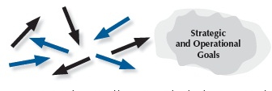



Steps toward Mature Processes
Reacting to Problems (0–25%)
Early Systematic Approaches (30–45%)
Aligned Approaches (50–65%)
Integrated Approaches (70–100%)
Notes:
This graphic is an aid for assessing process items (categories 1 through 6). In each case, the arrows indicate the degree of consistency and coordination among organizational units. The circular shapes shown next to the arrows depict the relative clarity or definition of an organization’s goals. The steps are as follows:
Reacting to Problems: Here operations are characterized by activities rather than by processes, and they are largely responsive to immediate needs or problems.
Early Systematic Approaches: Here the organization is at the beginning stages of conducting operations by processes with repeatability, evaluation and improvement, and some early coordination among organizational units.
Aligned Approaches occur in the third step toward a mature process. At this stage, operations are repeatable and are regularly evaluated for improvement, with learnings shared and with coordination among organizational units.
Integrated Approaches occur at the final stage of a mature process. The arrows indicate the evolution of the organization into an interconnected unit. At this stage, not only are processes repeatable, but also, in collaboration with other affected units, they are regularly evaluated for change and improvement. This collaboration and interconnection help organizations achieve efficiencies across units.

Slide 30
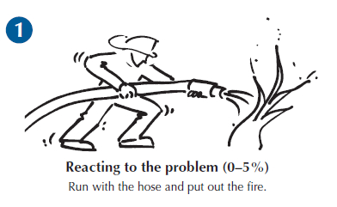
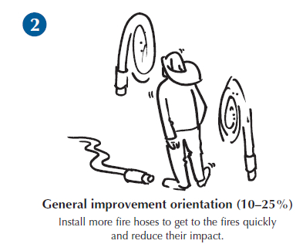
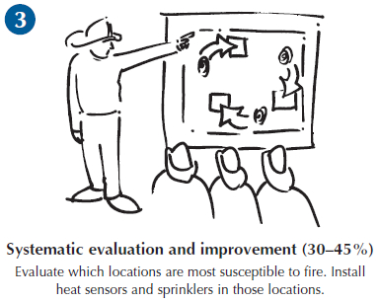
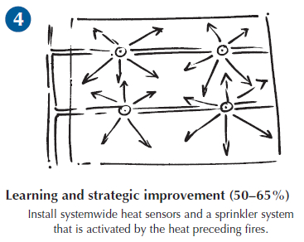
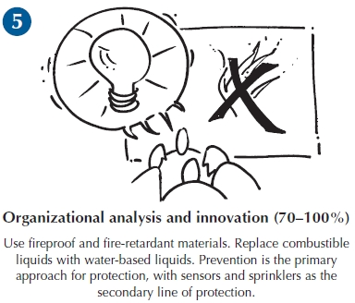
From Fighting Fires to Innovation:
An Analogy for Learning
Notes:
Learning is an essential attribute of high-performing organizations and, therefore, a critical concept in performance excellence. It is a key term used throughout the Baldrige Excellence Framework booklet and is one of the four scoring factors used to assess the maturity of an organization’s processes.
Effective, well-deployed organizational learning can help an organization improve from the early stages of reacting to problems to the highest levels of organization-wide improvement, refinement, and innovation. The firefighting analogy illustrated here shows a progression through the levels of maturity for this scoring dimension.

Slide 31
Evaluating Results
Levels: What is your current performance?
Trends: Are the results improving, staying the same, or getting worse?
Comparisons: How does your performance compare with others?
Integration: Are you tracking important results? Are you using the results?
Notes:
Your results are evaluated based on these four factors:
Levels: What is your current performance?
Trends: Are the results improving, staying the same, or getting worse?
Comparisons: How does your performance compare with that of other organizations and competitors, or with benchmarks?
Integration: Are you tracking results that are important to your organization? Are you using the results in organizational decision making?

Slide 32
For more information
Baldrige Excellence Framework booklets and free content
Self-assessment tools
Organizational assessments
Training, conferences, executive education
Award recipient profiles
Case studies
Connections to the Baldrige community
www.nist.gov/baldrige
301-975-2036
baldrige@nist.gov
Baldrige Performance Excellence Program | www.nist.gov/baldrige

