Slide 1
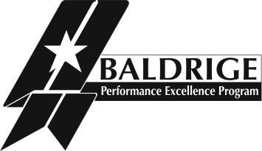
Baldrige Criteria for Performance Excellence
Baldrige Performance Excellence Program | www.nist.gov/baldrige

Slide 2
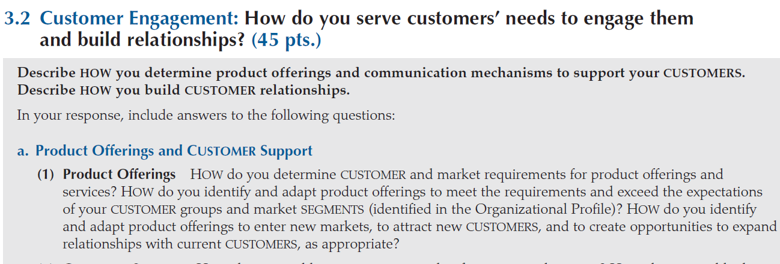
Criteria Categories
Leadership
Strategic Planning
Customer Focus
Measurement, Analysis, and Knowledge Management
Workforce Focus
Operations Focus
Results
Notes:
The Baldrige Criteria for Performance Excellence (often called the Business/Nonprofit Criteria) consist of these seven categories. Each category is subdivided into items and areas to address. There are 17 items, each focusing on a major requirement. Embodied within these is a set of core values and concepts.
Let’s take a look at these core values and concepts before discussing the categories and items and the related areas to address.

Slide 3
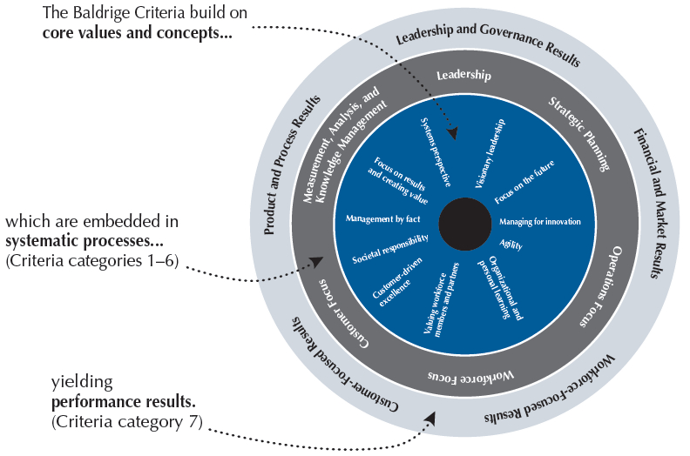
The Role of Core Values and Concepts
Notes:
The Criteria are built on a number of interrelated core values and concepts.
These values and concepts are embedded beliefs and behaviors found in high-performing organizations. They are the foundation for integrating key performance and operational requirements within a results-oriented framework that creates a basis for action, feedback, and sustainability.
This figure shows the role of the core values and concepts, shown in the innermost circle. The Criteria are built on them. Core values and concepts are embedded in the systematic processes addressed in Criteria categories 1 through 6, the next layer in the figure. These systematic processes yield the performance results found in Criteria category 7, represented by the outermost layer.
Let’s take a closer look at these core values and concepts.

Slide 4
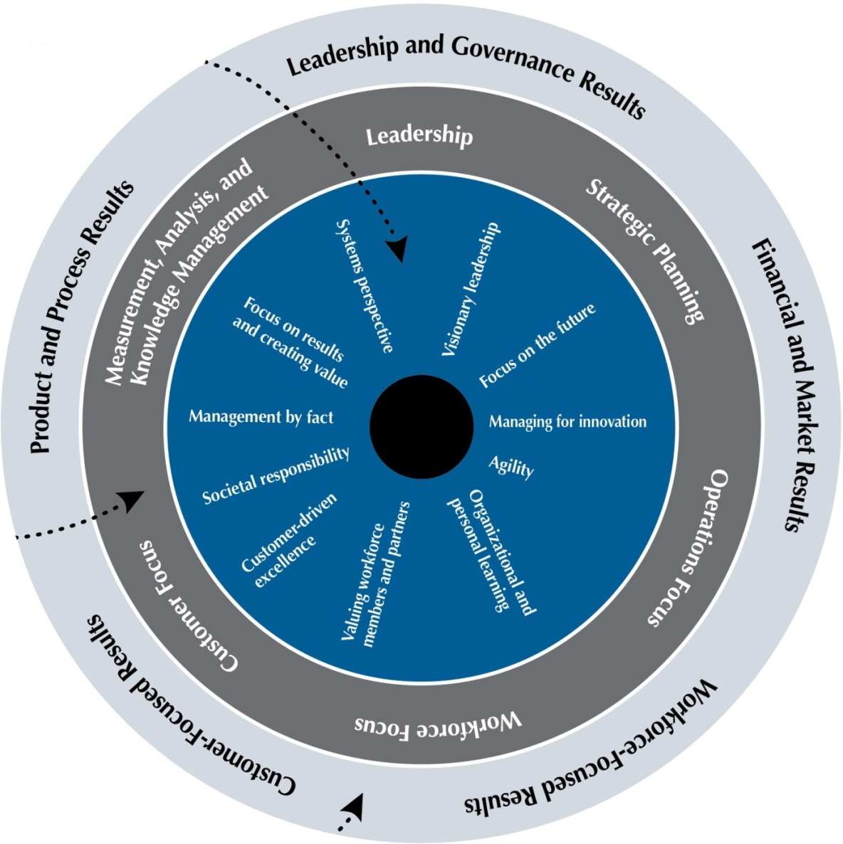
Visionary leadership
Customer-driven excellence
Organizational and personal learning
Notes:
Visionary leadership: Your organization’s senior leaders should set a vision for the organization, create a customer focus, demonstrate clear and visible organizational values and ethics, and set high expectations for the workforce. The vision, values, and expectations should balance the needs of all your stakeholders.
Customer-driven excellence: Your customers are the ultimate judges of performance and quality. Thus, your organization must take into account all product and service features and characteristics and all modes of customer access and support that contribute value to your customers.
Organizational and personal learning: Learning is directed not only toward developing better products and services but also toward being more responsive, adaptive, innovative, and efficient—giving your organization marketplace sustainability and performance advantages and engaging your workforce to increase satisfaction and the motivation to excel.
Organizational learning includes both continuous improvement of existing approaches and significant change or innovation, leading to new goals, approaches, products, and markets. Organizations invest in personal learning through education, training, and other opportunities for continuing growth and development.

Slide 5
Managing for innovation
Valuing workforce members and partners
Agility
Notes:
Valuing workforce members and partners: An organization’s success depends increasingly on an engaged workforce and capitalizes on the diverse backgrounds, knowledge, skills, creativity, and motivation of its workforce and partners. Valuing the people in your workforce means committing to their engagement, satisfaction, development, and well-being. To accomplish their overall goals, organizations need to build internal and external partnerships. Internal partners might include labor-management cooperation, while external partners might be customers, suppliers, and education or community organizations. Such partnerships may be a source of strategic advantage for an organization.
Agility: Success in today’s ever-changing, globally competitive environment demands agility—a capacity for rapid change and flexibility. Organizations face ever-shorter cycles for the introduction of new/improved products, as well as for faster and more flexible responses to customers. Cycle time has become a key process measure.
Focus on the future: The pursuit of sustained growth and performance leadership requires a strong future orientation and a willingness to make long-term commitments to key stakeholders, such as your customers, workforce, suppliers, partners, and stockholders, as well as the public and your community.
Managing for innovation: Innovation is no longer strictly the purview of research and development departments. Organizations should be led and managed so that innovation becomes part of the learning culture, is integrated into daily work, and reaches across the entire organization. Innovation should lead the organization to new dimensions of performance. Innovation requires a supportive environment, a process for identifying strategic opportunities, and the pursuit of intelligent risks.

Slide 6
Systems perspective
Focus on results and creating value
Management by fact
Societal responsibility
Notes:
Management by fact: Performance improvement requires measurement and analysis. The measures selected should best represent the factors that lead to improved customer, operational, societal, and financial performance. Analysis supports a variety of purposes, such as planning, reviewing your overall performance, improving operations, accomplishing change management, and comparing your performance with competitors’ or with best-practice benchmarks.
Societal responsibility: Leaders should stress responsibilities to the public, ethical behavior, and the need to consider societal well-being and benefit, which refers to leadership and support—within the limits of an organization’s resources—of the environmental, social, and economic systems in the organization’s sphere of influence. Leaders should be role models in focusing on ethics and the protection of public health, safety, and the environment. They should focus on opportunities to excel beyond mere compliance in these areas. Planning should anticipate adverse impacts that may arise and make available the information and support needed to maintain public awareness, safety, and confidence. Also, organizations should emphasize resource conservation and waste reduction at the source.
Focus on results and creating value: Results should be used to create and balance value for your key stakeholders. The use of a balanced composite of leading and lagging performance measures offers an effective means to communicate short- and longer-term priorities, monitor actual performance, and provide a clear basis for improving results.
Systems perspective: A systems perspective means managing the whole organization, as well as its key processes, to achieve results—and strive for performance excellence. The seven Baldrige Criteria categories, the core values, and the scoring guidelines form the building blocks and the integrating mechanism for the system. This systems perspective is depicted in the following slide.

Slide 7
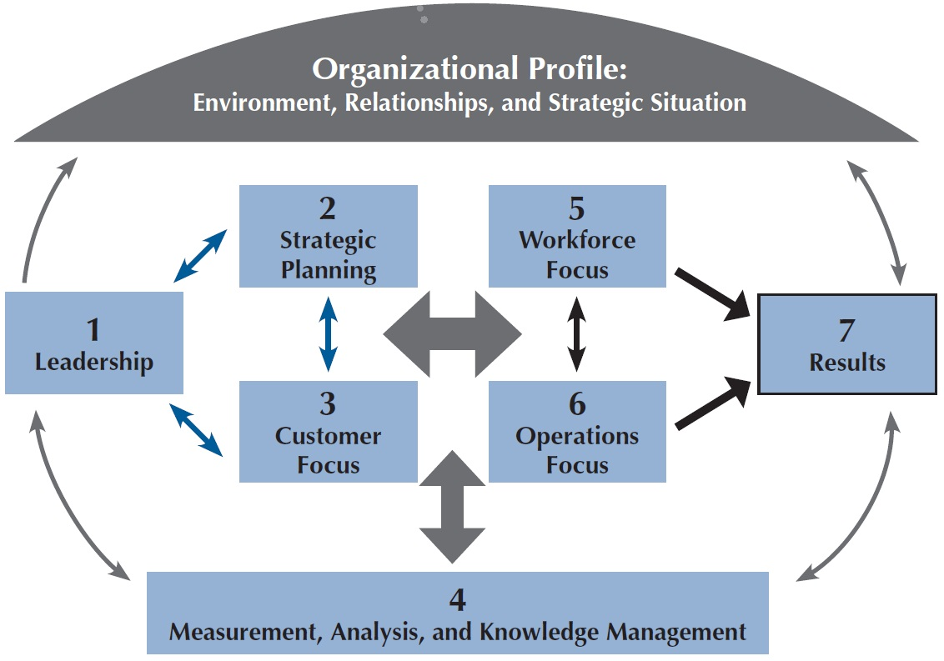
Baldrige Criteria Framework: A Systems Perspective
Notes:
The framework provides a high-level overview of the Baldrige Criteria for Performance Excellence and shows how the Criteria provide a systems perspective for managing your organization. From top to bottom, the framework has three basic elements—the Organizational Profile, the system operations, and the system foundation (Measurement, Analysis, and Knowledge Management).
The Organizational Profile (the umbrella at the top of the figure) sets the context for the way your organization operates. Your environment, key working relationships, and strategic challenges and advantages serve as an overarching guide for your organizational performance management system.
The system operations (middle of the figure) are consist of two linked triads, formed by the six Baldrige process categories, that define your operations and the results you achieve.
The leadership triad—Leadership, Strategic Planning, and Customer Focus—emphasizes the importance of a leadership focus on strategy and customers. Senior leaders set your organizational direction and seek future opportunities for your organization.
The results triad—Workforce Focus, Operations Focus, and Results—focuses on your workforce and key processes that accomplish the work of the organization, which yields your overall performance results.
ALL actions point toward results.
The horizontal arrow in the center of the framework links the two triads—a linkage critical to organizational success—and indicates the importance of feedback in an effective performance management system.
The system foundation (bottom of the figure) is composed of Measurement, Analysis, and Knowledge Management, which are critical to a fact-based, knowledge-driven system for improving performance and competitiveness.

Slide 8
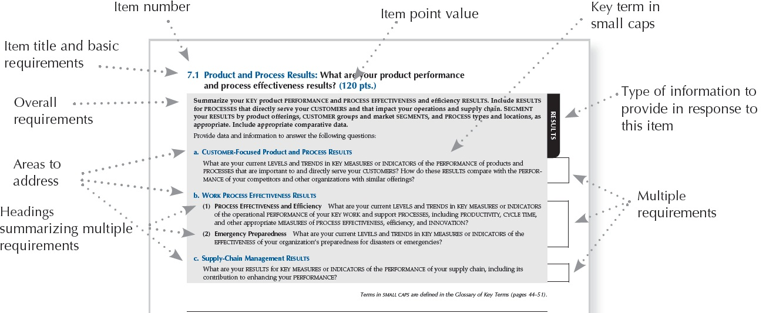
Item Format
Notes:
As previously mentioned, there are 17 items under the seven Baldrige categories. Let’s take a look at what an item looks like in the Criteria booklet. In this graphic of item 7.1, Product and Process Results, you can see that the basic requirements are presented in the item title (“What are your product performance and process effectiveness results?”) The overall requirements are expressed as introductory sentences in bold text at the top of the item. You can also see that this is classified as a results process item. (All items in categories 1 through 6 are classified as process items. Items in category 7 are results items.)
Two arrows at the left point out the item’s areas to address, which are in blue text and assigned a letter designation—in this case, “a,” “b,” and “c.” Each area to address is summarized in a boldface subheading.
Multiple requirements are shown here on the right in brackets. They appear under each area to address as individual questions in black text.
Key terms presented in the Glossary are shown in small capital letters throughout the Criteria and scoring guidelines

Slide 9
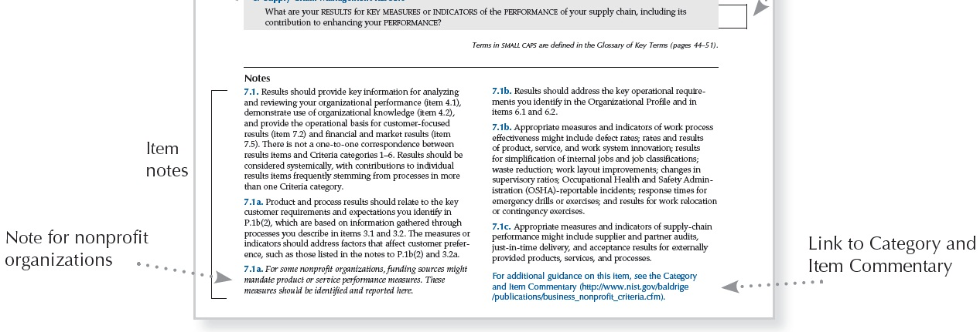
Notes
Notes:
Item notes serve three purposes: (1) to clarify key terms or requirements, (2) to give instructions and examples for responding to the item requirements, and (3) to indicate key linkages to other items.
Notes also provide additional guidance specifically for nonprofit organizations. These nonprofit-specific notes are shown in italics.
At the end of each item is a link to additional examples and guidance (free on the Baldrige Web site).

Slide 10
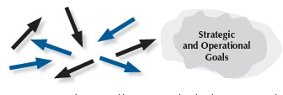
Steps toward Mature Processes
Reacting to Problems (0–25%)
Early Systematic Approaches (30–45%)
Aligned Approaches (50–65%)
Integrated Approaches (70–100%)
Notes:
This graphic is an aid for assessing and scoring process items (categories 1 through 6). In each case, the arrows indicate the degree of consistency and coordination among organizational units. The circular shapes shown next to the arrows depict the relative clarity or definition of an organization’s goals. The steps are as follows:
Reacting to Problems: Here operations are characterized by activities rather than by processes, and they are largely responsive to immediate needs or problems.
Early Systematic Approaches: Here the organization is at the beginning stages of conducting operations by processes with repeatability, evaluation and improvement, and some early coordination among organizational units.
Aligned Approaches occur in the third step toward a mature process. At this stage, operations are repeatable and are regularly evaluated for improvement, with learnings shared and with coordination among organizational units.
Integrated Approaches occur at the final stage of a mature process. The arrows indicate the evolution of the organization into an interconnected unit. At this stage, not only are processes repeatable, but also, in collaboration with other affected units, they are regularly evaluated for change and improvement. This collaboration and interconnection help organizations achieve efficiencies across units.

Slide 11
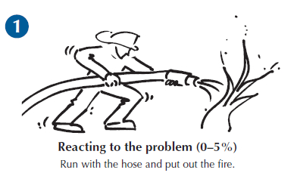
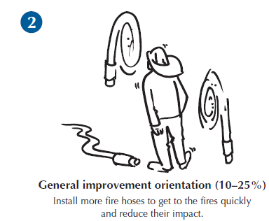
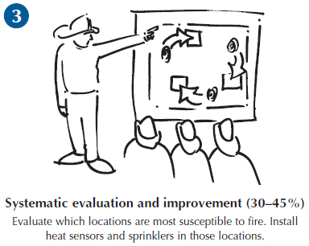
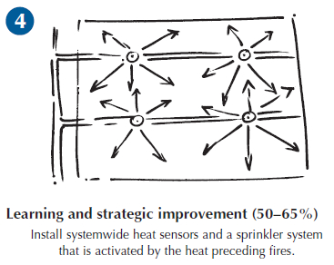
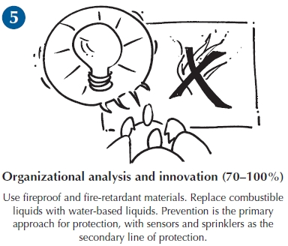
From Fighting Fires to Innovation:
An Analogy for Learning
Notes:
Learning is an essential attribute of high-performing organizations and, therefore, a critical concept in performance excellence. It is a key term used throughout the Criteria booklet and is one of the four scoring factors used to assess the maturity of an organization’s processes.
Effective, well-deployed organizational learning can help an organization improve from the early stages of reacting to problems to the highest levels of organization-wide improvement, refinement, and innovation. The firefighting analogy illustrated here shows a progression through the levels of maturity for this scoring dimension.

Slide 12
Organizational Profile
P.1 Organizational Description
P.2 Organizational Situation
Starting point for self-assessment and application preparation
Basis for early action planning
Notes:
Whether you use it as part of a self-assessment or as part of a Baldrige Award application, the Organizational Profile provides a snapshot of your organization, the key influences on how it operates, and the key challenges it faces. The placement of the Organizational Profile at the front of the Criteria sets the organizational context for responding to the Criteria items. The Organizational Profile helps everyone (e.g., organizations using the Criteria for self-assessment, application writers, and reviewers) understand what is most relevant and important to the your business and to performance.
The Organizational Profile is the starting point for self-assessment and for writing a Baldrige Award application. If you identify topics for which conflicting, little, or no information is available, it is possible that your assessment need not go any further, and you can use these topics for action planning. By addressing the questions in the Organizational Profile, you can identify potential gaps in key information and bring into focus areas that affect key performance requirements and results.
P.1, Organizational Description, asks, “What are your key organizational characteristics?” It asks you to describe your organization’s operating environment, including identifying its core competencies, and its key relationships with customers, stakeholders, suppliers, and partners. It also asks for a description of your governance system.
P.2, Organizational Situation, asks, “What is your organization’s strategic situation?” It asks you to describe your competitive environment, key strategic challenges and advantages, and system for performance improvement. It includes a request to identify available sources of comparative and competitive data to emphasize the need for these sources and to provide a context for later responses.

Slide 13
Category Point Values
1 Leadership 120
2 Strategic Planning 85
3 Customer Focus 85
4 Measurement, Analysis, and
Knowledge Management 90
5 Workforce Focus 85
6 Operations Focus 85
7 Results 450
Total 1,000
Notes:
All responses to the items within the boxed categories (1 through 6) should address your organization’s processes.
Responses to the results items (category 7) should address trends, performance levels, and comparisons, as well as the breadth and importance of the results. Because the bottom line for any organization is results, almost half of the application points are for results.
Results must be supported by linkages to the appropriate process items to show cause and effect.
Results may be the bottom line, but they are accomplished through a successful performance management system that is guided from the top.

Slide 14
1. Leadership (120 pts.)
Senior leaders’ actions, organizational governance, and societal responsibilities
1.1 Senior Leadership (70 pts.)
1.2 Governance and Societal Responsibilities (50 pts.)
Notes:
Category 1 (Leadership) asks how senior leaders’ personal actions and your governance system guide and sustain your organization.
1.1, Senior Leadership, asks about the key aspects of your senior leaders’ responsibilities, with the aim of creating a sustainable organization.
1.2, Governance and Societal Responsibilities, asks about key aspects of your organization’s governance system, including the improvement of leadership. It also asks how your organization ensures that everyone in the organization behaves legally and ethically, how it fulfills its societal responsibilities, and how it supports its key communities.

Slide 15
2. Strategic Planning (85 pts.)
Strategic and action planning, and implementation of plans
2.1 Strategy Development (45 pts.)
2.2 Strategy Implementation (40 pts.)
Notes:
Category 2 (Strategic Planning) asks how your organization develops strategic objectives and action plans, implements them, changes them if circumstances require, and measures progress.
The category stresses that your organization’s long‐term organizational sustainability and competitive environment are key strategic issues that need to be integral parts of your overall planning. Making decisions about your organization’s core competencies and work systems is an integral part of ensuring your organization’s sustainability, and these decisions are therefore key strategic decisions.
2.1, Strategy Development, asks how your organization establishes a strategy to address its challenges and leverage its advantages and how it makes decisions about key work systems and core competencies. It also asks about your key strategic objectives and their related goals. The aim is to strengthen your overall performance, competitiveness, and future success.
2.2, Strategy Implementation, This item asks how your organization converts your strategic objectives into action plans to accomplish the objectives and how your organization assesses progress relative to these action plans. The aim is to ensure that you deploy your strategies successfully and achieve your goals.

Slide 16
3. Customer Focus (85 pts.)
Listening to the voice of the customer and engaging customers
3.1 Voice of the Customer (40 pts.)
3.2 Customer Engagement (45 pts.)
Notes:
Category 3 (Customer Focus) asks how your organization engages its customers for long‐term marketplace success, including how your organization listens to the voice of the customer, builds customer relationships, and uses customer information to improve and to identify opportunities for innovation.
The category stresses customer engagement as an important outcome of an overall learning and performance excellence strategy..
3.1, Voice of the Customer, asks about your organization’s processes for listening to your customers and determining their satisfaction and dissatisfaction. The aim is to capture meaningful information in order to exceed your customers’ expectations.
3.2, Customer Engagement, asks about your organization’s processes for determining and customizing product offerings that serve your customers and markets; for enabling customers to seek information and support; and for identifying customer groups and market segments. The item also asks how you build relationships with your customers and manage complaints. The aim of these efforts is to improve marketing, build a more customer‐focused culture, and enhance customer loyalty.

Slide 17
4. Measurement, Analysis, and Knowledge Management (90 pts.)
Analysis, review, and improvement of organizational performance Management of information, knowledge, and information technology
4.1 Measurement, Analysis, and Improvement of Organizational Performance (45 pts.)
4.2 Knowledge Management, Information, and Information Technology (45 pts.)
Notes:
Category 4 (Measurement, Analysis, and Knowledge Management) This category is the main point within the Criteria for all key information about effectively measuring, analyzing, and improving performance and managing organizational knowledge to drive improvement, innovation, and organizational competitiveness. In the simplest terms, category 4 is the “brain center” for the alignment of your organization’s operations with its strategic objectives.
4.1, Measurement, Analysis, and Improvement of Organizational Performance, asks how your organization selects and uses data and information for performance measurement, analysis, and review in support of organizational planning and performance improvement. The item serves as a central collection and analysis point in an integrated performance measurement and management system that relies on financial and nonfinancial data and information. The aim is to guide your organization’s process management toward the achievement of key organizational results and strategic objectives, to anticipate and respond to rapid or unexpected organizational or external changes, and to identify best practices to share.
4.2, Knowledge Management, Information, and Information Technology, asks how your organization builds and manages its knowledge assets and how it ensures the quality and availability of data, information, software, and hardware, normally and in the event of an emergency. The aim of this item is to improve organizational efficiency and effectiveness and to stimulate innovation.

Slide 18
5. Workforce Focus (85 pts.)
Building an effective workforce environment Engaging, developing, and managing your workforce
5.1 Workforce Environment (40 pts.)
5.2 Workforce Engagement (45 pts.)
Notes:
Category 5 (Workforce Focus) addresses key workforce practices—those directed toward creating and maintaining a high‐performance work environment and toward engaging your workforce to enable it and your organization to adapt to change and to succeed.
5.1, Workforce Environment, asks about your workforce capability and capacity needs, how you meet those needs to accomplish your organization’s work, and how you ensure a supportive work climate. The aim is to build an effective environment for accomplishing your work and supporting your workforce.
5.2, Workforce Engagement, asks about your organization’s systems for managing workforce performance and developing your workforce members to enable and encourage all workforce members to contribute effectively and to the best of their ability. These systems are intended to foster high performance, to address your core competencies, and to help accomplish your action plans and ensure organizational sustainability.

Slide 19
6. Operations Focus (85 pts.)
Designing, managing, and improving work processes Improving operational effectiveness
6.1 Work Processes (45 pts.)
6.2 Operational Effectiveness (40 pts.)
Notes:
Category 6 (Operations Focus) This category asks how your organization focuses on its work, product design and delivery, and operational effectiveness to achieve success and organizational sustainability.
Item 6.1, Work Processes, asks about the management of your key products and work processes, with the aim of creating value for your customers and achieving organizational success and sustainability.
Item 6.2, Operational Effectiveness, asks how you ensure effective operations in order to have a safe workplace environment and deliver customer value. Effective operations frequently depend on managing your supply chain effectively and innovating for the future.

Slide 20
7. Results (450 pts.)
Performance and improvement in all key areas Performance levels, trends, and comparative data
7.1 Product and Process Results (120 pts.)
7.2 Customer-Focused Results (85 pts.)
7.3 Workforce-Focused Results (85 pts.)
7.4 Leadership and Governance Results (80 pts.)
7.5 Financial and Market Results (80 pts.)
Notes:
Category 7 (Results) provides a systems focus that encompasses all results necessary to sustaining an enterprise: your key process and product results, your customer‐focused results, your workforce results, your leadership and governance system results, and your overall financial and market performance.
Category 7 provides “real‐time” information (measures of progress) for evaluation, improvement, and innovation of processes and products, in alignment with your overall organizational strategy.
7.1, Product and Process Results, asks about your organization’s key product and operational performance results, which demonstrate product and service quality and value that lead to customer satisfaction and engagement.
7.2, Customer-Focused Results, asks about your organization’s customer‐focused performance results, which demonstrate how well your organization has been satisfying your customers and engaging them in loyalty‐building relationships.
7.3, Workforce-Focused Results, asks about your organization’s workforce‐focused performance results, which demonstrate how well your organization has been creating and maintaining a productive, caring, engaging, and learning environment for all members of your workforce.
7.4, Leadership and Governance Results, asks about your key results in the areas of senior leadership and governance, which demonstrate the extent to which your organization is fiscally sound, ethical, and socially responsible.
7.5, Financial and Market Results, asks about your key financial and market results, which demonstrate your financial sustainability and your marketplace achievements.

Slide 21
Manufacturing Leaders on the Criteria
The Baldrige Criteria challenged us to become leaders by any measure, and we succeeded—seeing productivity, customer loyalty, employee engagement, and financial returns.
Samuel Liang, president/CEO, two-time Baldrige Award winner MEDRAD, Inc.
The Baldrige opportunity . . . was a way for us to get a very disciplined, external perspective, an examination of our business, of how we manage our business. … That’s a very valuable thing.
Patrick McGinnis, president/CEO, Baldrige Award winner Nestlé Purina PetCare Americas
Notes:
More quotes:
“If you’re considering your own Baldrige quest, please do that. I would encourage you to get your team and your leadership behind such a journey. It’s a very rewarding journey. It really brings your team together, all of your employees. It builds upon success and allows you to strive for continuous improvement in delivering for your customer and then internally driving employee satisfaction and engagement.”
—Anthony Brancato III, president, Baldrige Award winner Honeywell Federal Manufacturing & Technologies
Because of Baldrige, because of our ability to manage shareholder expectations, customer satisfaction, and [because of] continuing to keep our employees happy and satisfied, the company has continued to thrive.
—Samuel Liang, president and CEO, two-time Baldrige Award winner MEDRAD
“Quality saves money and makes products appealing and attractive . . . anything that’s wrong is costing you money. To get the process exactly right is going to be cheaper and is going to be better.”
—Robert Galvin, chairman, Baldrige Award winner Motorola
“The Baldrige Criteria teach us how to put processes in place that allow us to actualize the things that are most important in driving our business success.”
—Alan Willets, president and business unit leader, Baldrige Award winner Cargill Corn Milling

Slide 22
Manufacturing Leaders on the Criteria
The economic environment is difficult for Cargill Corn Milling, as it is difficult for many manufacturing companies today. But . . . by utilizing the processes and tools that we’ve learned from Baldrige, we’re able to not only meet these challenges but actually excel in them.
—Alan Willets, president and business unit leader, Baldrige Award winner Cargill Corn Milling
Notes:
More quotes:
“If you’re considering your own Baldrige quest, please do that. I would encourage you to get your team and your leadership behind such a journey. It’s a very rewarding journey. It really brings your team together, all of your employees. It builds upon success and allows you to strive for continuous improvement in delivering for your customer and then internally driving employee satisfaction and engagement.”
—Anthony Brancato III, president, Baldrige Award winner Honeywell Federal Manufacturing & Technologies
“Quality saves money and makes products appealing and attractive . . . anything that’s wrong is costing you money. To get the process exactly right is going to be cheaper and is going to be better.”
—Robert Galvin, chairman of 1988 Baldrige Award recipient Motorola
“We didn’t apply the [Baldrige] concepts . . . to win an award. We did it to win customers. We did it to grow. We did it to prosper.”
—Earnest Deavenport, chairman and CEO of 1993 Baldrige Award recipient Eastman Chemical Company
“For seven years in a row we improved customer satisfaction, we improved occupancy, we improved employee satisfaction, we lowered employee departures [and] turnover, and we improved annually our profit.”
—Horst Schulze, president/CEO of 1999 Baldrige Award recipient The Ritz-Carlton Hotel Company, L.L.C.

Slide 23
Service Industry Leaders on the Criteria
We continuously improve. . . not because of me or anyone here. It’s because we work the Criteria. If we use the Criteria, sooner or later we will beat our competition. . . . The whole Criteria unequivocally works.
—Horst Schulze, former president and COO, two-time Baldrige Award winner Ritz-Carlton Hotel Company, L.L.C.
When you look at the Baldrige Criteria, what a great road map to say if you can do the things in all these categories and do them well, you’re going to be a well-run company.
—Robert F. Pence, president and CEO, Baldrige Award winner Freese and Nichols, Inc.
Notes:
More quotes:
“If you want sustainability in an organization, and you want to go from ‘great’ to ‘really, really great,’ you’ve got to have some kind of a model . . . and Baldrige is that model! . . . MidwayUSA has benefited tremendously from the Baldrige Criteria: Our sales are up over 20 percent per year over the last five years. Our profits are up over 40 percent per year for that same time. Customer satisfaction at 93 percent is at an all-time high. Employee satisfaction, at 82 percent, is at an all-time high also. All the winds are blowing in the right direction at MidwayUSA, and it’s all because of our efforts in engaging the Baldrige Criteria.”
—Larry Potterfield, CEO of 2009 Baldrige Award Recipient MidwayUSA
Baldrige involvement increased employee buy-in, providing terrific professional development and personal learning and achievement opportunities.
—Roger B. Quayle, executive vice president, quality and technology, Baldrige Award winner OMI, Inc.
“I see the Baldrige process as a powerful set of mechanisms for disciplined people engaged in disciplined thought and taking disciplined action to create great organizations that produce exceptional results.”
—Jim Collins, author of Good to Great: Why Some Companies Make the Leap . . . and Others Don’t

Slide 24
Small Business Leaders on the Criteria
MidwayUSA has benefited tremendously from the Baldrige Criteria: Our sales are up over 20% per year over the last five years. Our profits are up over 40% . . . . Customer satisfaction at 93% is at an all-time high. Employee satisfaction at 82% is at an all-time high.
—Larry Potterfield, CEO, Baldrige Award winner MidwayUSA
What Baldrige did for us is get us a business management model. [The Criteria] identify the key things to an organization’s success.
—Terry May, president, two-time Baldrige Award winner MESA
Notes:
More quotes:
Baldrige involvement increased employee buy-in, providing terrific professional development and personal learning and achievement opportunities.
—Roger B. Quayle, executive vice president, quality and technology, Baldrige Award winner OMI, Inc.
"It’s a big deal. We’re the first restaurant to have ever won the Malcolm Baldrige Award. We’re a small hot dog and hamburger operation in the hills of Tennessee but we can effectively apply the criteria and have tremendous success.“
—Thomas Crosby, President/CEO, Baldrige Award winner Pal's Sudden Service

Slide 25
Nonprofit/Government Leaders on the Criteria
People ask, “Why Baldrige?” My answer is very simple:
triple-A bond rating on Wall Street from all three rating agencies,
bringing capital projects in on time and within budget,
a 96% business satisfaction rating,
a 94% resident satisfaction rating,
an overall quality rating of 95%,
and an employee satisfaction rating of 97%
. . . that’s why we’re involved with Baldrige.
—Michael Levinson, city manager, Baldrige Award winner City of Coral Springs, Florida
Notes:
More quotes:
[The men and women of ARDEC] have earned distinction for our organization, the new high-technology Army, and the Department of Defense by embracing the Baldrige Criteria. . . . We [adopted the Baldrige Criteria] in order to become the best organization we can possibly be and provide the best products and support we can to the U.S. Warfighter.
—Dr. Joseph A. Lannon, director, Baldrige Award winner U.S. Army Armament Research, Development, and Engineering Center
In the past few years, we have seen a complete transformation of the book publishing industry. Despite this challenging landscape with the rapid-fire addition of new channels and business models, Concordia Publishing House continues to thrive. Our agility and flexibility during these times is due in great part to the guidance of the Criteria and the invaluable feedback from the examiners.
—Bruce G. Kintz, President & CEO, Baldrige Award winner Concordia Publishing House
I’ve seen a culture develop within the Center that is a culture of doing the right thing. It’s a culture of everyone standing up and trying to make our products and services the best they can be, and Baldrige has helped us along that line.
—Kathy Boardman, project director, Baldrige Award winner VA Cooperative Studies Program Clinical Research Pharmacy Coordinating Center

Slide 26
For More Information
Criteria booklets and free Criteria content
Self-assessment tools
Organizational assessments
Training, conferences, and executive education
Award recipient profiles
Case studies
Connections to the Baldrige community
www.nist.gov/baldrige
baldrige@nist.gov
(301) 975-2036
Baldrige Performance Excellence Program | www.nist.gov/baldrige

